Slide 1
Do My Workout
With MO Farah & Friends
Today you have the opportunity to workout like some famous sports stars!
On each of the following slides there is a sports star along with their Workout Challenge.
Choose one of the sport stars and complete their workout - you can choose either a Bronze, Silver or Gold level.
Let us know which sports star you choose!

Slide 2
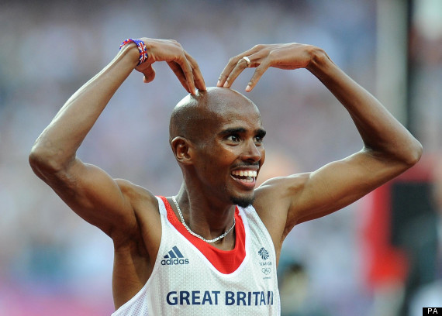


Mo Farah
HEALTHY BODY, HEALTHY MIND.
bronze
SILVER
GOLD
30 Seconds Jogging On The Spot
10 Sit Ups
10 Heel flicks
15 Star Jumps
30 Seconds High Knees
REPEAT X 3
45 Seconds Jogging On Spot
15 Sit Ups
15 Heel flicks
20 Star Jumps
45 Seconds High Knees
REPEAT X 3
1 Minute Jogging On The Spot
20 Sit Ups
20 Heel Flicks
25 Star Jumps
1 Minute High Knees
REPEAT X 3

Slide 3
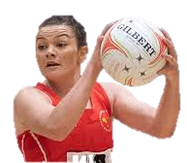
NIA JONES
HEALTHY BODY, HEALTHY MIND.
bronze
SILVER
GOLD
10 Shoulder Taps
30 Second Plank
10 Sit Ups
30 Second Wall Sit
30 Seconds Fast Feet
REPEAT X 3
15 Shoulder Taps
45 Second Plank
15 Sit Ups
45 Sec Wall Sit
45 Sec Fast Feet
REPEAT X 3
20 Shoulder Taps
1 Minute Plank
15 Bicycle Crunches
1 Minute Wall Sit
1 Minute Fast Feet
REPEAT X 3

Slide 4
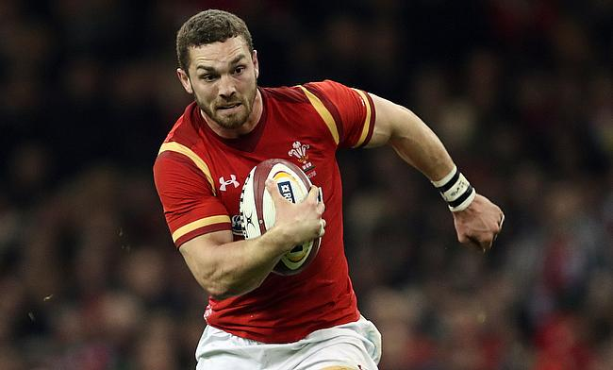
George north
HEALTHY BODY, HEALTHY MIND.
bronze
SILVER
GOLD
10 Squats
10 Lunges
10 Walking Burpees
10 Mountain Climbers
10 Half Press Ups on knees
REPEAT X 3
15 Squats
10 Lunges And Kick
10 Burpees
15 Mountain Climbers
10 Full Press Ups
REPEAT X 3
10 Squat Jumps
10 Jumping Lunges
10 Burpees
20 Mountain Climbers
10 Press Ups
REPEAT X 3

Slide 5
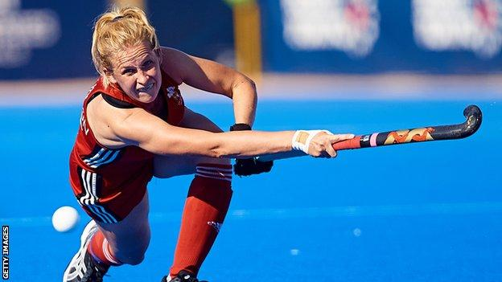
LEAH WILKINSON
HEALTHY BODY, HEALTHY MIND.
bronze
SILVER
GOLD
10 Scissor Kicks
10 Plank Forearm To Hands
15 Toe Taps
5 Tuck Jumps
30 Seconds Jumping Jacks
REPEAT X 3
15 Scissor Kicks
12 Plank Forearm To Hands
20 Toe Taps
8 Tuck Jumps
45 Seconds Jumping Jacks
REPEAT X 3
20 Scissor Kicks
15 Plank Forearm To Hands
25 Toe Taps
10 Tuck Jumps
1 Min Jumping Jacks
REPEAT X 3

Slide 6
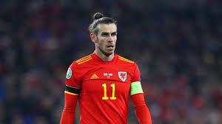
Gareth bale
HEALTHY BODY, HEALTHY MIND.
bronze
SILVER
GOLD
30 Seconds Fast Feet
10 Press Ups
30 Seconds High Knees
10 Lunges
30 Speed Bounces
REPEAT X 3
45 Seconds Fast Feet
10 Press Ups
45 Seconds High Knees
10 Lunges With Kick
35 Speed Bounces
REPEAT X 3
45seconds Fast Feet
10 Press Ups
45 Seconds High Knees
10 Lunges With Kick
35 Speed Bounces
REPEAT X 3

Slide 7
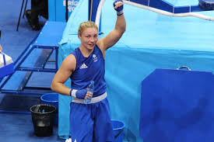
Lauren price
HEALTHY BODY, HEALTHY MIND.
bronze
SILVER
GOLD
10 Sit Ups
10 Squats
30 Speed Bounces
30 Seconds Jogging On Spot Arm Punches
30 Second Plank
REPEAT X 3
15 Sit Ups
10 Jumping Lunges
30 Seconds Speed Bounces
45 Seconds Jogging On Spot Arm Punches
45 Second Plank
REPEAT X 3
15 Bicycle Crunches
10 Jumping Lunges
45 Seconds Speed Bounces
1 Min Jog Arm Punch
1 Min Plank
REPEAT X 3

