Slide 1

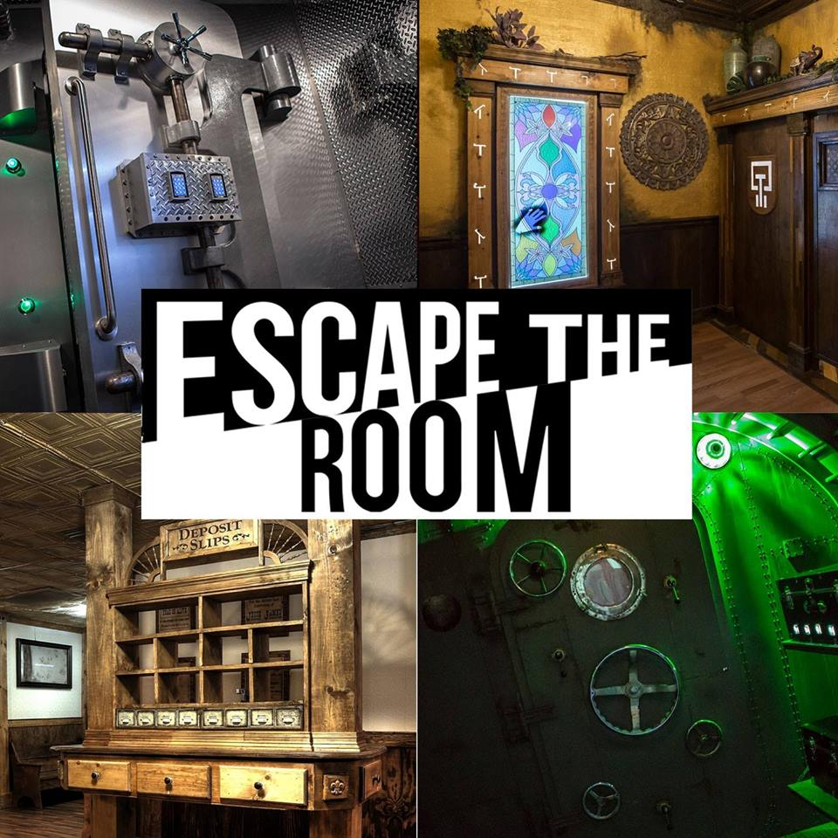


ESCAPE ROOM
Can you escape, complete the physical challenges and save the PE TEAM?

Slide 2

Back ground Story
The main hall has been taken over by pupils from another school and the PE Team have been kidnapped.
The hall has been transformed into 5 different rooms, all with different Physical Sporting Challenges you will need to complete to free the PE staff. Each room you complete you will gain a key, you need at least 5 keys to free the staff
You can only move onto the next room once the challenge has been completed……
You will need:
Safe space to perform the challenges.
A drink to hydrate you.
Super cool sporting clothes that make you look like a super hero!
A positive and winning attitude to save the day.

Slide 3
BEFORE COMPLETING THIS ESCAPE ROOM
Warm up
Wear sensible sporting clothes
Have a drink with you
Check with your parents if you are using house held objects to help you with challenges

Slide 4

Are you ready to save the PE TEAM?
Mr Ruparelia says ‘Leicester City are playing tonight at 8.00pm, I must watch the game! Please save us’.
Mr Bull says “Please help us, we will never make you run laps again”

Slide 5
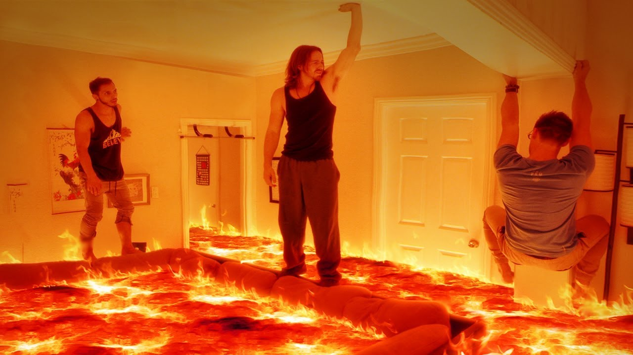

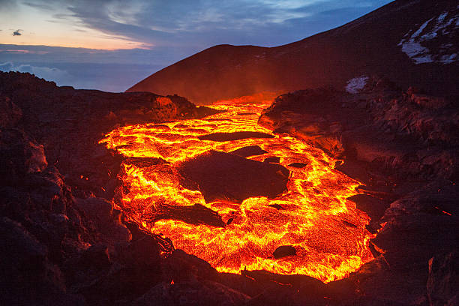
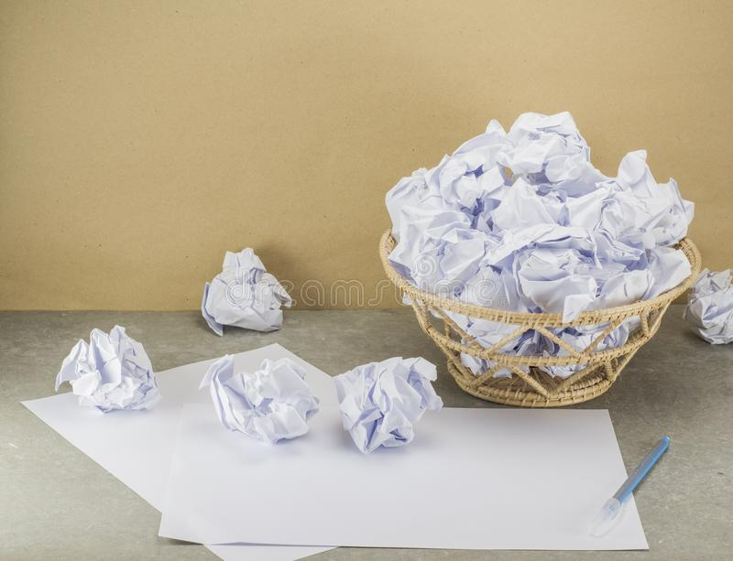
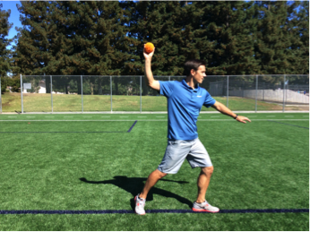
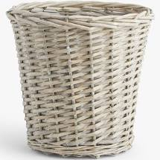
Room 1 - The floor is lava
Your challenge is to throw items from one side of the room, into a target on the other side of the room. To complete this challenge you must get at least 10 items in to the target
Start with lots of items on your side of the room so you don’t cross the lava (E.G. get lots of rolled up pairs of socks next to you
Target ideas:
Bin, bowl, cup, saucepan, bucket, laundry basket, shopping bag held open
Throwing object ideas:
Pair of socks rolled up
Table tennis ball
Tennis ball
Tea bags
Scrunched up scrap paper
You can throw underarm or over arm

Slide 6


Too easy? Challenge time!
Throw while balancing on one leg
Throw it backwards, don’t face the target
Your throwing item has to bounce of a wall and then drop into the target
Throw 2 at the same time, one pair of socks in each hand
The famous Bobby firmino ‘no look’ shot

Slide 7

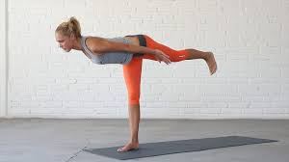

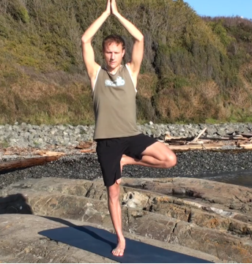
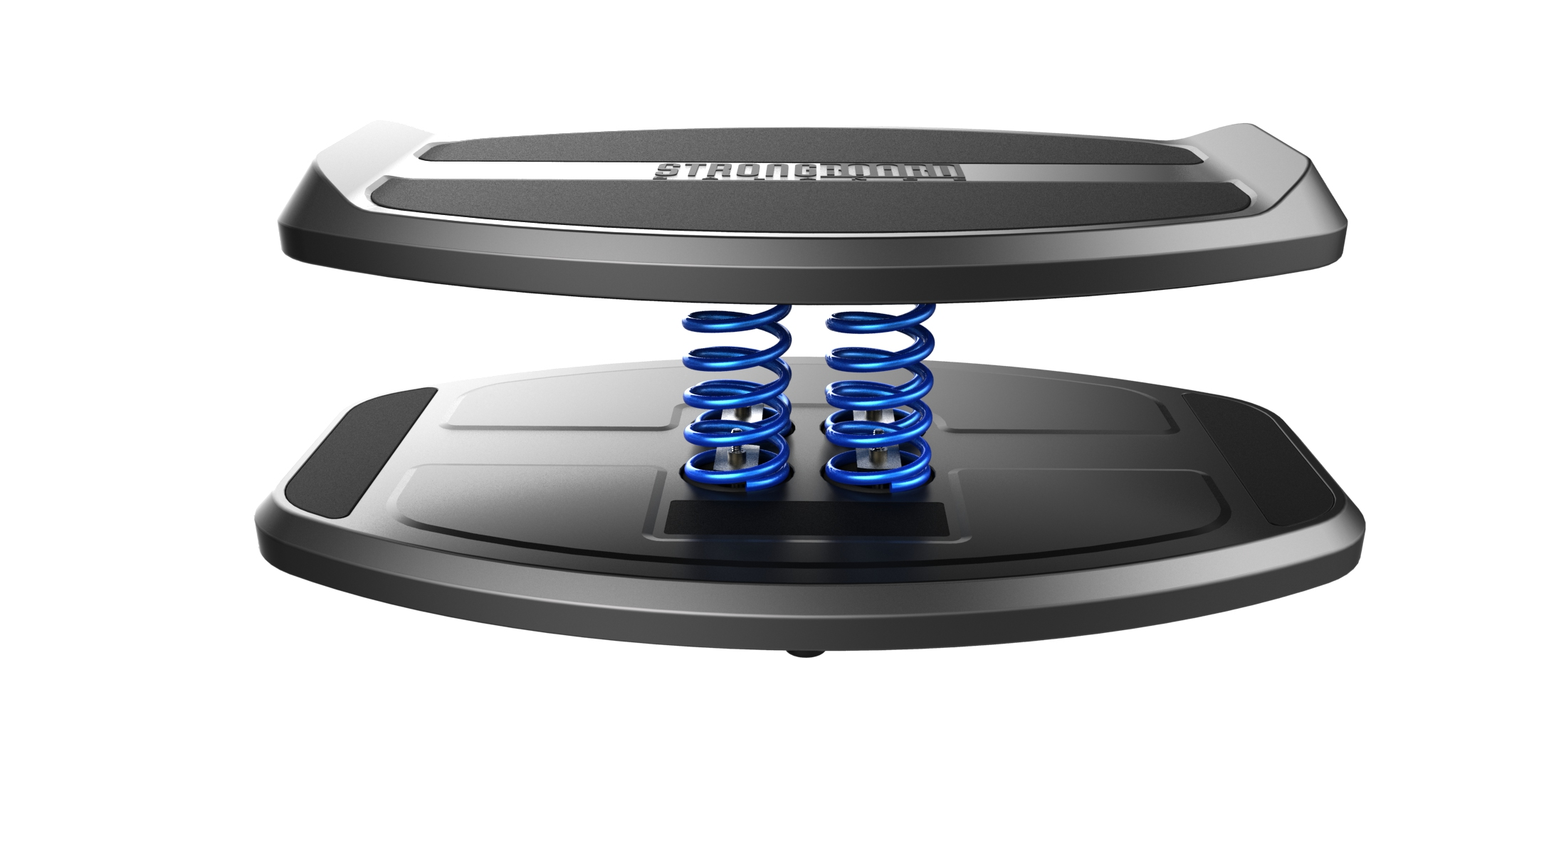

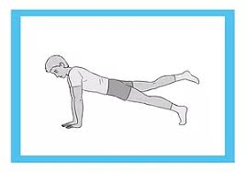
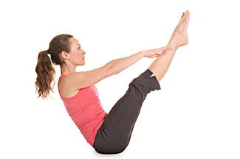
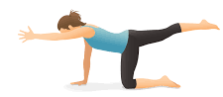
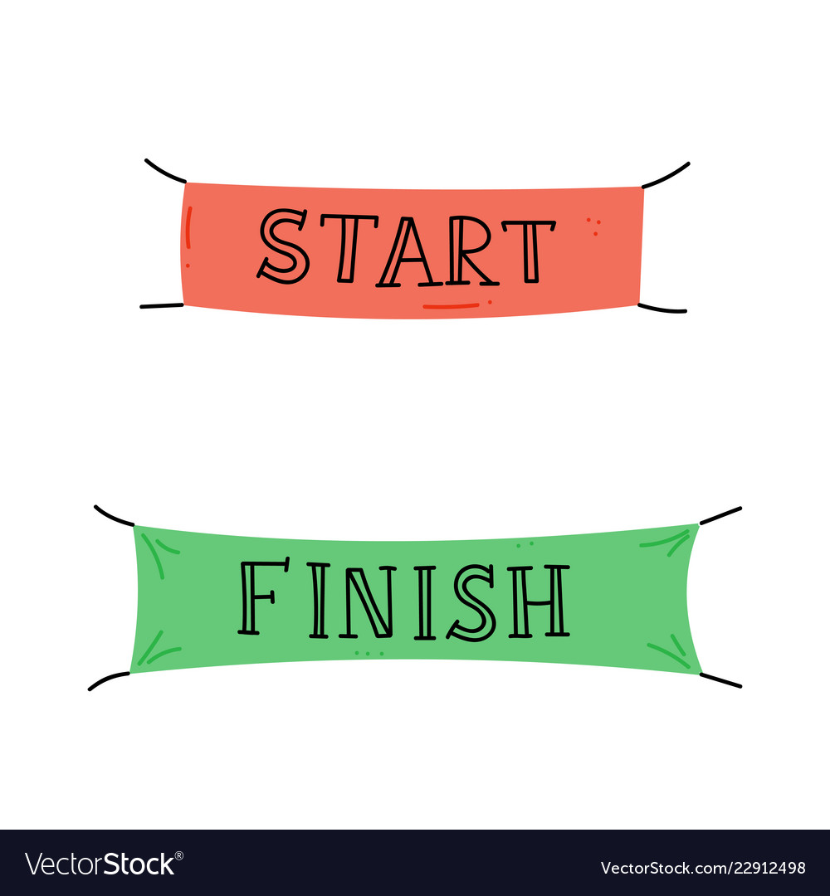
Room 2 – balance your way to freedom
There are 5 movement sensors across this room, to complete this room you must perform a balance on each sensor for 6 seconds or more. You can only move onto the next balance once you have been successful….. Good luck!

Slide 8
Too easy? Challenge time!
Hold the balance for 8-10 seconds instead of 6
Create your own balances
Close your eyes while balancing……this is tricky!

Slide 9



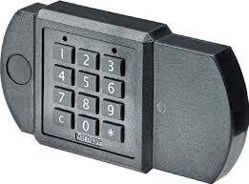



Room 3: 2 – 4 – 6 – 8
Minutes performing the plank
This can be broken down into smaller chunks (4 x 30 seconds)
Kicks up
Knee ups
Keep it up with a rolled up piece of paper and a hard back book.
Throw the ball or rolled up piece of paper in the air, clap 8 times and then catch.
Laps of your garden
Running or walking
Lunges

Slide 10
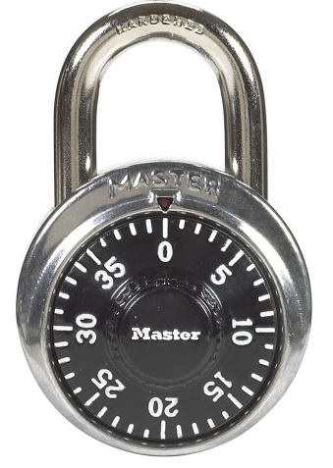


Too easy? Challenge time!
DOUBLE THE CHALLENGES FROM THE PREVIOUS SLIDE

Slide 11
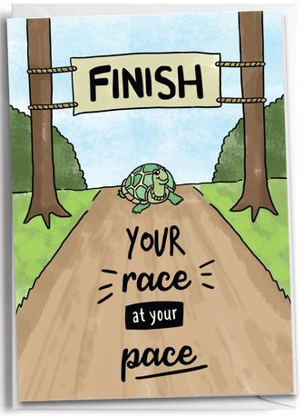

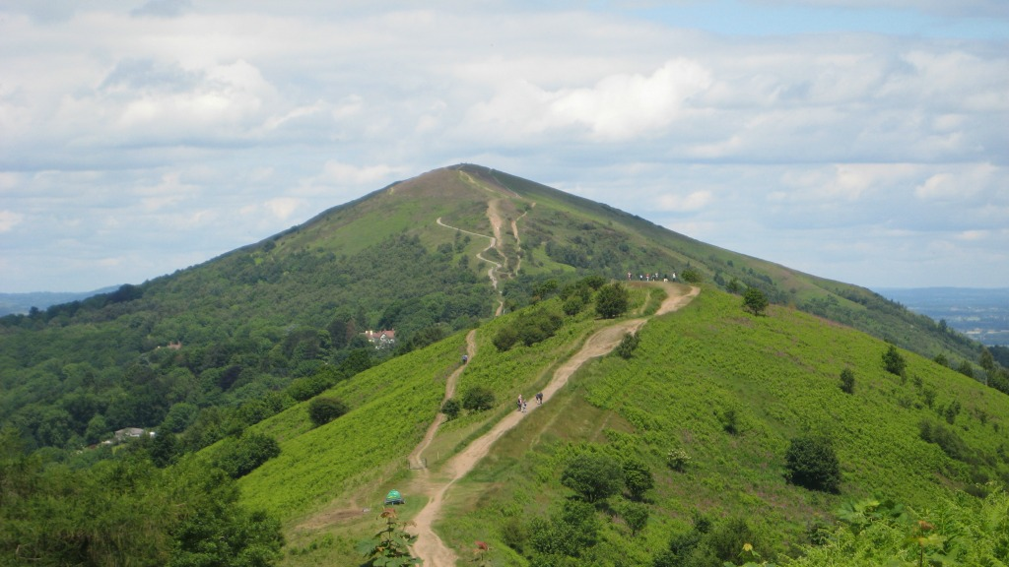
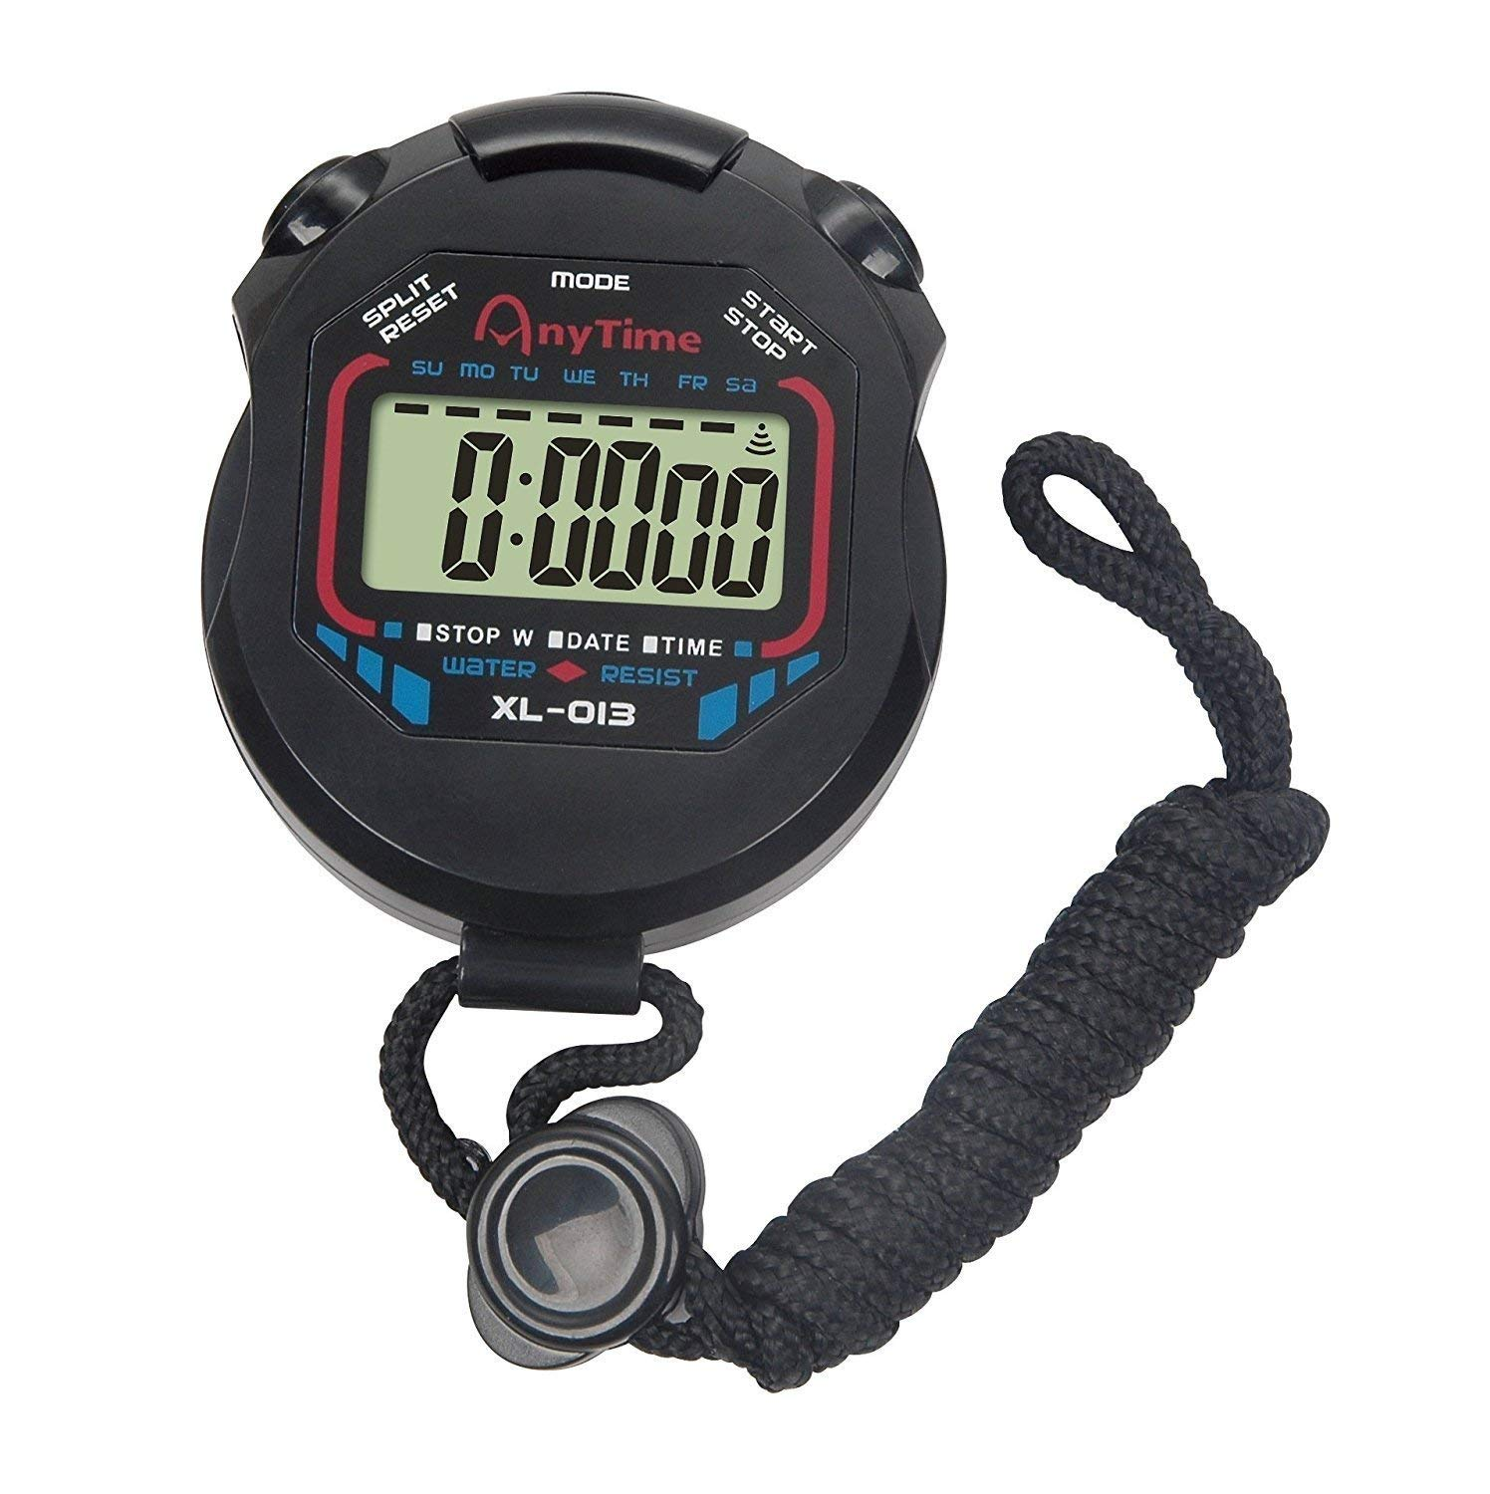
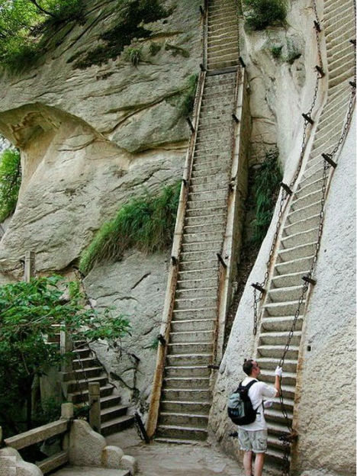
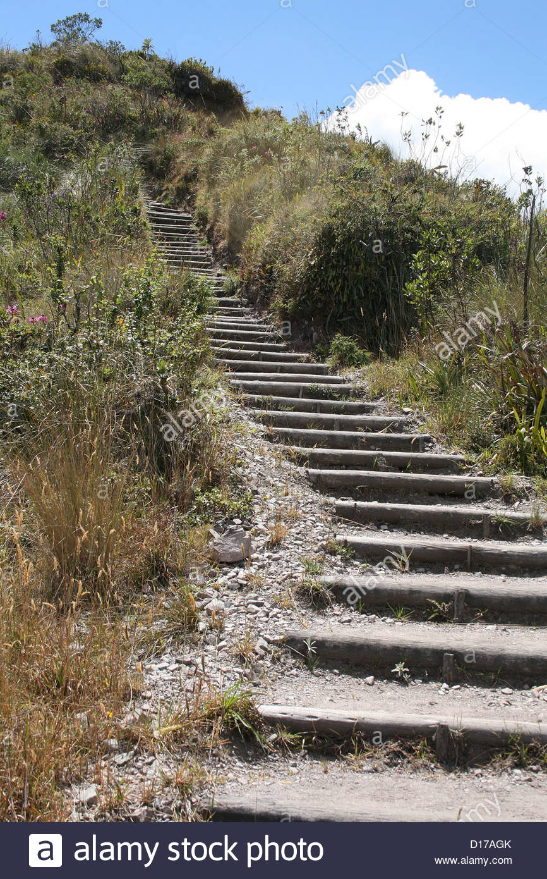
Room 4 – Can you reach the top?
It is not a race, no need to rush
Hold on to the banister if you need too
Especially careful on the way down stairs
The Malvern Hills is 425 meters high
Your challenge is to climb up and down your stairs for either:
4minutes and 25 seconds - pause the stop watch if you need a rest
OR
42 times ……… you can break this down and rest in-between
Or run or walk in your garden or in your living room for the same amount of time!
Walking up the stairs = 1 time
Going back down the stairs = 1 time
So going up and down = 2

Slide 12
Too easy? Challenge time!
Take a rest in-between, drink plenty of water
The Malvern Hills is 425 meters high
Your challenge is to climb up and down your stairs for either:
4minutes and 25 seconds - pause the stop watch if you need a rest
OR
42 times ……… you can break this down and rest in-between
Feeling fit?
Feeling like a challenge?
Complete both

Slide 13
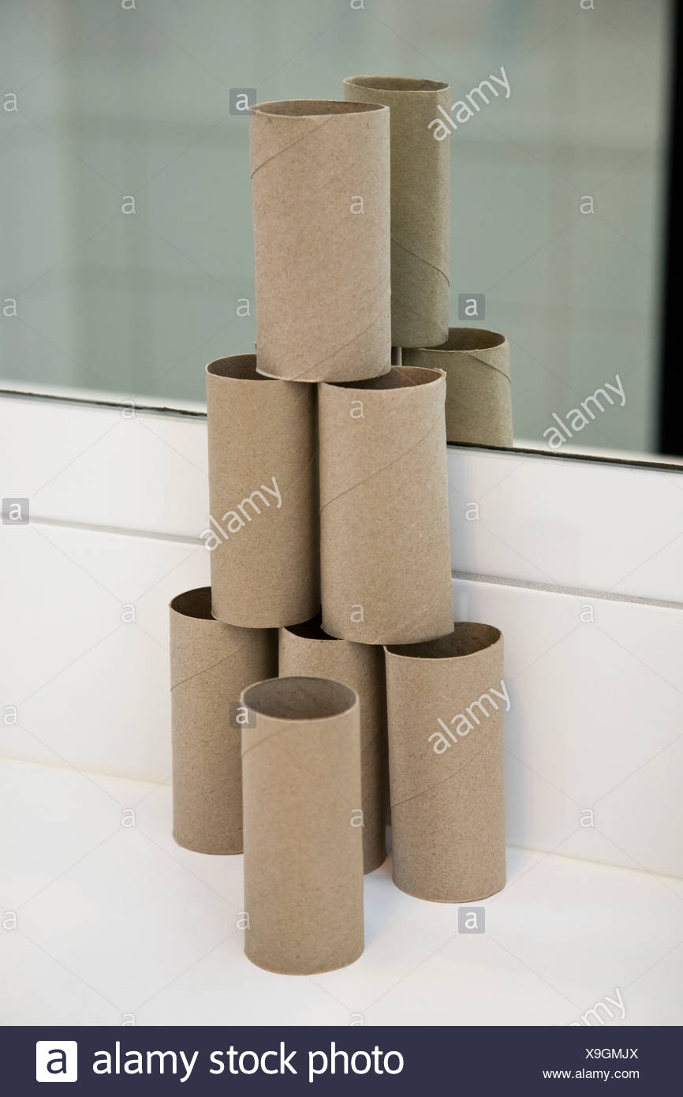
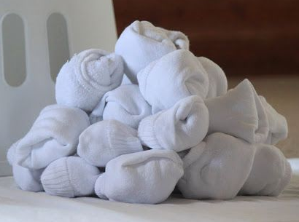


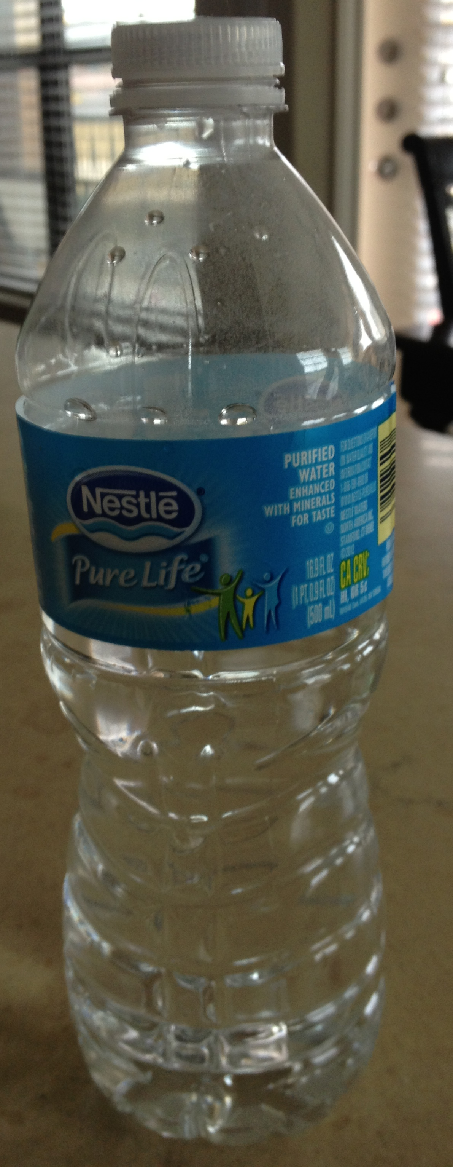


Room 5 – Target practice
Get your equipment ready Whitehall Children
(Rolled up socks)
Set up several targets, build them as big or as small as you like
Start on the opposite side of the room
Throw the socks at the targets until they have all fallen over
Aim is to see how many pairs of socks it takes to knock everything over
Repeat, but try to use as little pair of socks as possible

Slide 14
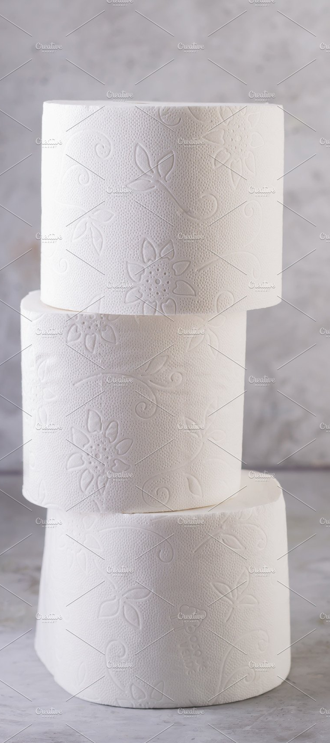
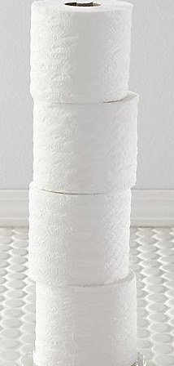
Too easy? Challenge time!
Grab as many toilet rolls in your house as you can find
Set a timer or get a parent / sibling to time you for 30 seconds
Stack the toilet rolls one on top of each other
See how many you can get on top of each other in 30 seconds with out them falling over
Challenge someone in your house
The tower must be able to stand without falling over at the end of the 30 seconds

Slide 15

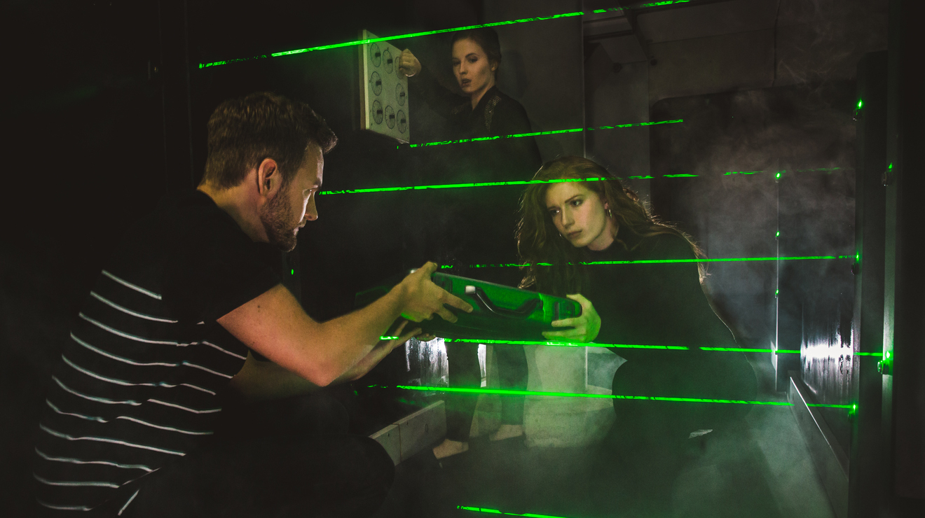

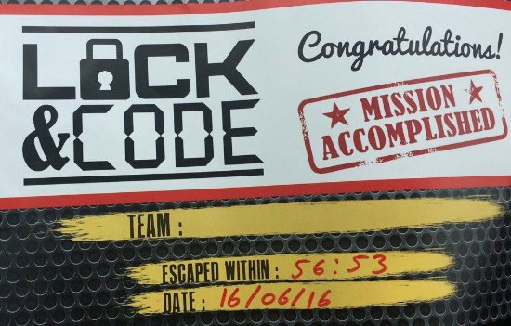

Nunnery Wood

