Slide 2
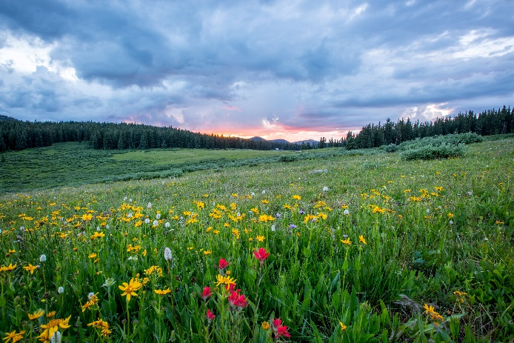
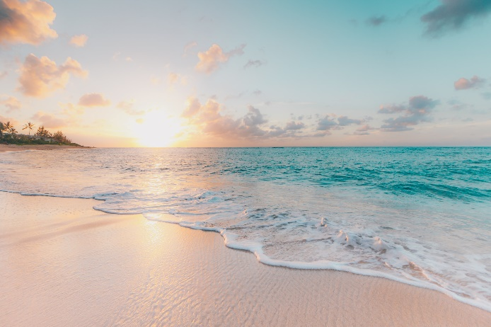
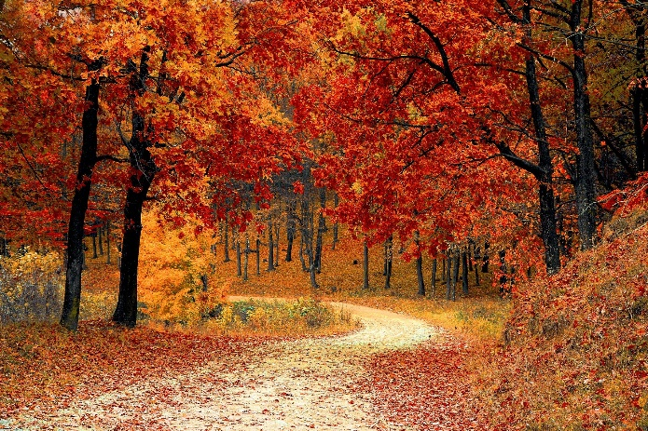
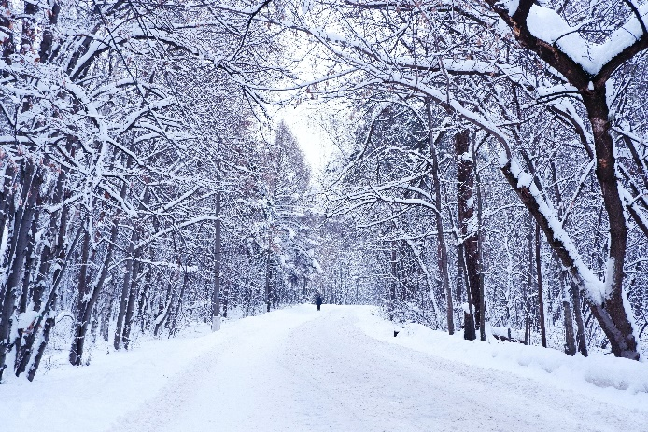
What is Autumn?
Autumn is one of the four seasons.
spring
summer
autumn
winter

Slide 3
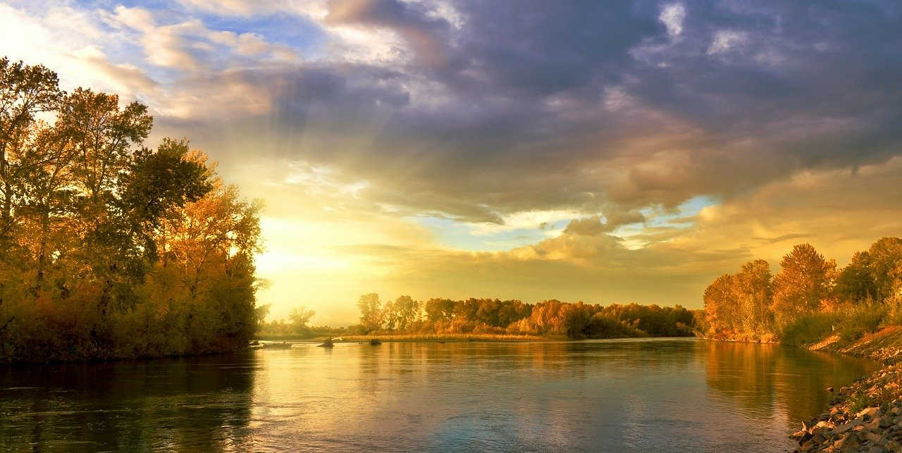
What is the Weather like in Autumn?
During autumn, the days start to get shorter and colder.

Slide 4
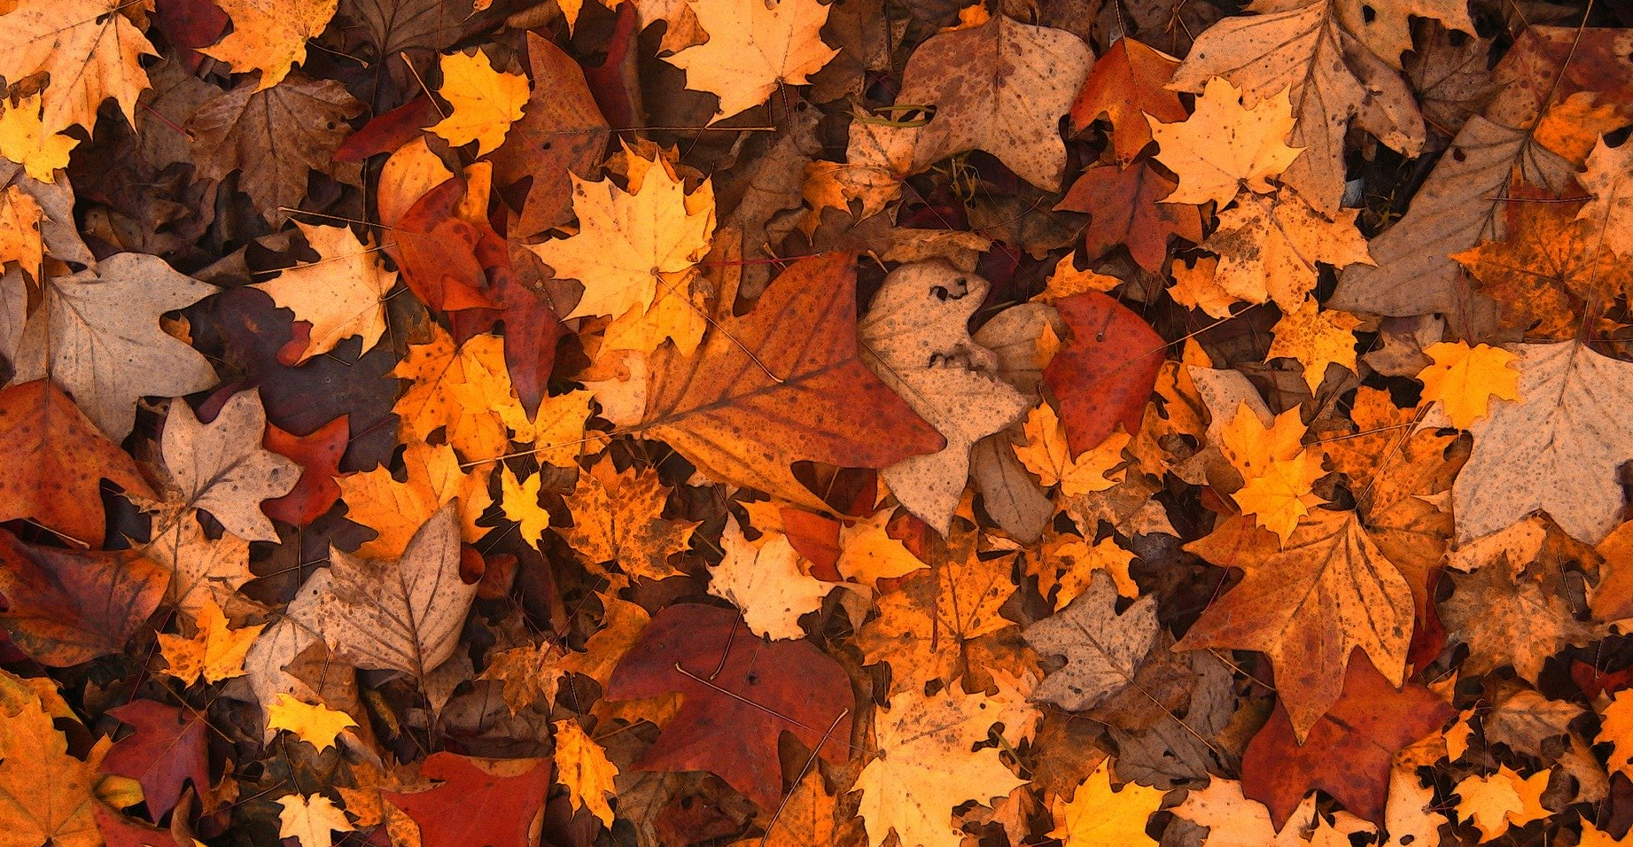
What Happens to the Trees in Autumn?
In autumn, the leaves start to turn bright colours and fall off the trees.

Slide 5
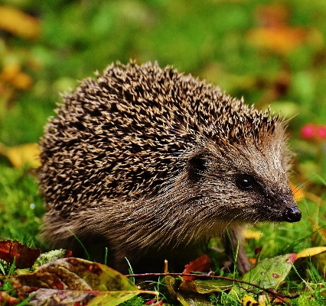
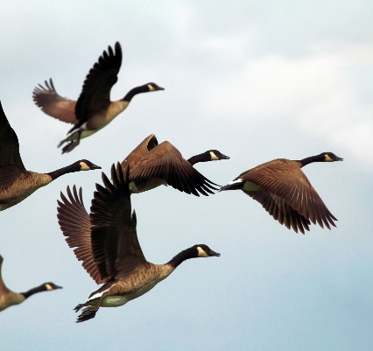
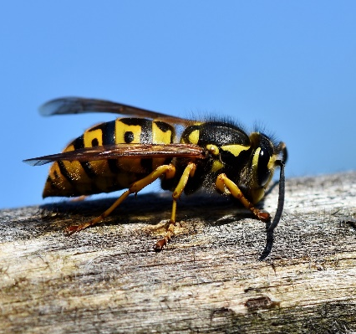
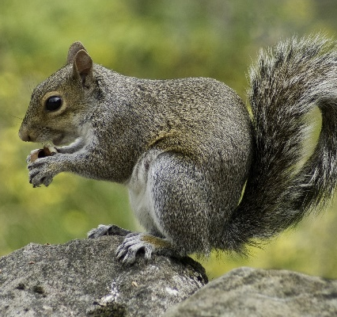
What Happens to the Animals in Autumn?
Hedgehogs hibernate through autumn and winter. This means they sleep until springtime.
Geese and lots of
other birds migrate
in autumn.
This means they fly to find a warmer place to live until spring.
During autumn, squirrels collect lots of nuts and acorns. They hide them in the ground. During winter they stay in their nests and only come out to eat the food they have hidden.
Most wasps will die in autumn but the queen wasp will survive in the nest.

Slide 6
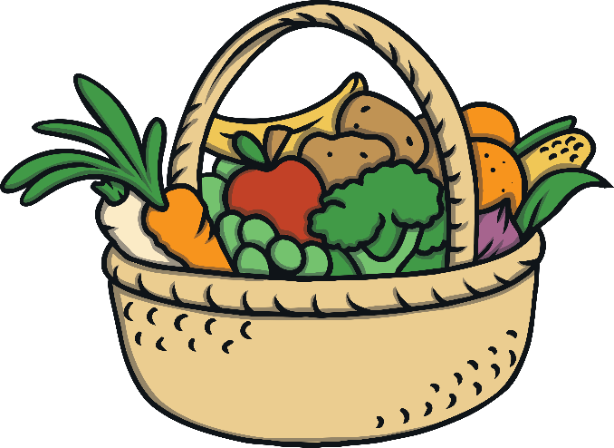
What Do We Celebrate in Autumn?
Harvest Festival
A harvest festival is a celebration of the food
that has been successfully grown and harvested.
They happen at different time of year around the world.
In the United Kingdom, harvest festivals take place in autumn.

Slide 7
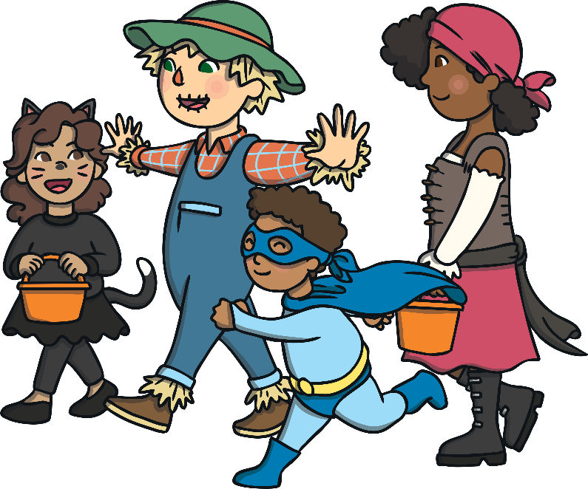
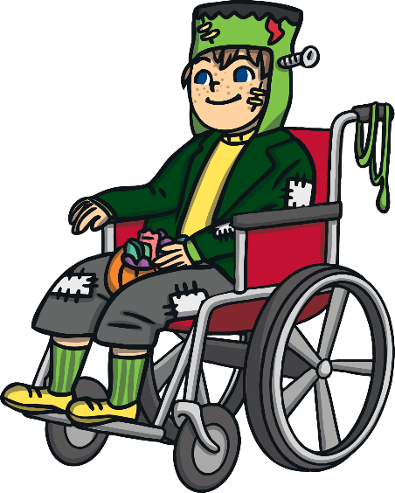
What Do We Celebrate in Autumn?
Halloween
Many people celebrate Halloween during autumn,
by dressing up in costumes and going trick-or-treating.
Pumpkins are often carved into silly
or scary faces and then lit up with candles.

Slide 8
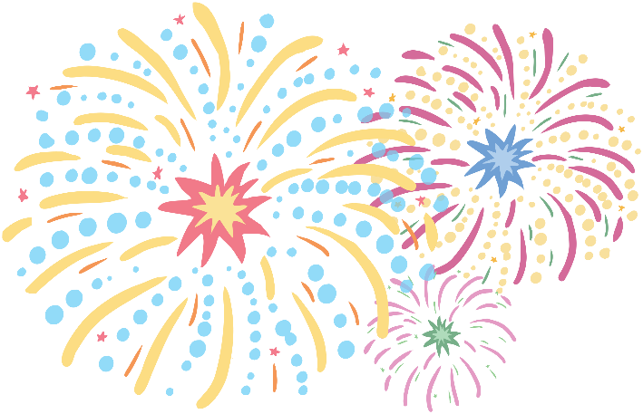
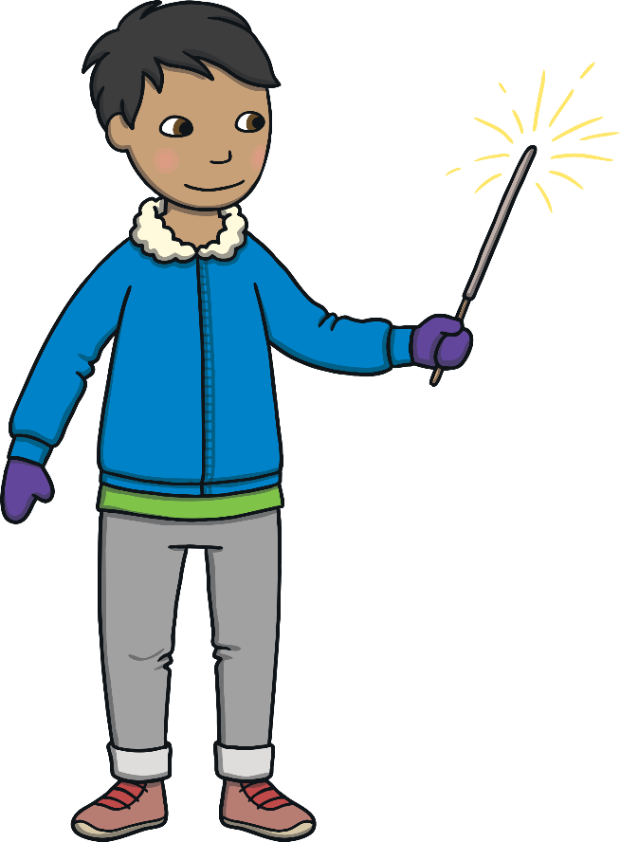
What Do We Celebrate in Autumn?
Bonfire Night
On the 5th November, Bonfire Night is celebrated in the United Kingdom.
People build bonfires and watch firework displays.

