Slide 2
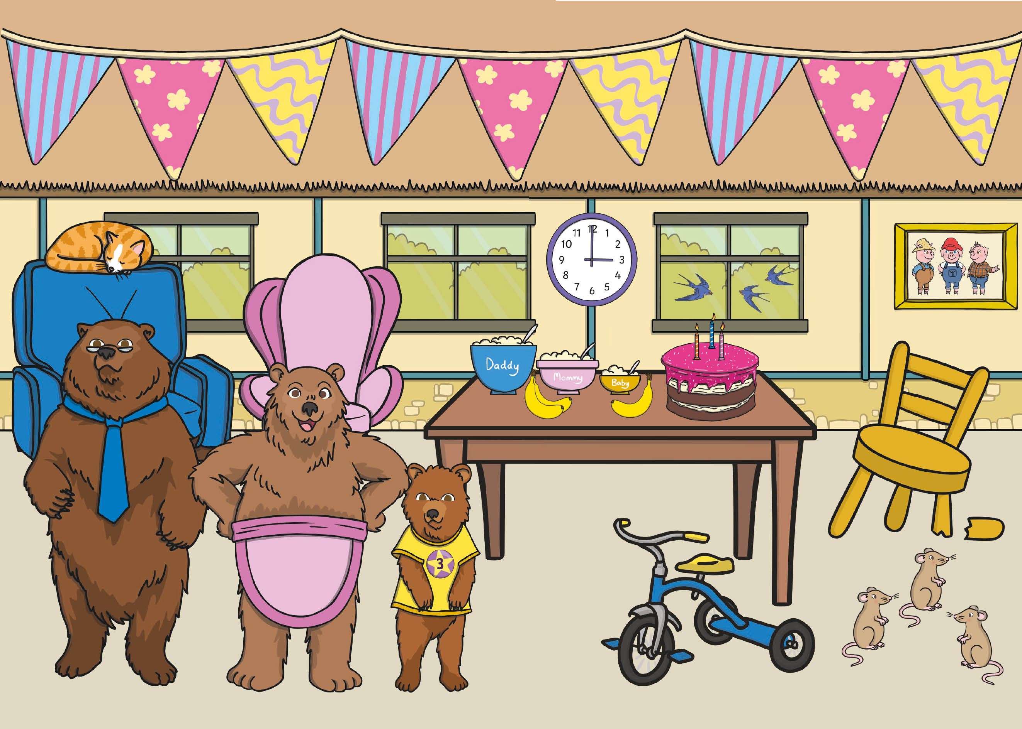

Slide 3

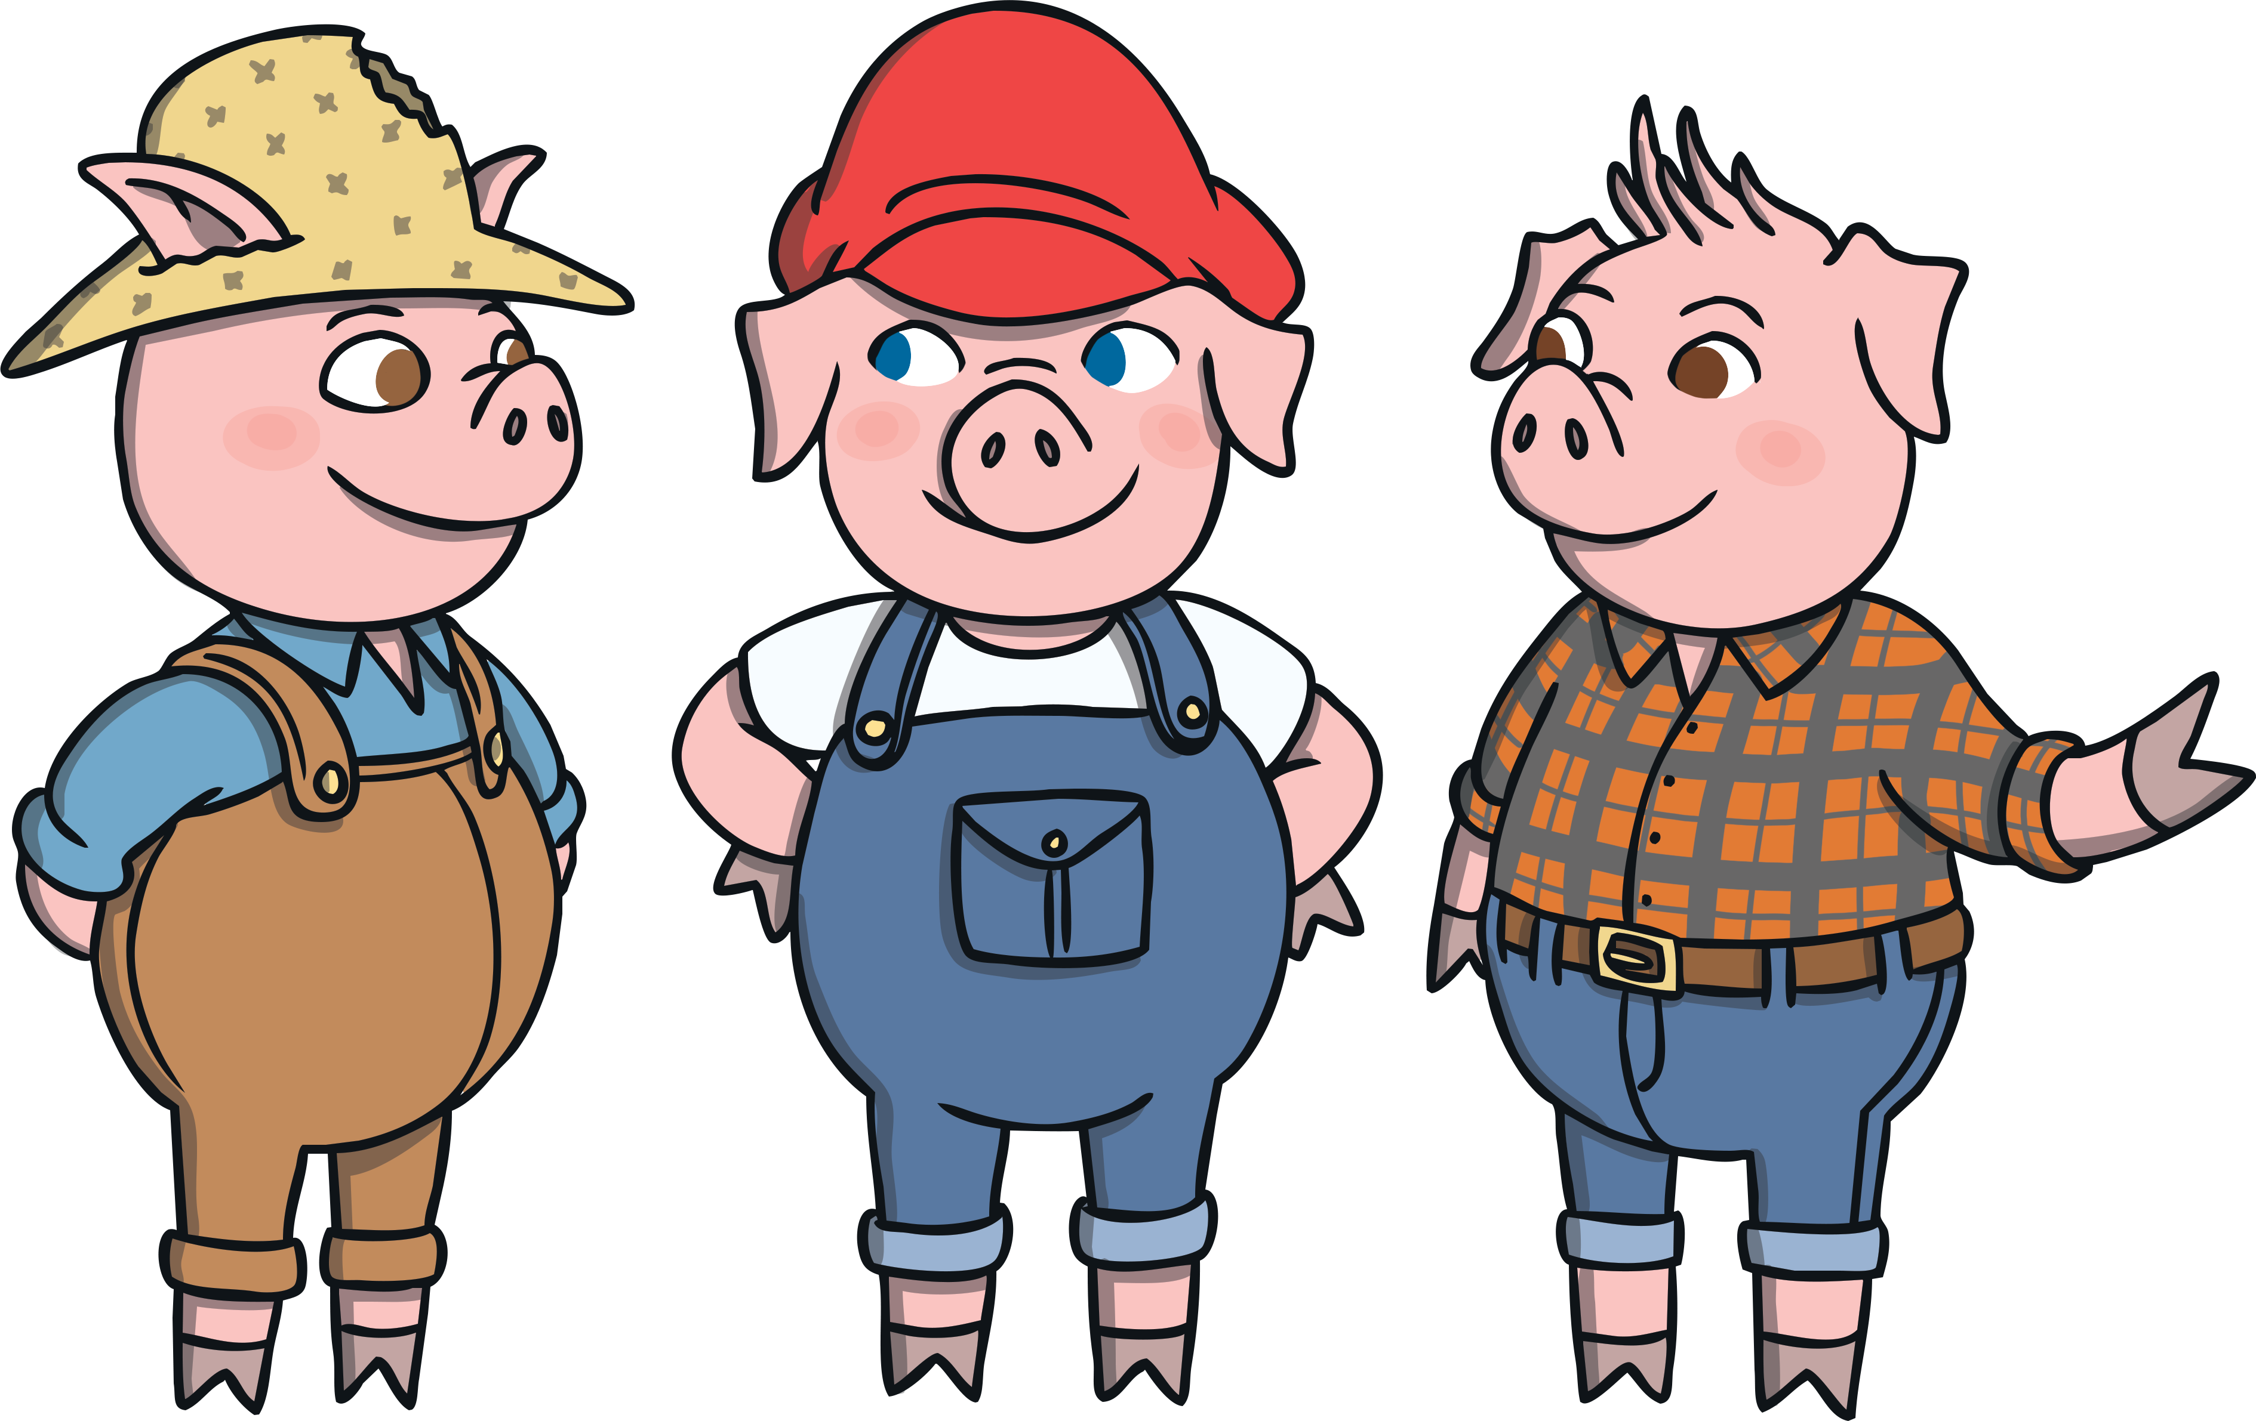
back to the picture
next

Slide 4
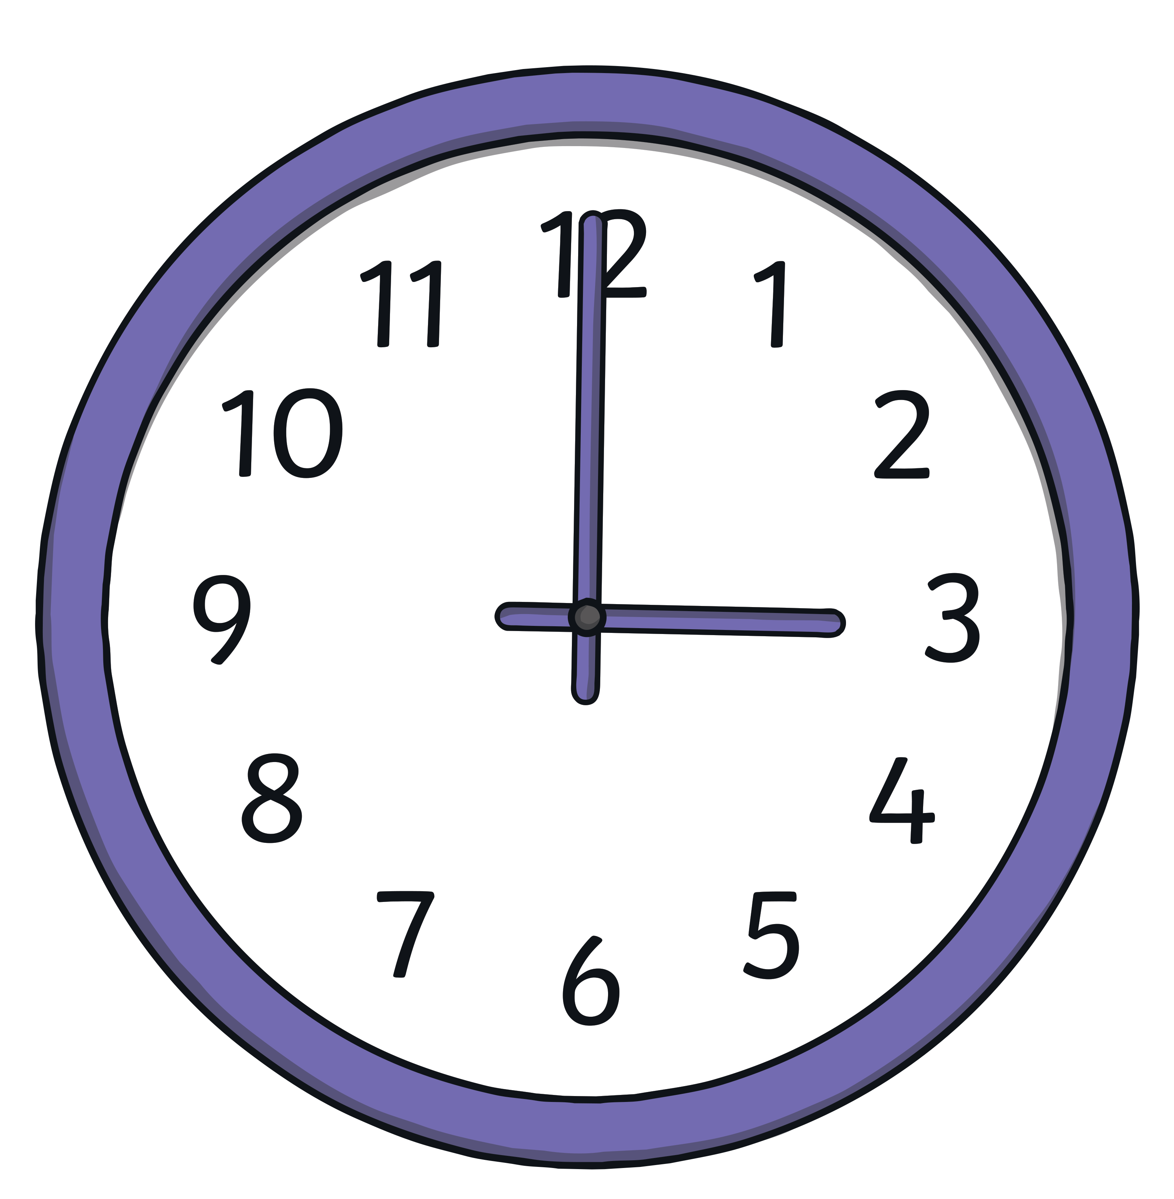
back to the picture
next

Slide 5


back to the picture
next

Slide 6


back to the picture
next

Slide 7
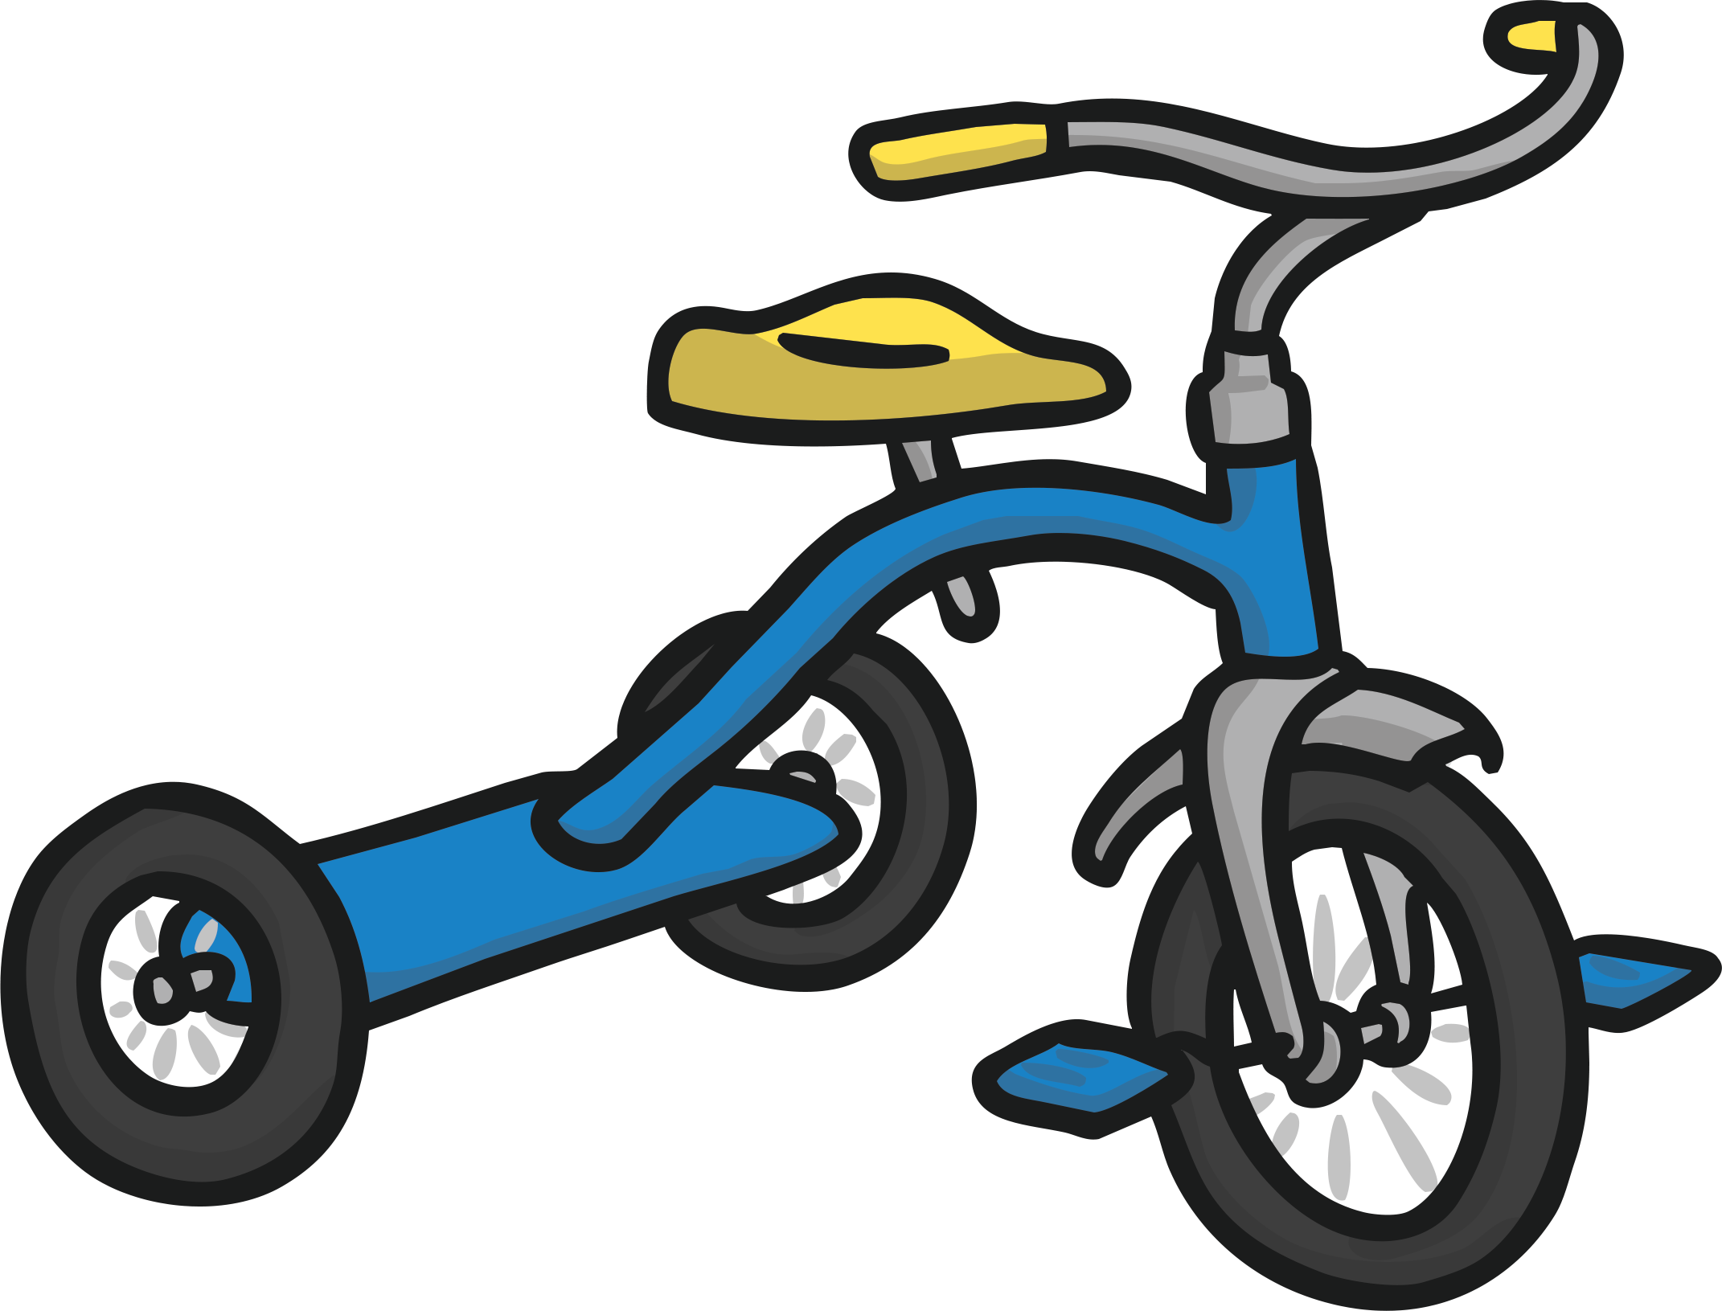
back to the picture
next

Slide 8

back to the picture
next

Slide 9


back to the picture
next

Slide 10

back to the picture
next

Slide 11
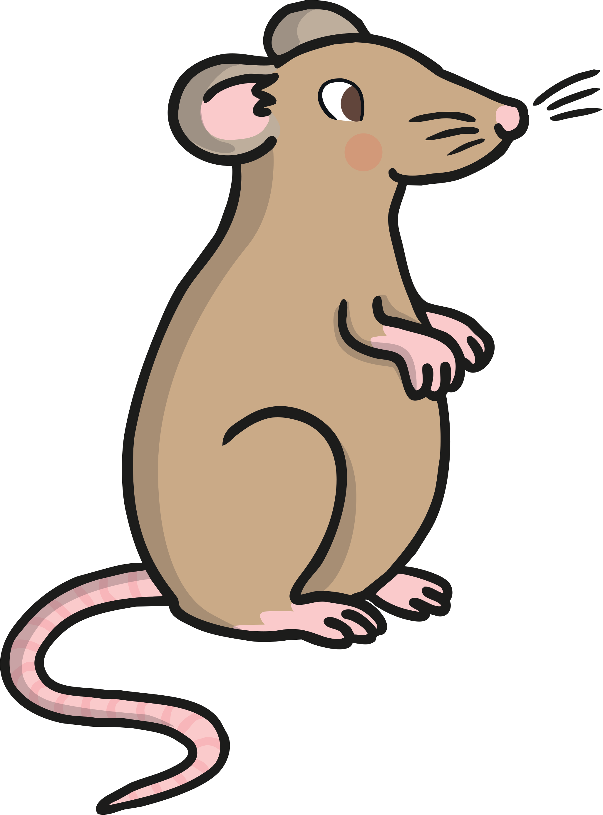
back to the picture
finish

