Slide 1



Slide 2
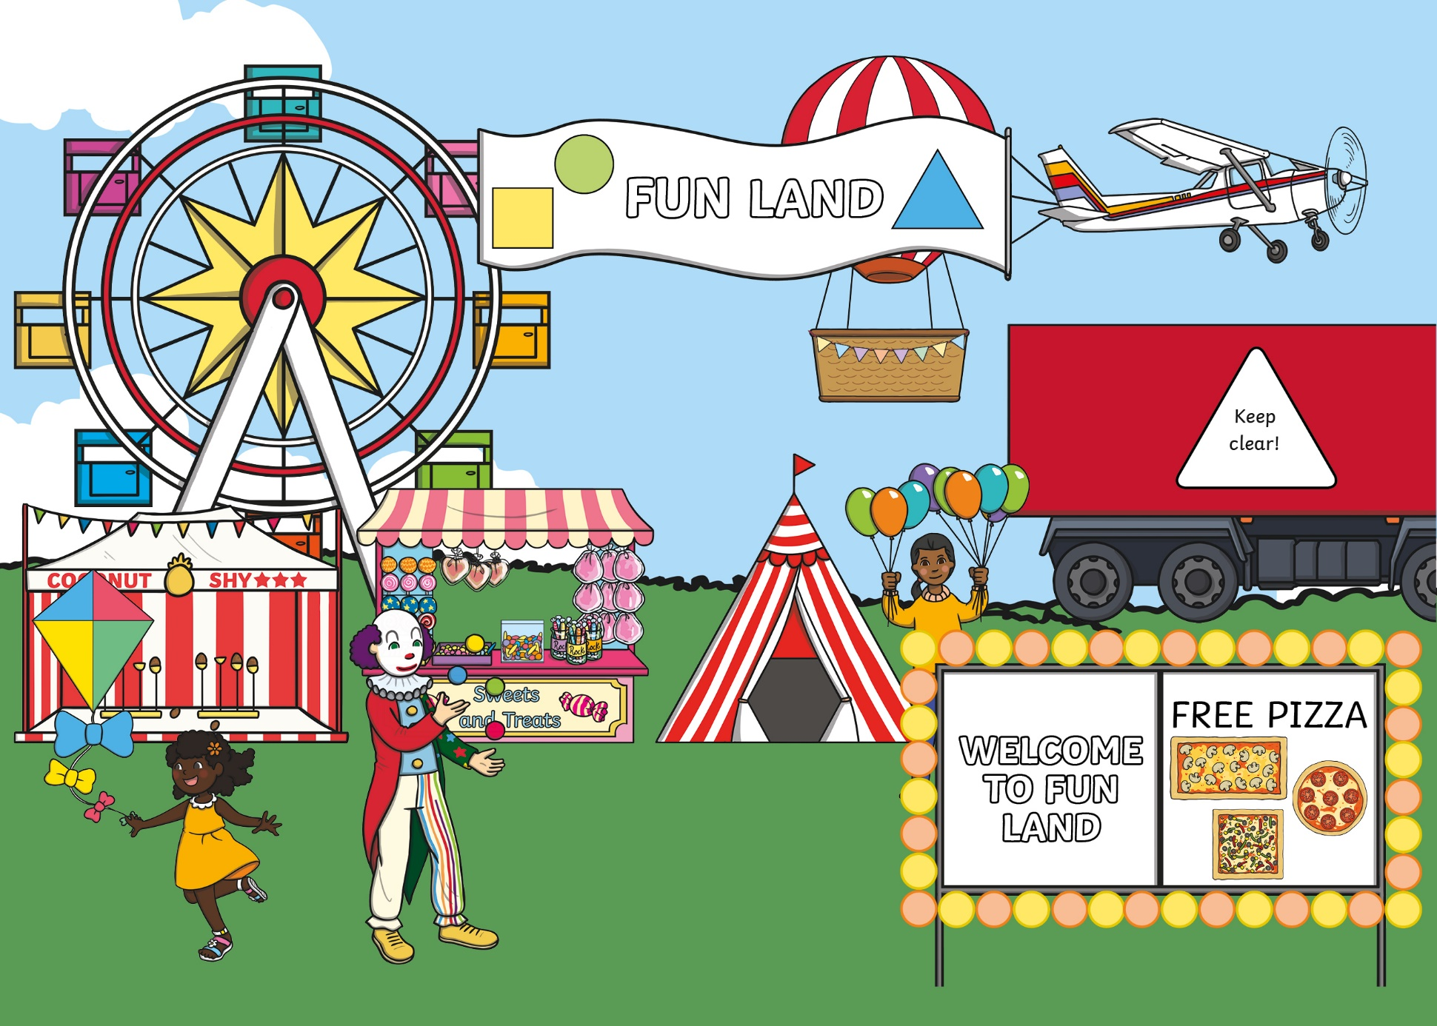

Slide 3
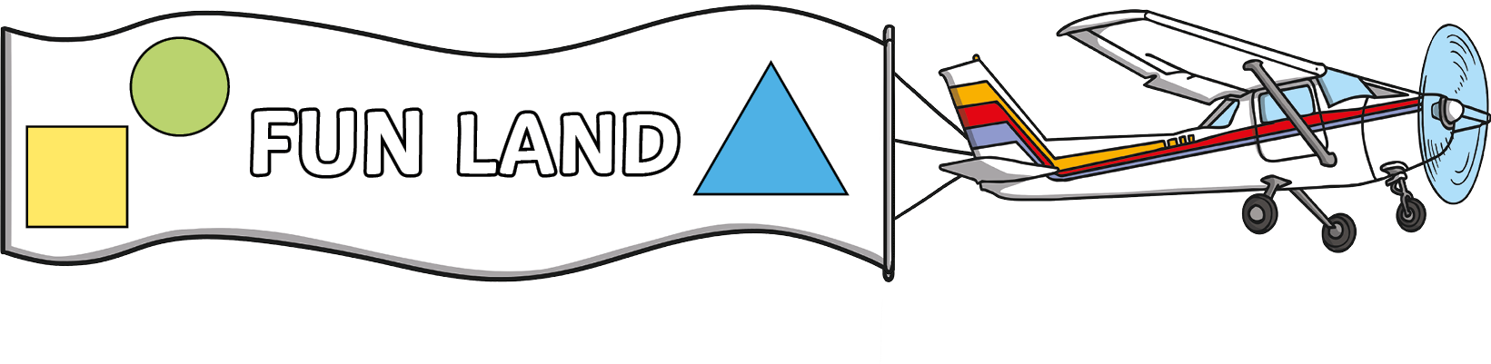
back to the picture
next

Slide 4
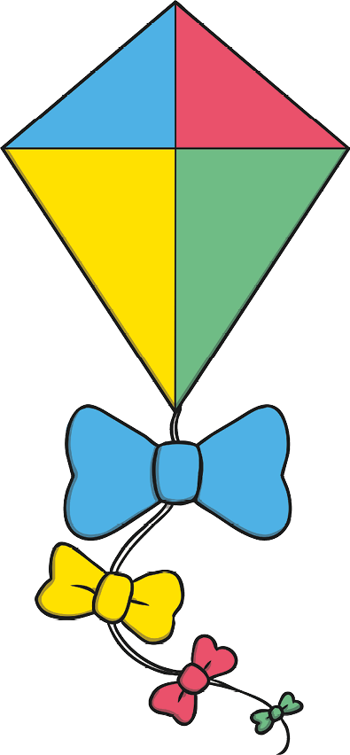
back to the picture
next

Slide 5
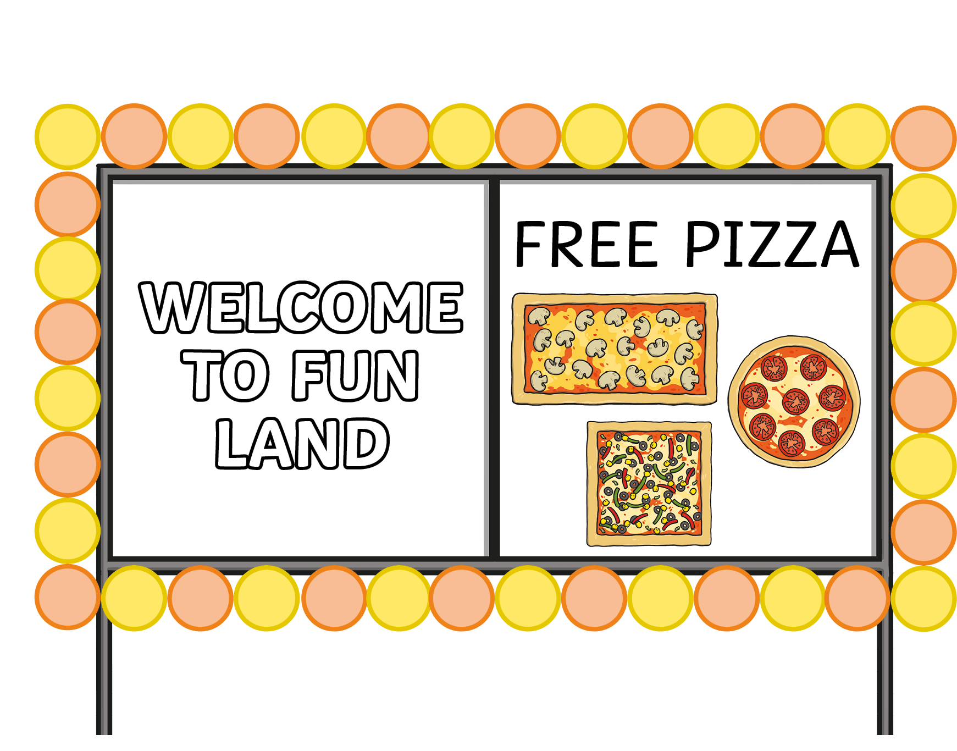
back to the picture
next

Slide 6

back to the picture
next

Slide 7

back to the picture
next

Slide 8
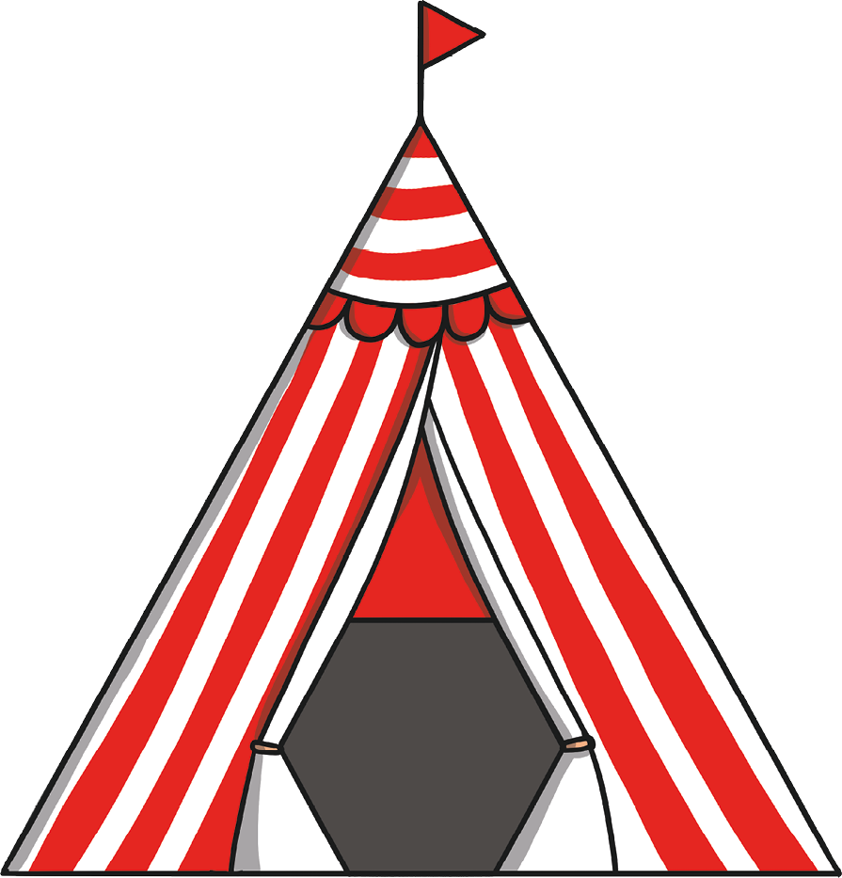
back to the picture
next

Slide 9

back to the picture
next

Slide 10

back to the picture
next

Slide 11

back to the picture
next

Slide 12
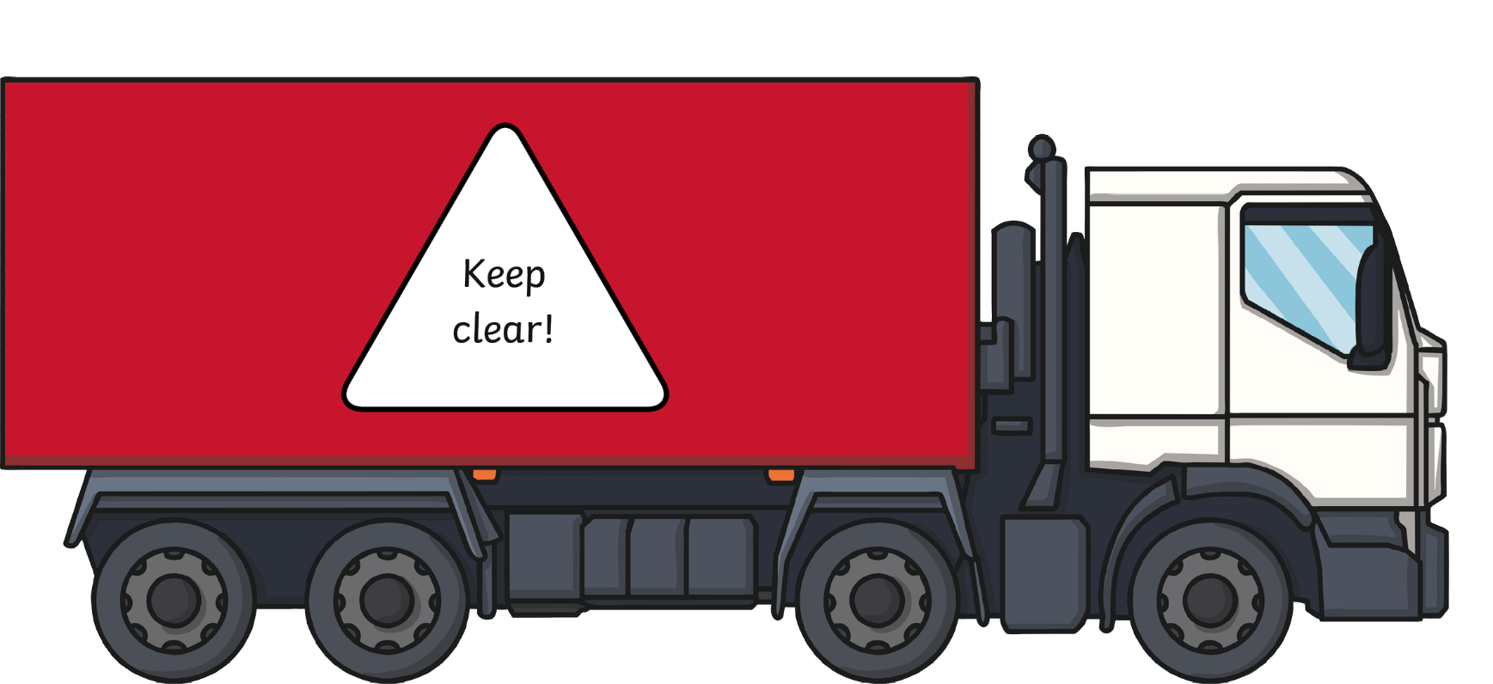
back to the picture
next

Slide 13

back to the picture
end

