Slide 2
This is the Christmas story of when
Jesus was born.
Click the highlighted words to reveal the action.
Each time you hear one of these words, do the action to retell the Nativity story.

Slide 3
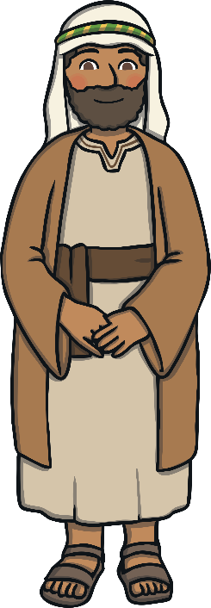
A long time ago
Tap your wrist with one finger as if you are pointing to your watch.
A long time ago, in a town called Nazareth, there lived a man called Joseph and a woman called Mary.
A long time ago
Joseph
Mary.
Joseph
Put your hands on your hips and smile.
Mary
Gently rest your hands on your tummy and smile.

Slide 4
angel
Slowly raise and lower
your arms by your
sides like an
angel’s
wings.
One day, Angel Gabriel came to visit Mary and he told her she was going to have a very special baby.
Angel
Mary
baby.
Mary
Gently rest your hands on your tummy and smile.
baby
Fold your arms in front of you
and slowly rock them from side to side.

Slide 5

Joseph
Joseph and Mary had to travel to a town called Bethlehem to register in a census. Mary travelled on a little donkey.
Joseph
Mary
Put your hands on your hips and smile.
donkey.
Mary
Gently rest your hands on your tummy and smile.
donkey
Put your hands on your head like a donkey’s ears.

Slide 6
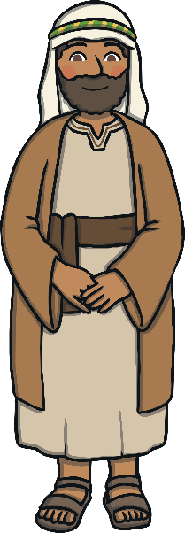
Mary
Gently rest your hands on your tummy and smile.
Mary
A kind innkeeper let Mary and
Joseph stay in a stable..
Joseph
stable.
Joseph
Put your hands on your hips and smile.
stable
Put your hands
above your head
in a triangle shape as if you are making a roof.

Slide 7

baby
Fold your arms in front of you
and slowly rock them from side to side.
That night, baby Jesus was born in the stable. They laid him in a manger.
baby
stable.
manger.
stable
Put your hands
above your head
in a triangle shape as if you are making a roof.
manger
Hold your hands a
slight distance
apart as though
holding a box.

Slide 8
baby
Fold your arms in front of you and slowly rock them from side to side.
When baby Jesus was born, an angel appeared in the sky and spoke to some shepherds. .
baby
angel
shepherds.
angel
Slowly raise and lower your arms by your sides
like an angel’s
wings.
shepherds
Hold an open hand over your eyes as though
looking for
your sheep.

Slide 9
shepherds
Hold an open hand over your eyes as though
looking for
your sheep.
The shepherds walked to Bethlehem to visit baby Jesus in the stable..
shepherds
baby
stable.
baby
Fold your arms
in front of you
and slowly rock them from side
to side.
stable
Put your hands
above your head
in a triangle shape as if you are making a roof.

Slide 10
Wise Men
Far away, Three wise men saw a bright star in the sky and knew it meant a new king had been born. They rode on camels to follow the star.
Hold closed hands in front of you and move them up and down as though
holding the reins
of a camel.
Wise Men
star
follow
star
Hold one hand
in the air and open and close your hand like a twinkling star.
follow
Point a finger
in the air and look up towards
the sky.

Slide 11
Wise Men
Hold closed hands in front of you and move them up and down as though
holding the reins
of a camel.
Soon, the wise men arrived at King Herod’s palace. King Herod wanted to know where baby Jesus was.
Wise Men
King
baby
king
Hold your hands either side of your head as though you are wearing
a crown.
baby
Fold your arms in front of you and slowly rock them from side to side.

Slide 12
Wise Men
Hold closed hands in front of you and move them up and down as though
holding the reins of a camel.
Wise Men
When the wise men reached the stable, they gave Jesus gifts of gold, frankincense and myrrh.
stable,
gifts
stable
Put your hands
above your head
in a triangle shape as if you are making a roof.
gifts
Hold your hands out in front of you and move them forwards as though giving a present to someone.

Slide 13
Wise Men
Wise Men
Hold closed hands in front of you and move them up and down as though
holding the reins
of a camel.
That night, the wise men had a dream that warned them not to tell King Herod where Jesus was. They did not go back to the palace.
King
did not
king
Hold your hands either side of head as though you are wearing a crown.
did not
Wave one finger from side to side and shake your head.

Slide 14
king
Hold your hands either side of head as though you are wearing a crown.
cross.
King Herod was very cross. He sent his soldiers to look for Jesus.
King
soldiers
cross
Fold your arms and look cross.
soldiers
Lift your hands up and down as
though you
are marching.

Slide 15
Joseph
Put your hands on your hips and smile.
Joseph had a dream where an angel told him to take Mary and Jesus to Egypt to keep safe.
Joseph
angel
Mary
angel
Slowly raise and lower
your arms by your
sides like an
angel’s
wings.
Mary
Gently rest your hands on your tummy and smile.

Slide 16
Mary
Gently rest your hands on your
tummy and
smile.
Mary and Joseph travelled to Egypt with baby Jesus and he was safe.
Mary
Joseph
baby
Joseph
Put your hands
on your hips
and smile.
baby
Fold your arms in front of you and slowly rock them
from side to side.

