Slide 1
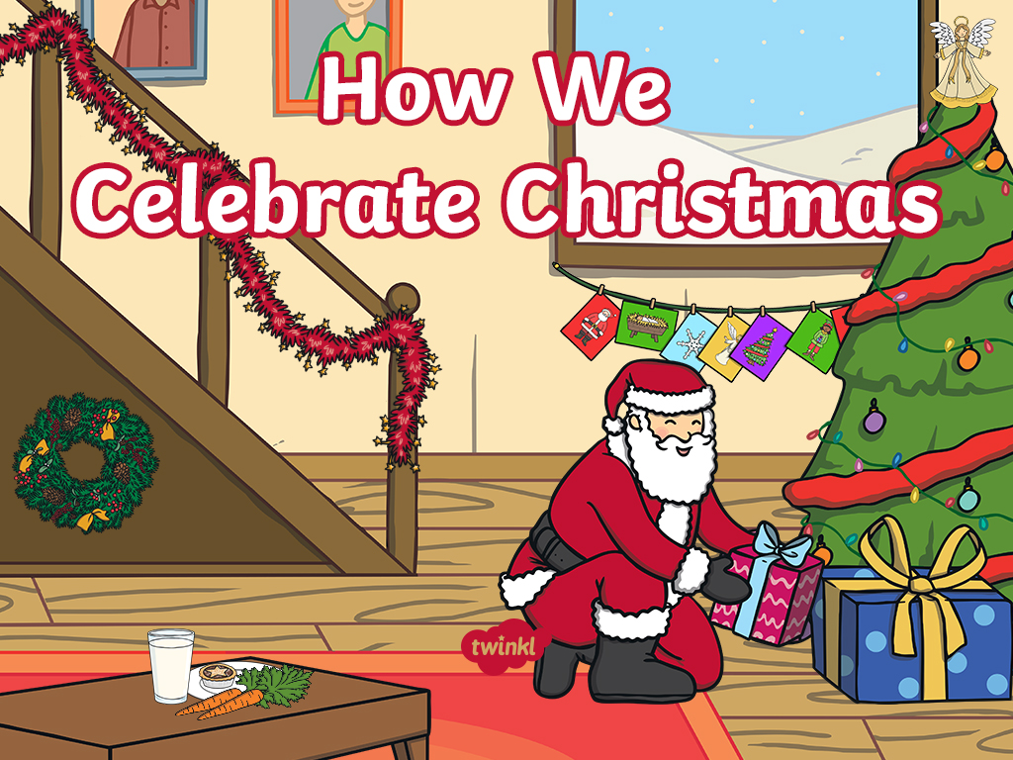

Slide 2

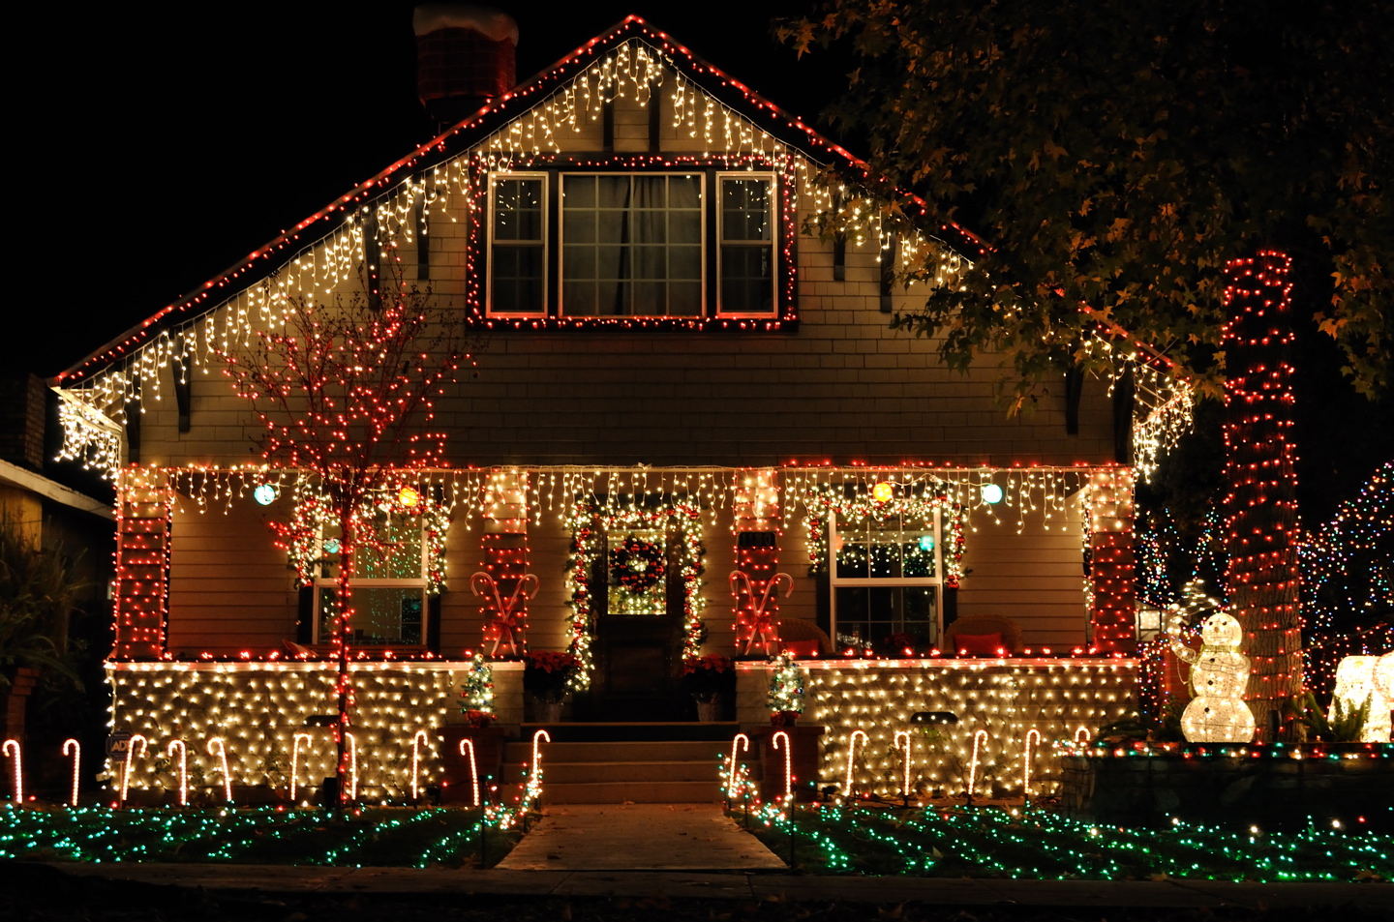
Many people decorate their houses with lights.
“unknown” by [Marc Flores - Flickr] is licensed under CC BY 2.0

Slide 3
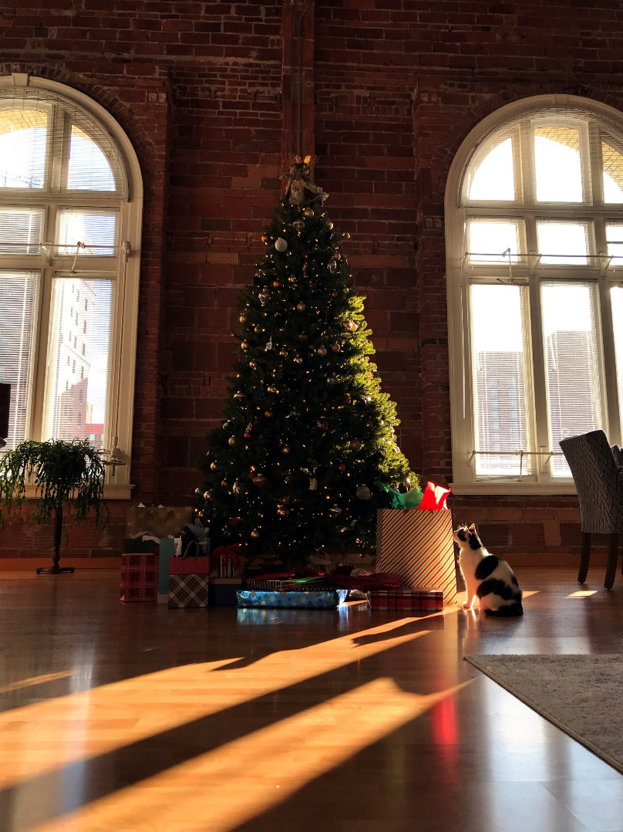
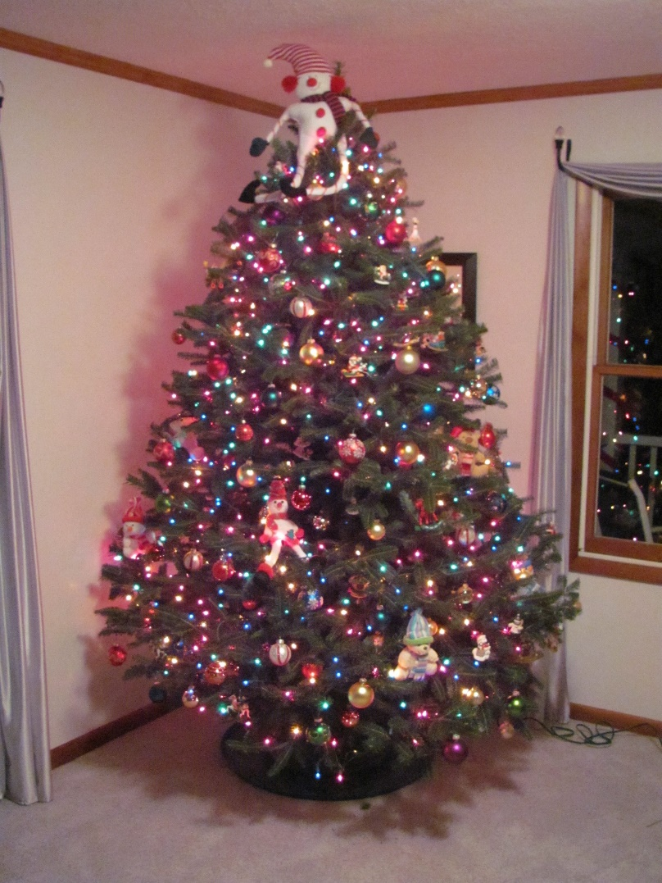
People put Christmas trees up near their windows.
“unknown” by [Ed Kennedy and Steam Pipe Tunk Distrubutions- Flickr] is licensed under CC BY 2.0

Slide 4
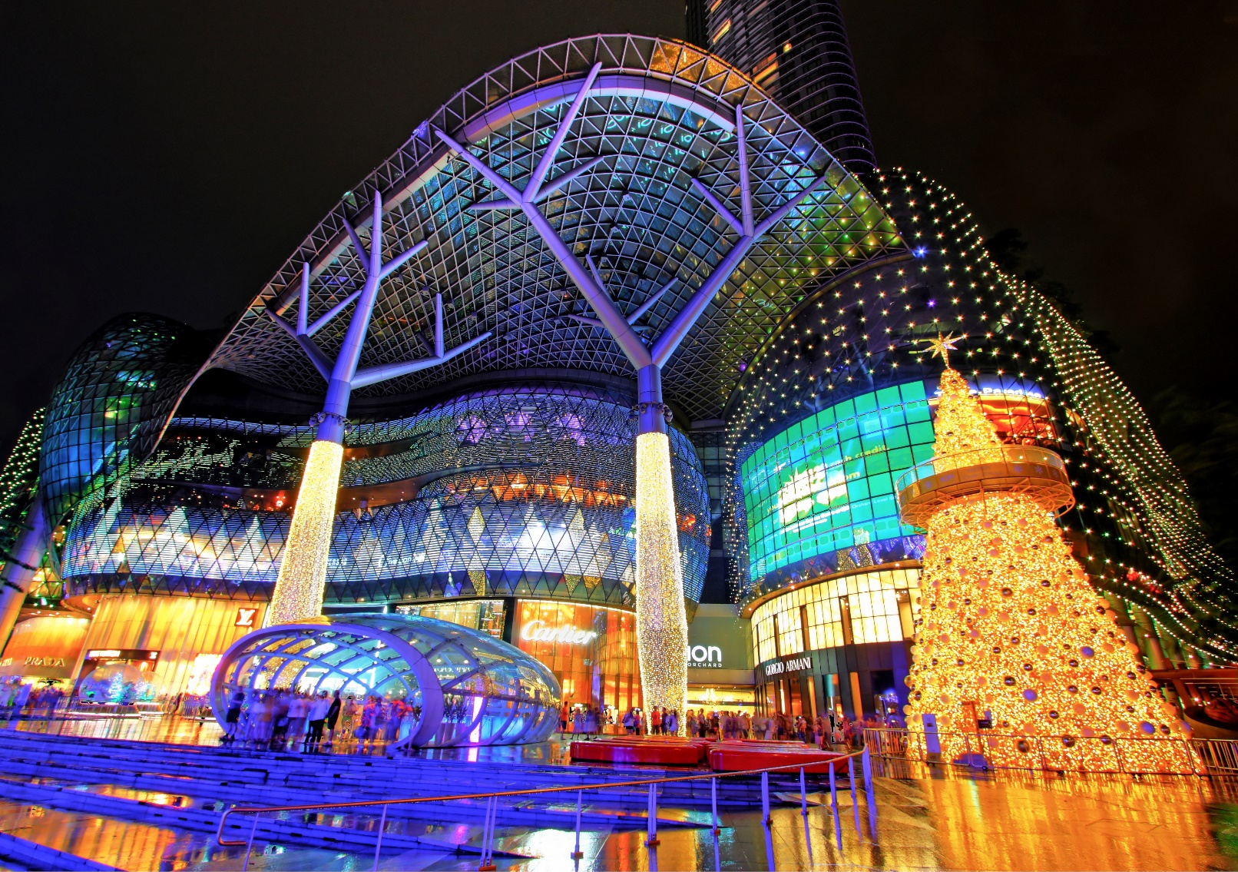
People go Christmas shopping for presents.
“unknown” by [Wenjie, Zang- Flickr] is licensed under CC BY 2.0

Slide 5
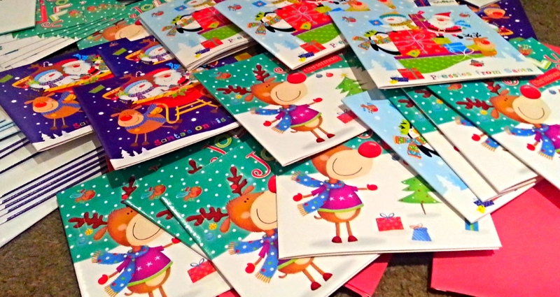
Christmas cards are exchanged and put up in our homes.
“unknown” by [Chez Mummy- Flickr] is licensed under CC BY 2.0

Slide 6
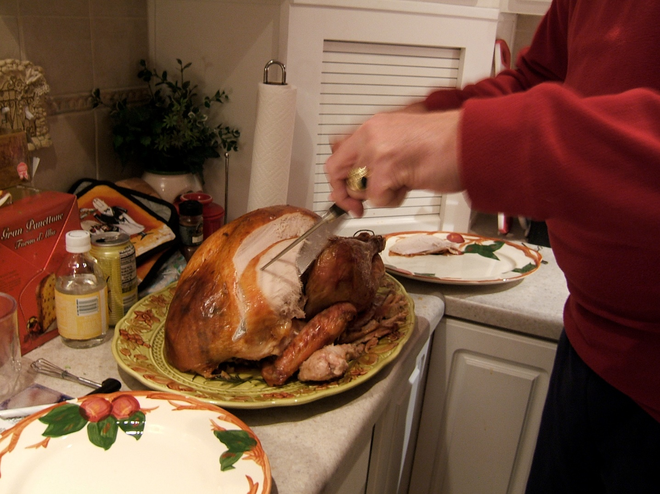
At Christmas turkey is eaten, often with friends and family.
“unknown” by [WordRidden - Flickr] is licensed under CC BY 2.0

Slide 7
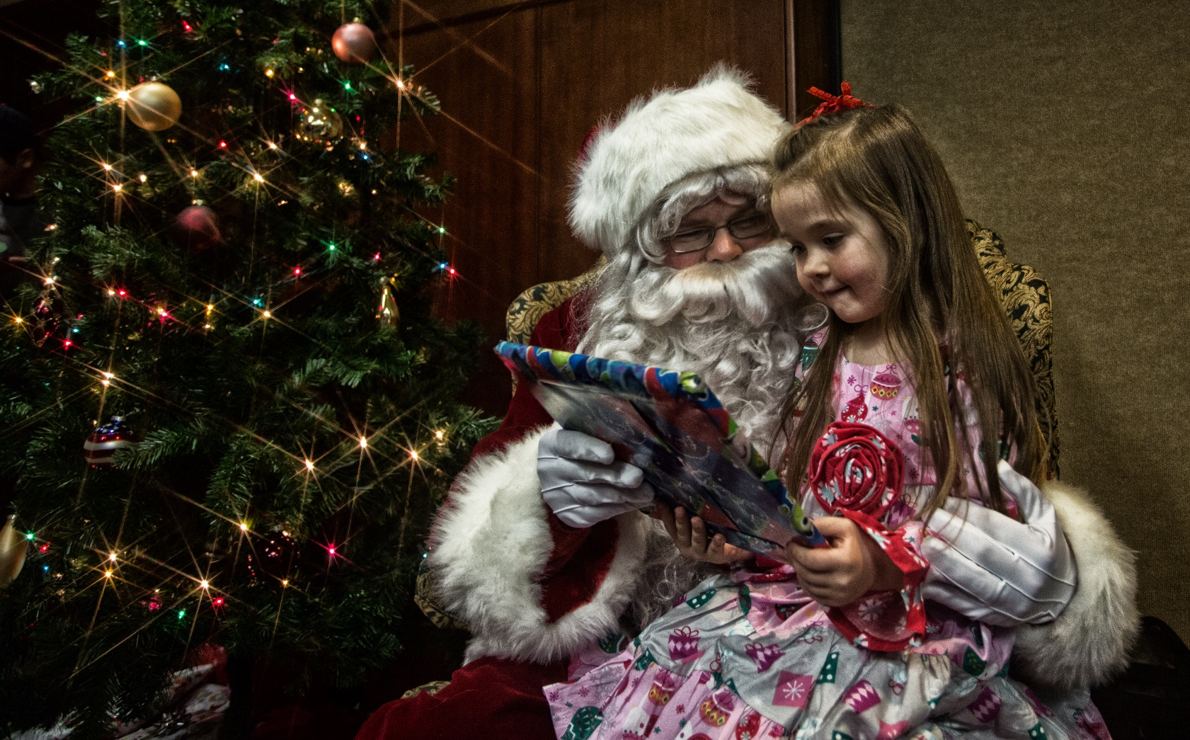
Children look forward to Santa’s visit on Christmas Eve.
“unknown” by [Johnny Silvercloud - Flickr] is licensed under CC BY 2.0

Slide 8
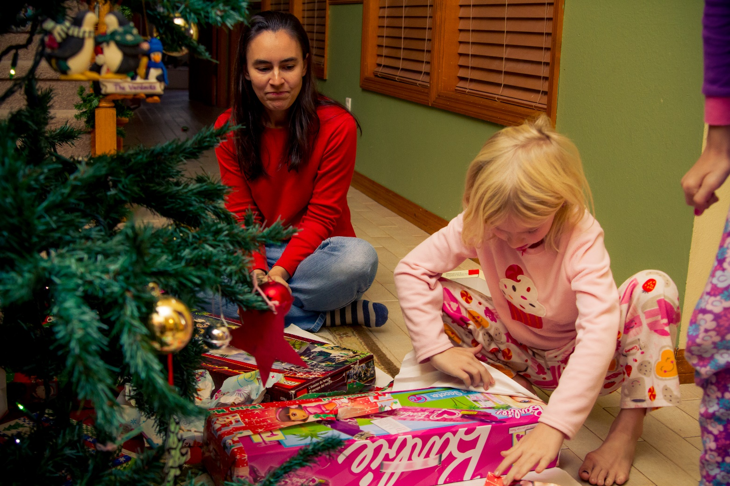
Presents are opened on Christmas morning.
“unknown” by [Rain0795 - Flickr] is licensed under CC BY 2.0

Slide 9
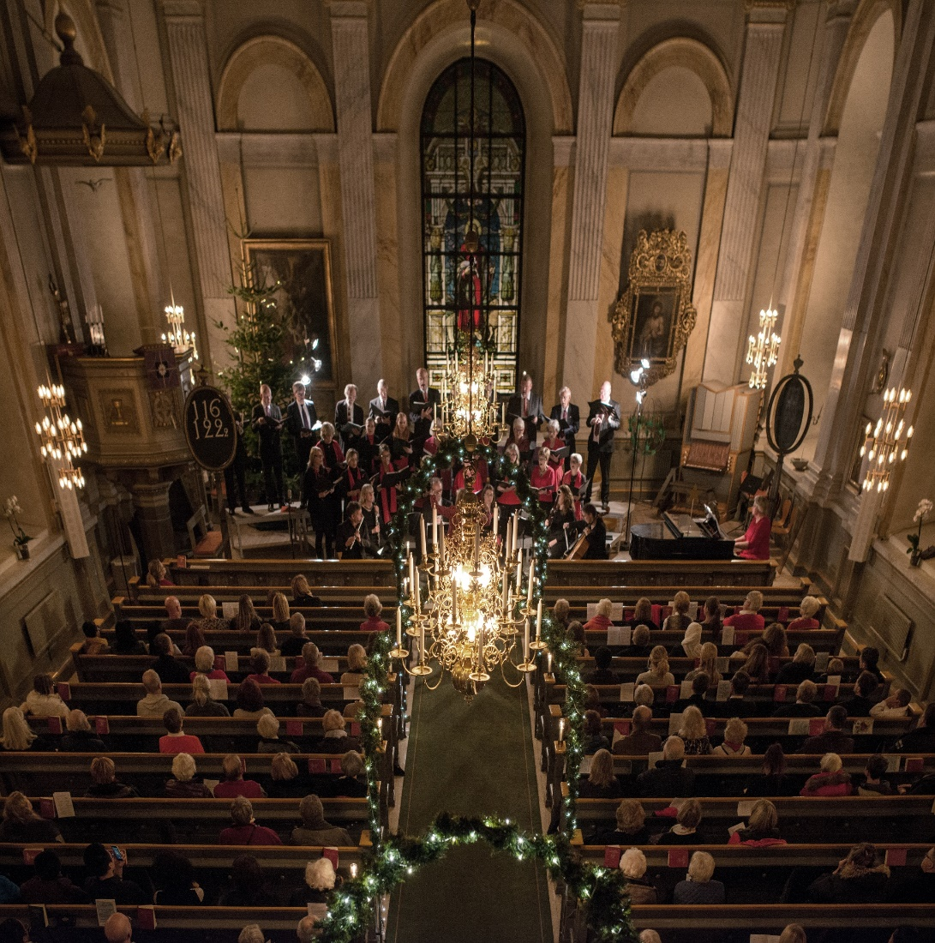
Many Christians go to church to celebrate Jesus’ birth.
“unknown” by [Bengt Nyman - Flickr] is licensed under CC BY 2.0

Slide 10
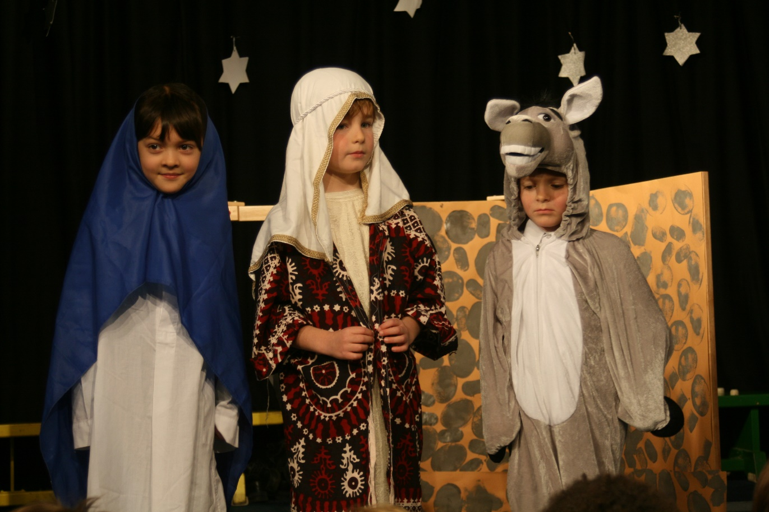
Schools act out the nativity story to remind us why
Christmas is celebrated.
“Nativity Play” by [Peter C - Flickr] is licensed under CC BY 2.0

Slide 11
