Slide 1
People who help us
11.1.21 - 15.1.21

Slide 2
Monday
11.1.21

Slide 3
Wake & Shake
https://www.youtube.com/watch?v=X7jSWdnoshw

Slide 4
Shared Read
Read the sight words:
I a mum
dad the see
can

Slide 5
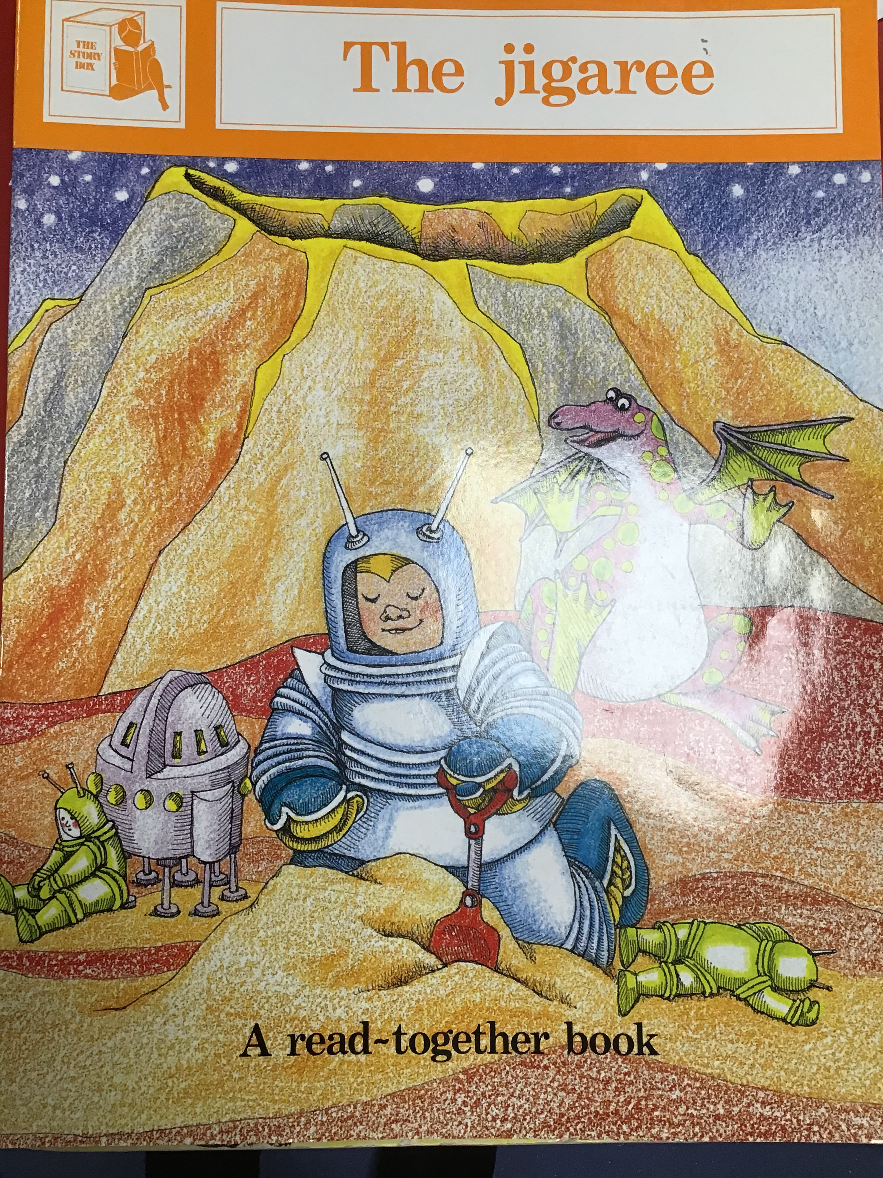
Where are the children going?
Read the title of the book twice then ask your child to read it.​
Ask “ What can you see on the front cover?”​
Encourage them to use the sentence “I can see…’’

Slide 6
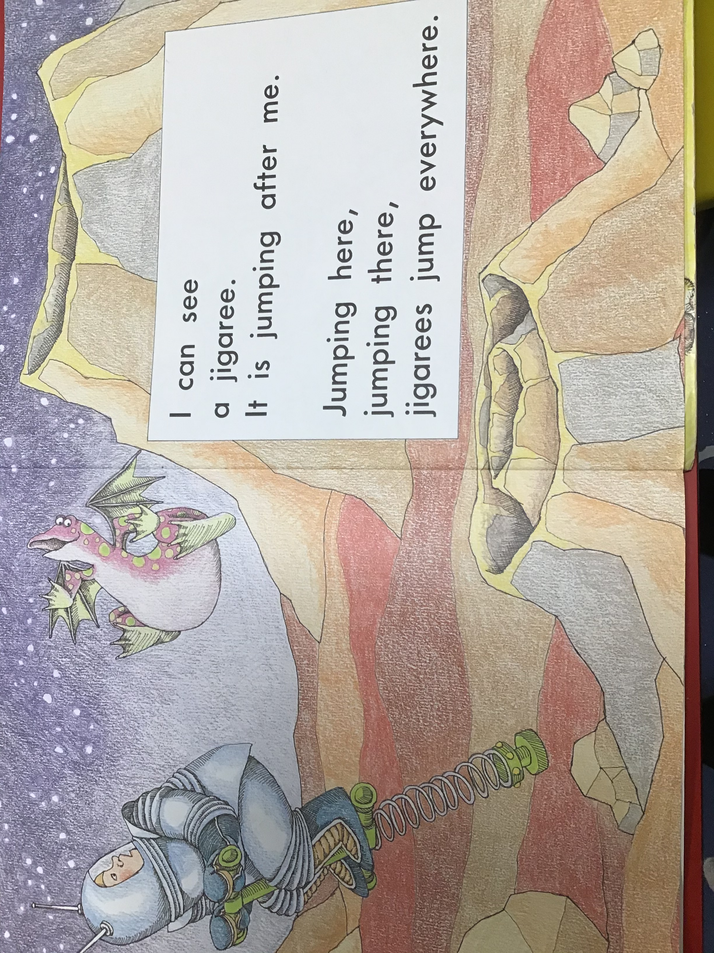
Can you find the sight word I?
What is the jigaree doing?

Slide 7
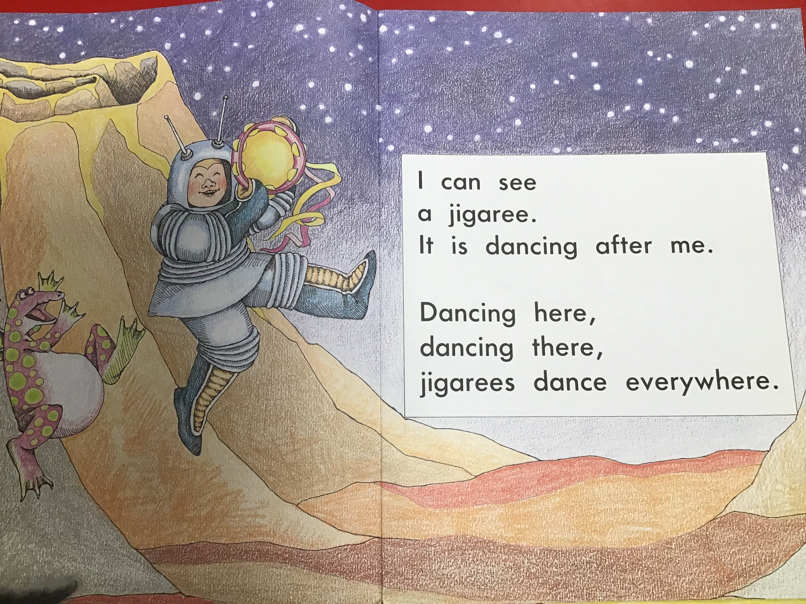
Can you find the sight word can?
What is the jigaree doing?

Slide 8
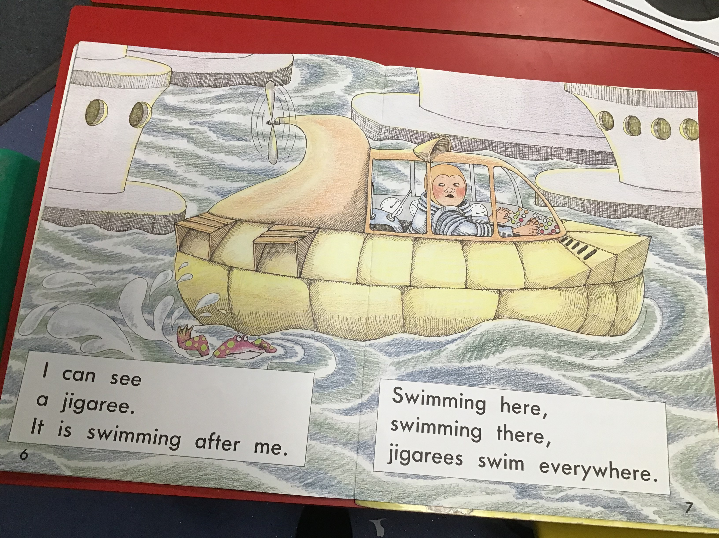
Can you find the sight word see?
What is the jigaree doing?

Slide 9
Maths
Please refer to the ‘I spy number 5 sheet’

Slide 10
Phonics
https://www.youtube.com/watch?v=ipf6zS5OM7s

Slide 11
Tuesday
12.1.21

Slide 12
Wake & Shake
https://www.youtube.com/watch?v=IkanoEmIcHM

Slide 13
Shared Read
Read the sight words:
I a mum
dad the see
can

Slide 14
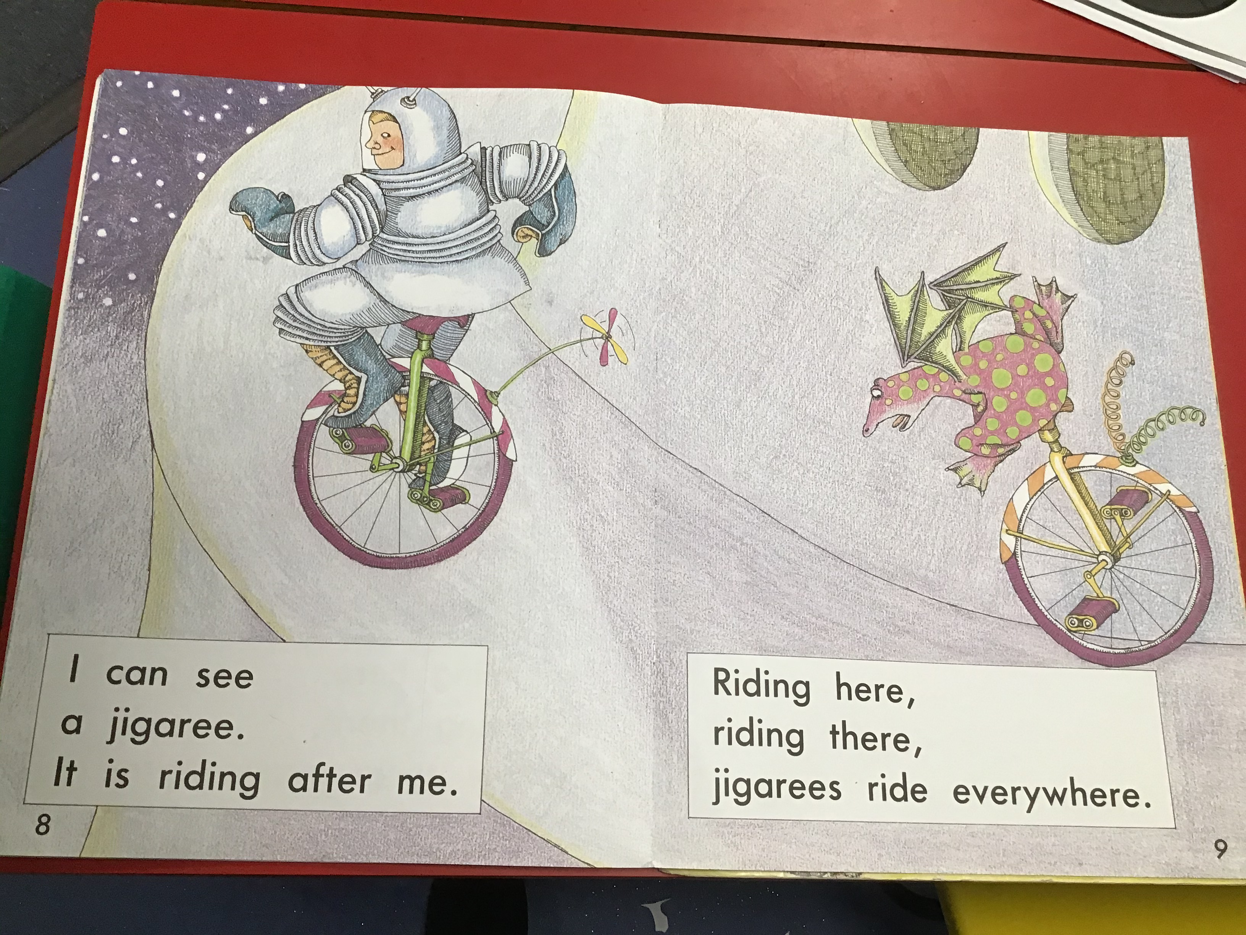
Can you find the sight word a?
What is the jigaree doing?

Slide 15
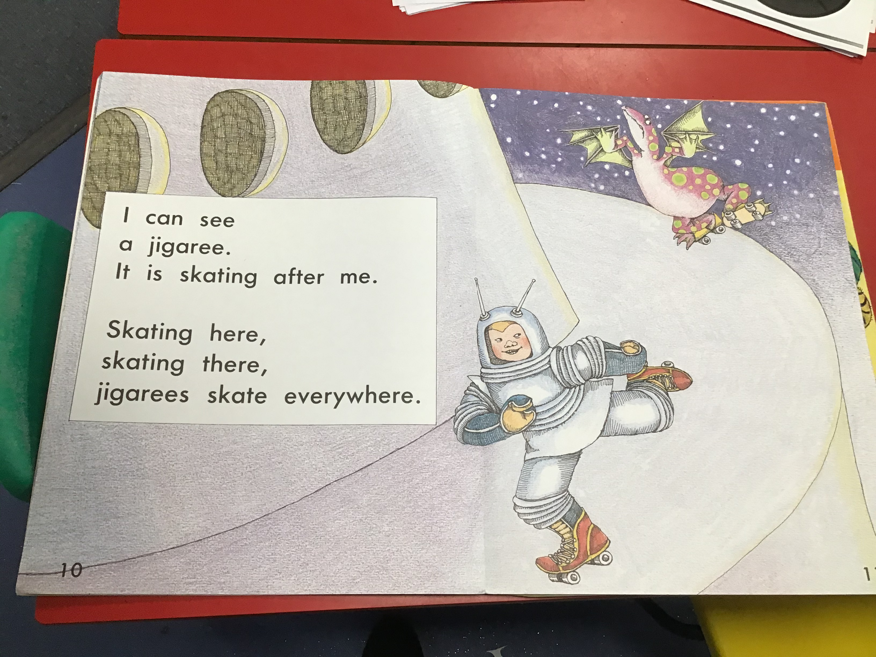
Can you find the sight word can?
What is the jigaree doing?

Slide 16
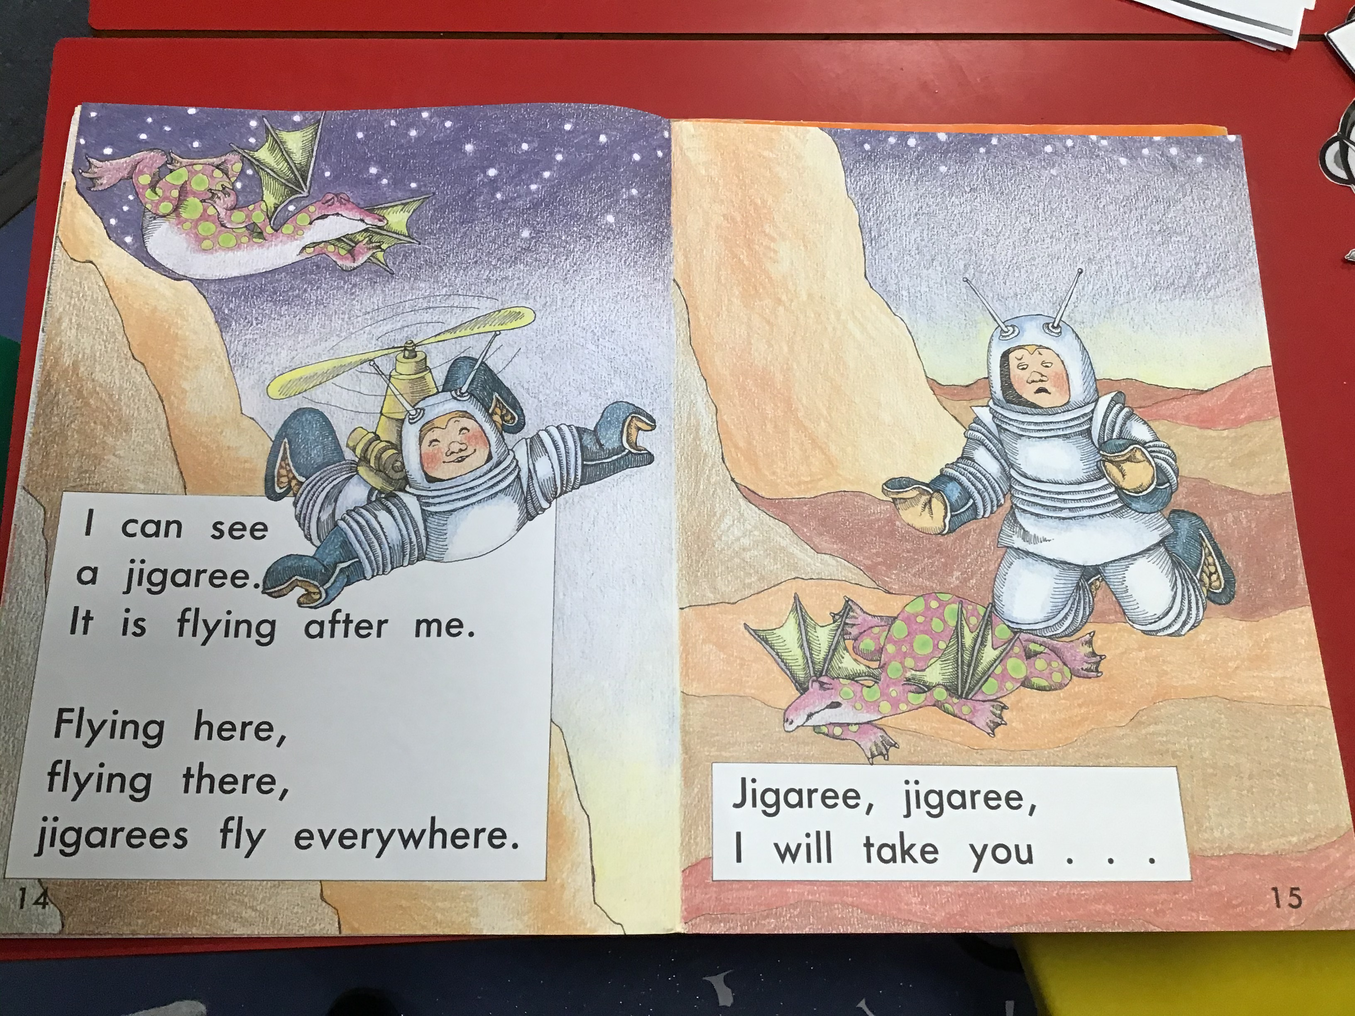
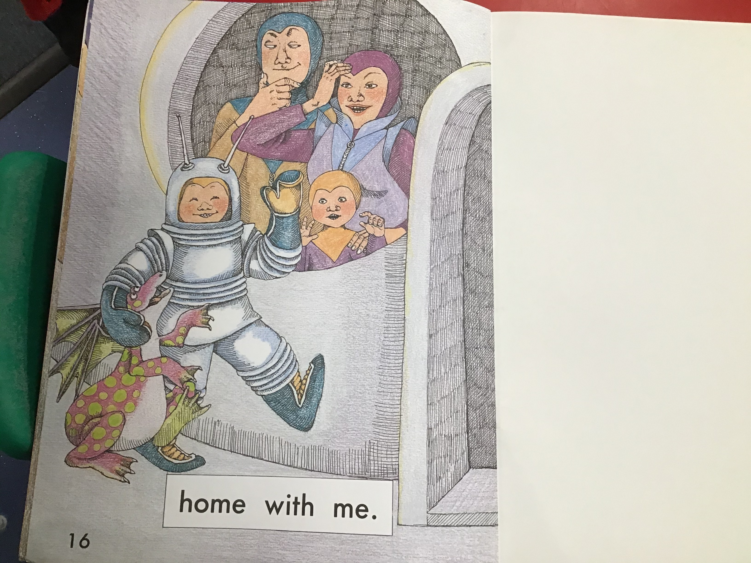
Can you find the sight word see?
What is the jigaree doing?

Slide 17
Maths
Please refer to the ‘Number 5 formation sheet’

Slide 18
Phonics
https://www.youtube.com/watch?v=g8u84XGhRgo

Slide 19
Wednesday
13.1.21

Slide 20
Wake & Shake
https://www.youtube.com/watch?v=1k2aD2XGXwM

Slide 22
What types of clothing do the
Police Wear?

Slide 23

Hats

Slide 24

Dark Blue Uniforms

Slide 25

High Visibility Jackets

Slide 26
Can you think of any more?

Slide 27

What do the Police do?
Police officers do many different things to help people, such as:
Help people with directions in town.
Help an elderly person if needed.
Has a police officer ever helped you?
If so, how?

Slide 28

Where can you find the Police?

Slide 29

Where can you find the Police?

Slide 30

Where can you find the Police?

Slide 31

Where can you find the Police?

Slide 32

Where can you find the Police?

Slide 33
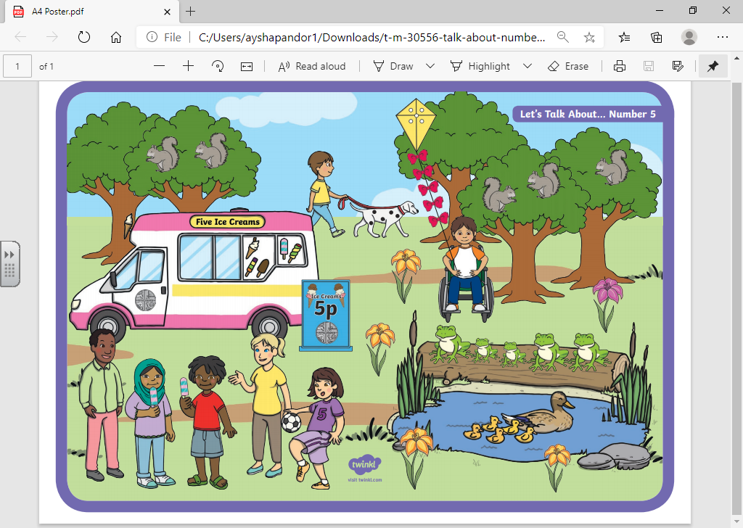
Maths

Slide 34
Phonics
Please refer to the ‘Instrumental sounds sheet’

Slide 35
Thursday
14.1.21

Slide 36
Wake & Shake
https://www.youtube.com/watch?v=NwT5oX_mqS0

Slide 38

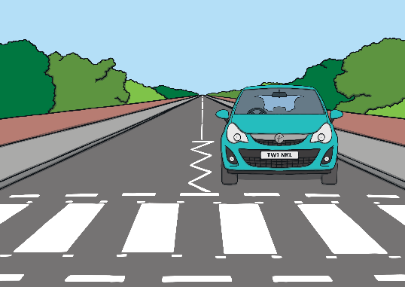

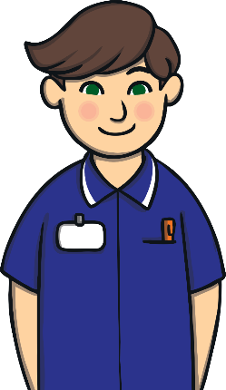



I need to cross the road.
Correct. Good job!
Never mind. Try again!
Who can help me?
or
Next
Lollipop person
Nurse

Slide 39

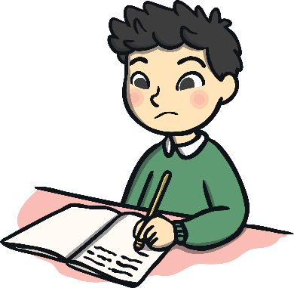


I need help with my work.
Correct. Good job!
Never mind. Try again!
Who can help me?
or
Next
Police
Teacher

Slide 40


I am lost.
Correct. Good job!
Never mind. Try again!
Who can help me?
or
Next
Police
Nurse

Slide 41


My dog is sick.
Correct. Good job!
Never mind. Try again!
Who can help me?
or
Next
Vet
Lollipop person

Slide 42


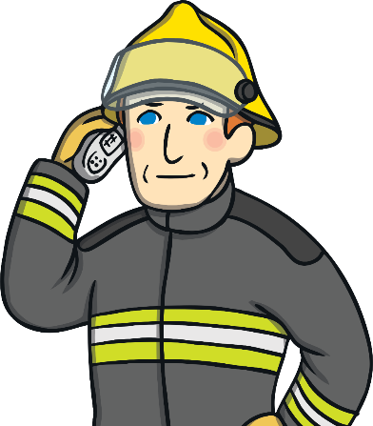
There is a fire.
Correct. Good job!
Never mind. Try again!
Who can help me?
or
Next
Lollipop person
Firefighter

Slide 43

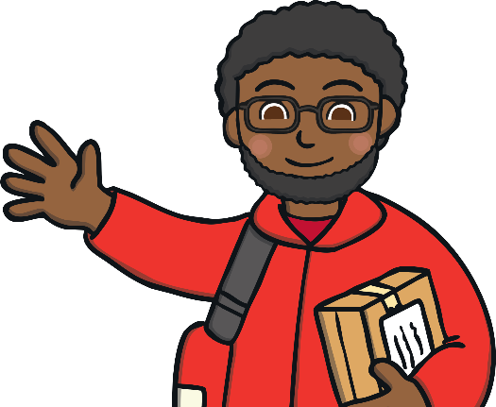

I have hurt my knee.
Correct. Good job!
Never mind. Try again!
Who can help me?
or
Next
Postal worker
Nurse

Slide 44
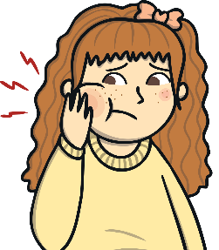
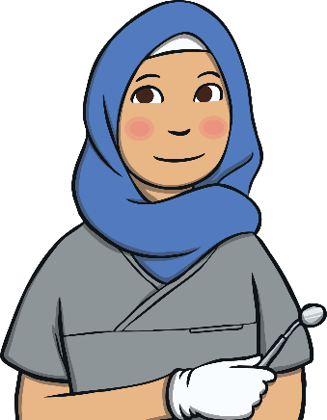
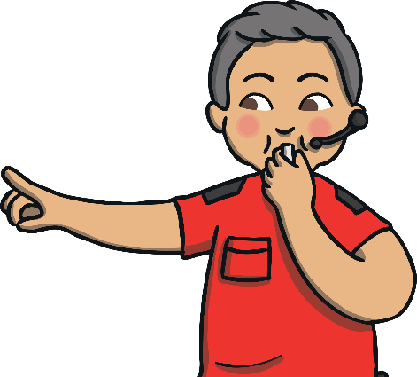
My teeth hurt.
Correct. Good job!
Never mind. Try again!
Who can help me?
or
Next
Dentist
Referee

Slide 45
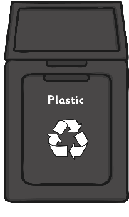
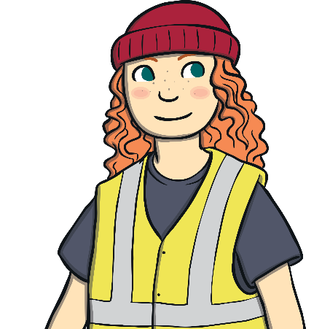

My bin is full.
Correct. Good job!
Never mind. Try again!
Who can help me?
or
Next
Bin collector
Vet

Slide 46
Maths
https://www.youtube.com/watch?v=DzKqCmjVXLI

Slide 47
Phonics
Please refer to the ‘Voice sound sheet’

Slide 48
Friday
15.1.21

Slide 49
Maths
https://www.topmarks.co.uk/learning-to-count/underwater-counting

Slide 50
Phonics
https://www.bbc.co.uk/teach/school-radio/nursery-rhymes-a-to-z-index/z4ddgwx

Slide 51
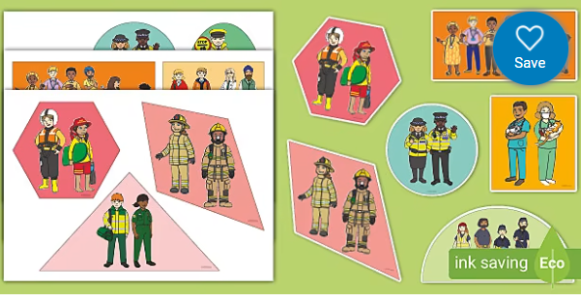
Cutting skills
Please refer to the ‘cutting skills sheet’

Slide 52
Don’t forget to send us all the learning you have done this week on the nursery email!​
nursery@whitehall.leicester.sch.uk​
Credit: Twinkl

