Slide 1
People who help us
08.02.21 - 12.02.21

Slide 2
Monday
08.2.21

Slide 3
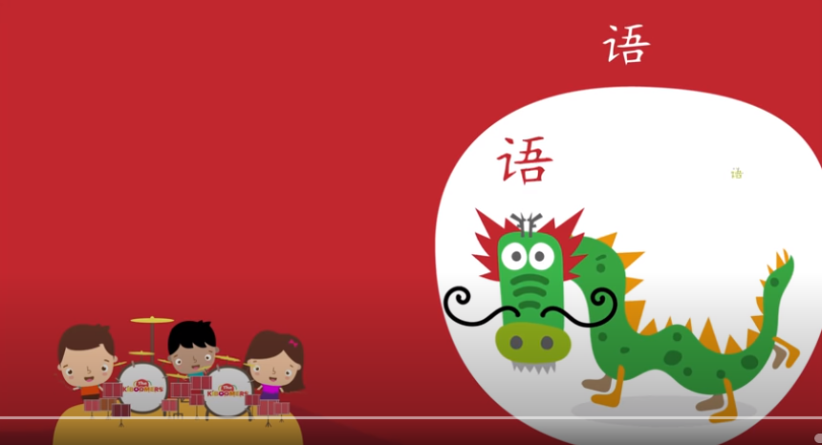
Wake & Shake
https://www.youtube.com/watch?v=by5sTzh67fU
The Kiboomers – Chinese New Year Song
Have a go at singing and dancing along to the song!

Slide 4

Shared Read
Read the sight words:
I a mum dad the see can and to is
New words – my like

Slide 5

Read the title of the book twice then ask your child to read it.​
Ask “ What can you see on the front cover?”​
Encourage them to use the sentence “I can see…’’
Ask – what is a Gran?
Ask what they think the book is going to be about.
“I think …”

Slide 6
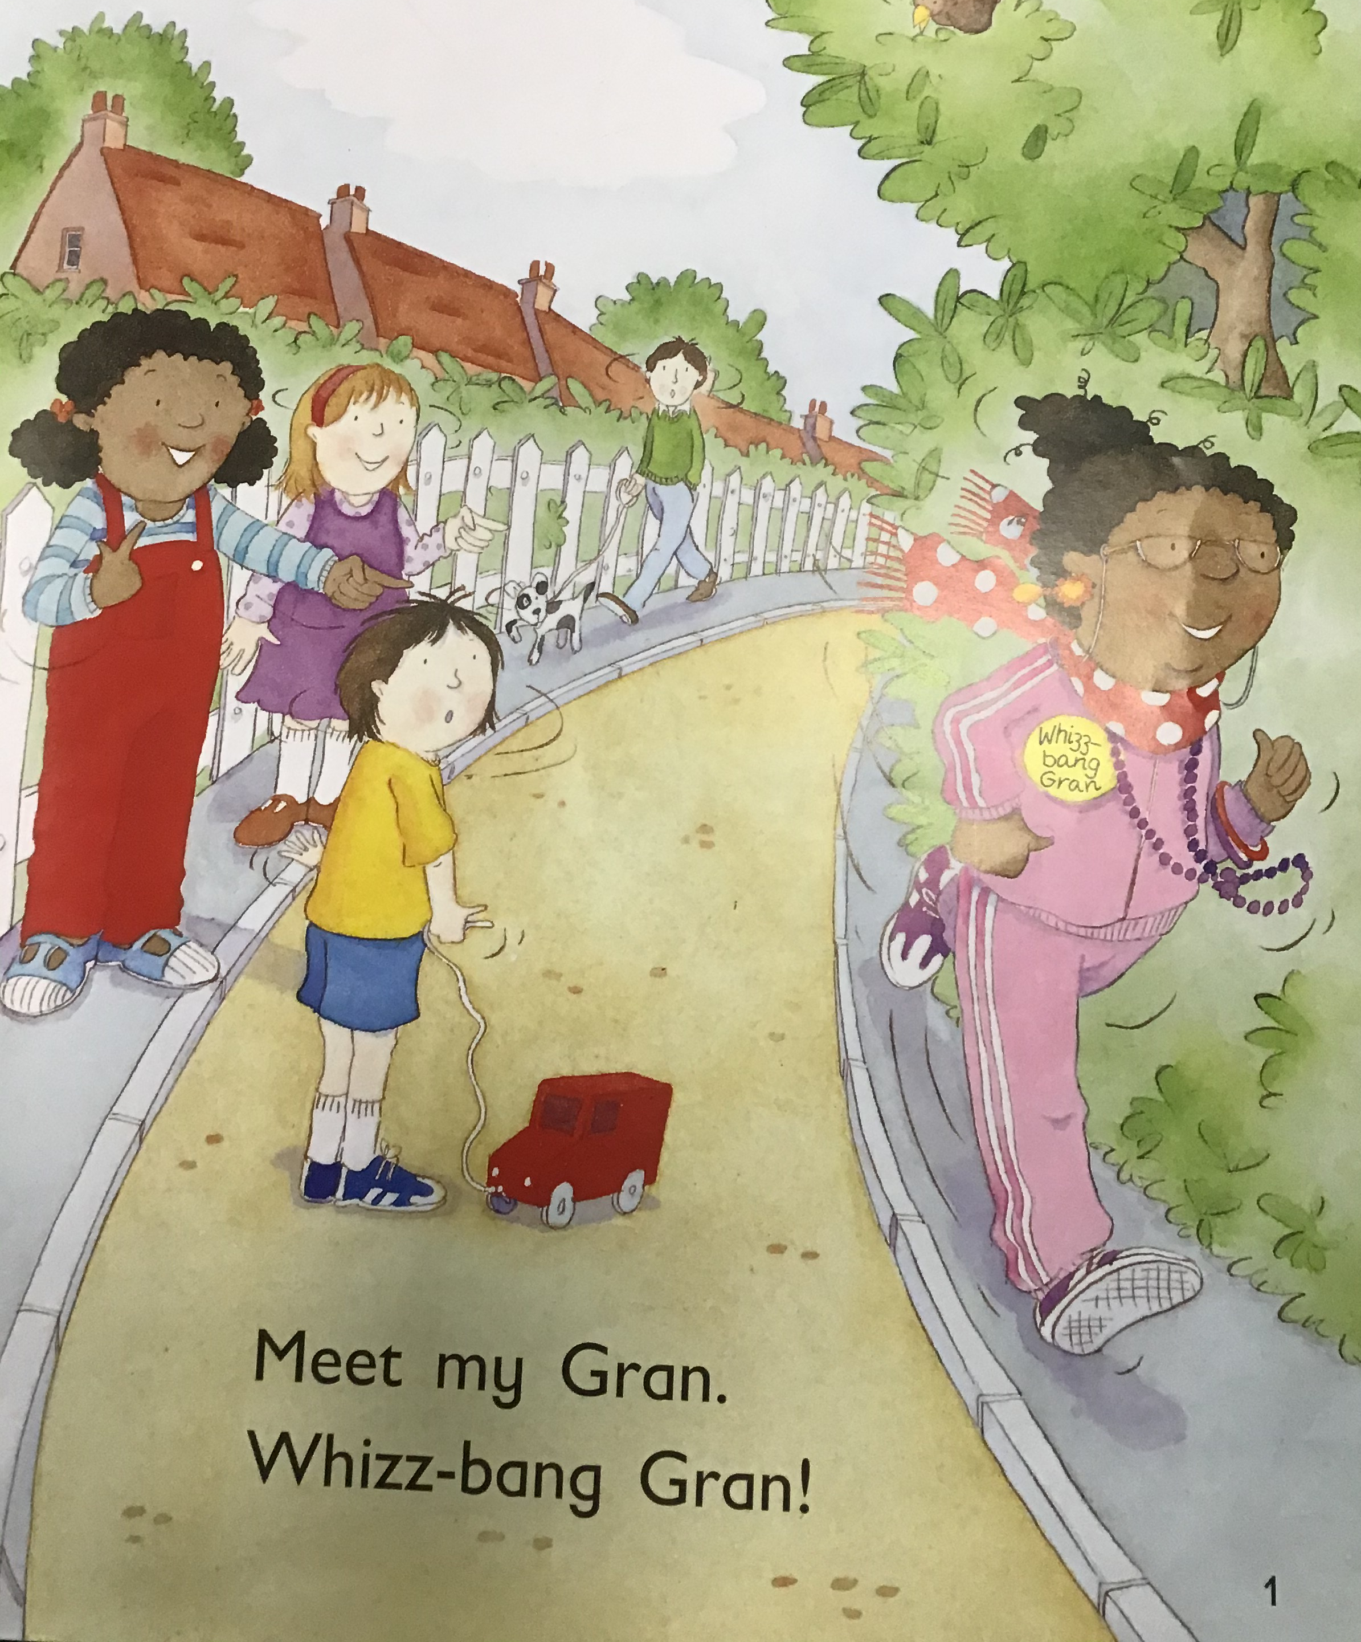
Put your finger under the words as you read with your child.
Ask – “Find the sight word my”
Ask – Where is Gran? Put your
finger on the picture of Gran.
What do you think she is called
Whizz-bang Gran?

Slide 7
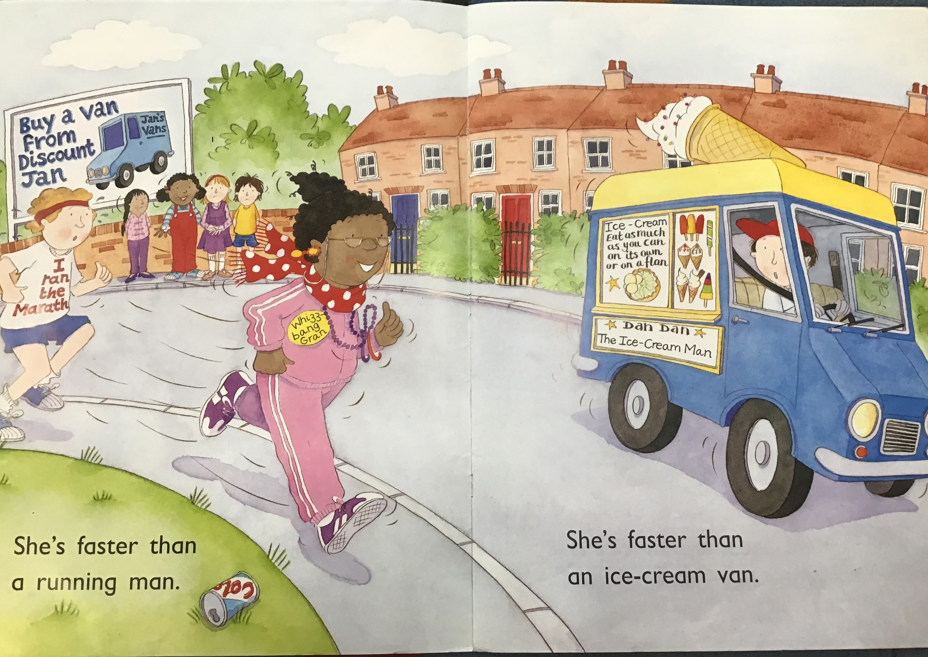
Read together
Ask - find the sight word a.
Ask - What is Gran
faster than?
Ask - What do you
notice about the words
‘man’ and ‘van’?
(They rhyme)
Ask – Point to the Capital
Letters at the beginning of
the sentence. Now point to
the full stop.

Slide 8
Stop the shared reading and say that we will continue tomorrow.
Ask – What does your Gran do? What is she good at?
Encourage them to use the sentence starter
“My Gran is ….”

Slide 9
Maths
Please refer to the number 7 formation sheet.
Make sure your child is forming the numbers correctly!
Learning Pack – Emergency vehicle counting to 10 Cut and Stick Booklet. You need to work through the booklet throughout the week.
Monday – Numbers 9 and 4 – cut and stick vehicles and stick on the first 2 pages.

Slide 10
Phonics – Phase 1 Voice Sounds
Find the picture cards from last week and practice the sounds yourself!
Can you make the sounds quietly first then loudly?
Click on the following link from last week to remind you if you need
https://www.youtube.com/watch?v=dqciRUv154A

Slide 11
What does a teacher do?
Go through the slides and talk about the role of a teacher.
Does your child want to be a teacher when they grow up?
What would they like to say to Mrs Variava and Mrs Odedra?
What is special about their teachers?

Slide 12

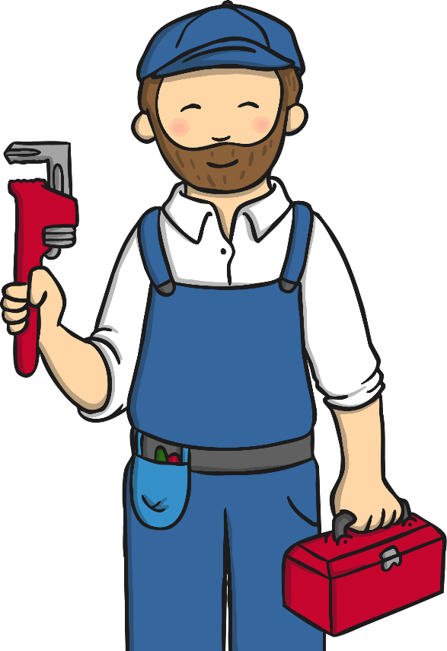
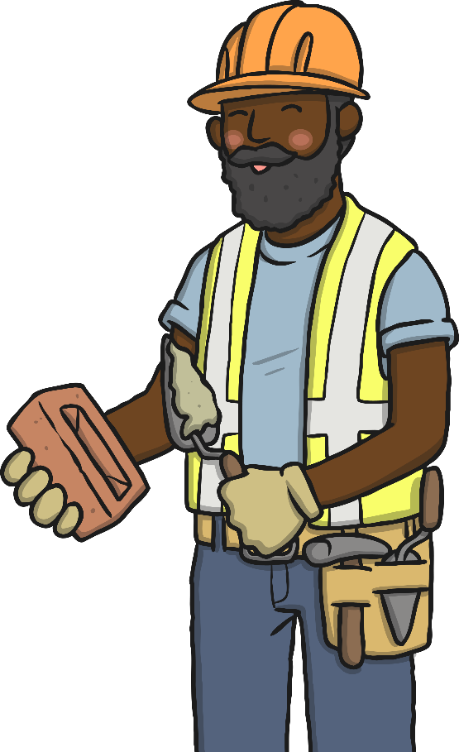




People Who Help Us
Can you name some people who help us in our lives...
Who can fix things in our homes?
Who can help us in an emergency?
Who can help us if we are feeling ill?

Slide 13





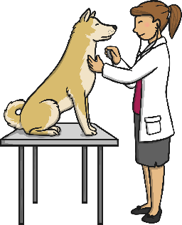





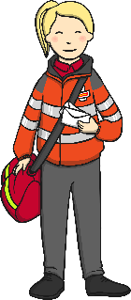
People Who Help Us
There are many people who help us in our lives…
doctors
nurses
paramedics
firefighters
police officers
vets
postal workers
builders
electricians
plumbers
bus drivers
teachers
…and lots of other important people who help us at school!

Slide 14
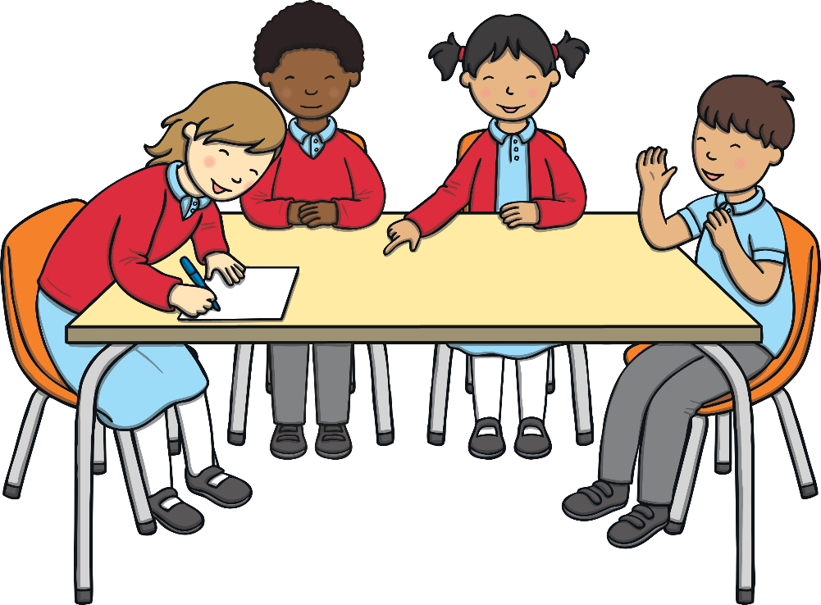
The Teacher’s Role
Teachers have the important job of giving children the best start in life, so that they can take their skills and use them in later life.
What has your teacher done for you?

Slide 15
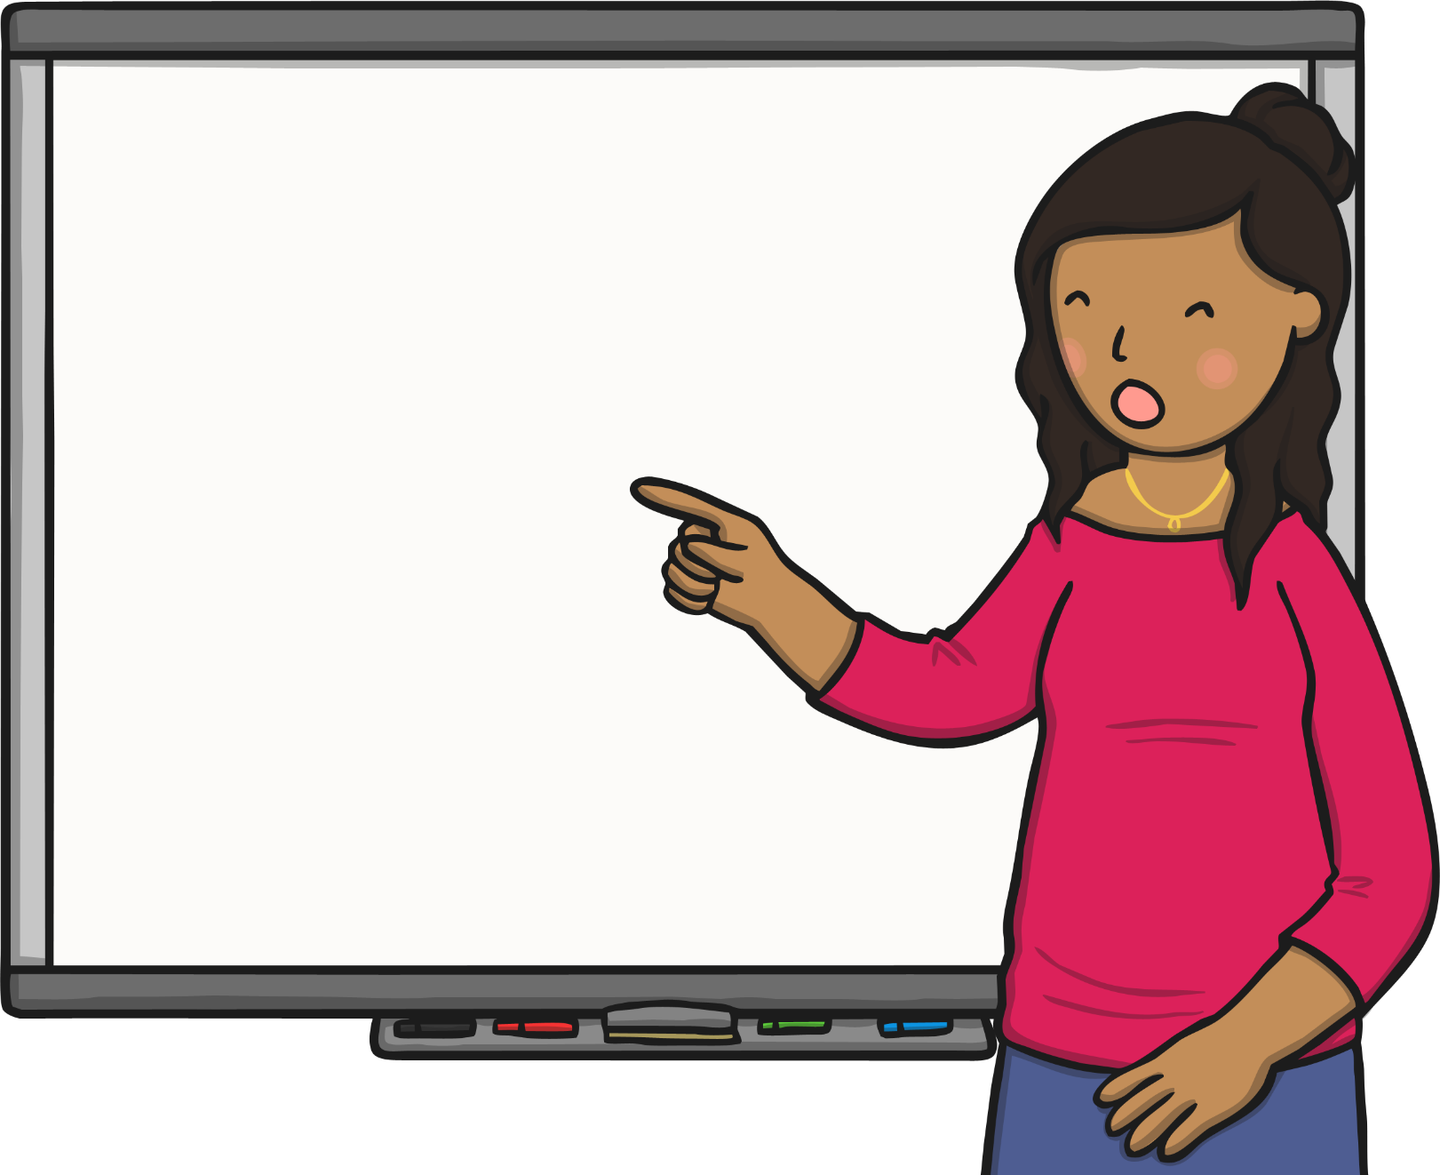
The Teacher’s Role
Teachers teach subjects following the National Curriculum, which is a document that tells schools what children must learn.
Most full-time primary school teachers teach all subjects and have one class, who they look after every day.

Slide 16


The Job of a Teacher
Do teachers work before and after the school day?
Yes! Teachers do lots before you get to school and do lots of jobs after school, during playtimes, during lunch breaks, in the evening at home, over the weekend and during the holidays.
Can you think of anything teachers might do when you are not there?

Slide 17
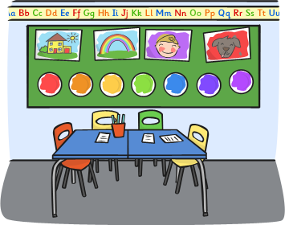
Teacher Tasks
Teachers have to...
plan lessons;
prepare teaching materials and resources;
create displays;
keep their classrooms tidy!

Slide 18
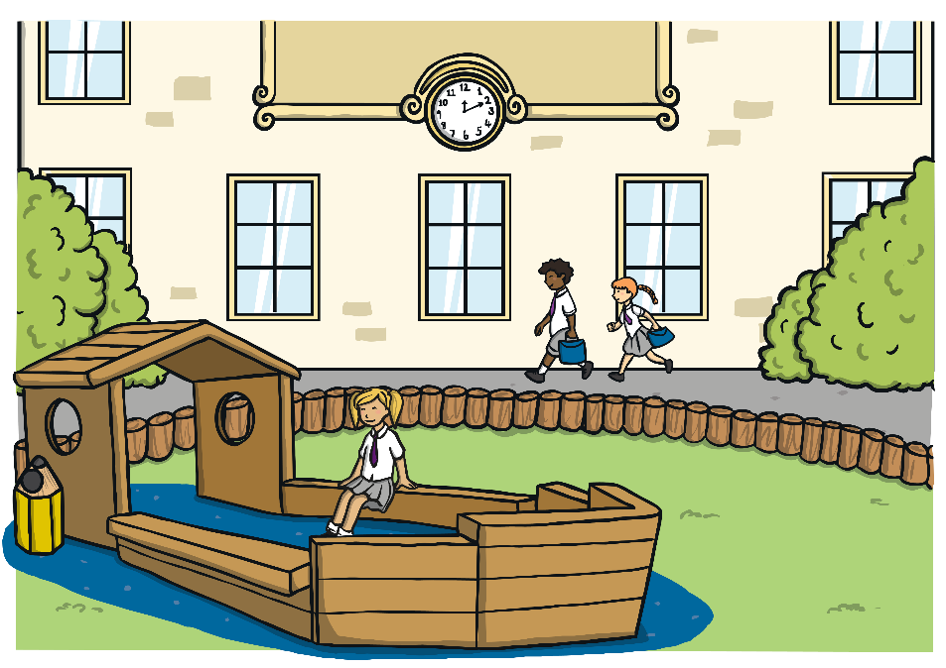
Teacher Tasks
Teachers have to...
mark books;
assess children’s work – sometimes by talking to the children or writing feedback;
manage behaviour – help children behave well.

Slide 19

What Do Teachers Wear?
Teachers wear a variety of smart, casual clothes.
They need to be comfortable and be able to move easily.

Slide 20

Teacher Tasks
Teachers need…
pencils
pens
sticky notes
books
crayons
and lots of other classroom equipment

Slide 21
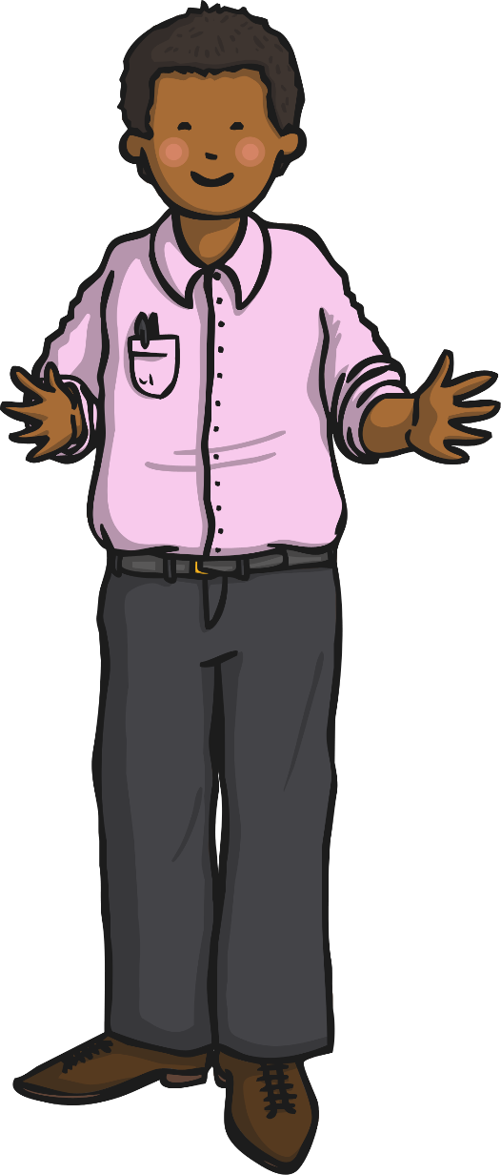
How do you become a teacher?
To become a teacher you have to have GCSEs, A-Levels and usually go to university to get a teaching degree.

Slide 22

Great Teachers…
create exciting lessons;
organise people;
work well with other people and on their own;
do lots of things at the same time;
help children to behave well;
are enthusiastic;
encourage good learners;
manage their time effectively;
have fun!

Slide 23

Thank You Teachers!
Which of these great skills do you think your teacher has?
How would you describe your teacher?
What would you like to thank them for?

Slide 24
Tuesday
09.02.21

Slide 25
Wake & Shake
https://www.youtube.com/watch?v=by5sTzh67fU
The Kiboomers – Chinese New Year Song
Have a go at singing and dancing along to the song!

Slide 26
Shared Read
Read the sight words:
I a mum dad the see can and to is
New words – my like

Slide 27
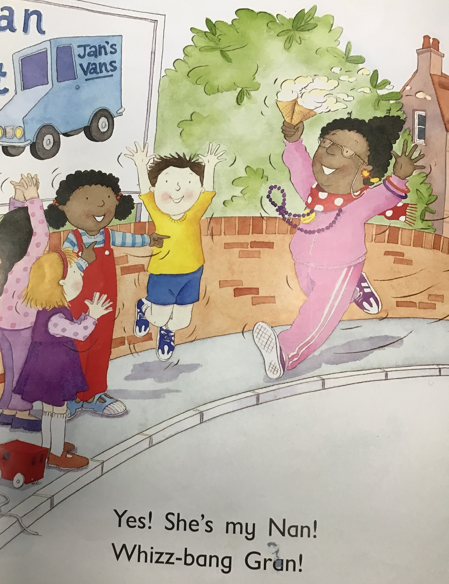
Ask – What is the title of the book? (can they remember?
Encourage them to put their finger under the words and read with them.
Ask – Find the word ‘my’.
Ask – What is Gran good at?
Ask – What is Gran called?

Slide 28
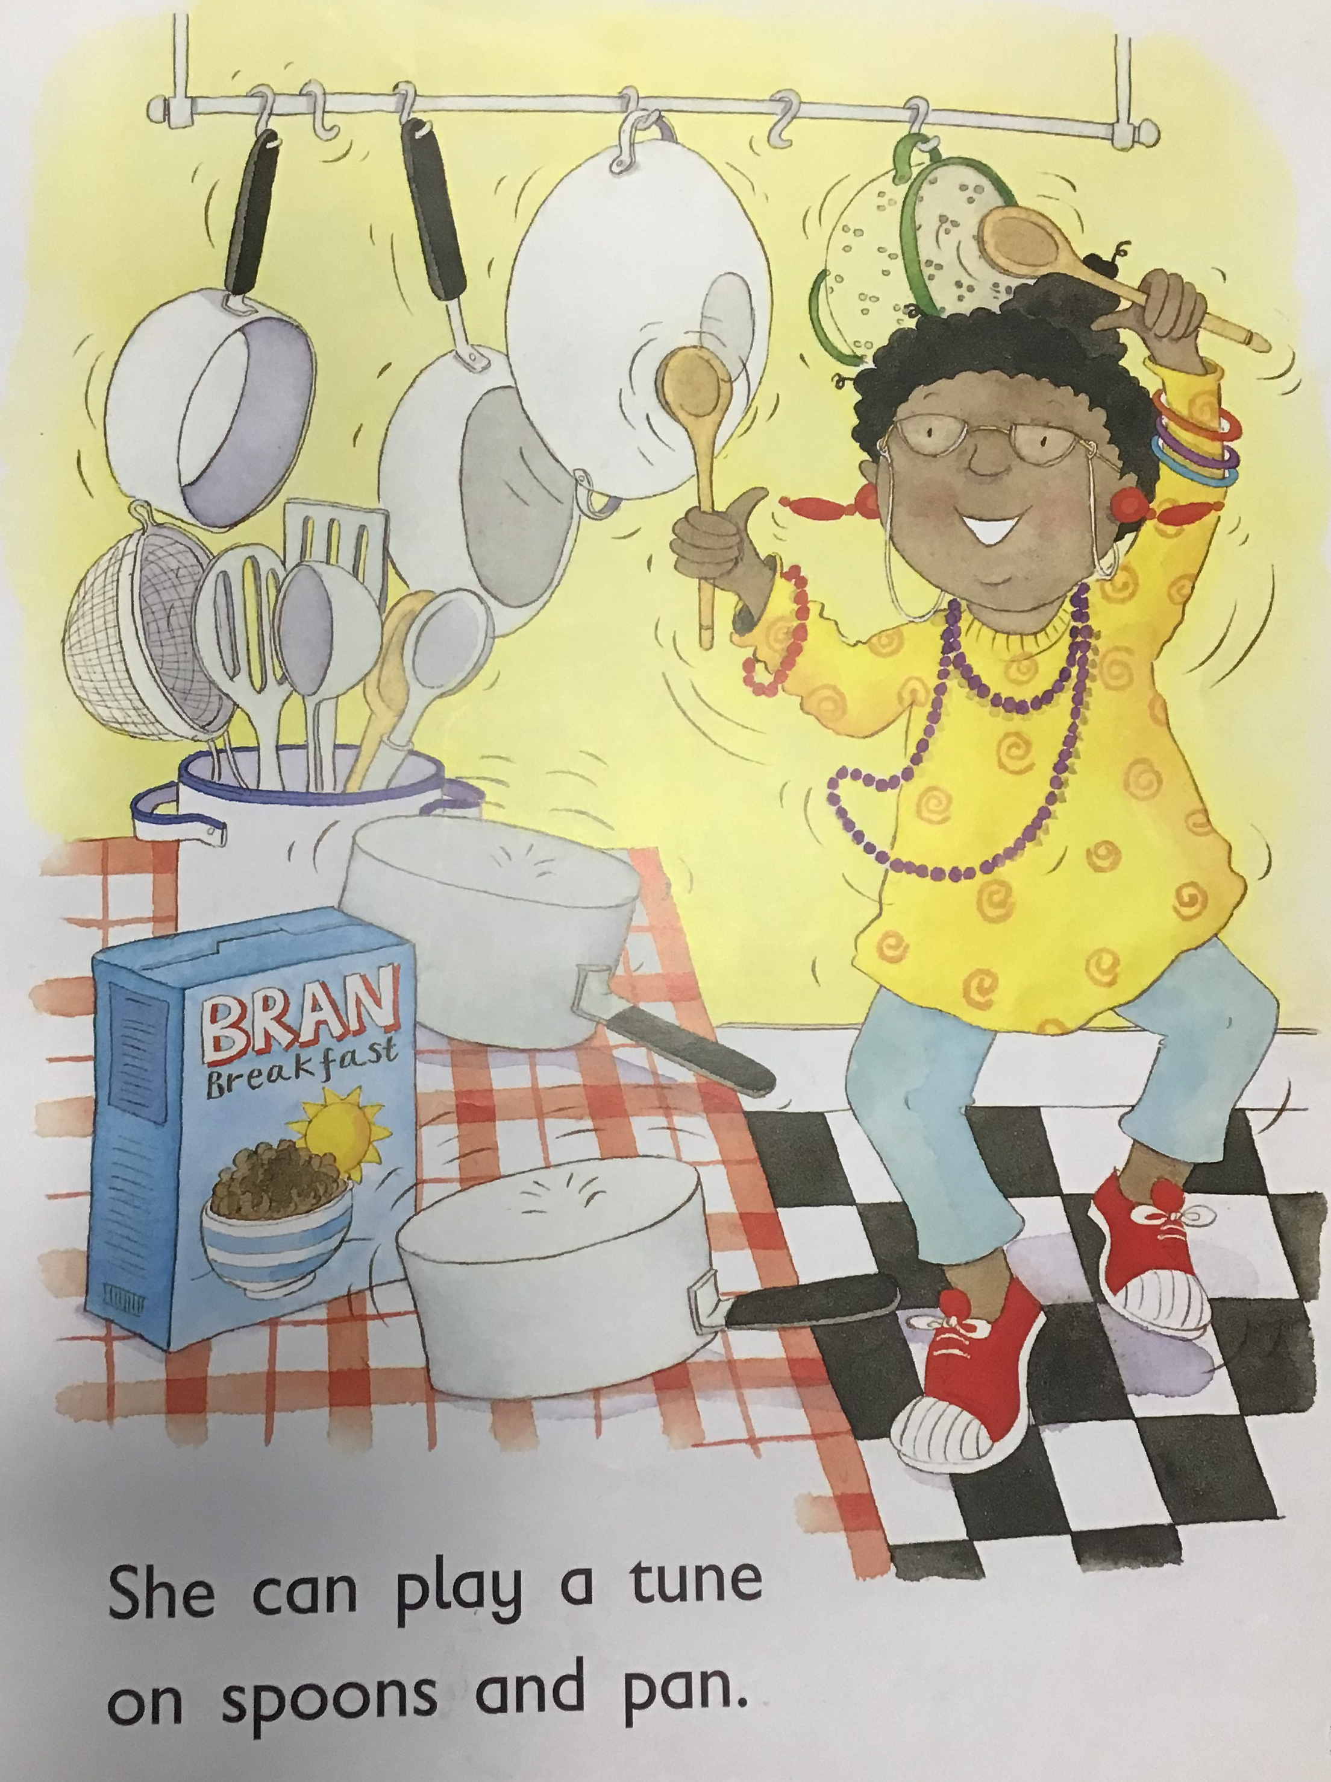
Read together putting finger under each word as you read.
Ask – Find the word ‘can’ and ‘and’.
Ask - What can Gran do?
Ask – What does Gran use to
play a tune?

Slide 29
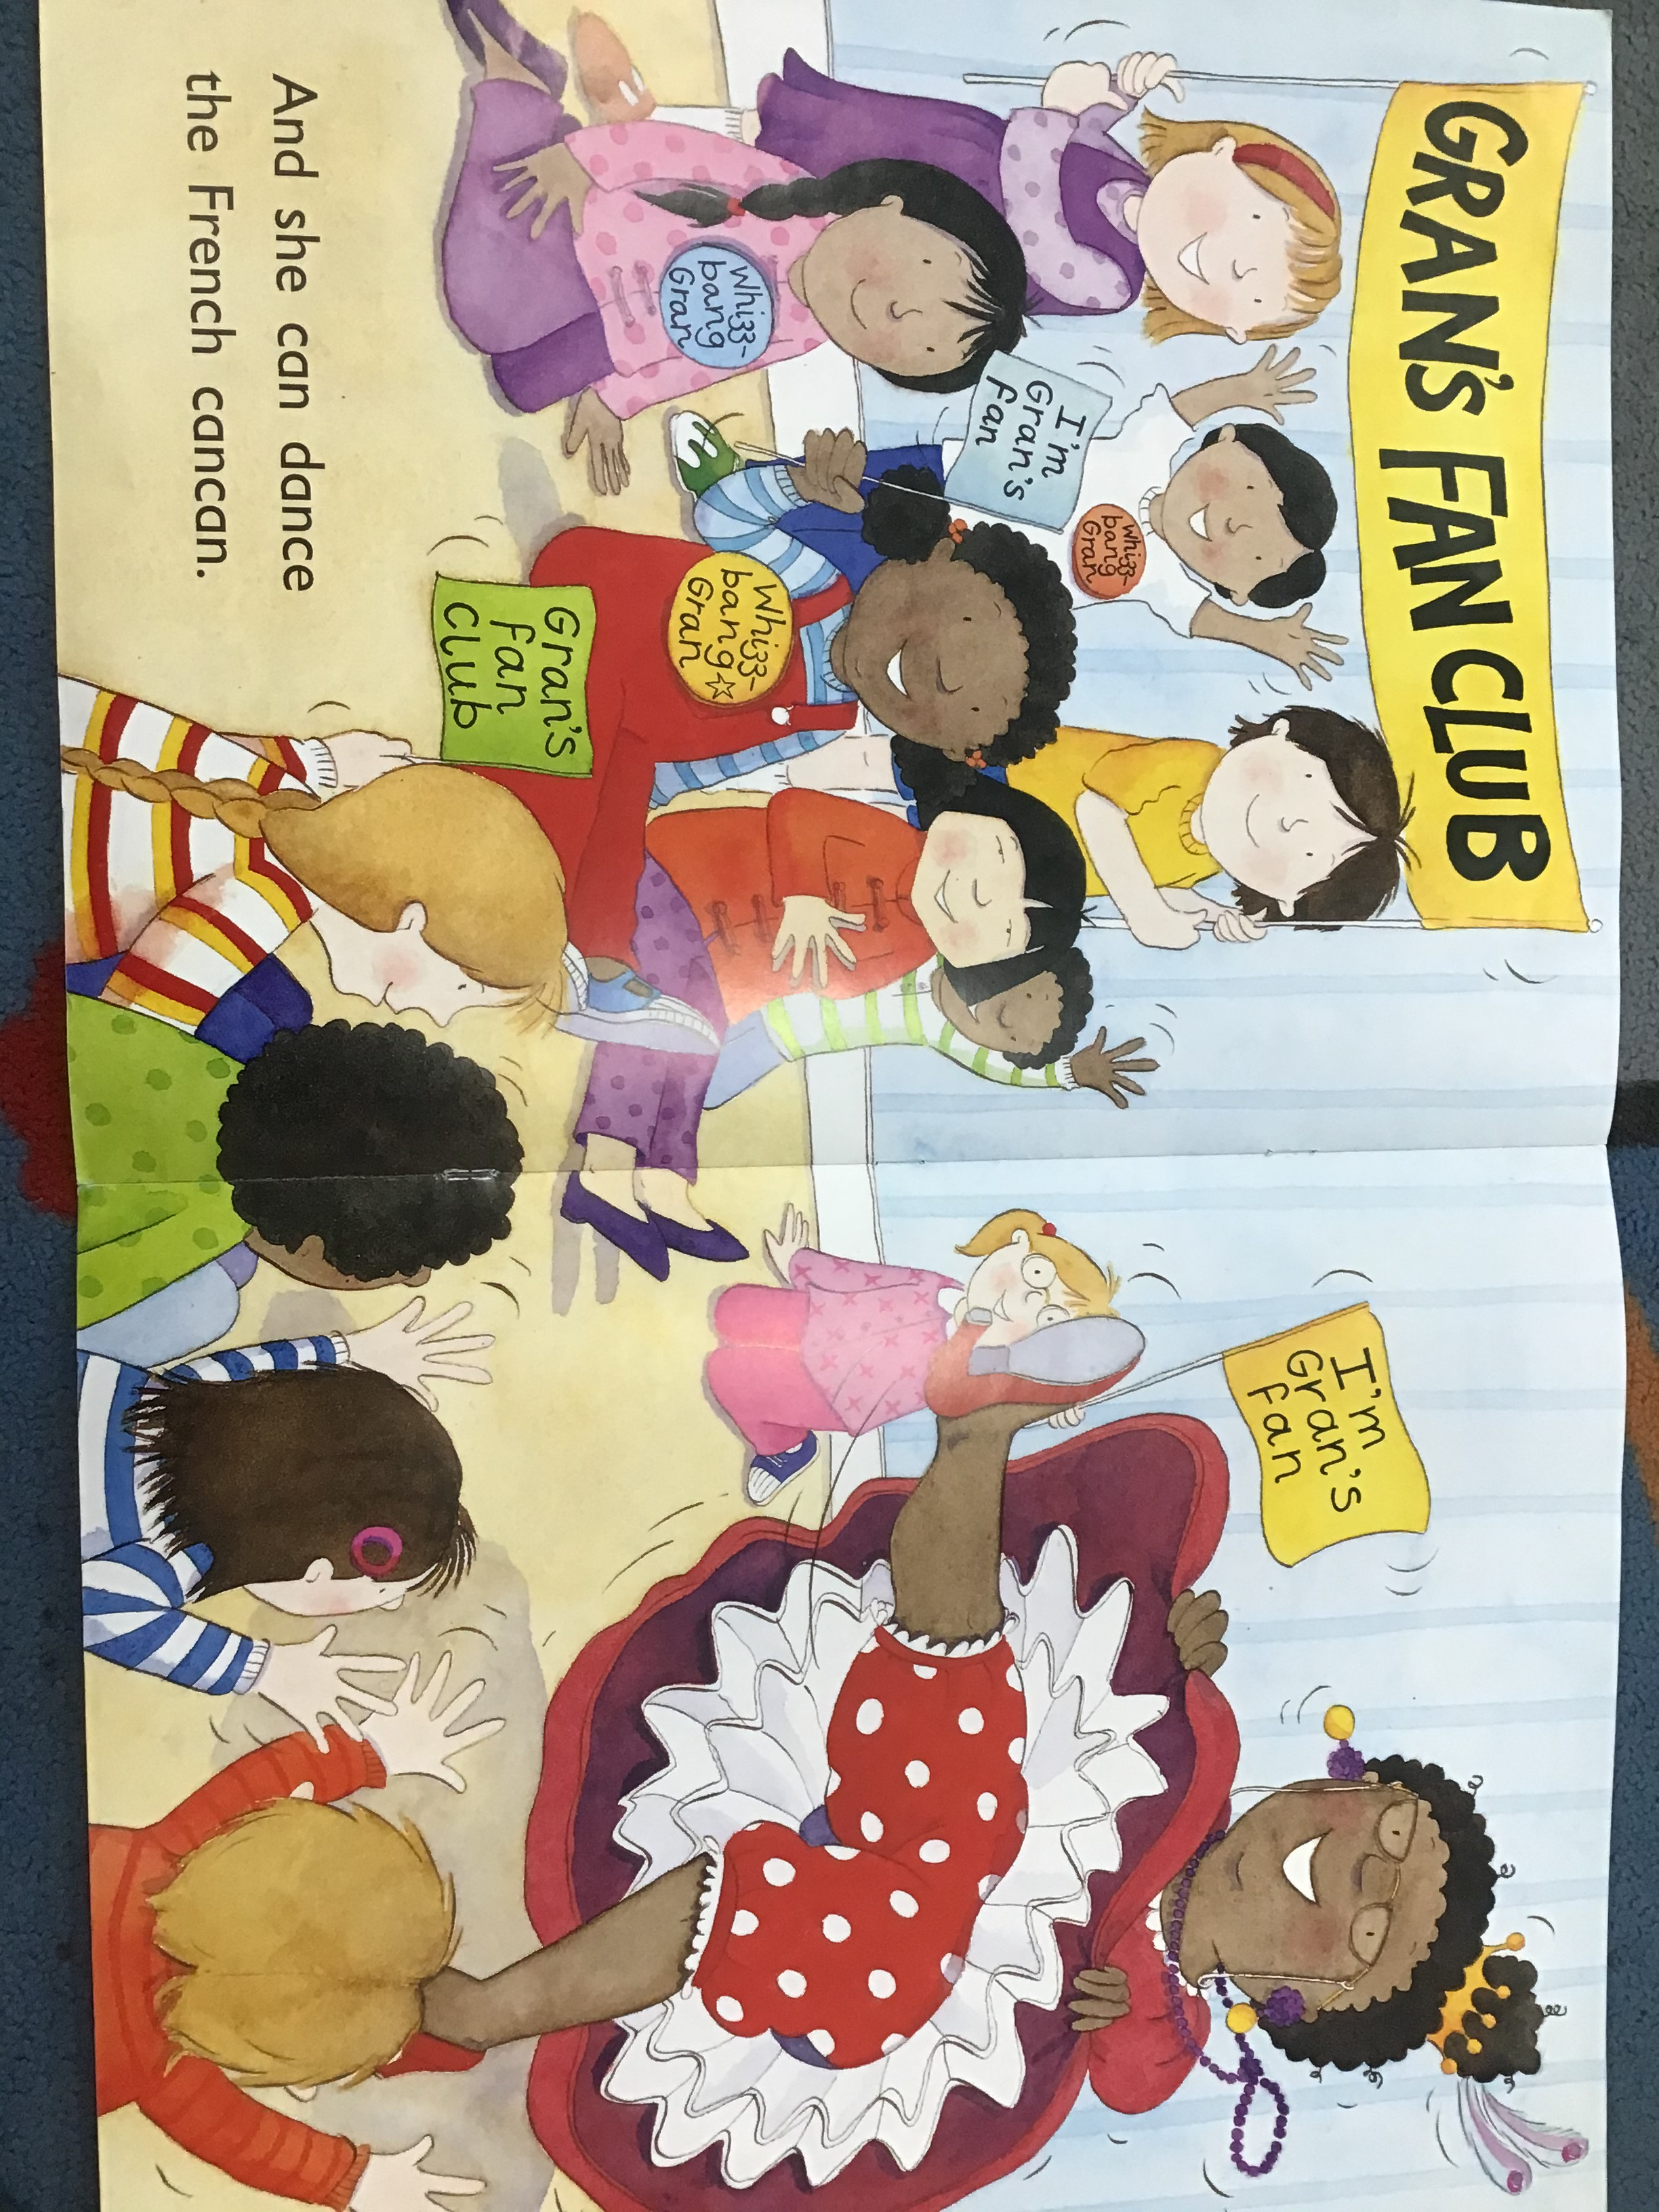
Read together putting finger under each word as you read.
Ask – Find the word ‘can’ and ‘the’.
Ask - What can Gran do?
Ask – Can you do the French Cancan? Have a go!

Slide 30
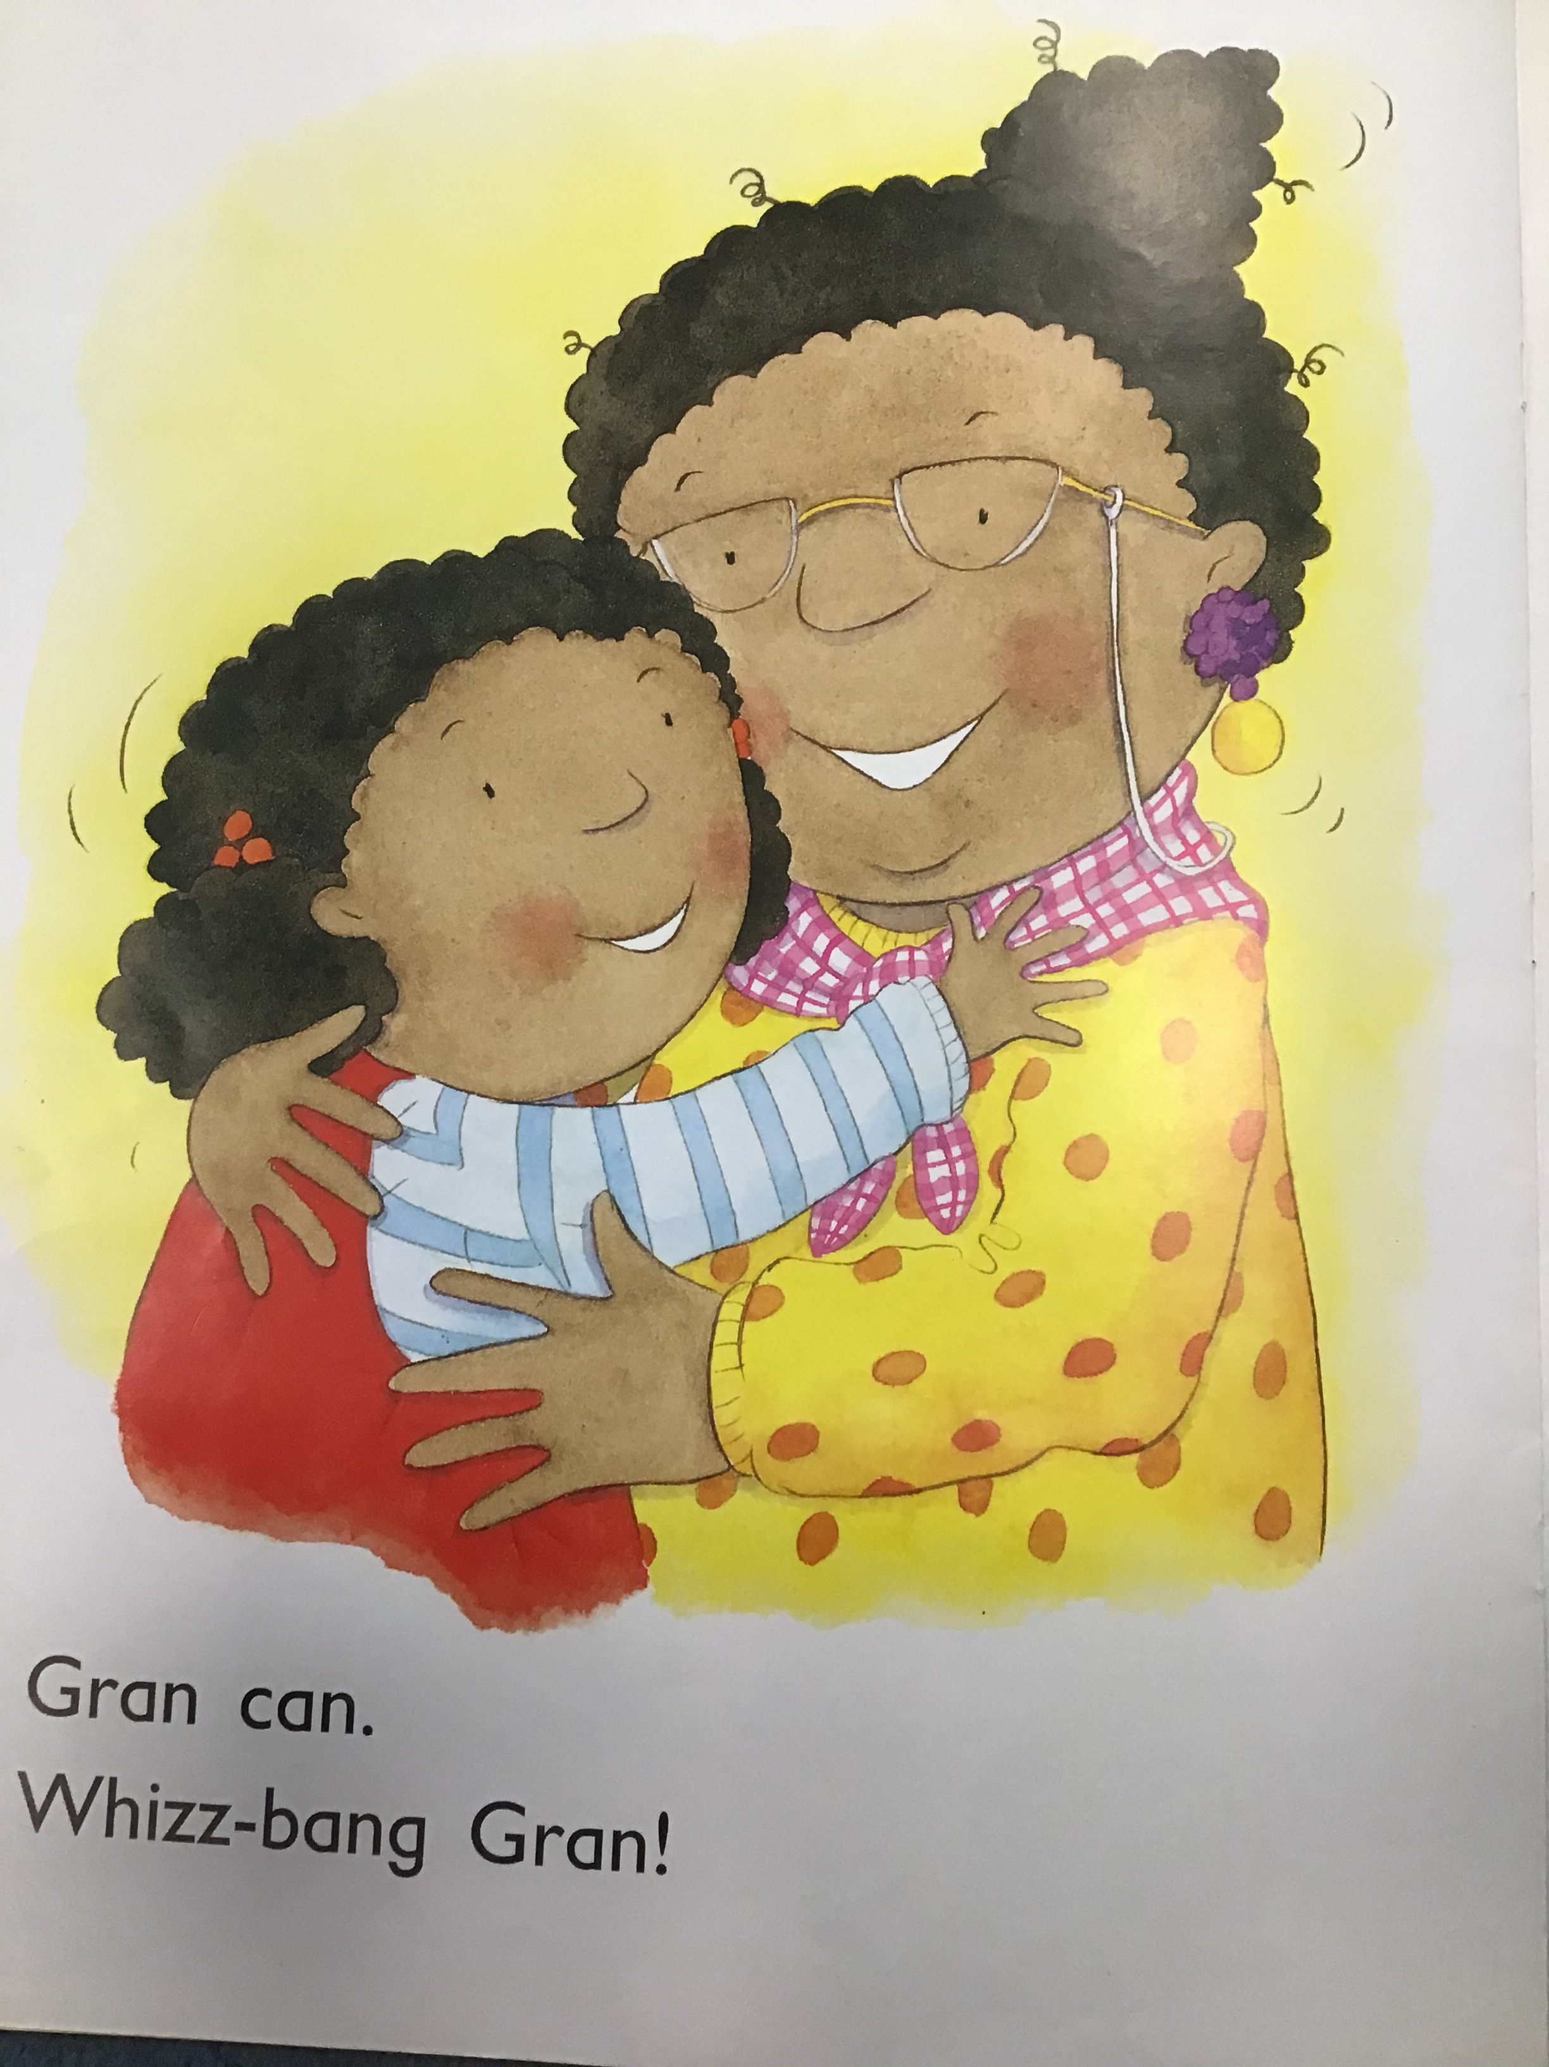
Read together
Ask – Find the word ‘can’.
Ask – Why do you think that
Gran is called
Whizz-bang Gran?
Ask - What do you like to do?

Slide 31
Maths – The Adventures of 7
Learning Pack – Emergency vehicle counting to 10 Cut and Stick Booklet. You need to work through the booklet throughout the week.
Tuesday – Numbers 5 and 8 – cut and stick vehicles and stick on the first 2 pages.

Slide 32

Meet Number Seven
Hello, I am Number Seven. Would you like to hear about my holiday to Devon?
Can you see Number Seven? What do you notice about her? What does she have seven of?

Slide 33



Number Seven went on holiday to Devon. She took the train.
Number Seven needed a ticket for the train. Her ticket had a number
7 on it.
Can you help me choose the correct ticket for my journey?
That’s my ticket!
Try again!
Try again!
5
7
4

Slide 34


Number Seven set off. As the train sped along, she sang a song...
Across the sky and down from heaven. Now I’ve made a number seven.

Slide 35



When Number Seven arrived at her hotel, she was told she would be staying in room number 7.
Which key belongs to me? How do you know?
Well done, you’ve found the right key! Can you count the spots to check?
Try again!
Try again!

Slide 36





Number Seven decided to go the beach, where she took part in a
sandcastle building competition.
Which sandcastle do you think is mine? Why do you think that?
Well done! That’s my sandcastle!
Try again!
Try again!

Slide 37











While she was at the beach, Number Seven found some pretty shells to collect.
Which bucket do you think is mine? How can you check?
You chose the right bucket! How did you know it was 7?
Try again!
Try again!

Slide 38






Then, Number Seven bought herself an ice cream. It cost 7p.
7p
Which purse shows the coins I used to pay for my ice cream?
Well done. That’s 7p! How did you check?
Try again!
Try again!

Slide 39







Number 7 used her binoculars to look around the beach.
I think there are 7 seagulls. Am I right?
Which set of fingers show 7?
You’re right! That’s 7. Can you show me 7 on your fingers?
Try again!
Try again!

Slide 40
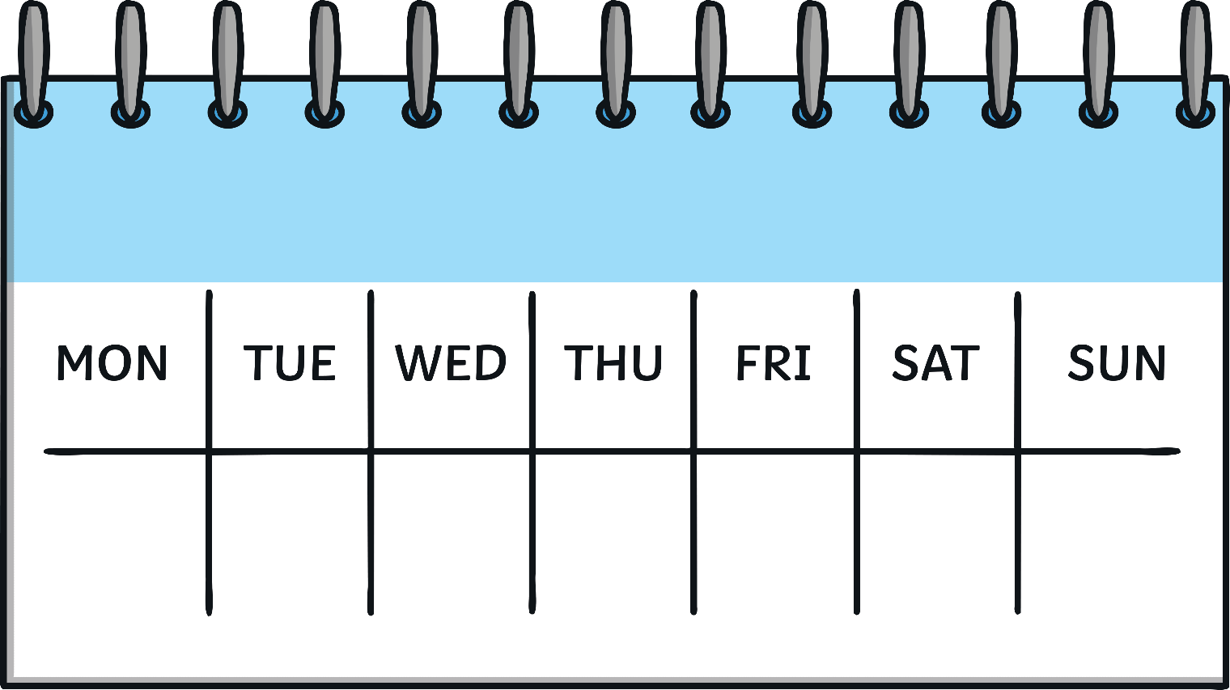








Number Seven had such a busy week on her holiday!
Look at all the things she did.
How many days are in a week? Can you say them?

Slide 41



Can you remember all of the ways that we saw 7 on my holiday?
7
ticket number 7
room number 7
7 flags
7 shells
7 pennies
7 seagulls

Slide 42











Can you find 7 on the number track? Click on Number Seven to move her onto the number track.
1
2
3
4
5
6
7
8
9
10
Which number comes before 7? Which number comes after? Can you count along the number track from 1 to 10?

Slide 43
Phonics
Phase 1 Phonics – Environmental Sounds. Watch the video and see how many sounds you can get right! Have fun!
https://www.phonicsplay.co.uk/resources/phase/1/sound-starters

Slide 44
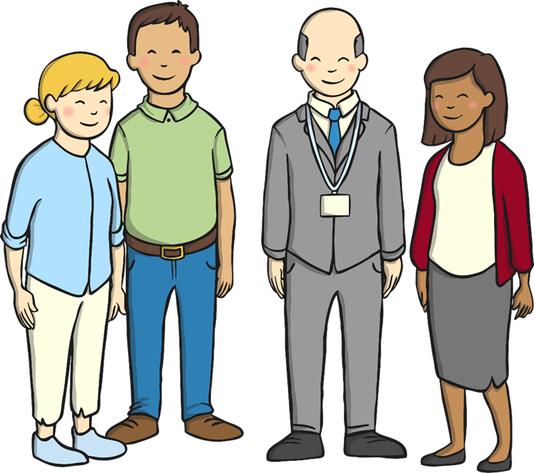
People who help us at school
Can you think of other people at school who help us apart from Teachers?
Look through the slides and talk
about the jobs the people do
in school.

Slide 45
People at School
There are lots more important people who help us at school.
Can you think of someone?
Do you know what their job is?

Slide 46
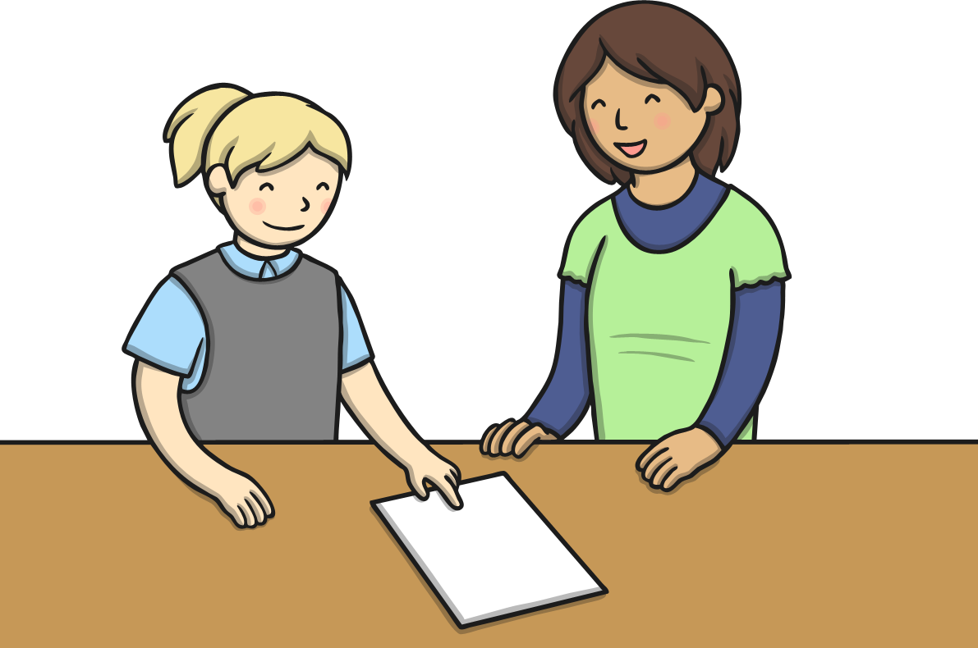
Teaching Assistants
Some teaching assistants help in the classroom and some help children outside the classroom.
Teaching assistants help children with their learning, help teachers with their lessons, get lots of things ready, tidy and help children to remember good behaviour. They sometimes teach groups of children, help create displays and do lots more!

Slide 47

Leaders
Who are your school leaders?
When do you see them?
Headteachers are in charge of the school. You may also have deputy headteachers, assistant headteachers or heads of school. They do lots of important jobs to help you, the school, the people who work there and parents and carers.
You may visit the headteacher or someone else if you have done something special, to get an award or if something has gone wrong.

Slide 48
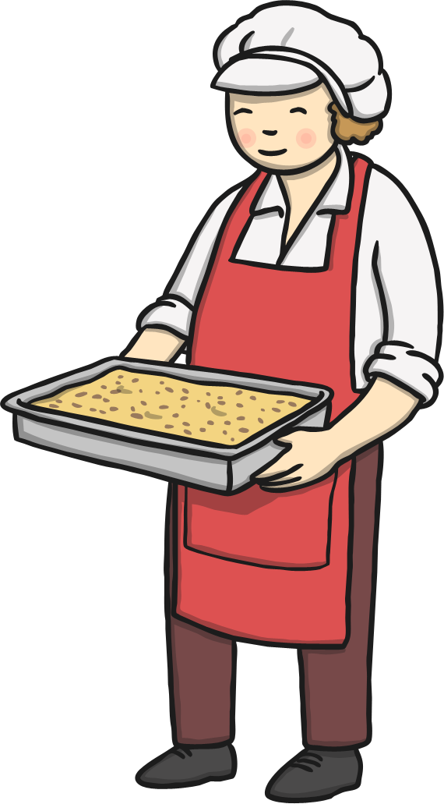
School Cooks
School cooks make the food you have at lunchtime if you have school meals. They get the food ready while you are learning, look after the school kitchen and many serve the food to you too.
Who is your school cook?
What is your favourite school meal?

Slide 49

Lunchtime Assistants
Lunchtime assistants help you at lunchtime. They get the hall ready, put the chairs and tables out, give you school meals, help with any problems at lunchtime inside and out in the playground, clean and tidy up.
Who are your lunchtime and playground assistants?
What do you like to do after
you finish your lunch?

Slide 50

Office People
There are people who work at the school to help everything run smoothly. Some people help greet people, take in the school registers, answer the phones, show people around the school and sort out lots of other jobs.
Who works in your
school office?
What do they help you with every day?

Slide 51

Lollipop People
If your school is near a road, there may be a school lollipop person who helps you cross the road before and after school. They help keep you safe from the cars and other traffic.
Does your school have a
lollipop person?
Who are they?
Have they helped you cross
the road?

Slide 52

Building Supervisors
Building supervisors do lots of jobs around the school. Building supervisors put display boards up, fix broken furniture and other things, paint the walls and doors, look after the playground and lots of other important jobs. If your school has a school field, they might look after that too.
Does your school have a
building supervisor?
Who are they?
Have they helped you make, fix or look after?

Slide 53
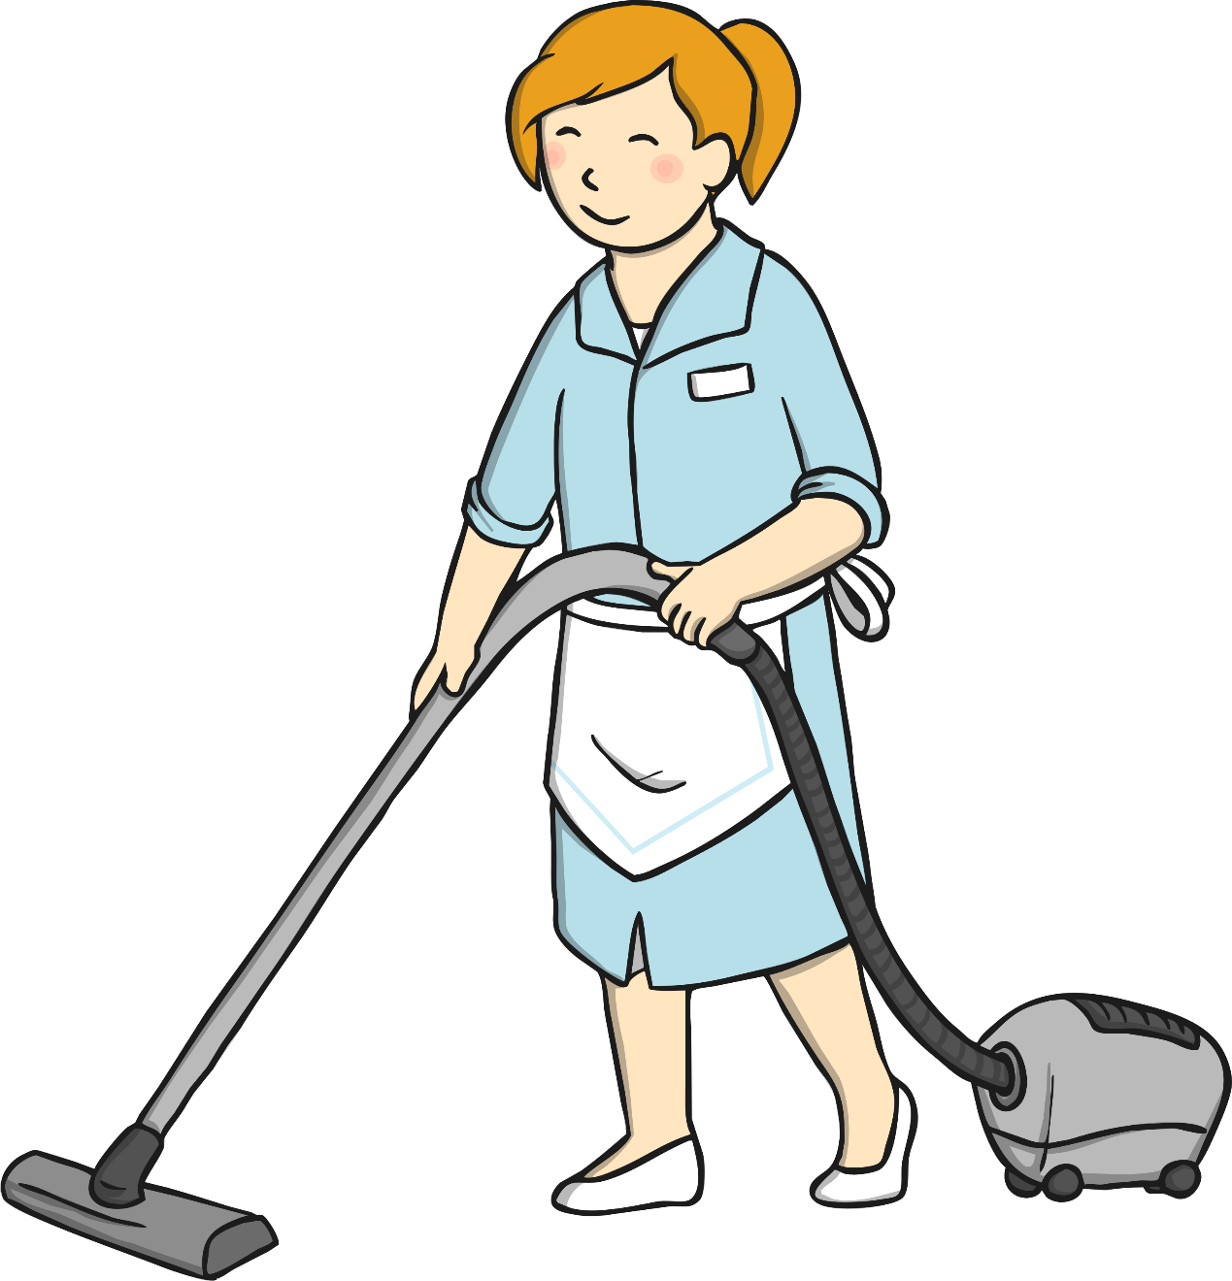
Cleaners
School cleaners help keep your school clean, tidy and ready for you. They vacuum (hoover), sweep and wash the floors, wipe the tables, clean the windows and walls, clean the sinks, toilets, rooms and hall.
Who are your school cleaners?
Have you ever said thank you
for cleaning up a big mess in your classroom?

Slide 54
Thank You!
How many adults are there in your school?
Can you think of even more people at your school that help you?
Who would you like to say a big ‘thank you’ to?
How many people at your school have helped you?

Slide 55
People Who Help Us
Matching Game
See Learning Pack for the activity.

Slide 56
Wednesday
10.02.21

Slide 57
Wake & Shake
https://www.youtube.com/watch?v=by5sTzh67fU
The Kiboomers – Chinese New Year Song
Have a go at singing and dancing along to the song!

Slide 58
Maths
Learning Pack – Emergency vehicle counting to 10 Cut and Stick Booklet. You need to work through the booklet throughout the week.
Wednesday – Numbers 1 and 10 – cut and stick vehicles and stick on the first 2 pages.
Learning Pack – Chinese New Year number dot–to-dot

Slide 59
Phonics – Phase 1 – Body Percussion
Explain to your child that they are going to use different parts of the body to make music and pretend to be an orchestra!
Start with the head.
Head – bounce hand up and down and say “boing boing”
Nose – push finger on nose and say “honk honk”
Ear – pull ear lobe and say “ding dong”
Hands – clap hands and say “clap clap”
Knees – tap kneesnand say “tap tap”
Feet – stamp feet and say “stamp stamp”
Keep the same order from the beginning and build up the sounds. Make patterns with the sounds. Have fun!

Slide 60
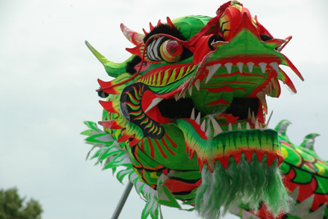
The Chinese New Year
The Chinese New Year! Kung Hey Fat Choi!
Watch the videos and learn all about the Chinese New Year.
2021 is the Year of the Ox – It starts on February 12th
Watch how the first part of how the festival is
celebrated.
https://www.youtube.com/watch?v=c8ssHXZ9_qU

Slide 61
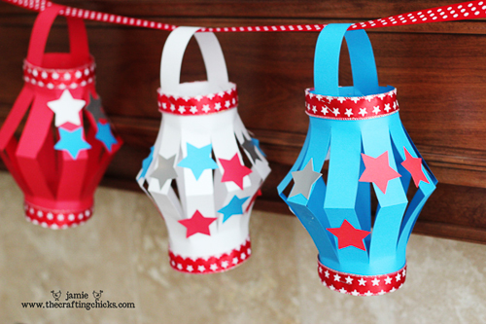
Creative Activity
Make Chinese lanterns from the learning pack.

Slide 62
Thursday
11.02.21

Slide 63
Wake & Shake
https://www.youtube.com/watch?v=by5sTzh67fU
The Kiboomers – Chinese New Year Song
Have a go at singing and dancing along to the song!

Slide 64
Maths
Learning Pack – Emergency vehicle counting to 10 Cut and Stick Booklet. You need to work through the booklet throughout the week.
Thursday – Numbers 3 and 6 – cut and stick vehicles and stick on the first 2 pages.

Slide 65
Phonics – Phase 1
All About The Letter ‘Aa’
Go through the following slides and talk about what you can see.

Slide 66

All About the Letter…
Aa
Can you draw it with your finger?

Slide 67
The letter A Sounds like This…
A, A, A
Notes:
Teachers Note: Say the sound /a/ multiple times and ask children to repeat back to you

Slide 68
It Can Also look like This…
A
a

Slide 69
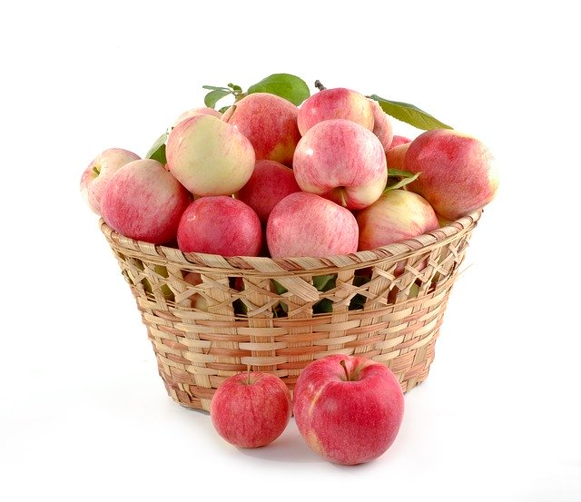
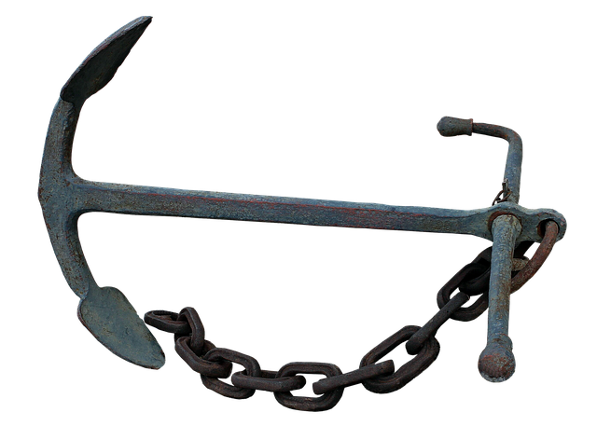
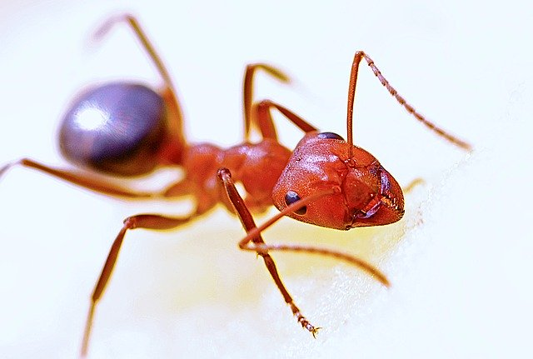
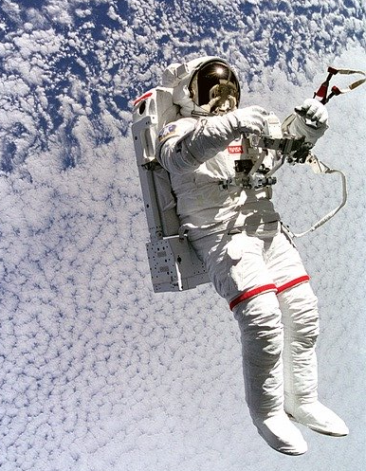
Some Things That Start with
A Are…

Slide 70
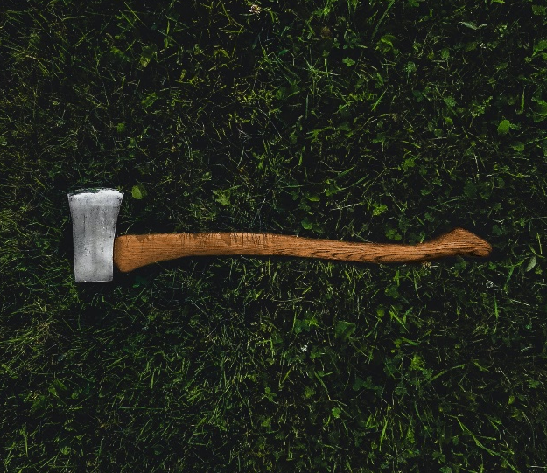

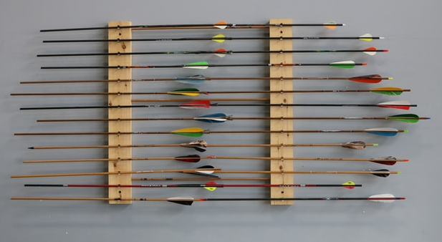
Some Things That Start with
A Are…

Slide 71

Which of These Start with A?
Yes!
No

Slide 72
Which of These Start with A?
Yes!
No

Slide 73
Which of These Start with A?
Yes!
No

Slide 74
Which of These Start with A?
Yes!
No

Slide 76
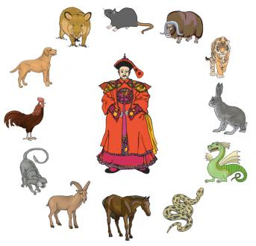
Chinese New Year Story
The Chinese New Year Story
Watch the story of how each year is named after an animal.
https://www.globetrottinkids.com/chinese-new-year-resources-activities/

Slide 77
Friday
12.02.21

Slide 78
Wake & Shake
https://www.youtube.com/watch?v=by5sTzh67fU
The Kiboomers – Chinese New Year Song
Have a go at singing and dancing along to the song!

Slide 79
Maths – Number 7
Learning Pack – Emergency vehicle counting to 10 Cut and Stick Booklet. You need to work through the booklet throughout the week.
Friday – Numbers 7 and 2 – cut and stick vehicles and stick on the first 2 pages.

Slide 80
Phonics – Phase 1 – Alliteration
Learning Pack – Alliteration sheet.
Read the words to your child and ask them to find them in the picture.

Slide 81
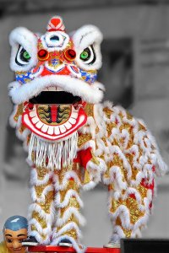
Chinese New Year
Watch the second part of the video and see how the festival is celebrated.
https://www.youtube.com/watch?v=1cRMRp9-Z08
Colour and decorate the dragon mask in the pack! Make sure you use bright colours.

Slide 82
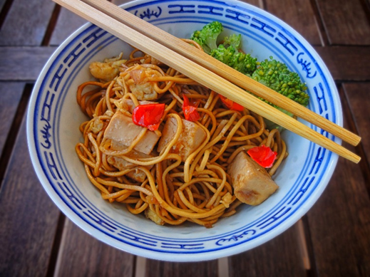
Cooking
Make Dragon Cookies – recipe in pack.
Make noodles and try to eat them with chopsticks!
Read the story in the link below and talk about what
they have learned about Chinese New Year.
https://www.youtube.com/watch?v=iGghkuEMZl8

Slide 83
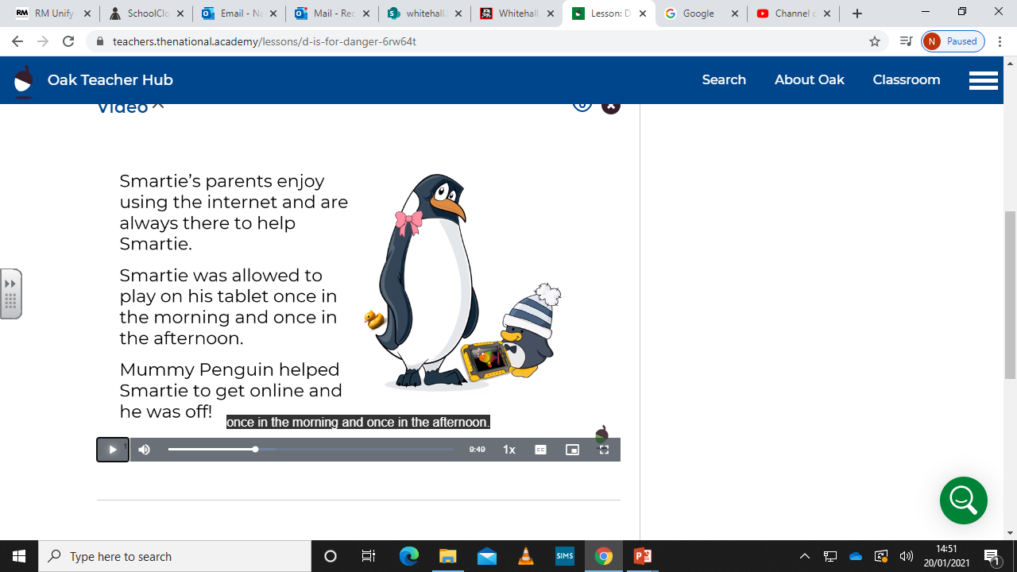

Friday afternoon - Personal, Social and Emotional Development
Talking about E-Safety and how to stay safe online.
This week we will continue to learn how to keep safe online. Watch the lesson with your child and talk about what they have seen.
Start the video from 2.07 minutes.
https://classroom.thenational.academy/lessons/d-is-for-danger-6rw64t

Slide 84
We Hope you had fun with this weeks learning!
Don’t forget to send us all the learning you have done this week on the nursery email!​
nursery@whitehall.leicester.sch.uk​
Credit: Twinkl, BBC, Topmarks, YouTube and Oak Academy

