Slide 1
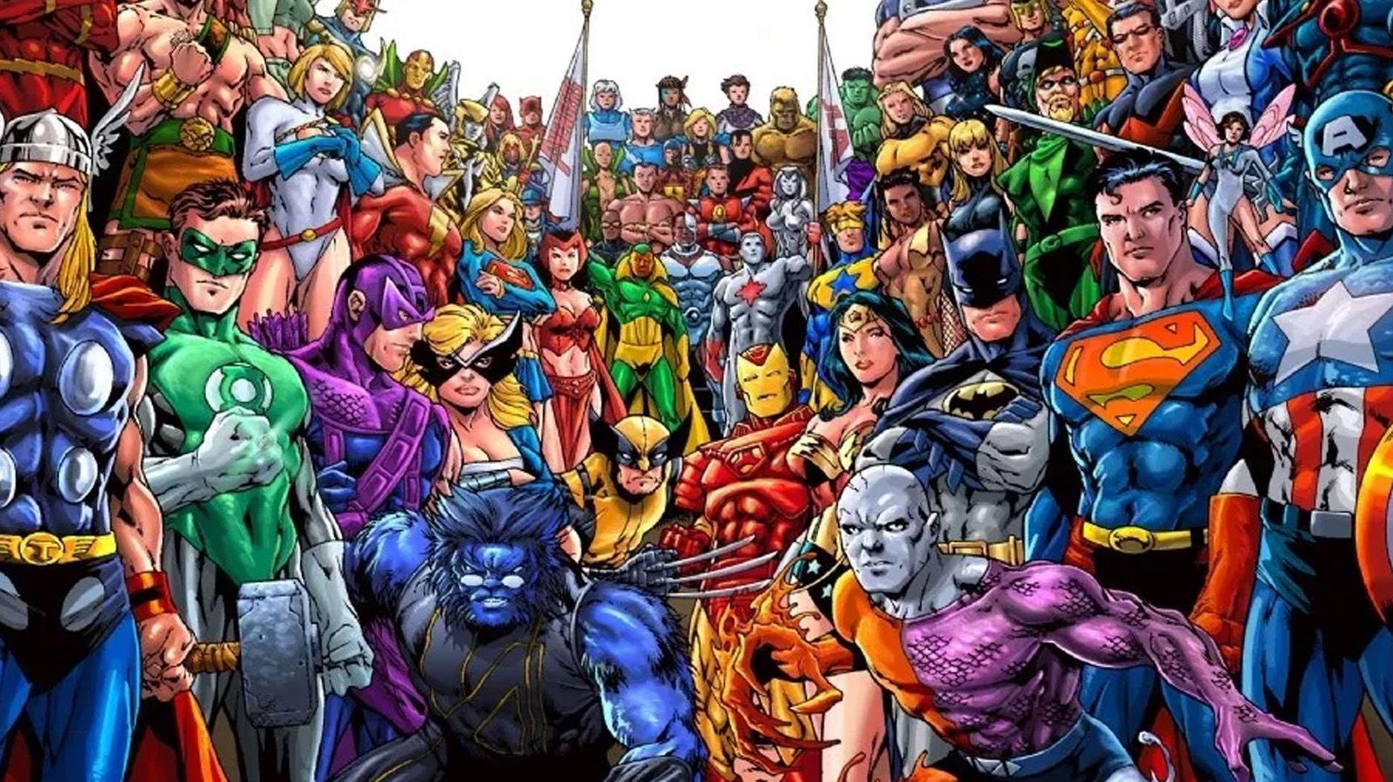
Superheroes
22.2.21-26.2.21

Slide 2
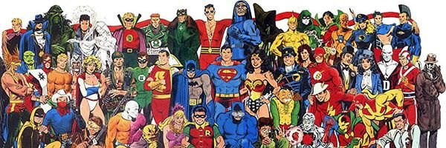
Monday
22.2.21

Slide 3
Wake & Shake
https://www.youtube.com/watch?v=Py4fhsx3Ct4
Kids Superhero Song - Let's Be Superheroes

Slide 4

Shared Read
Read the sight words:
I a mum dad
the see can and
to is my

Slide 5
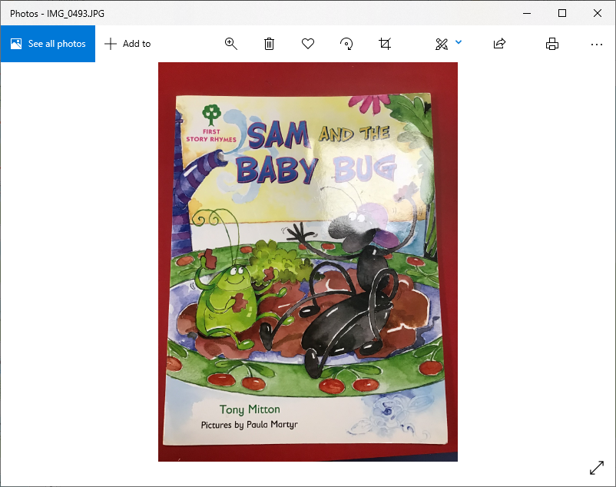
Read the title of the book twice then ask your child to read it.​
Ask “ What can you see on the front cover?”​
Encourage them to use the sentence “I can see…’’
Ask what they think the book is going to be about.
“I think …”

Slide 6
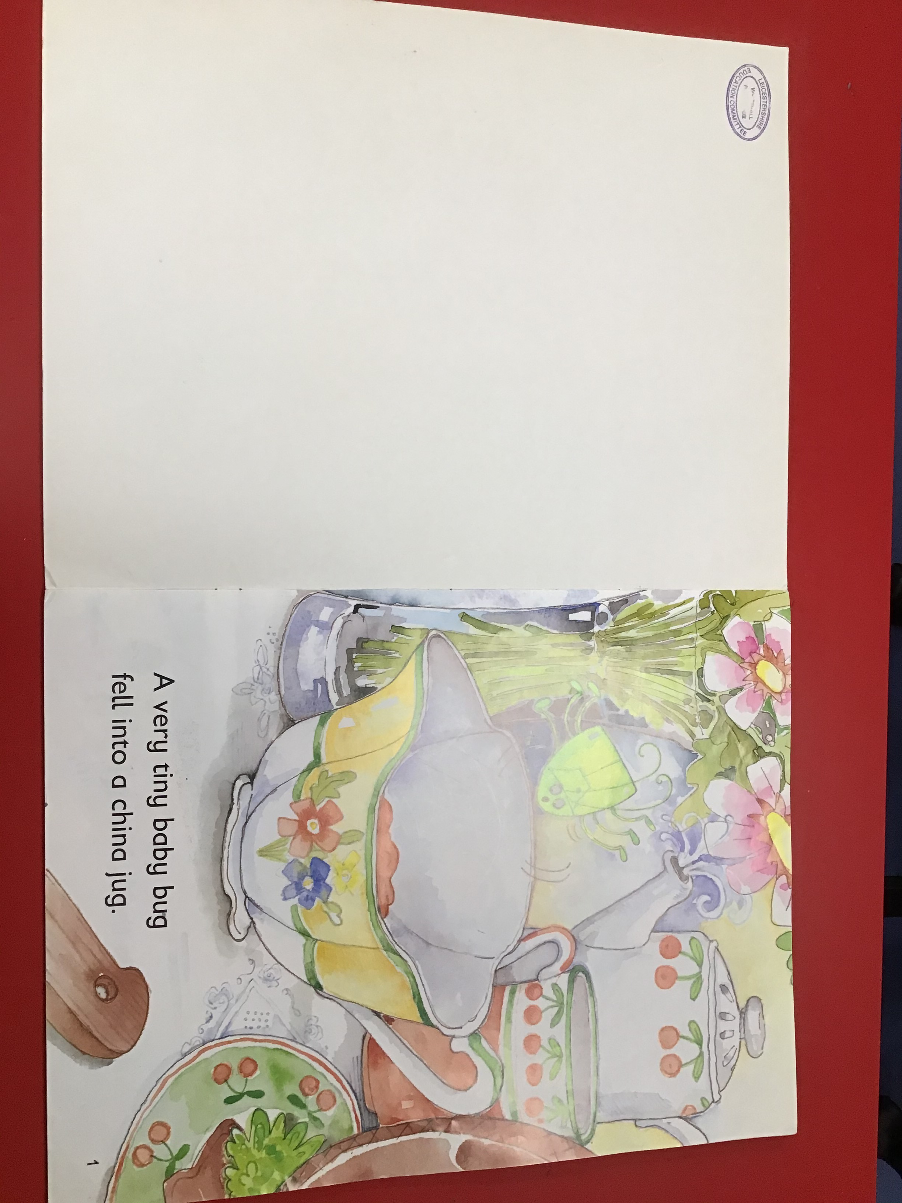
Put your finger under the words as you read with your child.
Ask – “Find the sight word a”
Ask – Who fell into the
china jug?

Slide 7
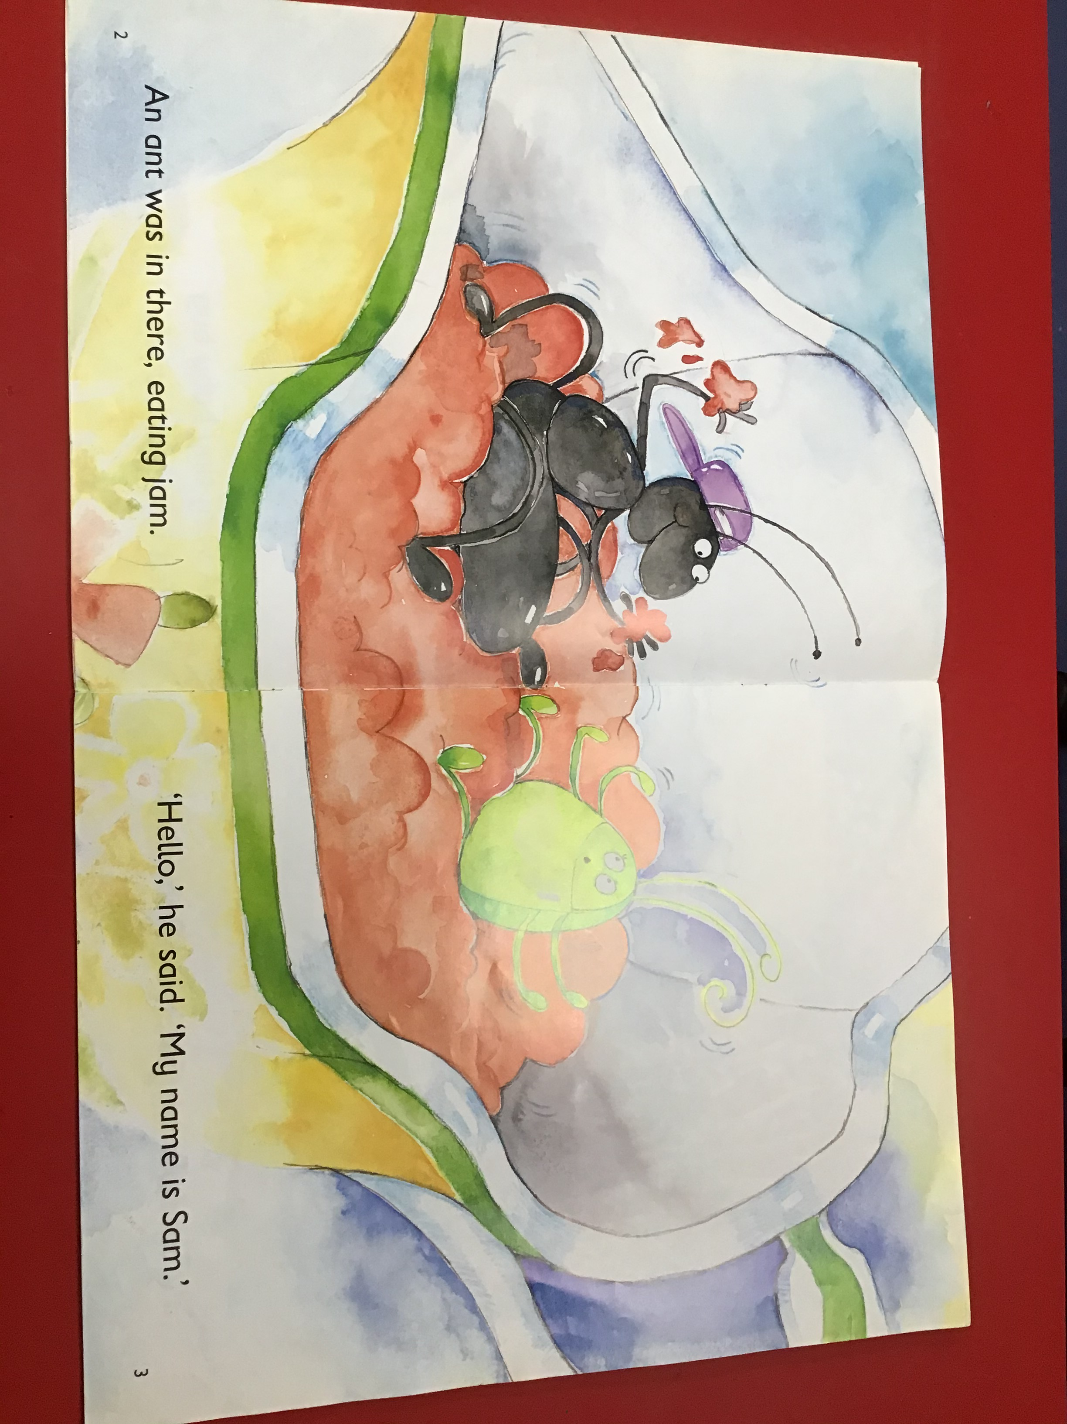
Read together putting finger under each word as you read.
Ask – “Find the sight word is”
Ask – What was the ant
eating?
Ask – What was the ants
name?
Ask – Point to the Capital
Letters at the beginning of
the sentence. Now point to
the full stop at the end of
the sentence.

Slide 8
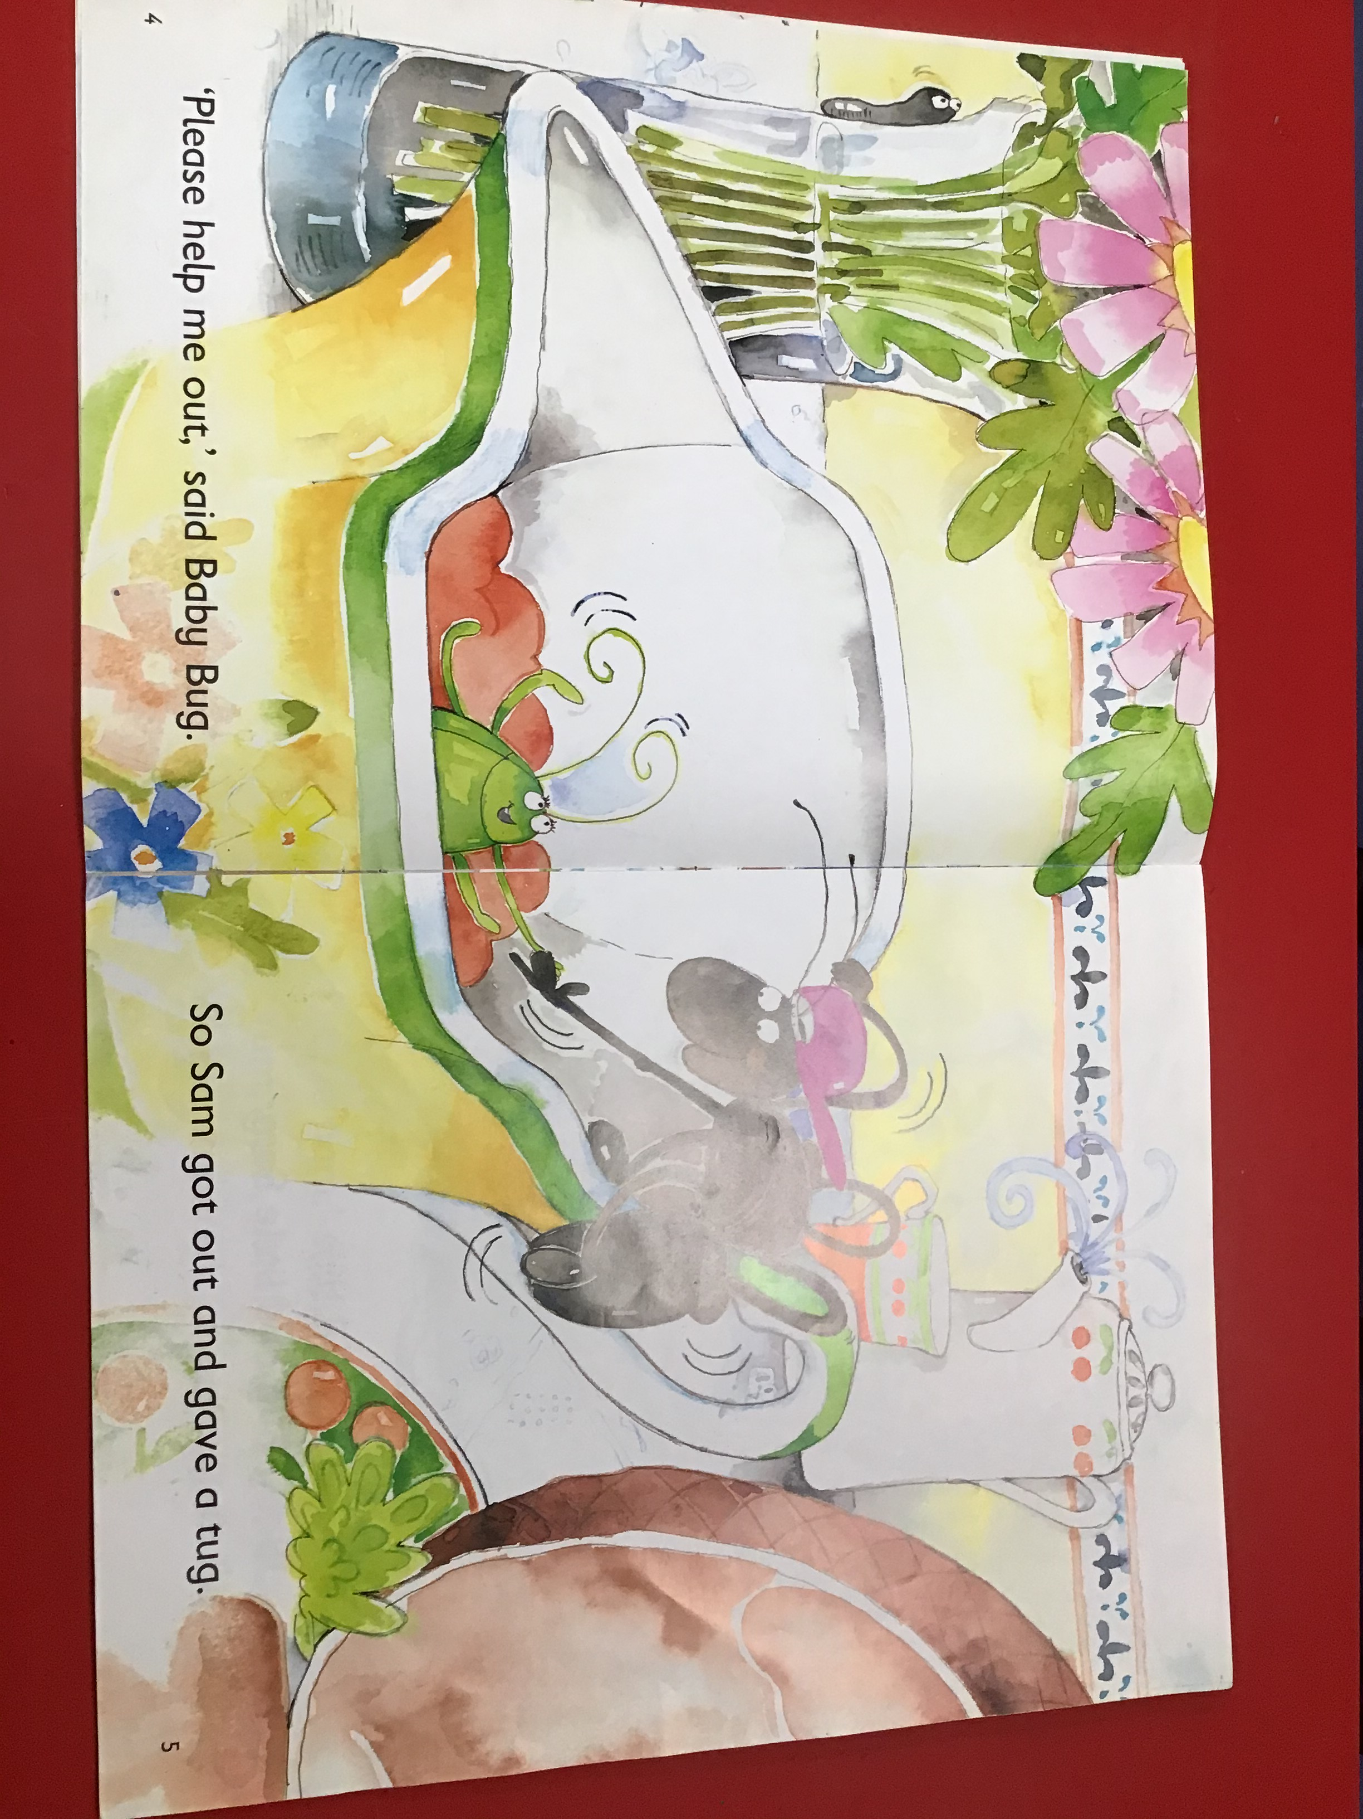
Read together putting finger under each word as you read.
Ask – “Find the sight word and”
Ask – “Find the sight word a”
Ask – What did Baby Bug
say?
Ask – Point to the Capital
Letters at the beginning of
the sentence. Now point to
the full stop at the end of the sentence.

Slide 9
Maths - Number 8
https://www.bbc.co.uk/iplayer/episode/b08pgvmb/numberblocks-series-2-eight
Octopuses are sea creatures. Can you find out why the number 8 is special for an octopus? Draw a picture of an octopus to show what you find out.
Spiders have 8 legs. Make a model spider using playdough, paper or empty packaging. You could use an empty yoghurt pot or section of egg box, or playdough and pipe cleaners. Count the legs carefully as you add them to your model. We would love to see your model spiders!

Slide 10
Phonics – Instrumental Sounds
Not a sound - Pass a tambourine/car keys/jar of sweets/pasta/rice around without making a sound. If it can be heard continue passing it round to keep the game moving but praise listening skills and quiet movement.

Slide 11

Superheroes
What are superheroes? Let’s find out!
https://www.youtube.com/watch?v=I4Wv3J2trMs

Slide 12
Show & Tell
Dress up as a superhero! Send in a picture! Then go through the questions talking about your superhero. Send in a video of yourselves talking about your superhero!
What is your superhero called?
What does your superhero look like?
What special powers does your superhero have?
Where does your superhero live?

Slide 13
Tuesday
23.2.21

Slide 14
Wake & Shake
https://www.youtube.com/watch?v=ok7V1pWtRzs
Koo Koo Kanga Roo - Superheroes Unite (Dance-A-Long)

Slide 15
Shared Read
Read the sight words:
I a mum dad
the see can and
to is my

Slide 16
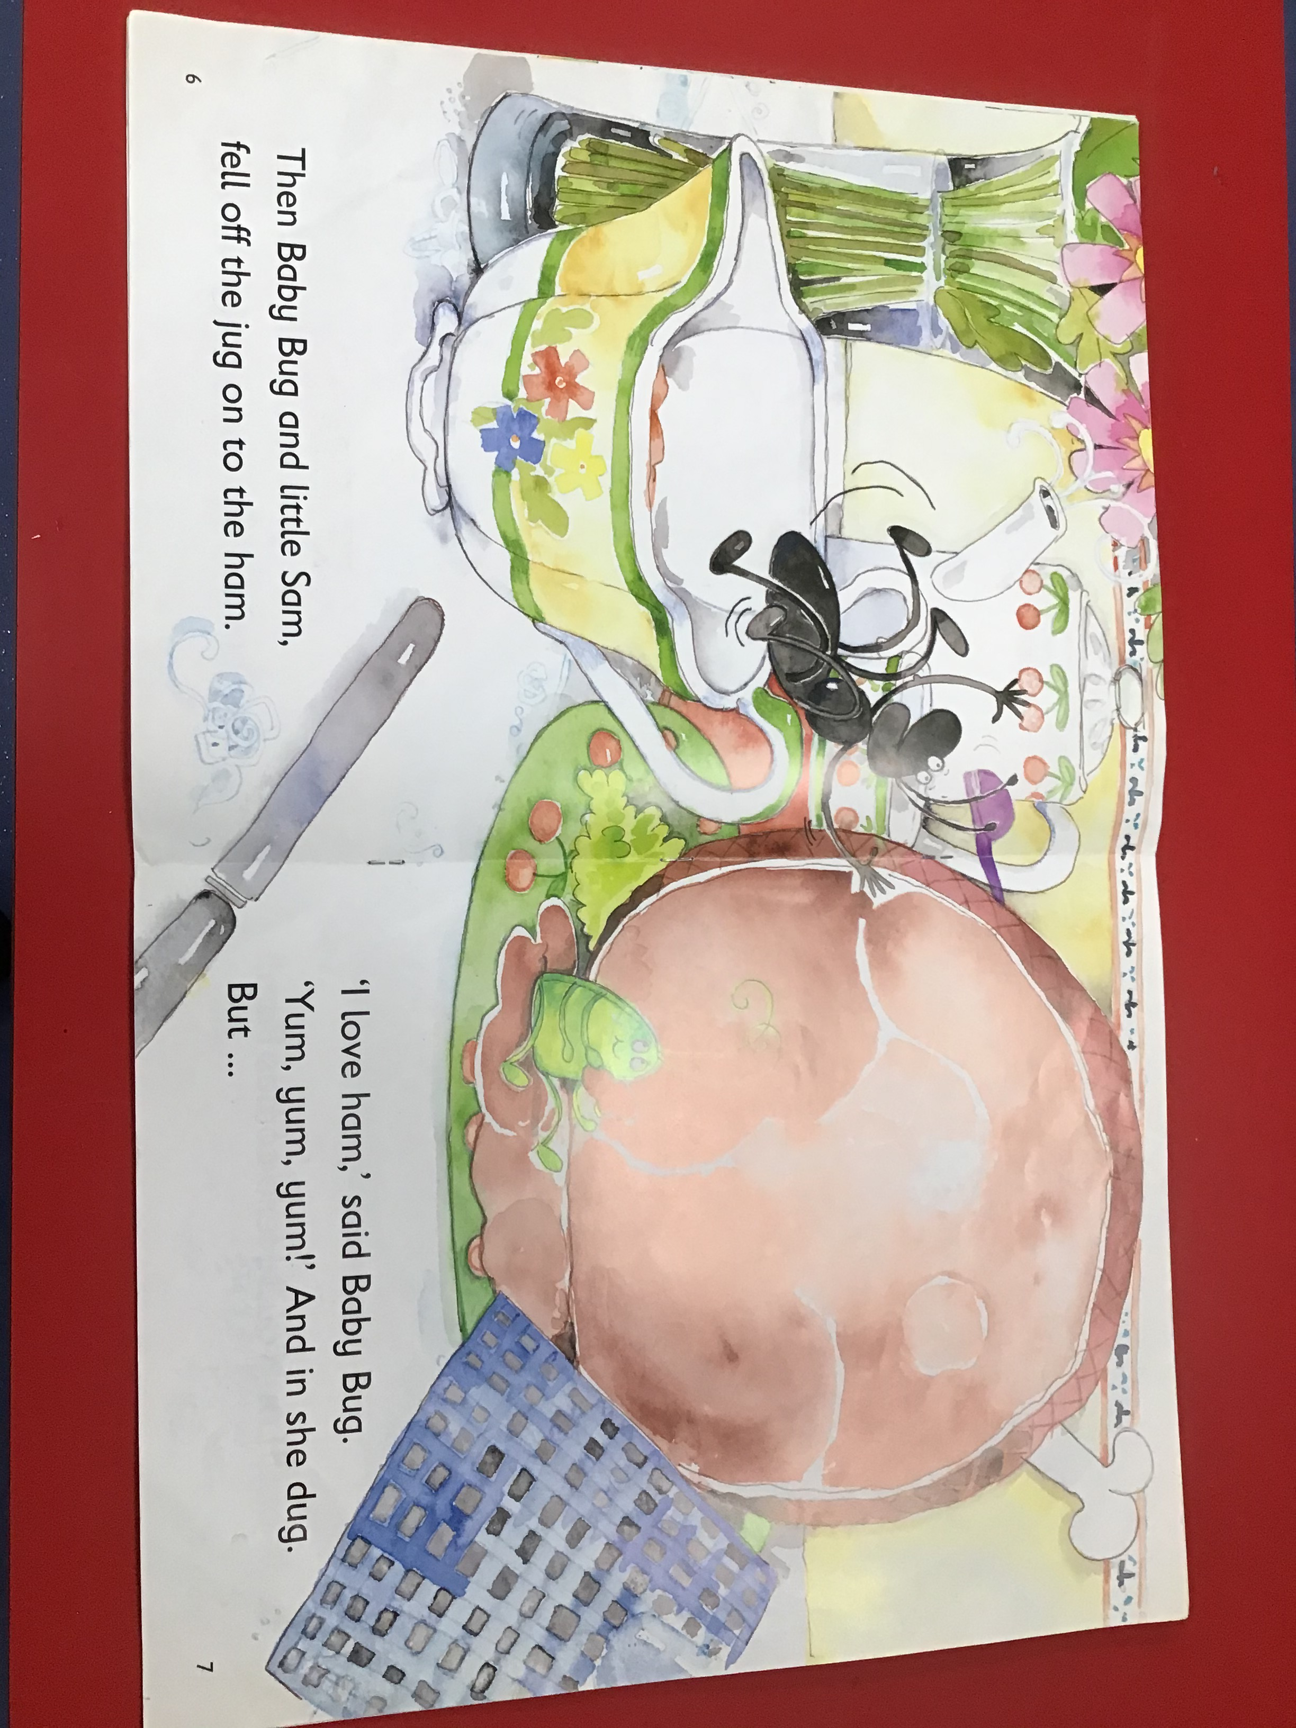
Read together putting finger under each word as you read.
Ask – What is the title of the book? (can they remember?
Encourage them to put their finger under the words and read with them.
Ask – What did Baby Bug and Little Sam fall on?
Ask – What did Baby Bug say?

Slide 17
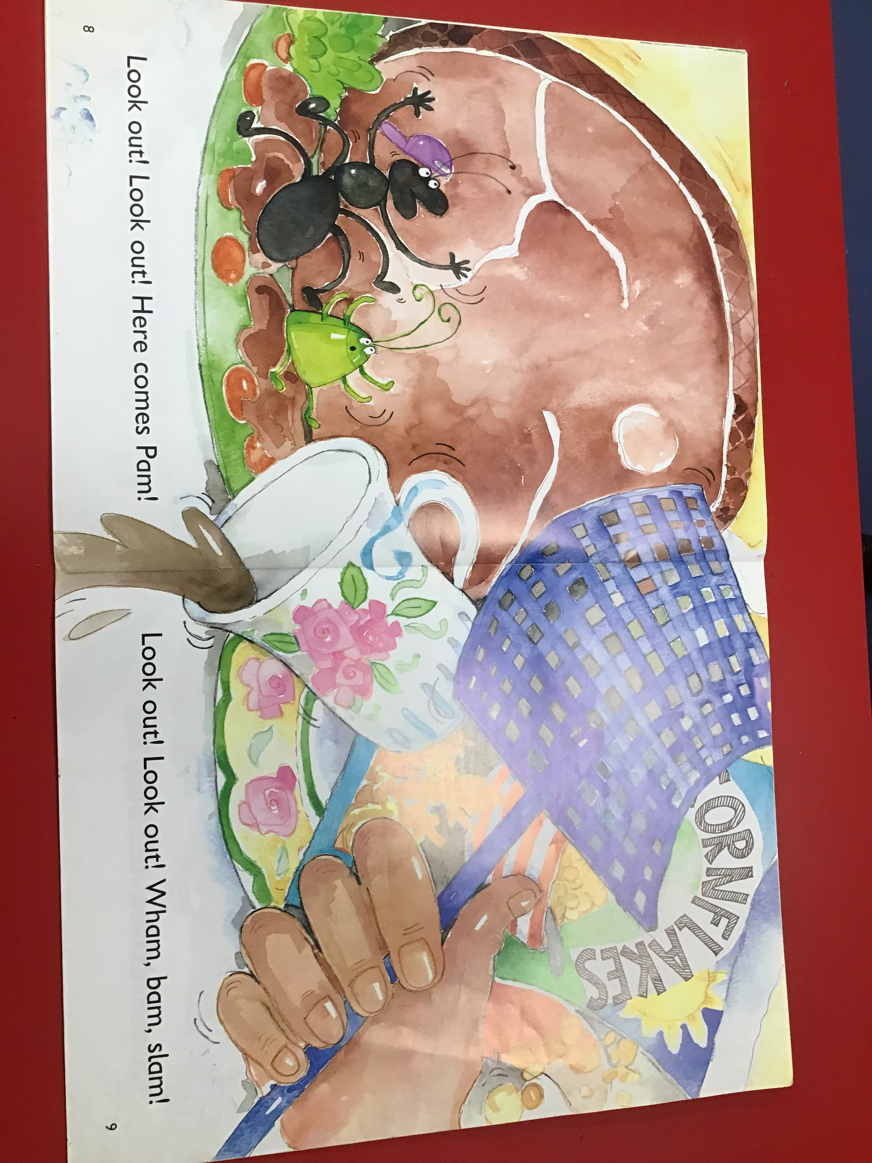
Read together putting finger under each word as you read.
Ask – What is going to
happen to Sam and Baby Bug?
Ask –

Slide 18
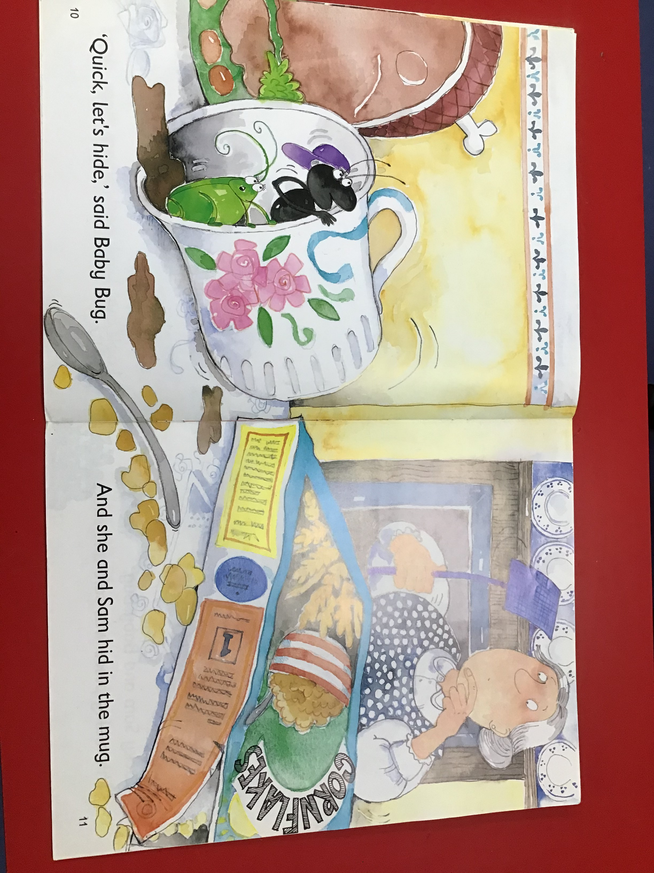
Read together putting finger under each word as you read.
Ask – Find the word ‘and’.
Ask – Find the word ‘the’.
Ask –What did Sam and Baby Bug hide in?

Slide 19
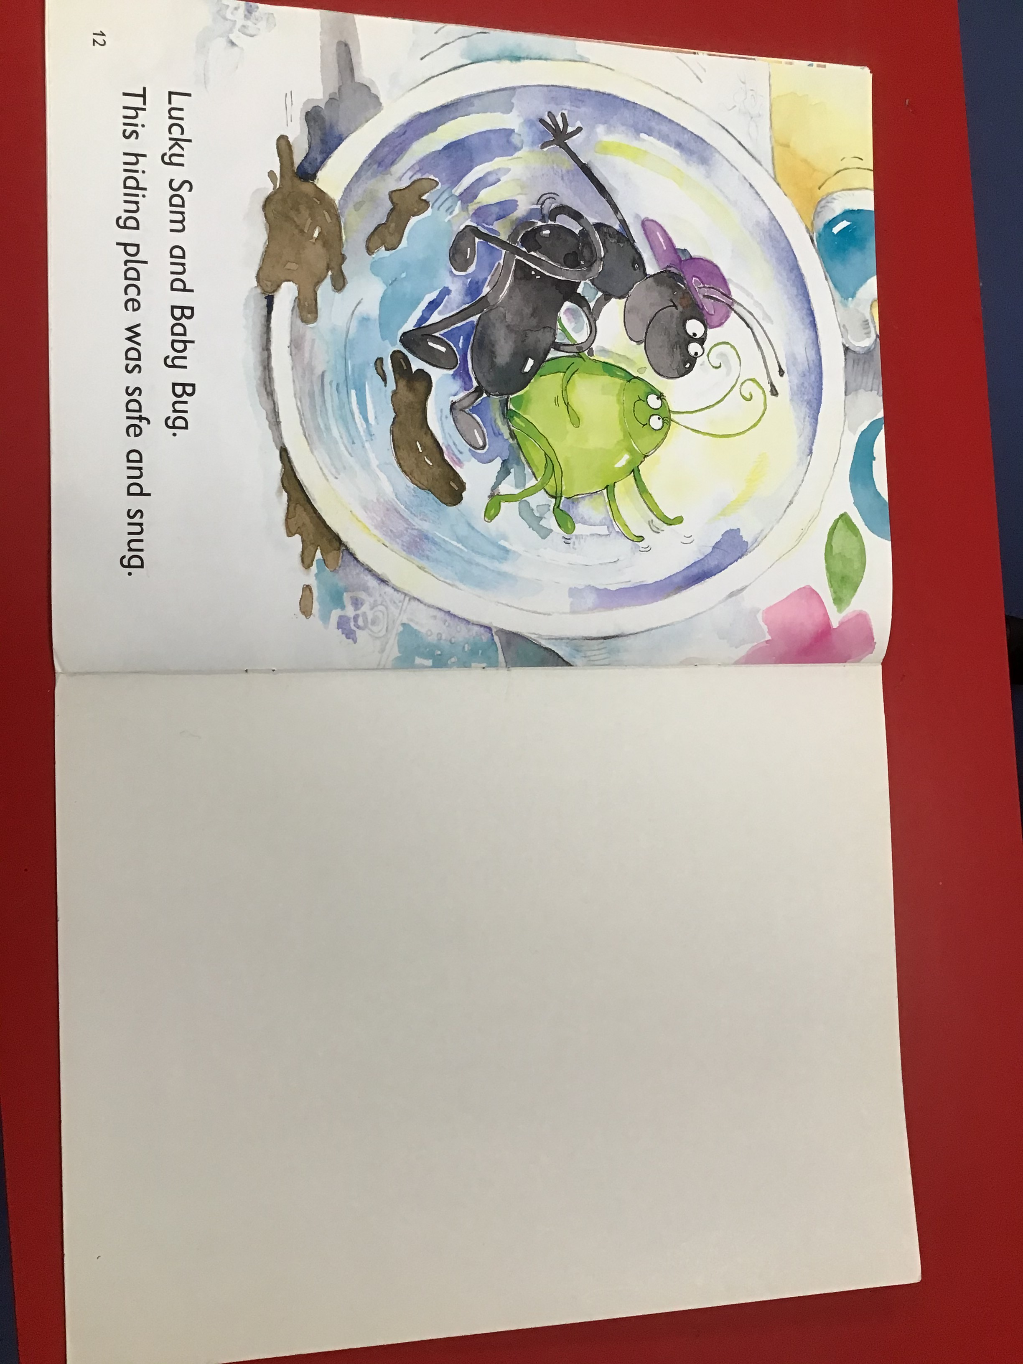
Read together putting finger under each word as you read.
Ask – Find the word ‘and’.
Ask –What was the hiding place like?
Ask – Point to the Capital
Letters at the beginning of the sentence. Now point to the full stop at the end of the sentence.

Slide 21
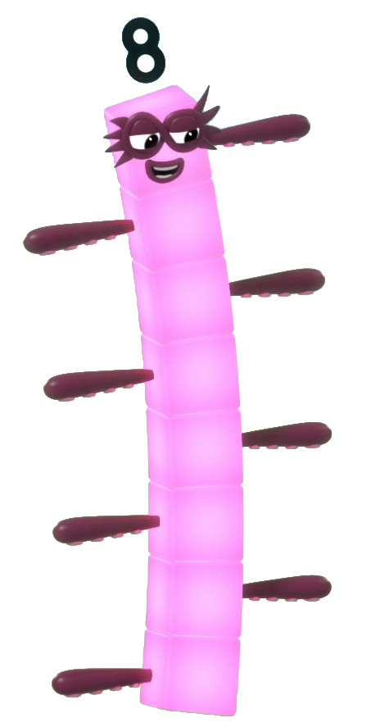
next
I am Octoblock! Let’s save the eights together!

Slide 22


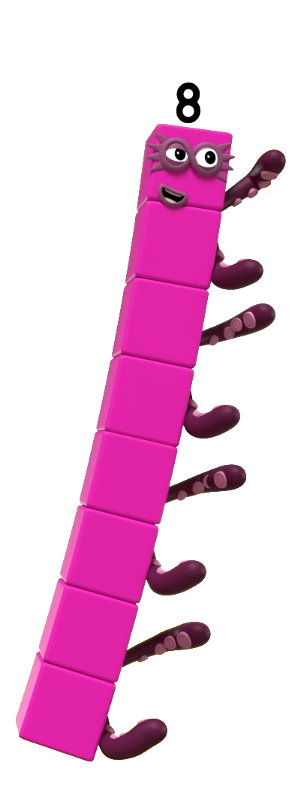
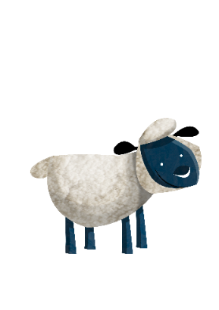
Is this 8?
Click me to find out.

Slide 23
next
Is this 8?
Should I save the sheep or leave them? How do you know?
Save
Well done! There are 8 sheep.
Try again.
Leave

Slide 24
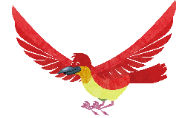
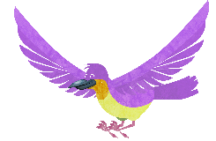
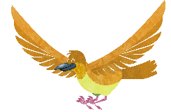
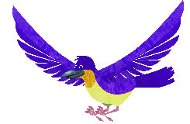
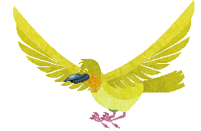
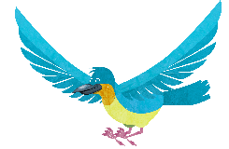
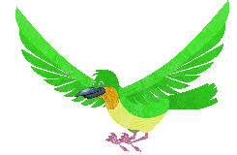
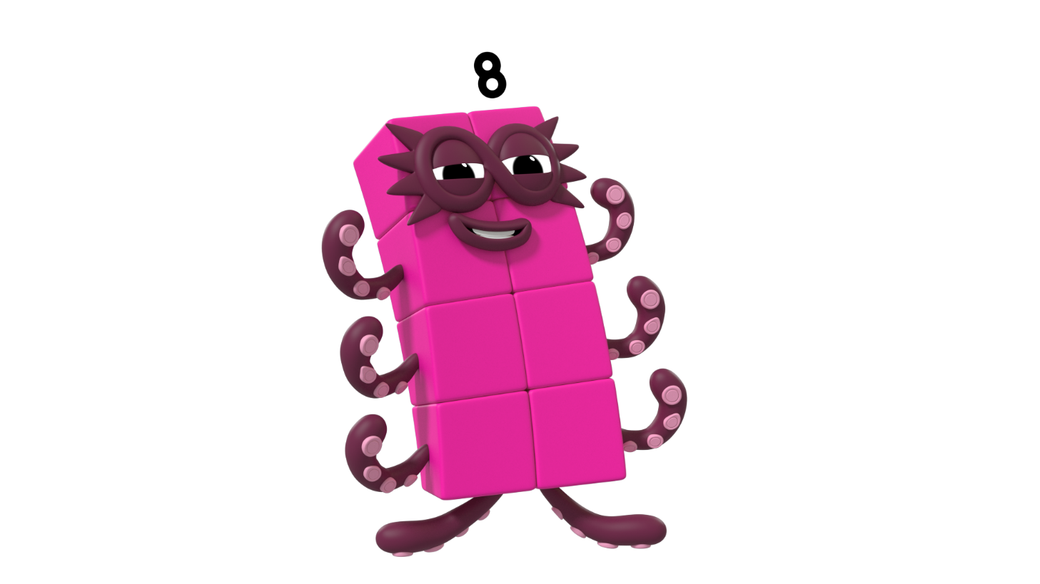
Is this 8?
Click me to find out.

Slide 25
next
Is this 8?
Should I save the birds or leave them? How do you know?
Save
Try again.
Well done! This is not 8. How many did you count?
Leave

Slide 26
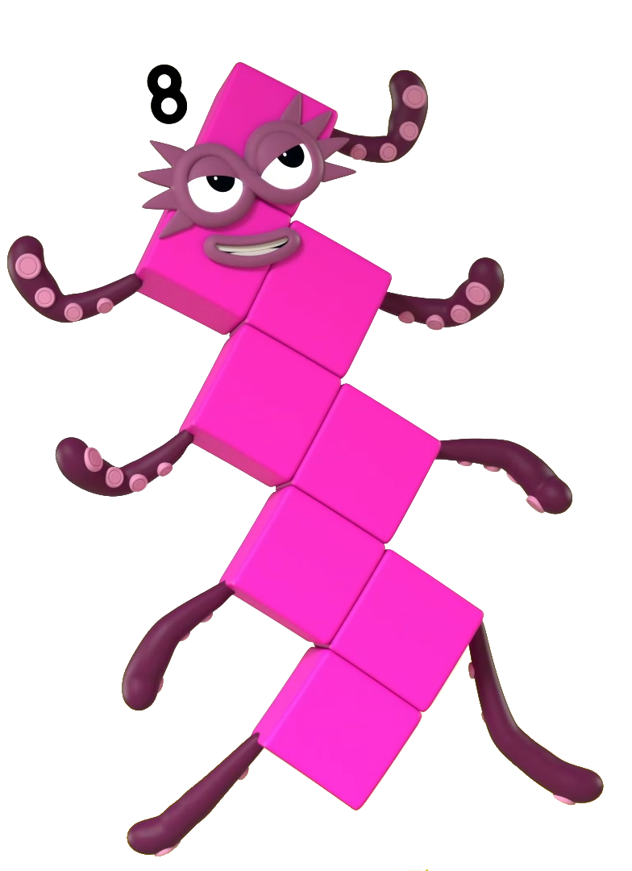
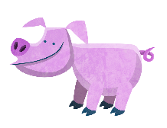
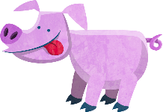
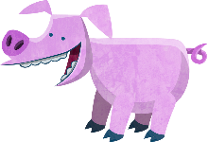
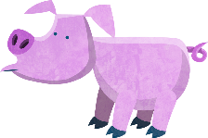
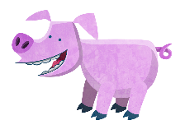
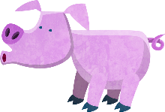
Is this 8?
Click me to find out.

Slide 27
next
Is this 8?
Save
Should I save the pigs or leave them? How do you know?
Try again.
Well done! There are 8 pigs.
Leave

Slide 28

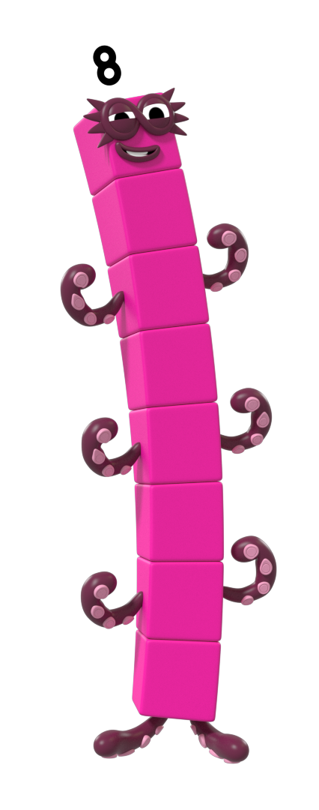
next
Is this 8?
Try again.
Well done! This is not 8.
Save
Should I save this shape? How many sides has it got? How can you check?
Leave

Slide 29

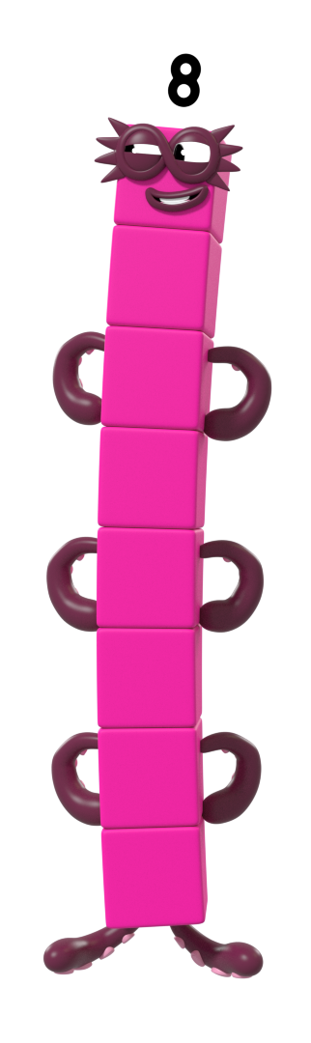
Is this 8?
7
7
Click me to find out.

Slide 30
Is this 8?
7
Click me to find out.

Slide 31
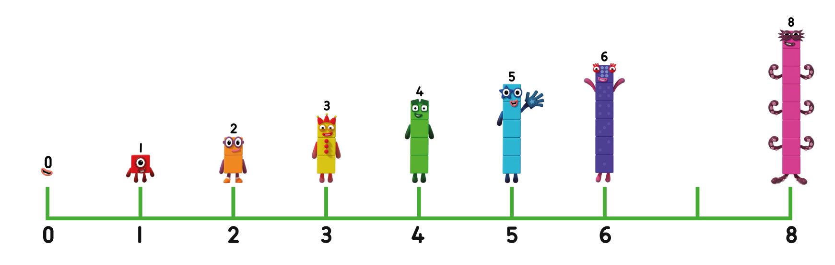
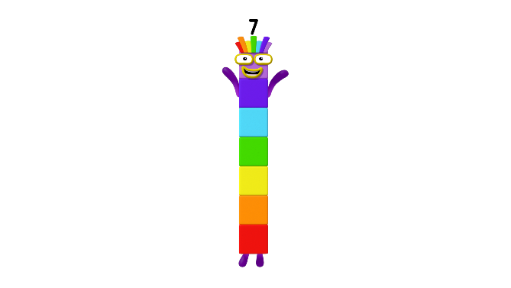
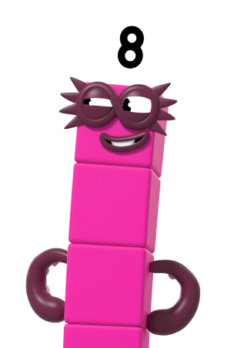
next
0
1
2
3
4
5
6
7
8
Save
Try again.
Well done! This is not 8.
Should I save this number? Can you show me on your fingers what number this is?
Leave

Slide 32

Is this 8?
Click me to find out.

Slide 33
next
Should I save this shape? How many sides has it got? How can you check?
Well done! This shape has 8 sides. Can you name my shape?
Try again.
Save
Leave

Slide 34
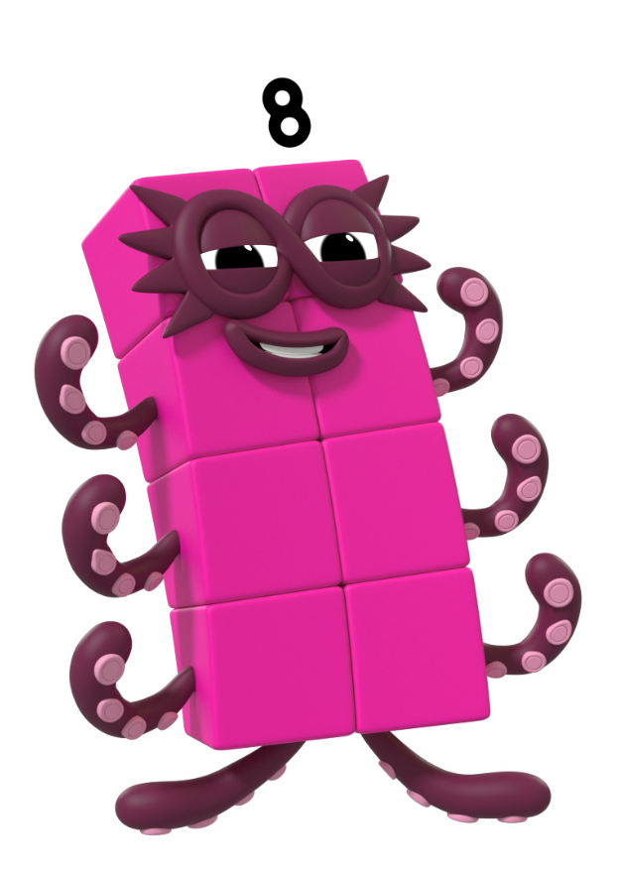
Is this 8?
8
8
Click me to find out.

Slide 35
Is this 8?
8
Click me to find out.

Slide 36
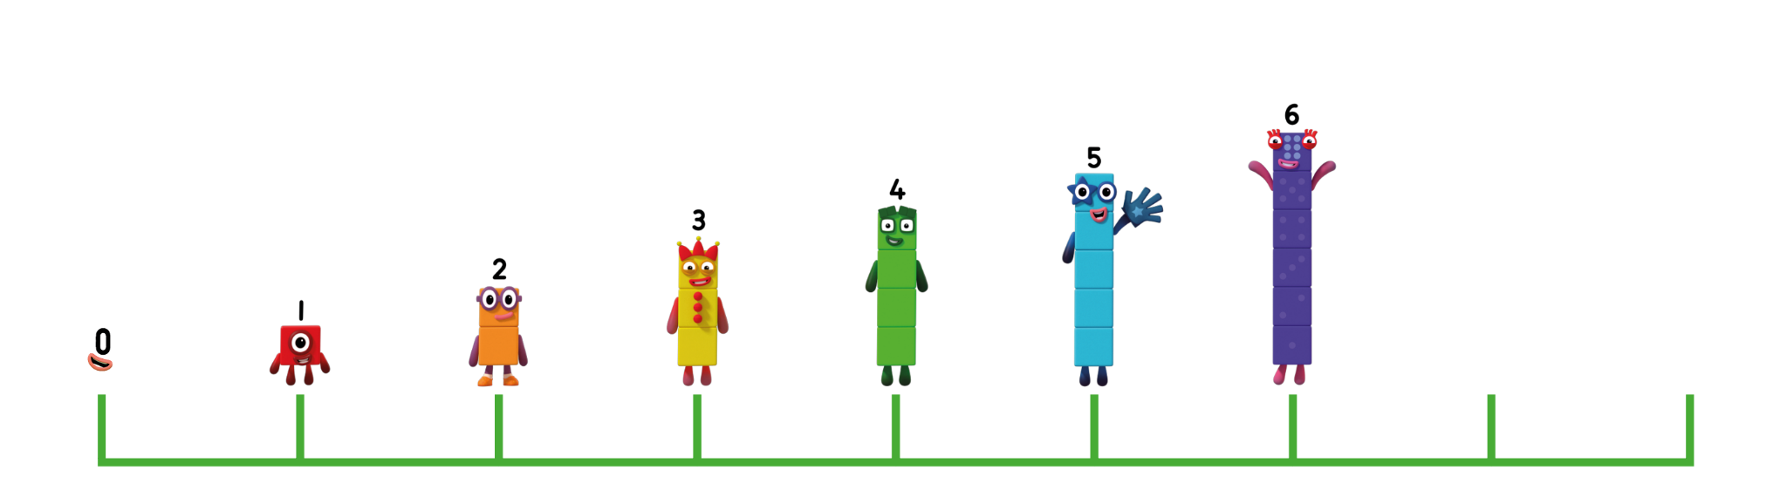

next
0
1
2
3
4
5
6
7
8
Save
Try again.
Well done! This is 8.
Should I save this number? Can you show me on your fingers what number this is?
Leave

Slide 37




Which building should I hide in? Click the one I should choose.
Try again.

Slide 38
Which building should I hide in? Click the one I should choose.

Slide 39

next
Can you count the windows to check? Click the building and count with the Numberblocks.

Slide 40
next
Can you remember all the
ways we saw number 8?

Slide 41
next
We saved…

Slide 42

next
We saved…

Slide 43
next
We saved…

Slide 44


finish
8
8
An "S" to start, looking great! Loop back up to make an 8.
Let’s practise writing 8. Can you draw it in the air like me? Click me to start.

Slide 45
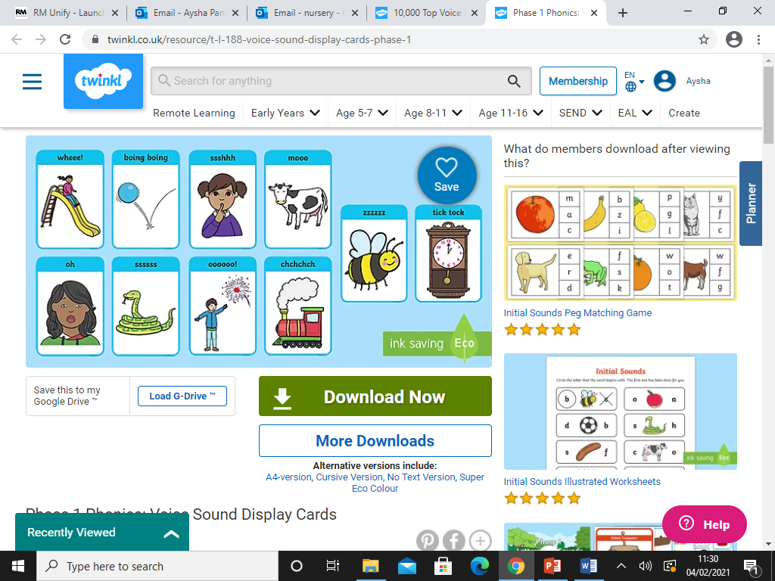
Phonics – Voice Sounds
Using your voice sound flash cards – can you make the sounds, try making them loudly, quietly etc

Slide 46
Biggleton – Superheroes
https://www.bbc.co.uk/iplayer/episode/m00023yk/biggleton-series-2-25-superheroes

Slide 47
Wednesday
24.2.21

Slide 48
Wake & Shake
https://www.youtube.com/watch?v=Py4fhsx3Ct4
Kids Superhero Song - Let's Be Superheroes

Slide 49
Maths - Number 8
https://www.youtube.com/watch?v=-vdLIV_Oukc
Eight Legs
https://www.youtube.com/watch?v=DzKqCmjVXLI
Number Formation 1-8
Please refer to the ‘Find the Real Octoblocks Activity Sheet’

Slide 50
Phonics – Body Percussion
Wake up Mr Bear – have a teddy and a pot, explain that Mr Bear keeps losing his honey and we are going to help him to find it.
Clap loudly if he is close and quietly if he moves further away. Adults model first.
Children can wake up Mr Bear by chanting (quiet to loud) ‘Wake up Mr Bear, Wake up Mr Bear, Wake up Mr Bear and go and find your honey.’
When he finds the honey one of the children can feed him then repeat.

Slide 51
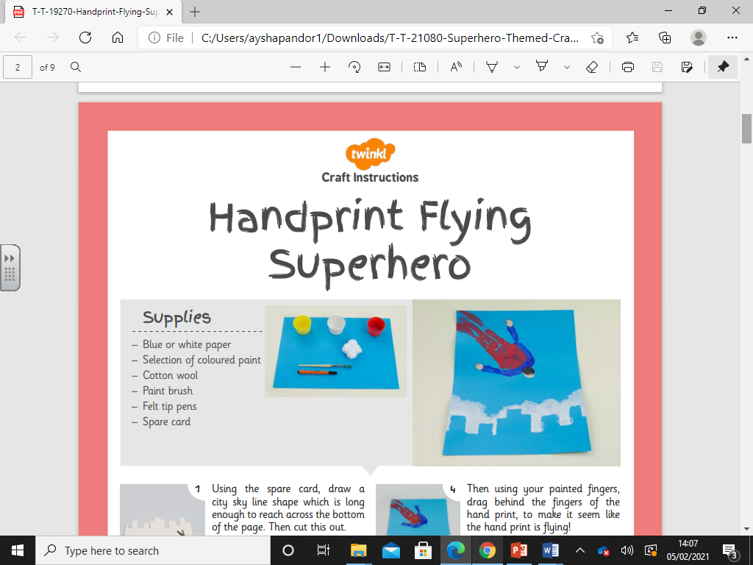
Creative Work
Please refer to the handprint superhero flying craft sheet.

Slide 52
Thursday
25.2.21

Slide 53
Wake & Shake
https://www.youtube.com/watch?v=ok7V1pWtRzs
Koo Koo Kanga Roo - Superheroes Unite (Dance-A-Long)

Slide 55
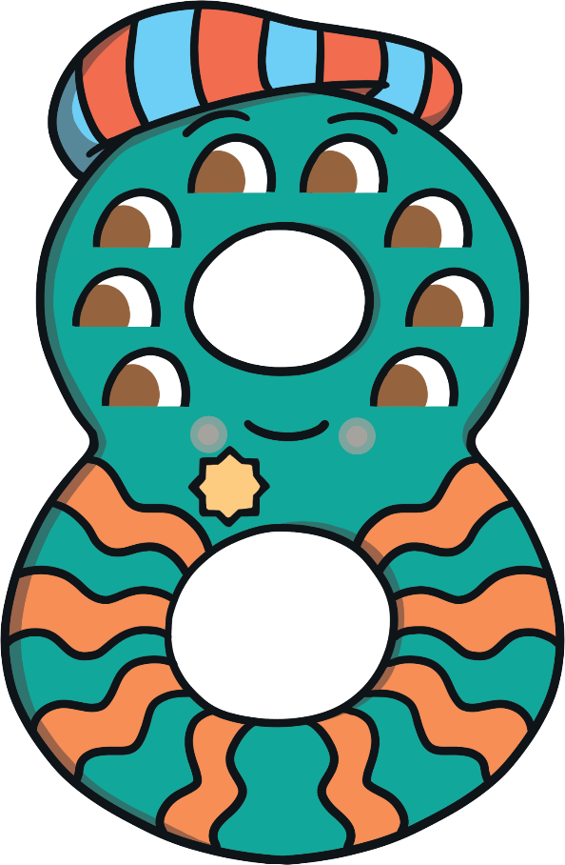
Meet Number Eight
Hello, my name is Number Eight and I love the number 8. Can you tell? Do you want to hear about my adventure to the farm?
What do you notice about Number Eight? Talk to a friend about
what you can see.

Slide 56



One day, Number Eight decided to go and visit his friend, Farmer Flo, and see all the animals on her farm. As he walked down the path to his garden gate, he was so excited that he did a little dance and sang a song.
Make an ‘s’ and close the gate, now I’ve made the number 8!

Slide 57
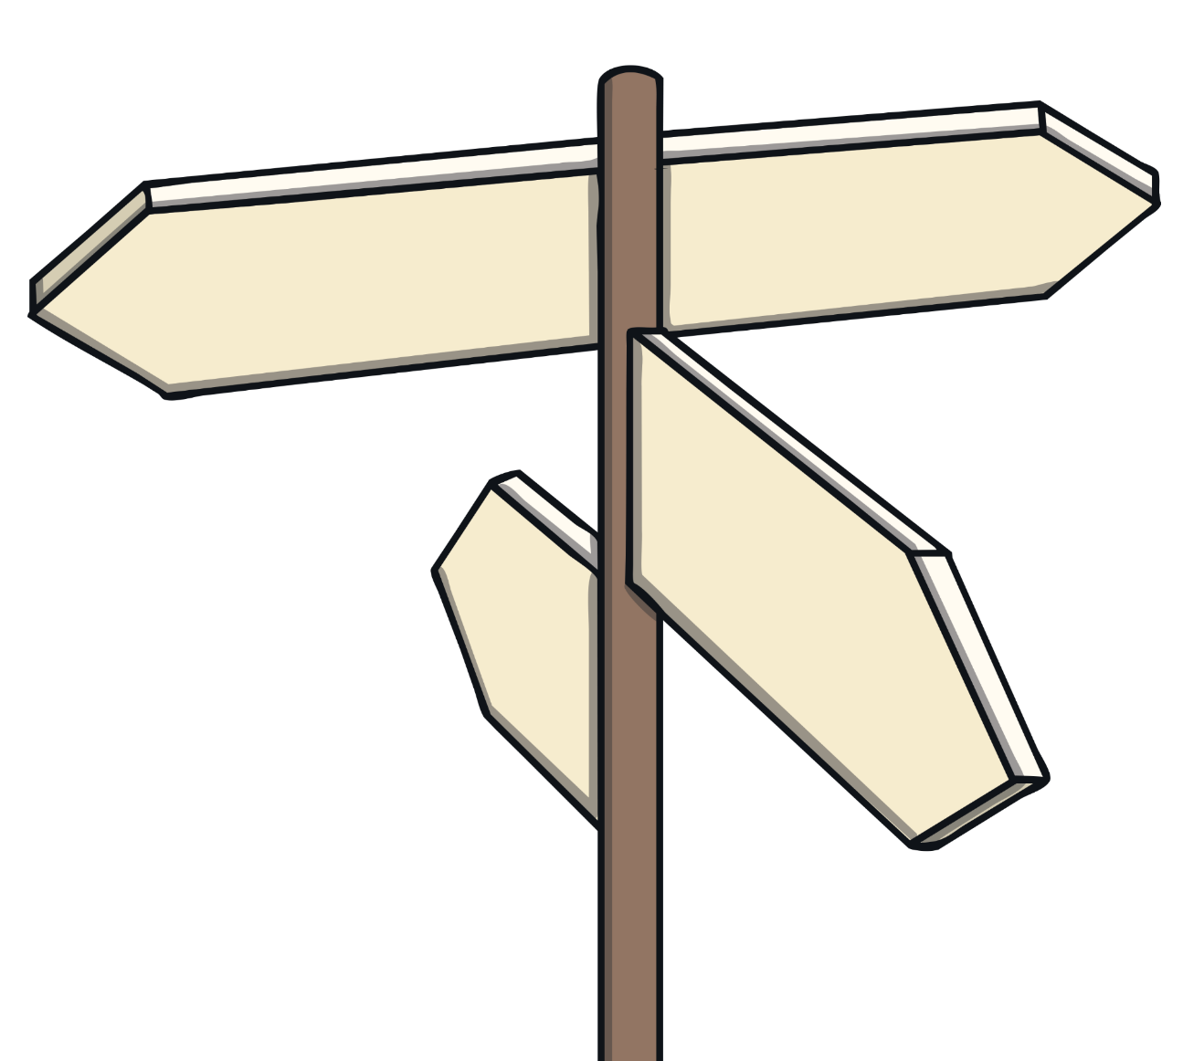





Number Eight walked down the road to the road sign and stopped to decide which way to go. Which is the way to Farmer Flo’s farm? How do you know? Click on the sign that Number Eight followed.
Railway Station
That’s right. This sign says ‘Farmer Flo’s Farm – 8 miles’.
Farmer Flo’s Farm
5 miles
8 miles
Try again!
Try again!
Try again!
Town Centre
Seaside
10 miles
2 miles

Slide 58
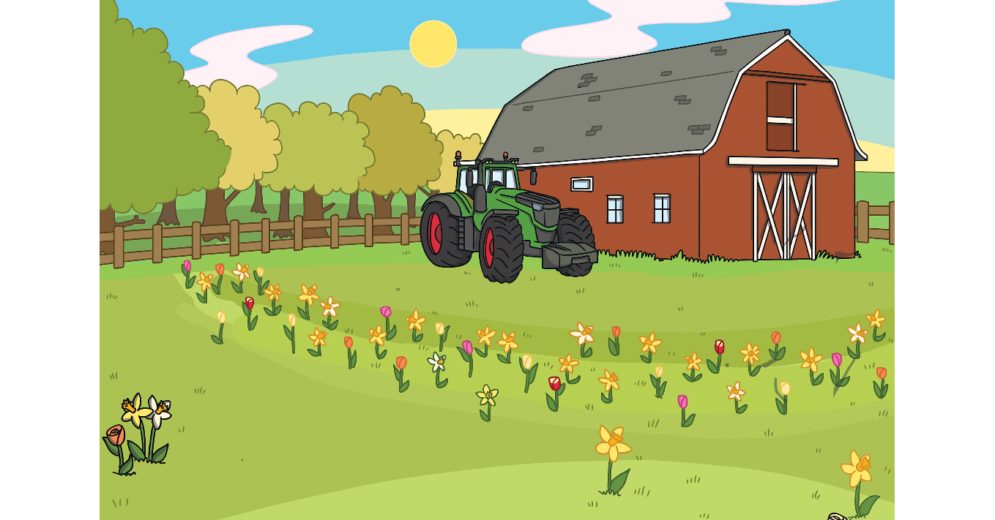
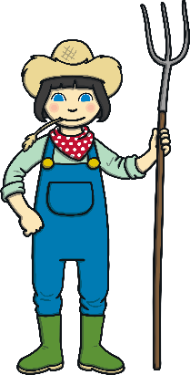

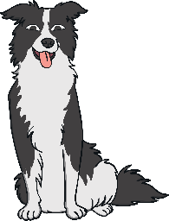



It was 8 o’clock by the time Number Eight got to Farmer Flo’s farm. What did he see on his watch?
Try again!
Try again!
Yes! This watch says 8 o’clock. How did you know?

Slide 59
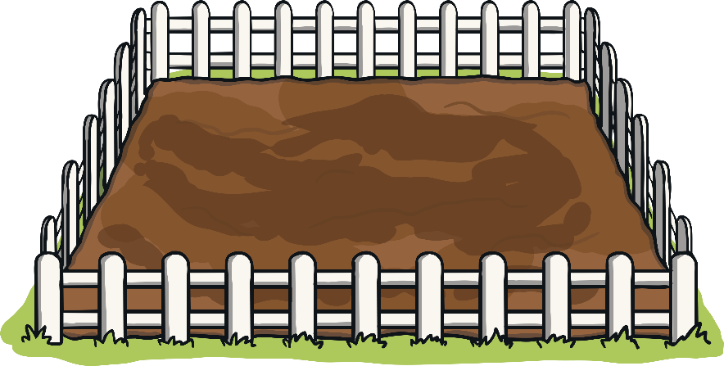
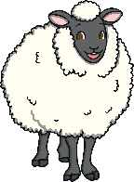

First, it was time to round up the sheep with the help of Sheepdog Shep. Which pen has 8 sheep in it?
Yes! There are 8 sheep in this pen. Can you count how many sheep are in the other two pens?
Try again!
Try again!

Slide 60
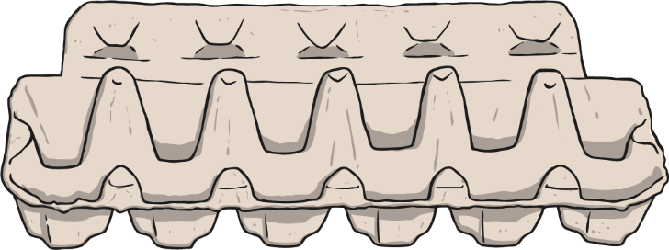


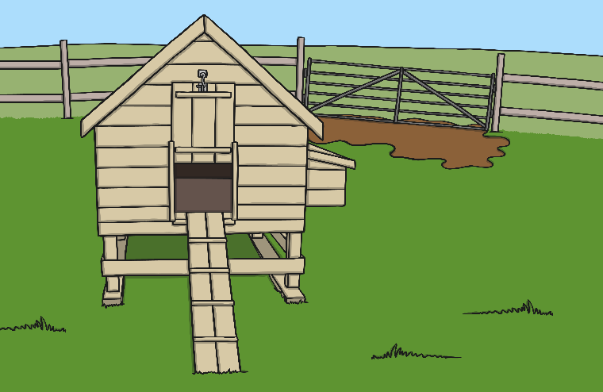
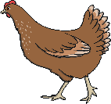
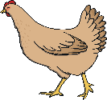
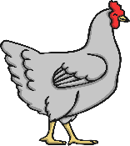
Next, Number Eight and Farmer Flo went to collect some eggs from the hens. Number Eight found 8 eggs. Which egg box do you think is his?
Yes! There are 8 eggs in this box.
Try again!
Try again!

Slide 61



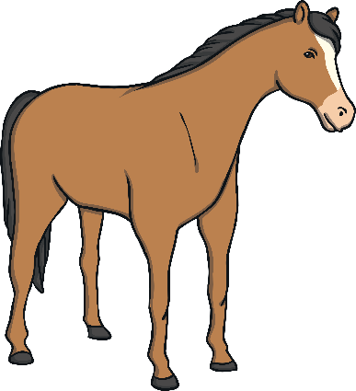
Finally, it was time to feed the horses with some yummy apples. Which tree has 8 apples on it?
Try again!
Try again!
Well done! This tree has 8 apples.

Slide 62






Before Number Eight went home, he and Farmer Flo had a lovely cup of tea and a biscuit. Which biscuit do you think Number Eight chose? Why?
That’s right! I picked the biscuit that has 8 sides because I love the number 8! My biscuit is an octagon.
Try again!
Try again!

Slide 63




Number Eight was very tired after his busy day at the farm, so he decided to get the train home. His ticket cost £8. Which purse does he need?
Well done! This purse has £8.
Try again!

Slide 64









Let’s look at all the things Number Eight saw on his adventure to the farm.
Farmer Flo’s Farm
8 miles
8 miles
8 o’clock
8 sheep
8 eggs
8 apples
8 sides

Slide 65











Can you find 8 on the number track? Click on Number Eight to move him onto the number track.
1
2
3
4
5
6
7
8
9
10
Which number comes before 8? Which number comes after number 8? Can you count along the number line from 1 to 8?

Slide 67


What are syllables?
Syllables are the beats or chunks that we hear in words.
Let’s clap out the syllables in the word syllables.
Sy - lla - bles = 3 claps
Now practise clapping your name.

Slide 68

Clap Your Hands
Let’s clap out these family name syllables.
brother
sister
cousin
mum
dad
grandpa
grandma
friend

Slide 69

Stamp Your Feet
Let’s stamp out these animal name syllables.
crocodile
chimpanzee
hippopotamus
tiger
zebra
kangaroo
koala
horse

Slide 70

Jump Up and Down
Let’s jump out these food name syllables.
broccoli
carrot
cucumber
tomato
banana
apple
watermelon

Slide 71

Cutting Skills
Please refer to the ‘Practicing Cutting Skills’ sheet.

Slide 72
Friday
26.2.21

Slide 73
Wake & Shake
https://www.youtube.com/watch?v=Py4fhsx3Ct4
Kids Superhero Song - Let's Be Superheroes

Slide 74
Maths - Number 8
Please refer to the ‘Number Maze Sheet’

Slide 75


Slide 76
Rhyming Matches
Click on the rhyming match for the picture on each slide. Good luck!
Play

Slide 77






Slide 78





Slide 79




Slide 80





Slide 81





Slide 82





Slide 83




Slide 84





Slide 85





Slide 86

Super-Sensory Superheroes
Please refer to the ‘Super-Sensory Superheroes’ sheet.

Slide 87
We hope you had fun with this weeks learning!
Don’t forget to send us all the learning you have done this week on the nursery email!​
nursery@whitehall.leicester.sch.uk​
Credit: Twinkl, BBC, Topmarks, YouTube, Cbeebies

