Slide 1
5th October 2020

Slide 2
Our reading strategies
As you read with your child, use the following strategy to help your child to work out the animal words.
“I can look at the first letter, make the sound and cross check with the picture”

Slide 3
Literacy- Monday
Read the sight words
you see a can

Slide 4

Brown bear, brown bear
Read the title of the book twice then ask your child to read it.
Ask “ What can you see on the front cover?”
Ask “What do you think the book is about?” Encourage them to use the sentence “I think the book is about....”

Slide 5
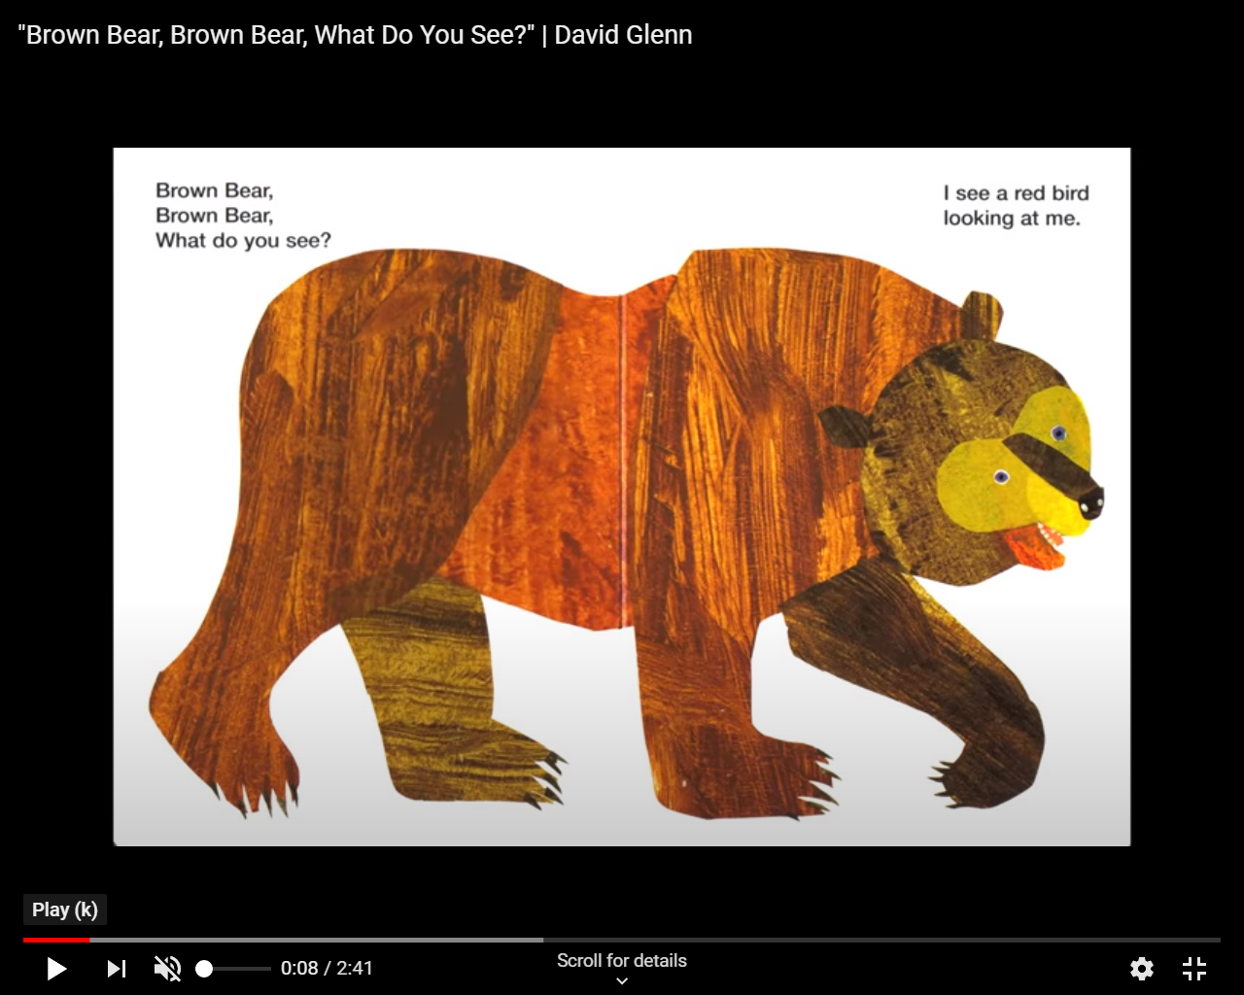
Stop at the word Bear and say I can’t read this word. What can I do?
Encourage them to say the following strategy
“I can look at the first letter, make the sound and cross check with the picture”
Model to your child. Look at the first letter of bear and say the sound (b) cross check with the picture and say bear. This word says bear. Continue this as you read the rest of the book.

Slide 6
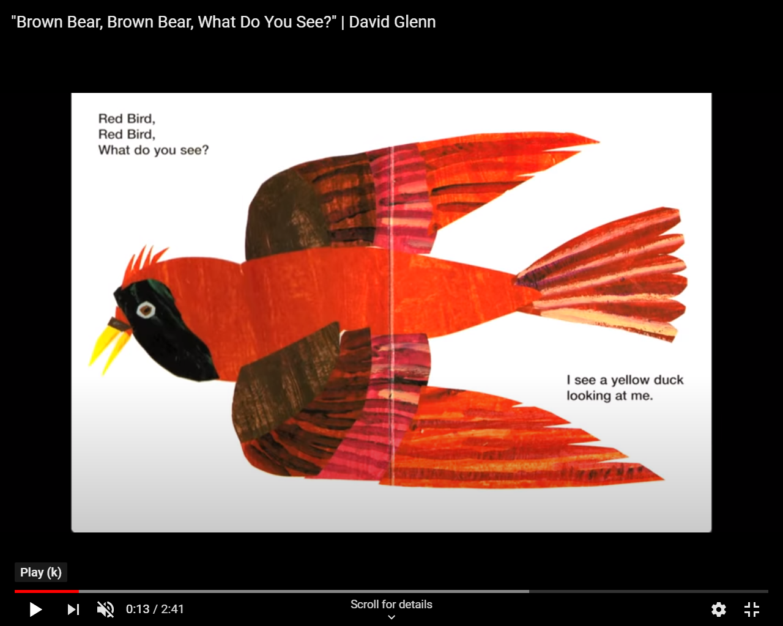
Find the sight word “see”

Slide 7
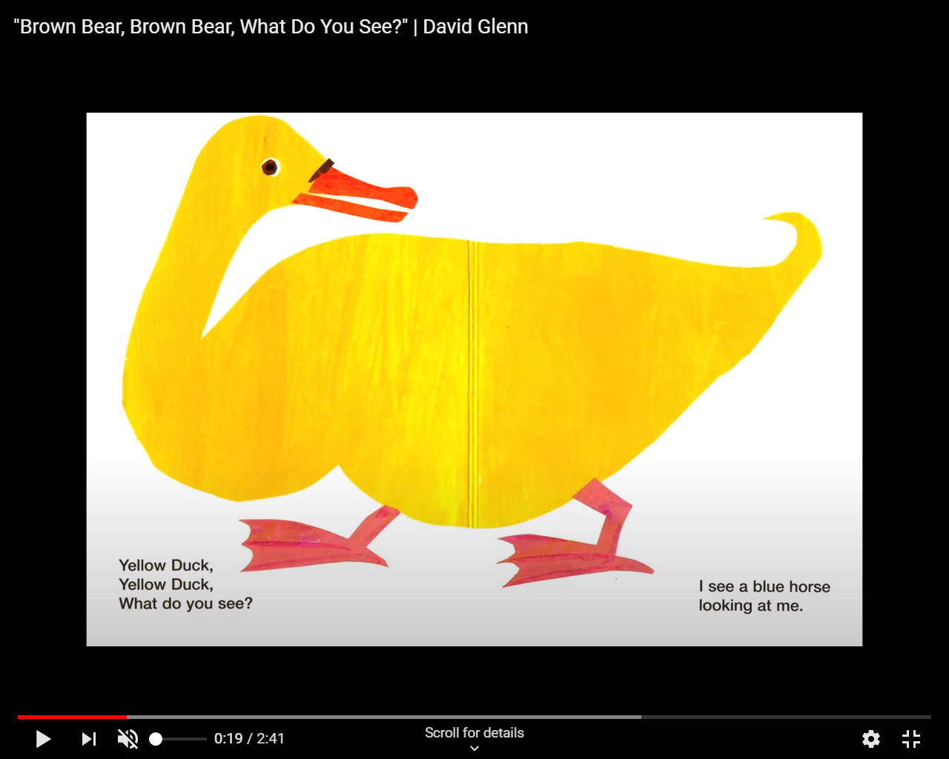
Find the sight word “you”

Slide 8
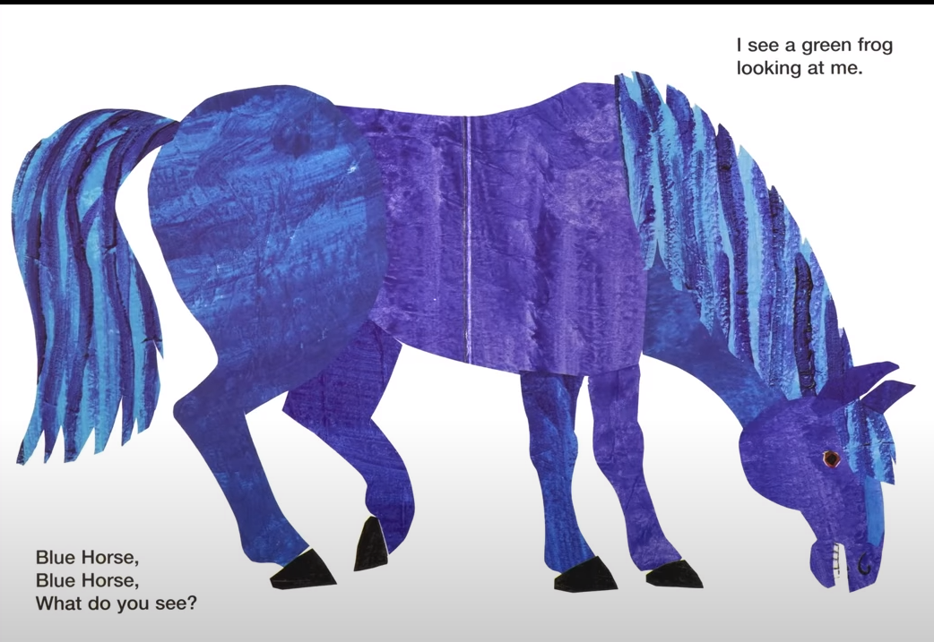
Find the sight word “a”

Slide 9
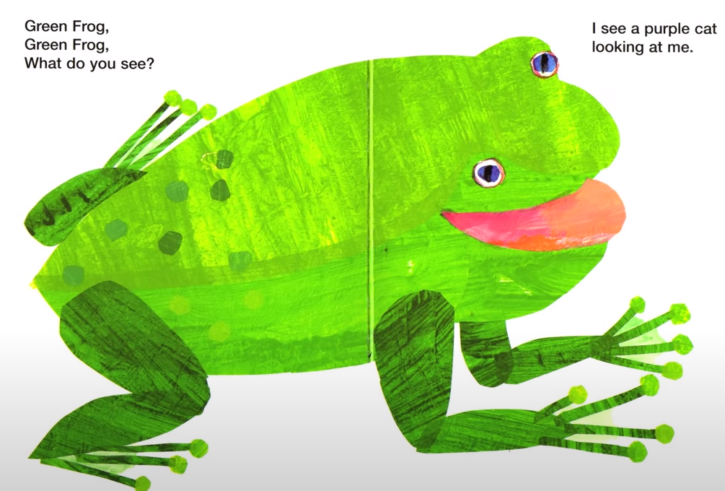

Slide 10
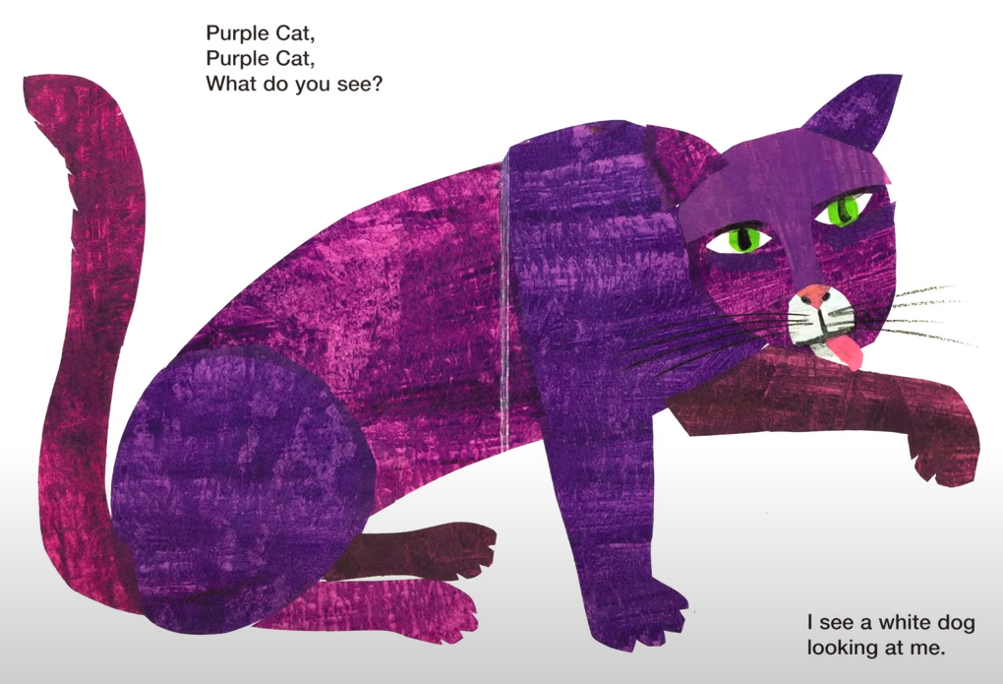

Slide 11
Questions
What colour was the duck? Find the word
What did the Brown Bear see? Find the sentence
What did the Blue horse see? Find the sentence

Slide 12
Tuesday - Literacy
Read the sight words
you see a can
Recap the story from yesterday

Slide 13
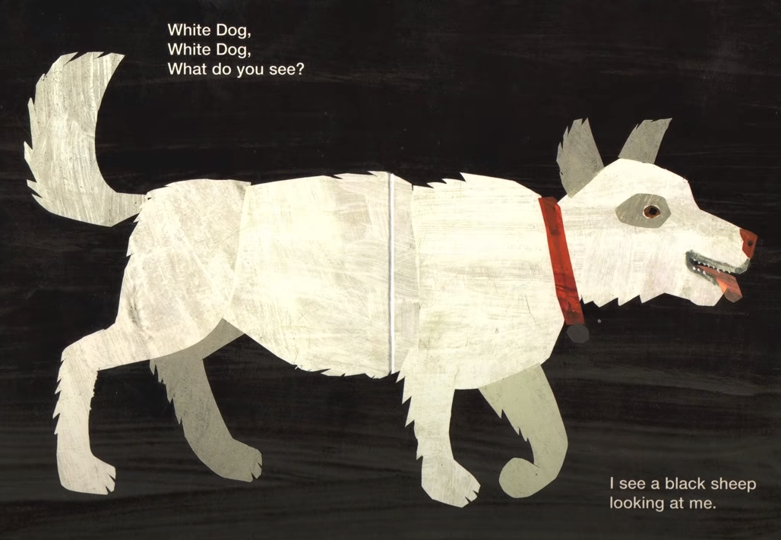

Slide 14
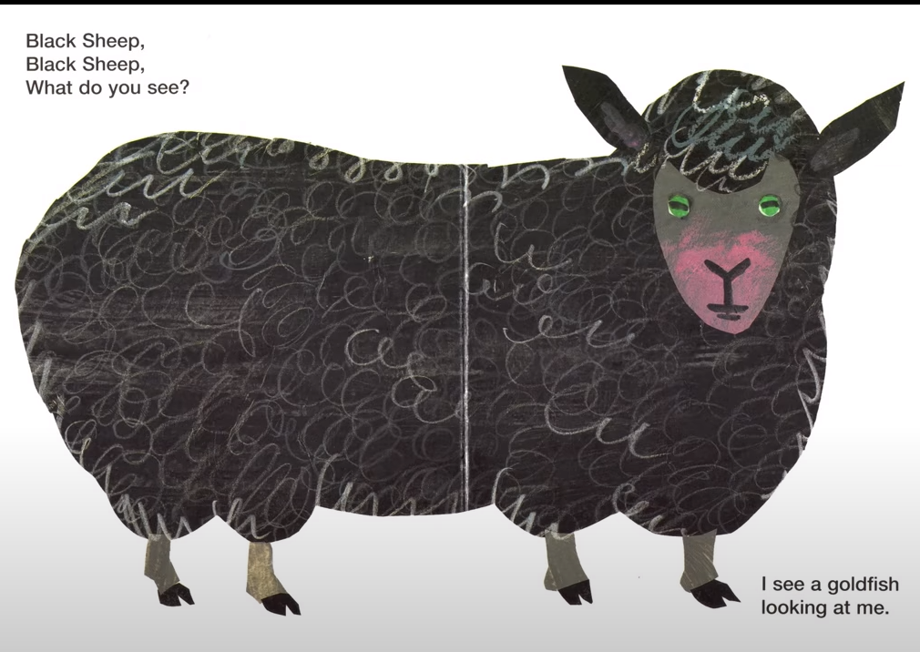

Slide 15
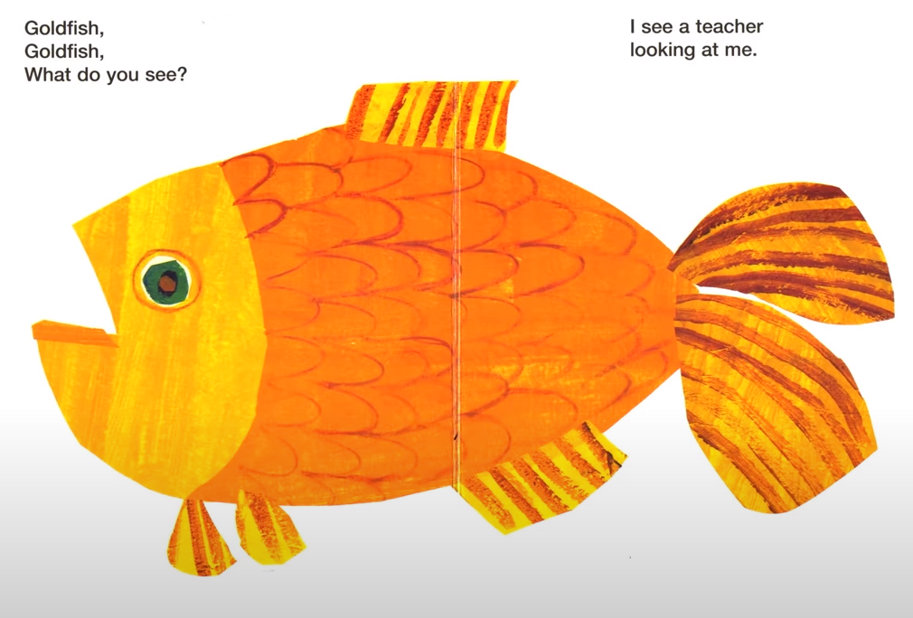
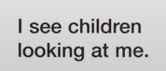

Slide 16
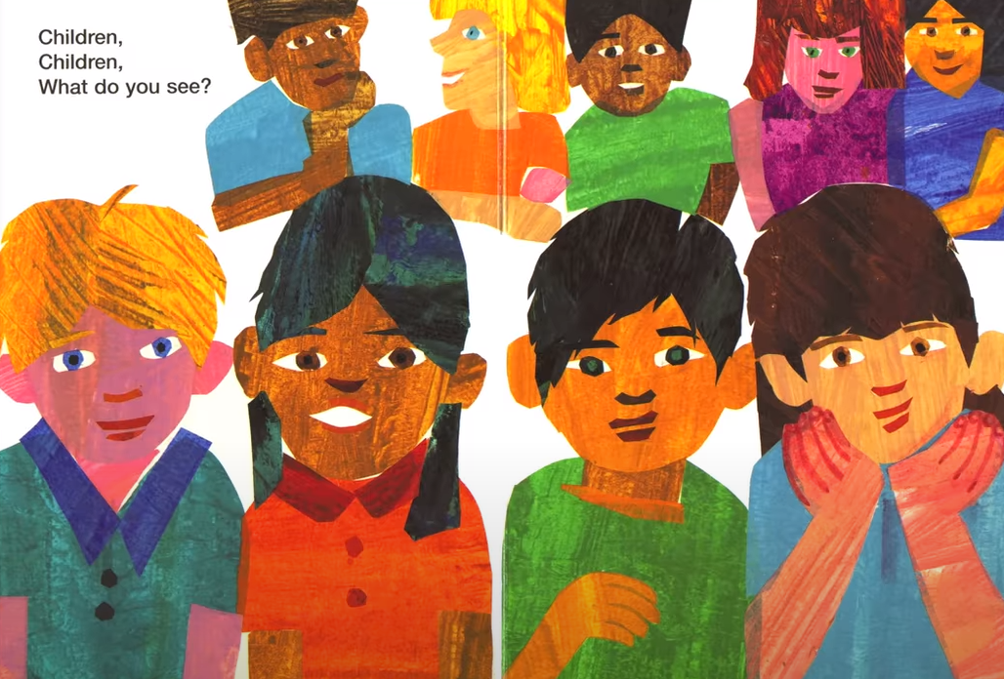

Slide 17
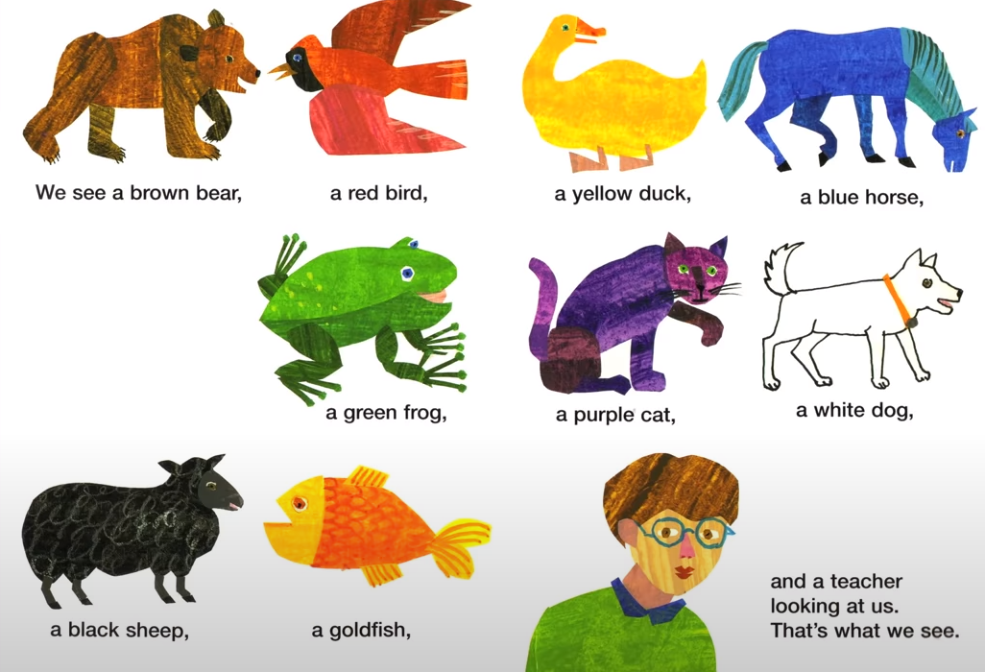

Slide 18
QUESTIONS
What happened at the end of the book? How do you know?
What did the Goldfish see? Find the sentence
What did the children see?
What other animals would they see in a zoo?
Ask if we went to the zoo what animal would you like to see?

Slide 19
WEDNESDAY-LIteracy
Read the sight words
you see a can
Recap the story from yesterday- Can you remember the animals from the story?
Watch the YouTube sing along of Brown Bear, Brown Bear.
https://www.youtube.com/watch?v=eTfqOSUyDHs

Slide 20
Thursday- Literacy - Writing
Recap the animals from the story.
Ask your child to choose an animal and encourage them to say
“ I can see a.....”
Tap the sentence on their heads, shoulders.
Then count out the words on their fingers.
Ask How many words are there in your sentence? Write the number on your page.

Slide 21
On a post it note/paper write the sight words learnt this week
you see a can
What is the first word in our sentence (I)
Encourage your child to write I independently.
What do we need next? (finger space)
What is the next word? (can)
If your child cannot write the word can, ask them to look at the post it notes and find the word can. They can then copy this word to form their sentence. Continue with this method until you've reached “a”

Slide 22
When you write the animal name
Say to your child, if you cant write a word , then we have to
“ say the word, robot the word, write the word”
Say the animal name e.g. Duck
Robot it- d-u-ck
Ask your child to have a go at writing duck using the sound mat on the next slide.
Ask them to find the d sound, then the u then the ck.

Slide 23
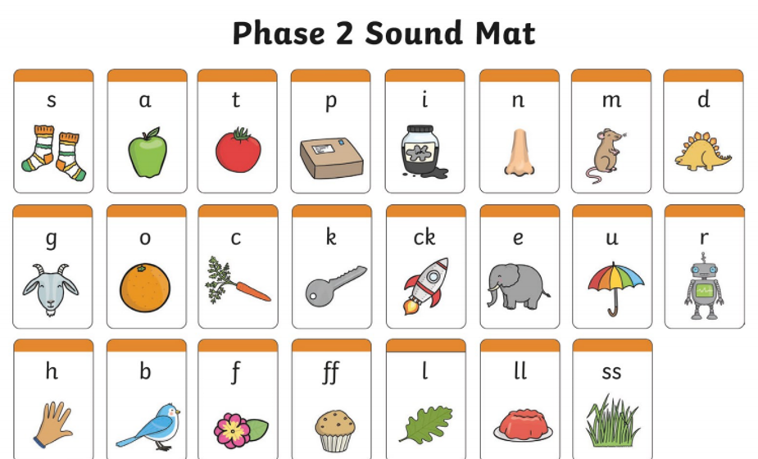

Slide 24
Once they have finished.
Ask what do we need at the end of our sentence? (full stop)
Ask your child to read their sentence.

Slide 25
Friday-Literacy
Go back to your child's work from yesterday.
Read the sentence and ask, “how can we make this sentence better?”
We can add a describing word.
Tell your child when we edit our work, we use a blue pencil crayon.
With a blue pencil crayon, add the colour of the animal in the correct place within the sentence.
e.g. I can see a yellow duck.

Slide 26
Senses
Go through the PowerPoint about senses.

Slide 27
Senses
Watch the video on textures
https://www.youtube.com/watch?v=SgjNbDyIfsQ
There are lots of different textures around us
Can you find something in your house which is
Spiky soft rough hard
Take photos or write a list using the table on the next page.

Slide 28
Touch
spiky | soft | hard | rough

Slide 29
seeing
Watch visit to the opticians.
https://www.youtube.com/watch?v=76bw4hl5n_E
Have you been to the opticians? Talk about how an optician checks our eyes.
Discuss how things can look through different colour lenses
Discuss what it is like not being able to see. Talk about guide dogs and how they help blind people walk around places.
https://www.youtube.com/watch?v=z4n0N4tj0MI

Slide 30
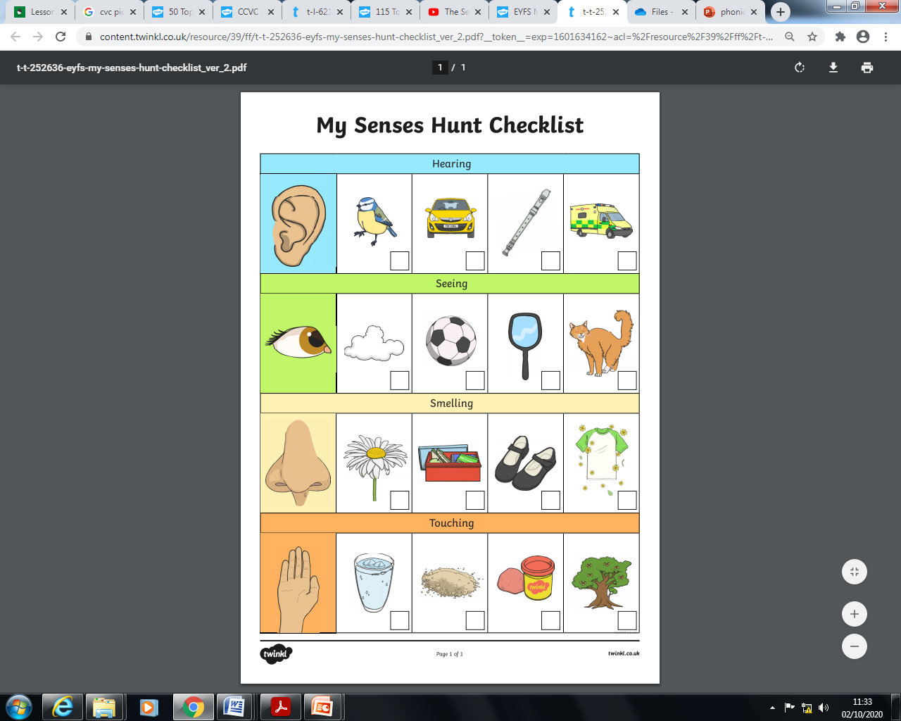
Senses Hunt- Tick the box if you can Find the objects and see or touch them

Slide 32
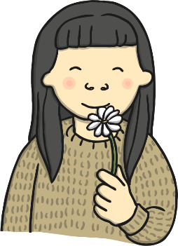


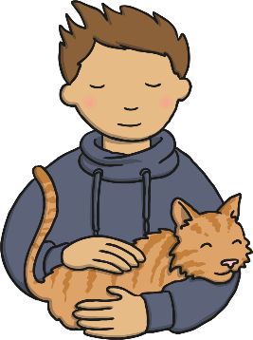
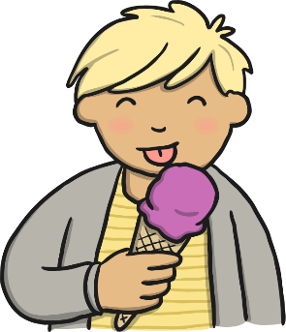
Our Senses
Your body is very clever – it is always working hard to help you learn about the things around you.
There are five main senses that your body uses everyday…
taste
smell
sight
hearing
touch
You are using your senses right now!

Slide 33




Sight
We use our eyes to see things. We can see things that are near to us and things that are far away. Some people wear glasses to help them see things more clearly.
What things have you seen today?
Can you see your friends smiling at you?

Slide 34

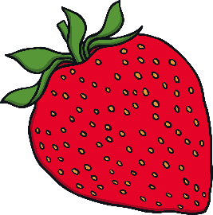
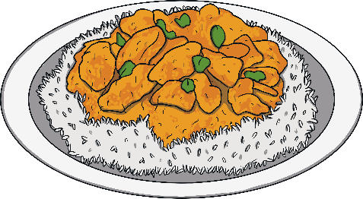


Taste
We use our mouths and tongues to taste food and drinks. We can tell if things taste bitter, salty, sweet or sour. Everyone has foods they like and foods they dislike!
Which foods do you like the taste of?
What tastes do you not like?

Slide 35
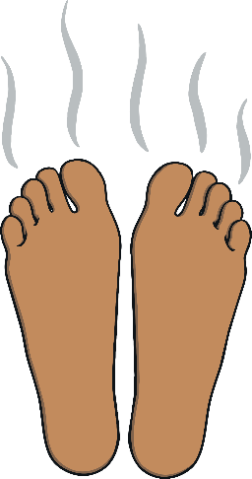

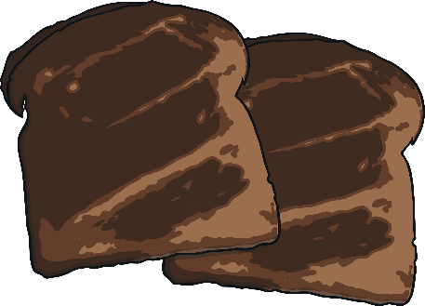
Smell
We use our noses to smell things. Noses can detect things that smell nice, such as flowers and cakes baking in the oven. However, noses can also detect nasty smells, such as a rubbish bin or old socks!
Which smells do you like?
Which smells are not nice?

Slide 36
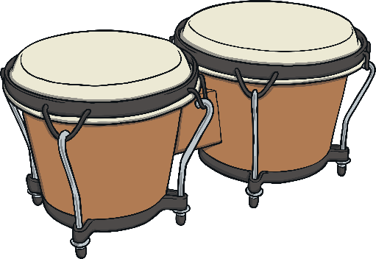
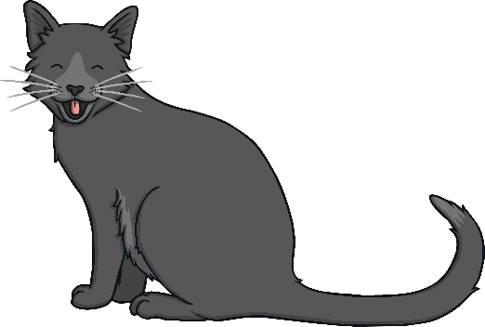
Hearing
We use our ears to hear sounds. Some sounds are loud and some are quiet. For example, fire alarms are loud, but someone whispering is quiet. Even when you are sleeping, your ears will be busy listening to hear what is going on around you. Some people use hearing aids to help them hear more clearly.
What sounds have you heard today?
Were they loud or quiet?

Slide 37

Which senses have you used today?

Slide 38
Physical Development
Using playdough, ask your child to follow the moves on “Dough Disco”
https://www.youtube.com/watch?v=3K-CQrjI0uY
You can find recipes online or use the one below
You will need
8 tbsp plain flour
2 tbsp table salt
60ml warm water
food colouring
1 tbsp vegetable oil
Method
1. Mix the flour and salt in a large bowl. In a separate bowl mix together the water, a few drops of food colouring and the oil.
2. Pour the coloured water into the flour mix and bring together with a spoon.
3. Dust a work surface with a little flour and turn out the dough. Knead together for a few minutes to form a smooth, dough.
4. Store in a plastic sandwich bag (squeeze out the air) in the fridge to keep it fresh.

Slide 39
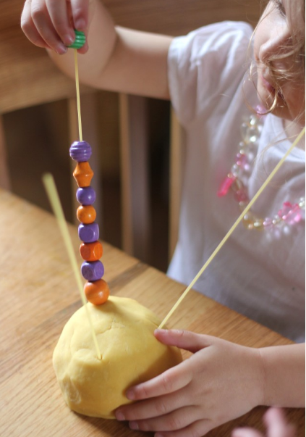
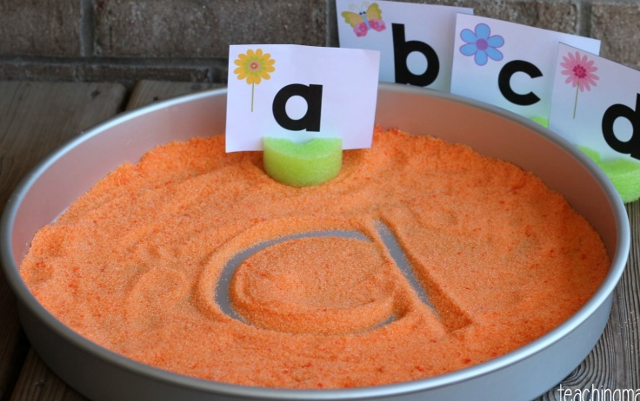
Fine motor skills activity
Put spaghetti in some dough and ask your child to to thread beads, or weetos cereal, pasta through it.
Link to Maths- Give your child a number and ask them to bead e.g. 8 weetos.
You can also ask your child to make patterns-
In a tray put some sand/ salt flour
Ask your child to use their fingers to write letters/ numbers

Slide 40
Fine motor skills activity
Put spaghetti in some dough and ask your child to to thread beads, or weetos cereal, pasta through it.
Link to Maths- Give your child a number and ask them to bead e.g. 8 weetos.
You can also ask your child to make patterns-
In a tray put some sand/ salt flour
Ask your child to use their fingers to write letters/ numbers

Slide 41
Maths
Watch the numberblock 4 song
https://www.bbc.co.uk/cbeebies/watch/numberblocks-the-four-song
Can you say whether the objects on the next slide show 4 or not?

Slide 42
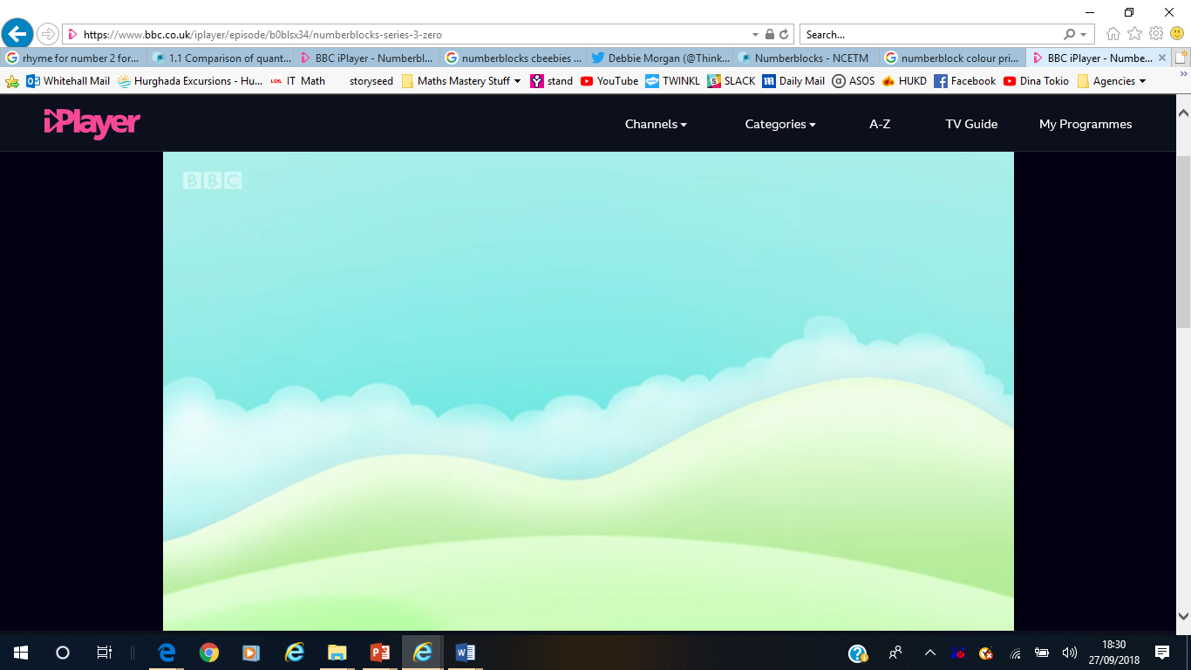
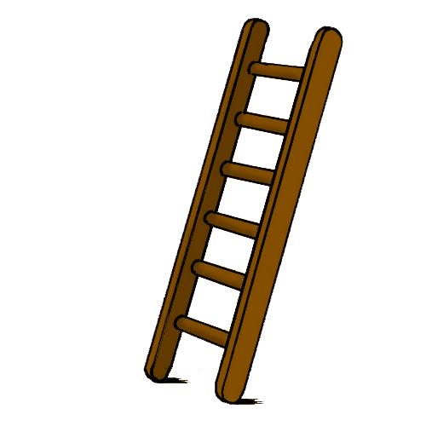
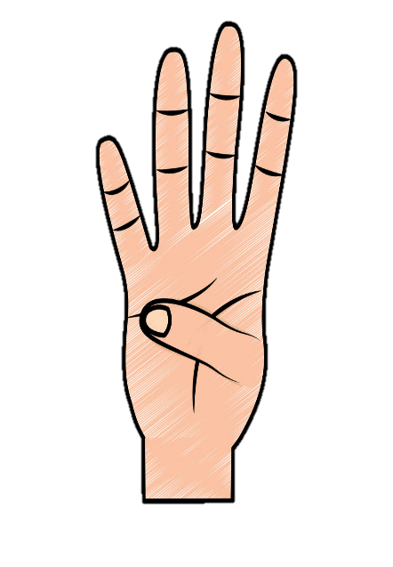
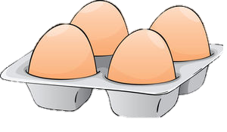

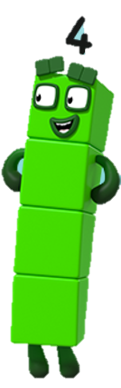
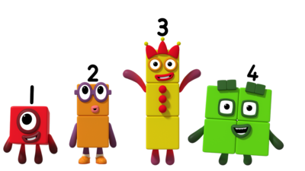



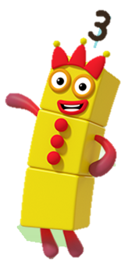


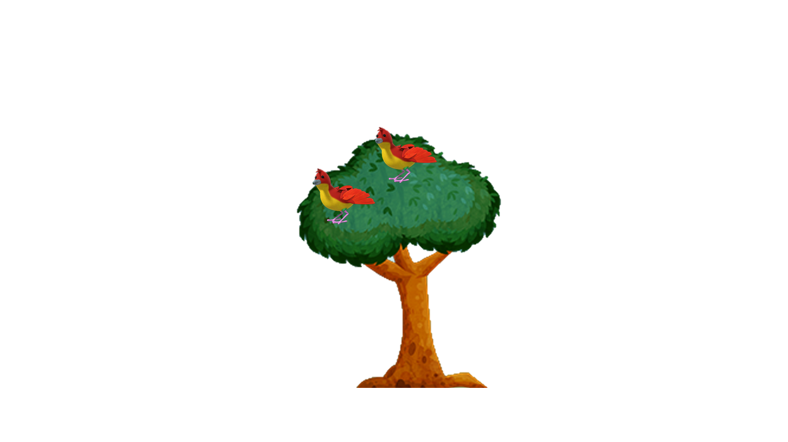
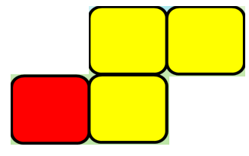
Not

Slide 43
Watch the lesson about number 4
https://classroom.thenational.academy/lessons/develop-an-understanding-about-the-number-four-cmu3cr

Slide 44
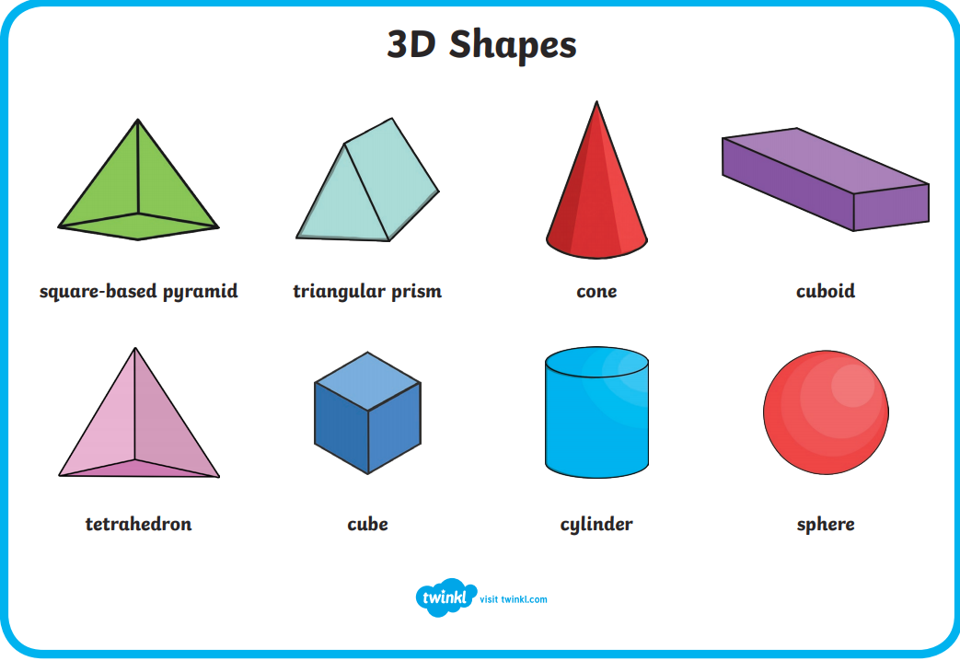
3D SHAPES
Go through the 3D shapes

Slide 45
3d shapes
Print out the worksheet on 3D shapes and ask your child to sort and stick the objects under the right heading.

Slide 46
Addition
Use objects and make addition number stories
Introduce the word add
What does add mean?
e.g. Brown bear saw 2 birds and 3 ducks. How many animals did he see altogether?
2 + 3= 5

Slide 47
Don’t forget to send us all the learning you have done at home on
reception@whitehall.Leicester.sch.uk

