Slide 1
5th October 2020

Slide 2
Our reading strategies
As you read with your child, use the following strategy to help your child to work out the animal words.
“I can look at the first letter, make the sound and cross check with the picture”

Slide 3
READING
Please read with your child everyday and ask them questions about what they have read.
Visit www.oxfordowl.co.uk for books to read with your child.

Slide 4
Literacy- Monday
Read the sight words
you in my

Slide 5

Polar bear, polar bear
Read the title of the book twice then ask your child to read it.
Ask “ What can you see on the front cover?”
Ask “What do you think the book is about?” Encourage them to use the sentence “I think the book is about....”

Slide 6
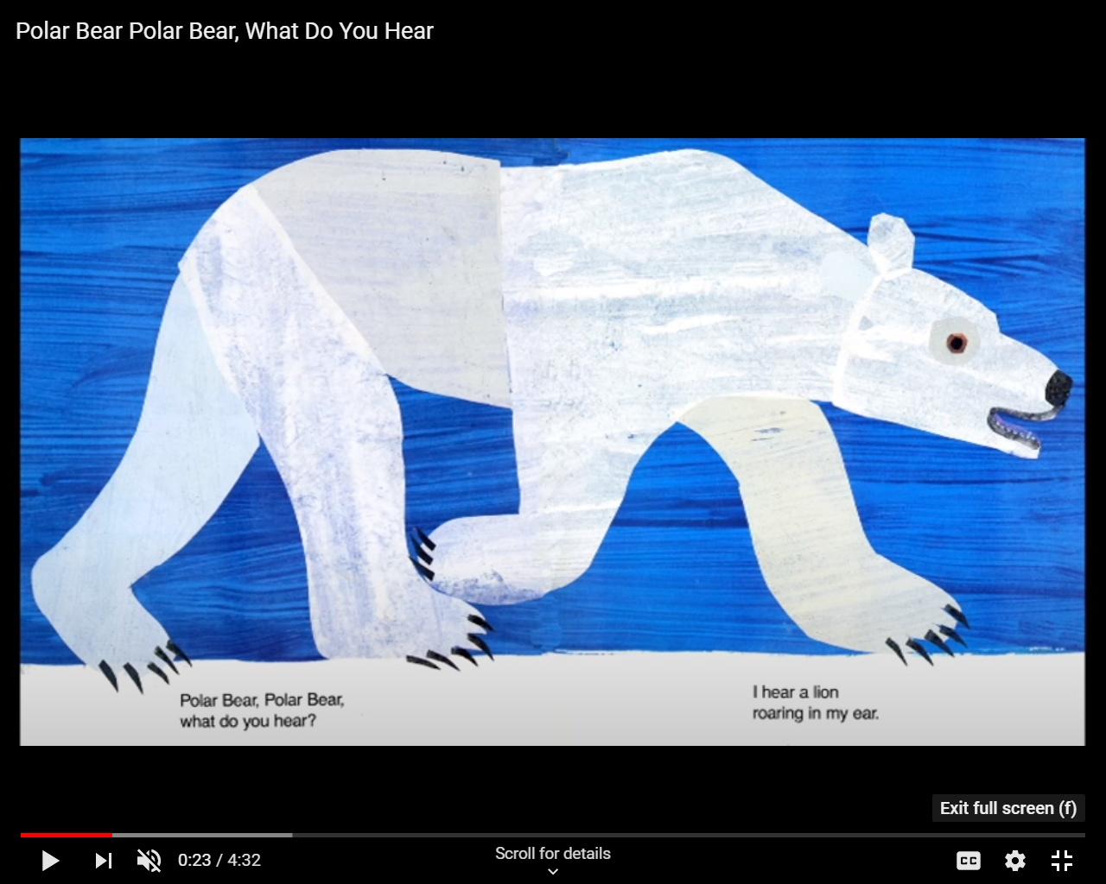
Polar Bear, polar Bear, I hear a lion
What do you hear? roaring in my ear.
Say I can’t read this word. What can I do?
Encourage them to say the following strategy
“I can look at the first letter, make the sound and cross check with the picture”
Model to your child. Look at the first letter of Polar and say the sound (p) cross check with the picture and say polar. This word says polar. Continue this as you read the rest of the book.

Slide 7
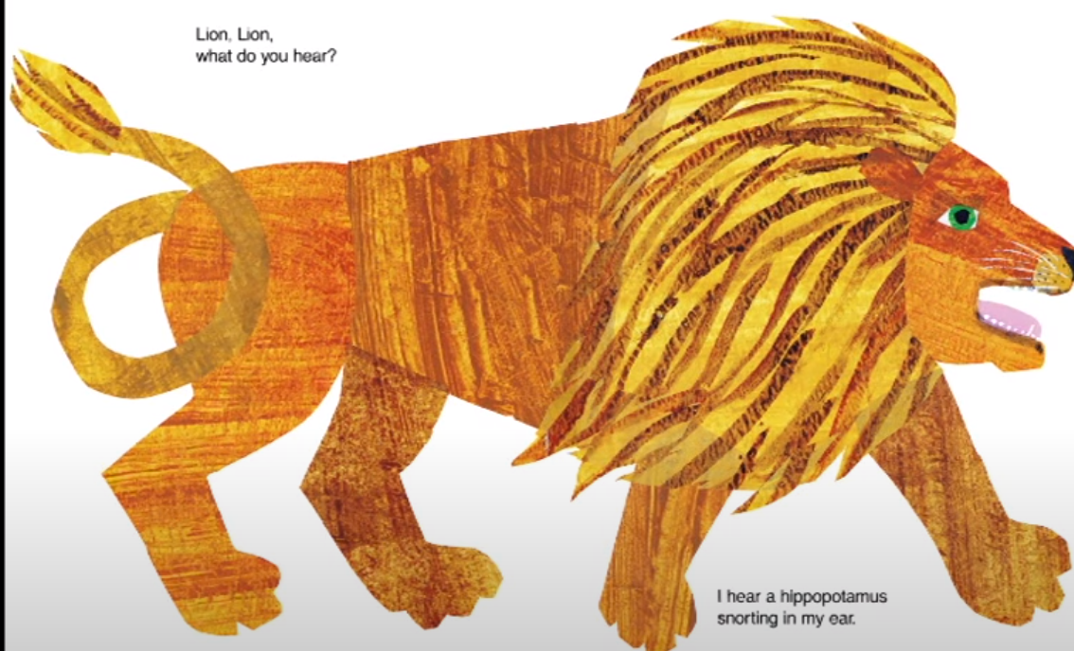
Lion, Lion,
What do you hear?
I hear a hippopotamus snorting in my ear.
Find the sight word “you”

Slide 8
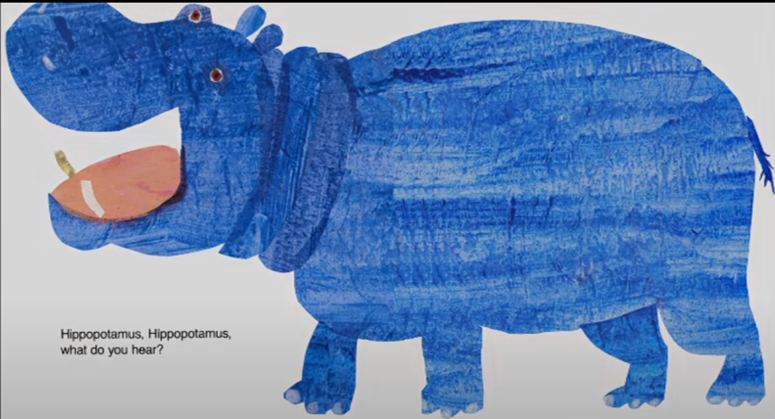
Hippopotamus, Hippopotamus,
What do you hear?
I hear a flamingo fluting in my ear.
Find the sight word “in”

Slide 9
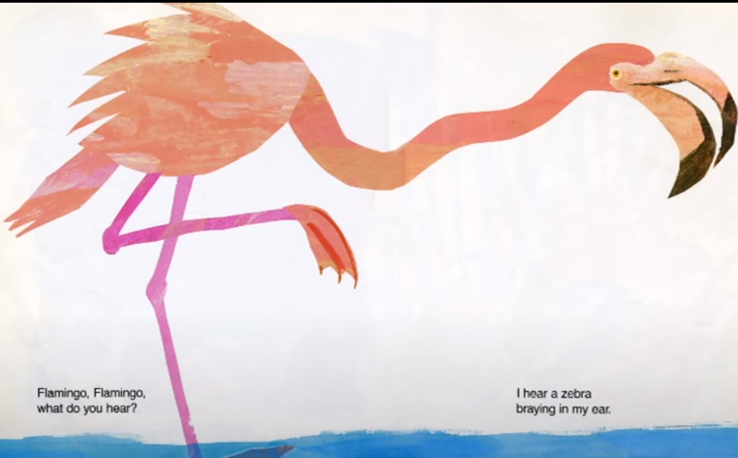
Flamingo, Flamingo,
What do you hear?
I hear a zebra
braying in my ear.
Find the sight word “my”

Slide 10
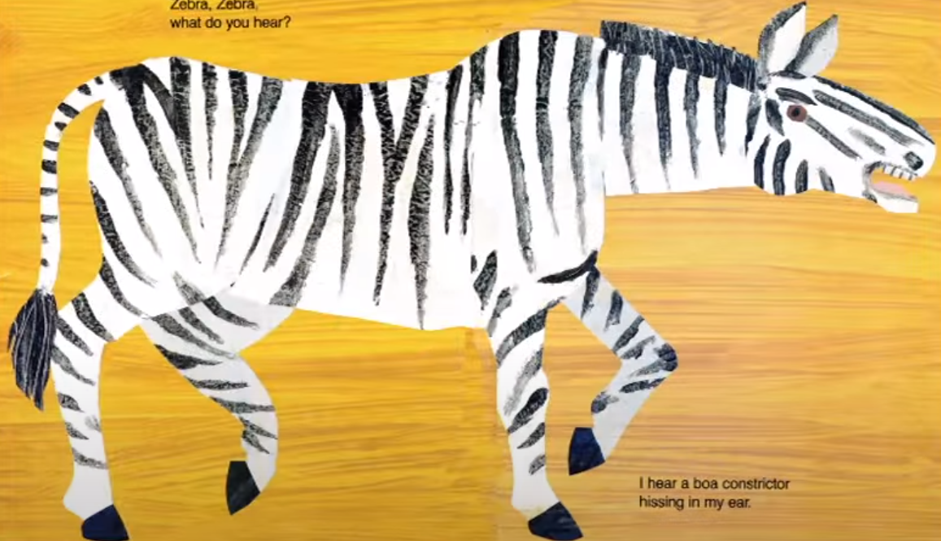
Zebra, Zebra
What do you hear?
I hear a boa constrictor
hissing in my ear.
Find the sight word “you”

Slide 11
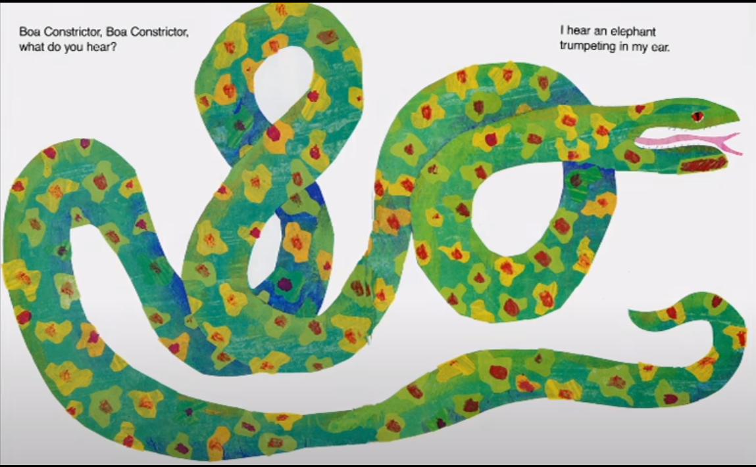
Boa constrictor, Boa constrictor,
What do you hear?
I hear an elephant
trumpeting in my ear.
I hear a boa constrictor
hissing in my ear.
Find the sight word “in”

Slide 12
Questions
What noise does a lion make? Find the word
What animal came after the zebra? Find the word.
What did the hippopotamus hear? Find the sentence
What did the flamingo hear? Find the sentence

Slide 13

Phonics- rhyming
Talk about rhyming.
Rhyming is when the first sound changes but the ending stays the same.
E.g. Cat, hat, bat, mat
Go through the YouTube videos about rhyming.
https://www.youtube.com/watch?v=3Cc1TL-0bXo
https://www.youtube.com/watch?v=JHroOYO1iOo
Notes:
Hello,
Today we are going to be segmenting and blending some words. Are you ready?
Look at the first picture. It is a cat
My turn cat- your turn
Well done.
Now we are going to robot the words
My turn c-a-t – cat – your turn
Were going to play a game
I am going to robot a word and you have to blend the sounds together and find the correct object.
Are you listening- Get your blending hand ready
J- a – m? What word am i trying to say j-a-m?
Well done if you got jam!

Slide 14
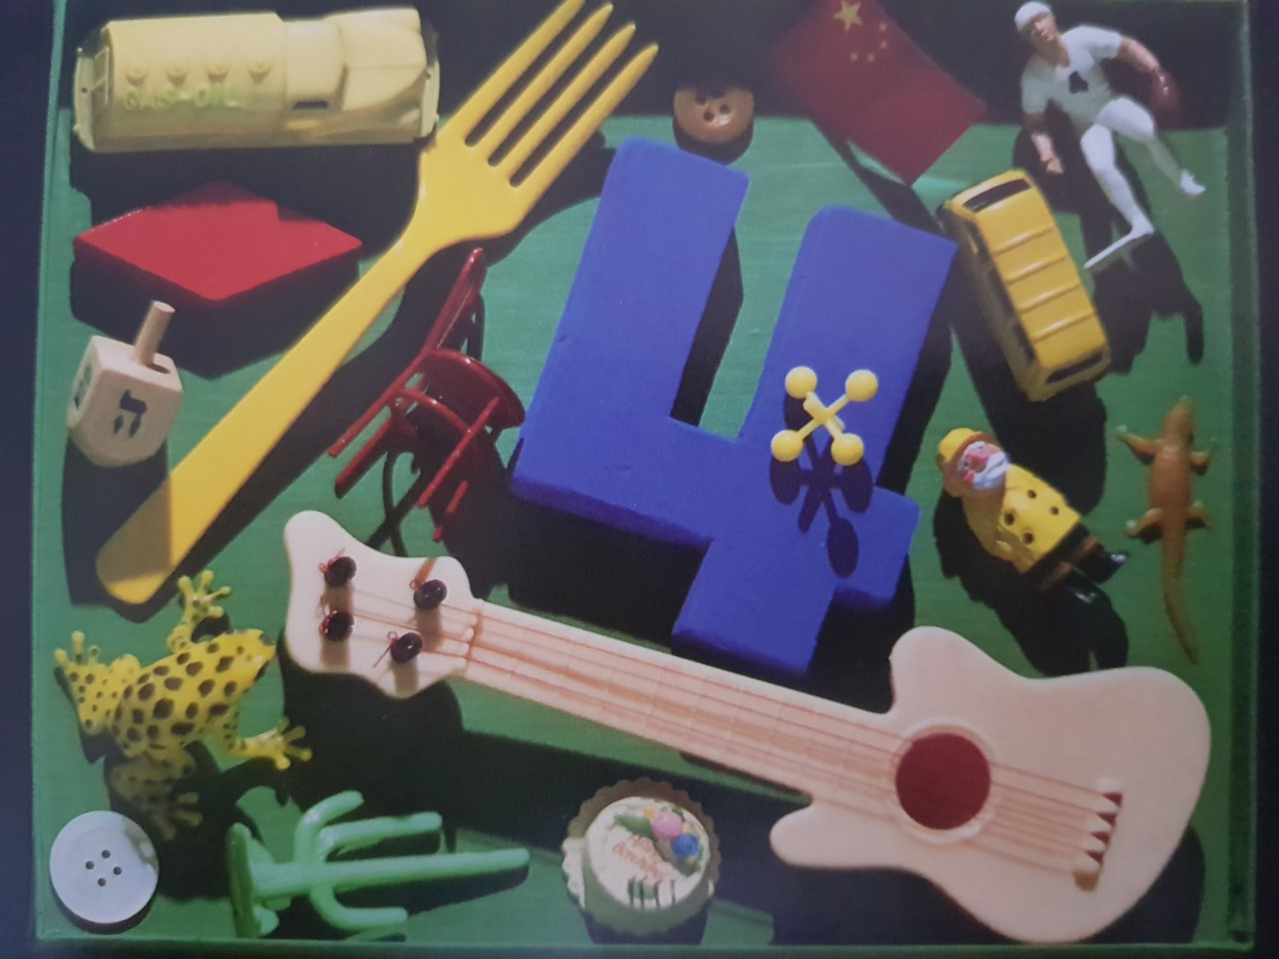
Maths- i spy- Monday
What can you see that has 4?

Slide 15
Maths- counting
Can you match the correct quantity to the numeral?

Slide 16
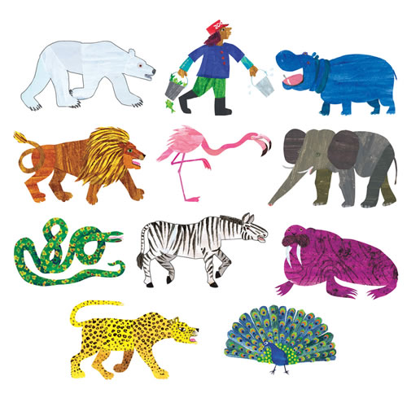
2
3
1
4

Slide 17
2
3
1
4

Slide 18
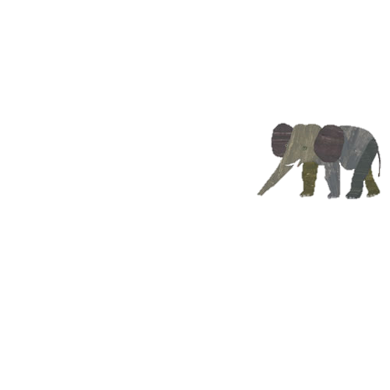
4
3
1
2

Slide 19
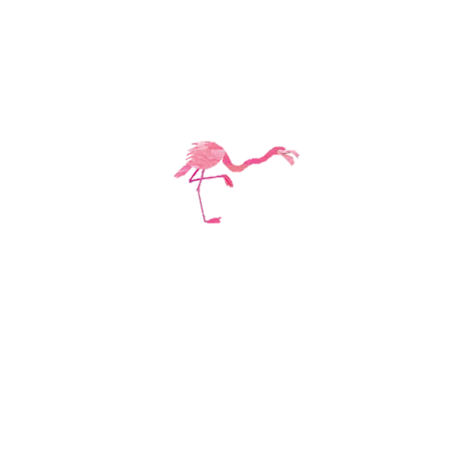
2
3
1
4

Slide 20
2
1
4
3

Slide 21
1
2
3
4

Slide 22
1
4
3
2

Slide 23

1
4
3
2

Slide 24
Literacy- Tuesday
Read the sight words
you in my
Recap the story from yesterday

Slide 25
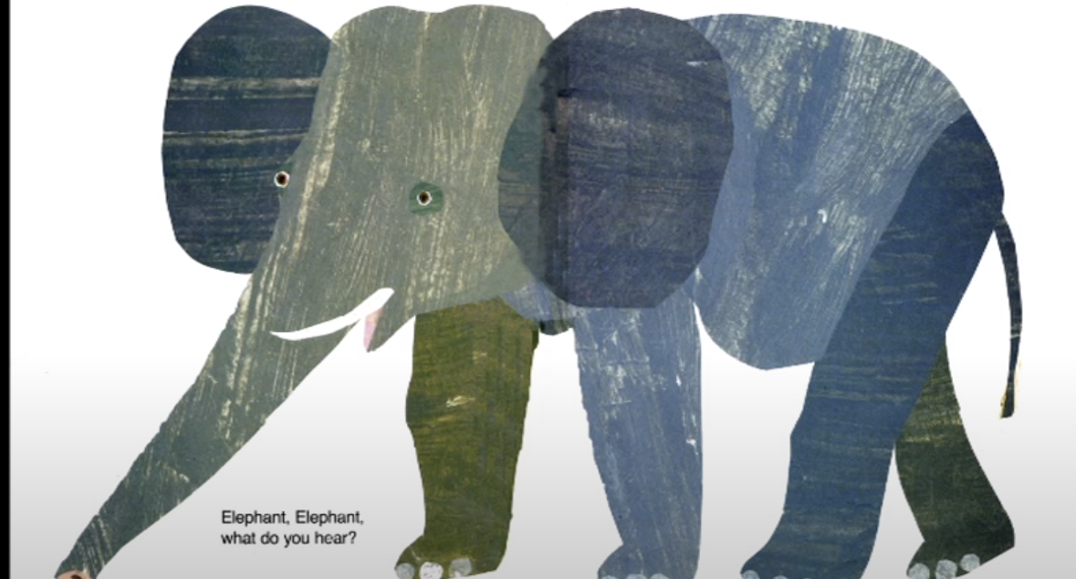
Elephant ,Elephant,
What do you hear?
I hear an leopard
snarling in my ear.

Slide 26
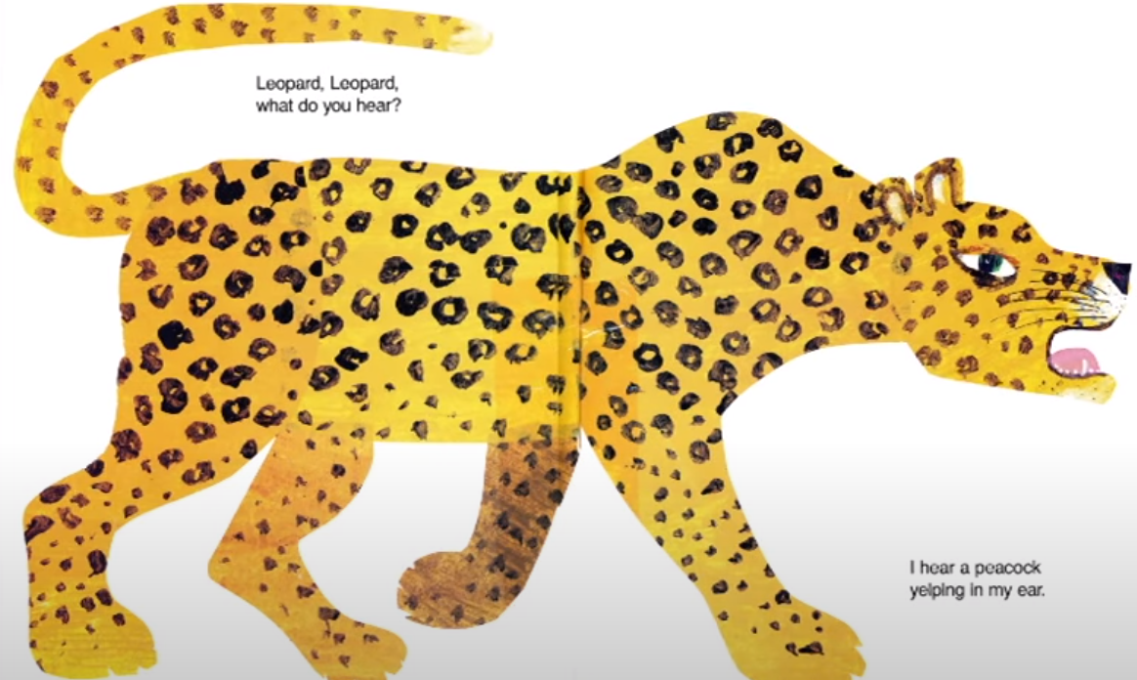
Leopard, Leopard,
What do you hear?
I hear a peacock
yelping in my ear.

Slide 27
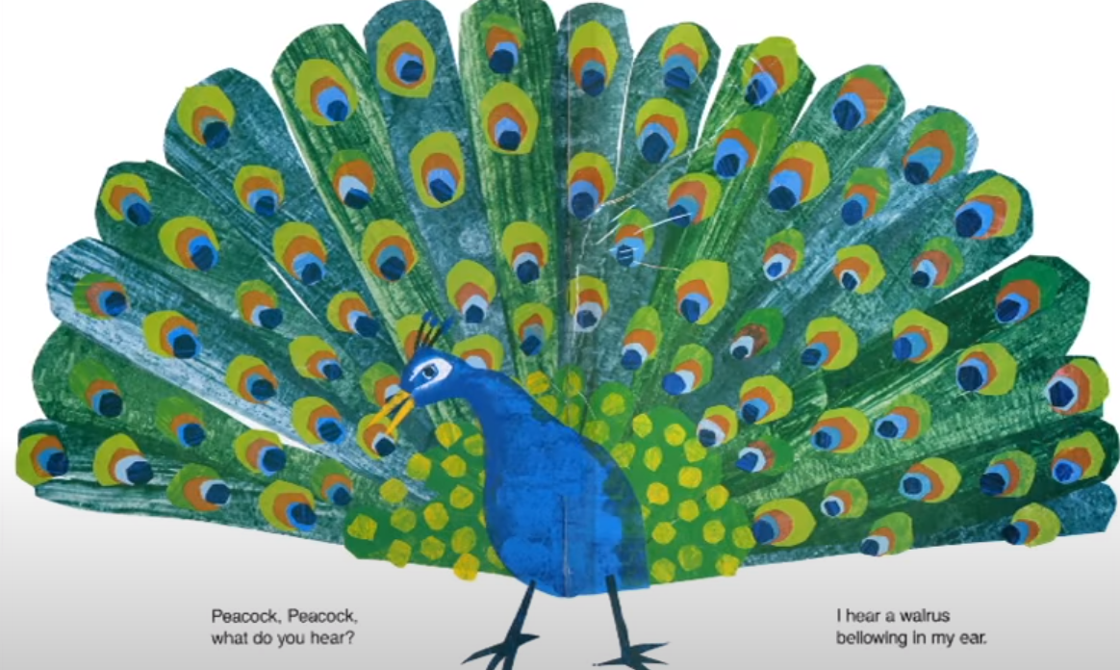
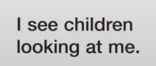
Peacock, Peacock,
What do you hear?
I hear a walrus
bellowing in my ear.

Slide 28
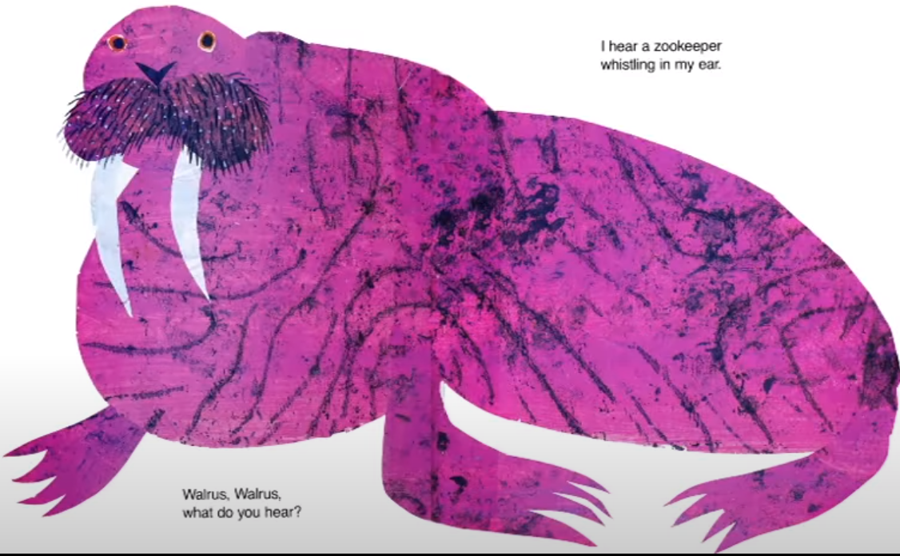
I hear a zookeeper
whistling in my ear.
Walrus, Walrus,
What do you hear?

Slide 29
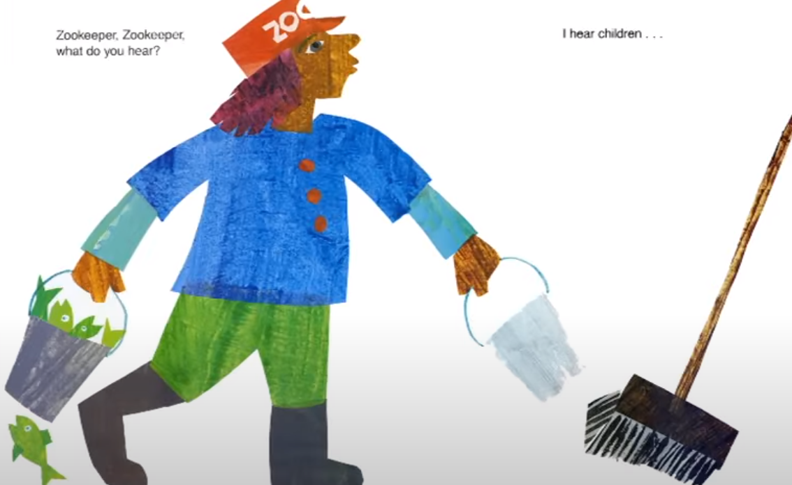
Zookeeper, Zookeeper,
What do you hear?
I hear children ....

Slide 30
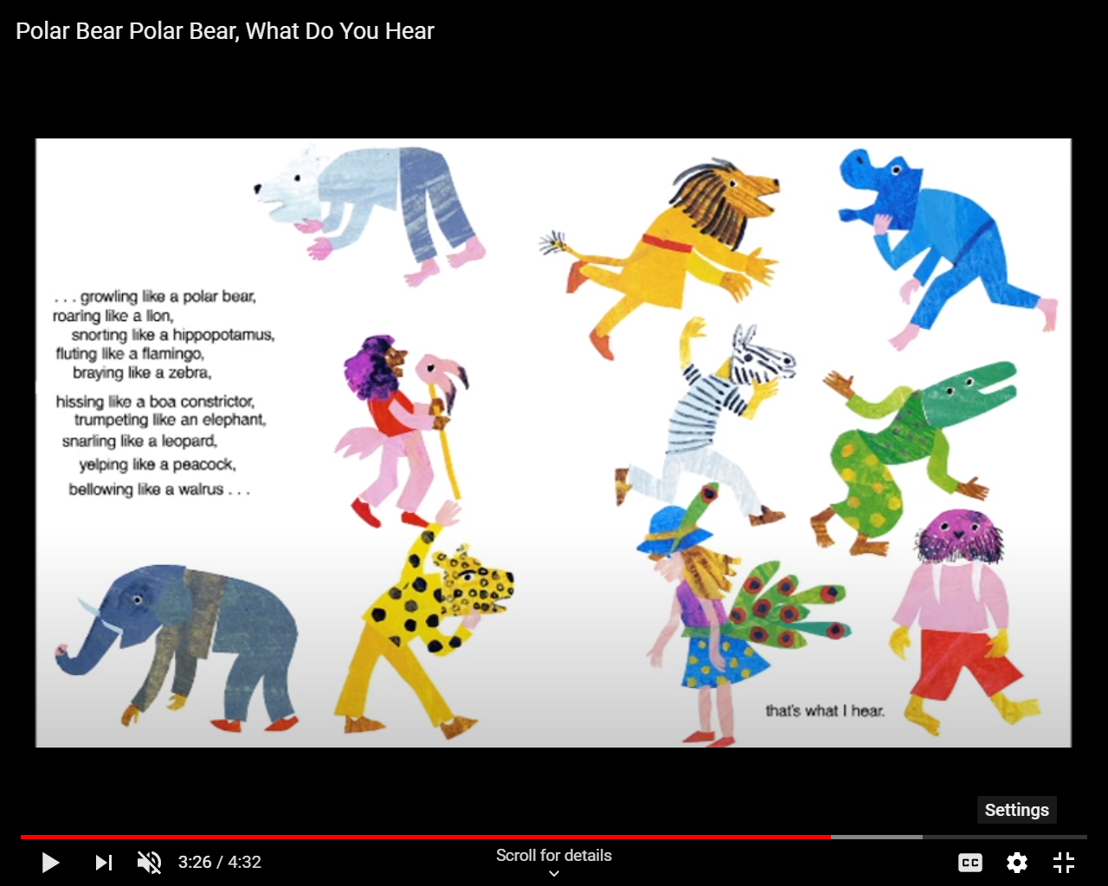

Slide 31
QUESTIONS
What did the Walrus see? Find the sentence
What noise did the hippo make? Find the word
What did the zookeeper see?

Slide 32
Maths lesson- number 4- Tuesday
https://classroom.thenational.academy/lessons/count-four-objects-reliably-75jk4r?activity=video&step=1

Slide 33
Phonics- Alliteration
Complete the phonics lesson with Miss Patel on Alliteration

Slide 34
WEDNESDAY-LIteracy
Read the sight words
you in my
Recap the story from yesterday- Can you remember the zoo animals from the story?
Ask if they went to the zoo what animal would they hear?
Watch the YouTube story of Polar Bear, Polar Bear
https://www.youtube.com/watch?v=ctQjLfMKinU

Slide 35
Maths- Adding- WEdnesday
Go through the next few slides
Today we are going to be adding
How many fireworks can you see first? E.g.2
How many more fire works appeared? E.g. 2 more
How many altogether? 4
How did you know there are 4 altogether? (Counting)
Say 2 add 2 equals four
Ask your child to repeat the sentence
Let them have a go at the next one by themselves

Slide 36
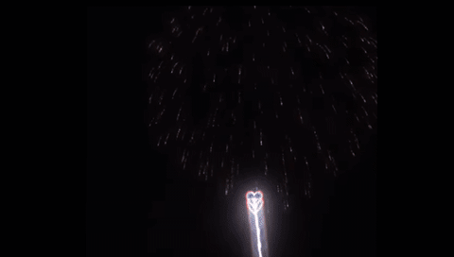
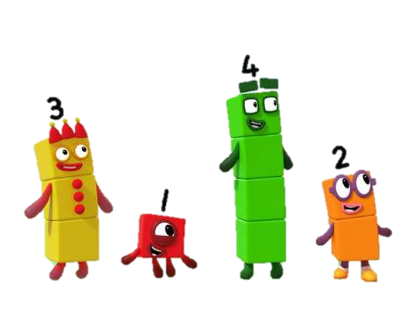


Slide 37


Slide 38



Slide 40
Wednesday
Phonics- Blending anD segmenting
Complete the phonics lesson with Miss Patel on ‘Oral blending and segmenting 1’

Slide 41
Thursday- Literacy - Writing
Recap the animals from the story.
Ask your child to choose an animal and encourage them to say
“ I hear a........ In my ear”
Tap the sentence on their heads, shoulders.
Then count out the words on their fingers.
Ask How many words are there in your sentence? Write the number on your page.

Slide 42
On a post it note/paper write the sight words learnt this week
you in my
What is the first word in our sentence (I)
Encourage your child to write I independently.
What do we need next? (finger space)
What is the next word? (can)
If your child cannot write the word can, ask them to look at the post it notes and find the word can. They can then copy this word to form their sentence.

Slide 43
When you write the animal name
Say to your child, if you cant write a word , then we have to
“ say the word, robot the word, write the word”
If it is a long word- you can chunk the word
e.g. Flamingo – flam-in-go
Use the mat and have a go at writing the animal name

Slide 44
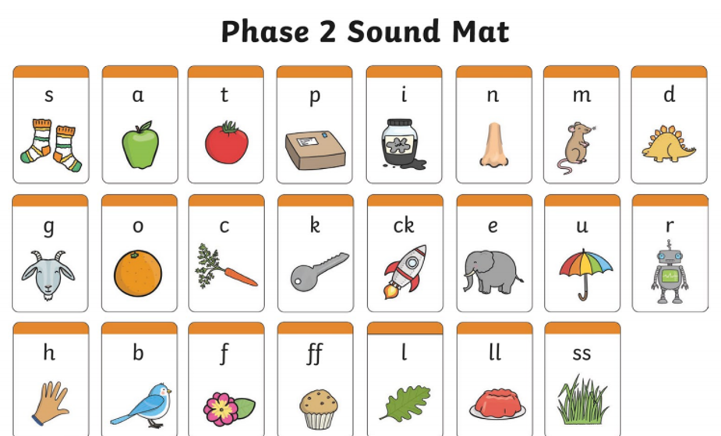

Slide 45
Once they have finished.
Ask what do we need at the end of our sentence? (full stop)
Ask your child to read their sentence.

Slide 46
Thursday
Phonics- Blending anD segmenting
Complete the phonics lesson with Miss Patel on ‘Oral blending and segmenting 2’

Slide 47
Thursday- Number stories
Using manipulatives create a number story with your child.
E.g.
The zoo keeper was walking through the zoo. He heard 3 elephants trumpeting (have them in one group) and 2 lions roaring (another group)
How many animals did he hear altogether?
What do you think altogether means?
3 elephants trumpeting add 2 lions roaring (move the lions to show altogether) makes 5 animals altogether.
The zoo keeper heard 5 animals altogether
What could I do to check? (Counting)
Repeat with other examples and then ask your child to create a story.

Slide 48
Friday-Literacy
Go back to your child's work from yesterday.
Read the sentence and ask, “how can we make this sentence better?”
We can add a describing word.
Tell your child when we edit our work, we use a blue pencil crayon.
With a blue pencil crayon, add the colour of the animal in the correct place within the sentence.
e.g. I can hear a scary lion roaring in my ear.

Slide 49
Friday 3D shapes
Recap what 3D shapes are.
3D shapes are ‘fat’ shapes. They are solid.
Most of the things around us are 3D
See next slide for 3D shapes

Slide 50
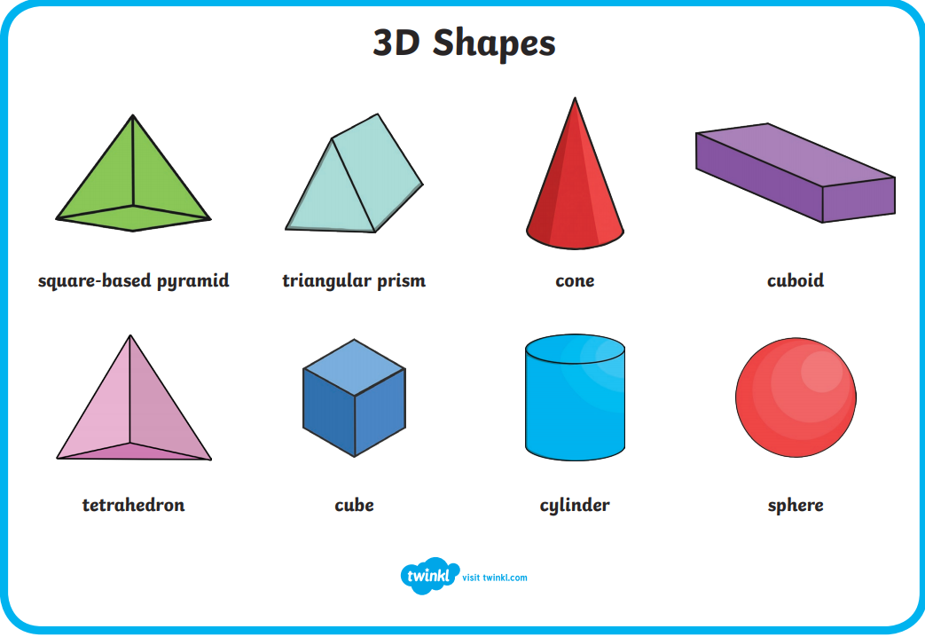

Slide 51
FRiday
Phonics- Blending anD segmenting
Complete the phonics lesson with Miss Patel on ‘Oral blending and segmenting 3’

Slide 52
Cube, Cuboid, Sphere
Find something which is a cube shape in the house. Show your child and say this is a cube. It is a 3D shape
Talk about faces, corners,
E.g. cube has 6 square faces. It has 8 corners and 12 sides/edges
Ask your child to find objects that is a cube
Repeat with Cuboid ( 12 edges/corners, 4 rectangular faces and 2 square faces and 8 corners)
Sphere (0 corners and 1 curved edge)

Slide 53

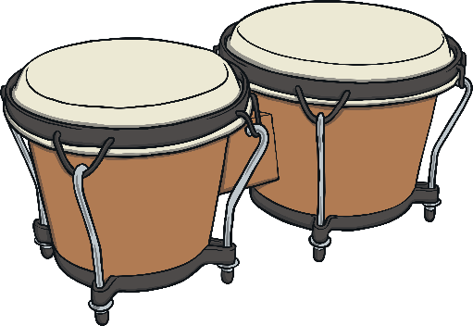
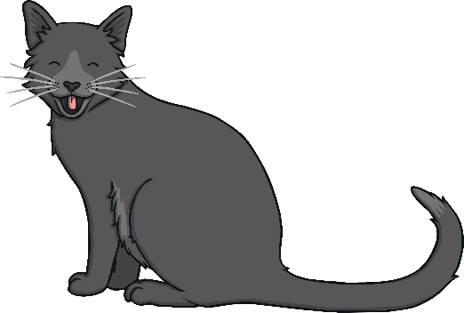
Senses- Hearing
We use our ears to hear sounds. Some sounds are loud and some are quiet. For example, fire alarms are loud, but someone whispering is quiet. Even when you are sleeping, your ears will be busy listening to hear what is going on around you. Some people use hearing aids to help them hear more clearly.
What sounds have you heard today?
Were they loud or quiet?

Slide 54
Senses
Watch the video on hearing
https://www.youtube.com/watch?v=fOMBzdzh6tQ
Talk about how we listen with our ears and people who cant hear are called deaf.

Slide 55
HEaring
Write a list or take photos of all the things you can hear at home or outside

Slide 56
Art and design
Make shakers using empty milk bottles/Pringles boxes. Fill with rice, sand, kidney beans, cotton wool etc
To use a variety of household items, boxes, corrugated card, foil, bags, tubs, pans etc to make sounds and then playing them quietly and loudly.

Slide 57
Physical Development
Using playdough, ask your child to follow the moves on “Dough Disco”
https://www.youtube.com/watch?v=3K-CQrjI0uY
You can find recipes online or use the one below
You will need
8 tbsp plain flour
2 tbsp table salt
60ml warm water
food colouring
1 tbsp vegetable oil
Method
1. Mix the flour and salt in a large bowl. In a separate bowl mix together the water, a few drops of food colouring and the oil.
2. Pour the coloured water into the flour mix and bring together with a spoon.
3. Dust a work surface with a little flour and turn out the dough. Knead together for a few minutes to form a smooth, dough.
4. Store in a plastic sandwich bag (squeeze out the air) in the fridge to keep it fresh.

Slide 58
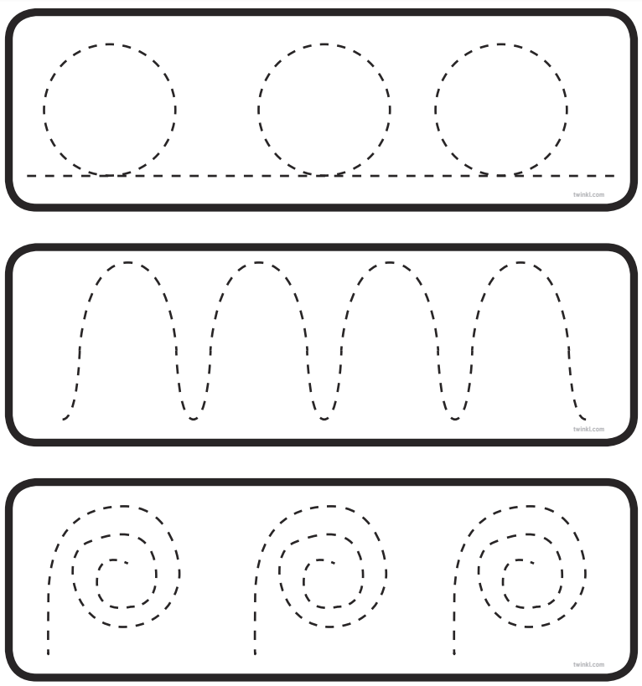
Fine motor skills activity
Print out this page and follow the lines

Slide 59
Fine motor skills -cutting
Print the following pages and ask your child to cut along the line

Slide 60
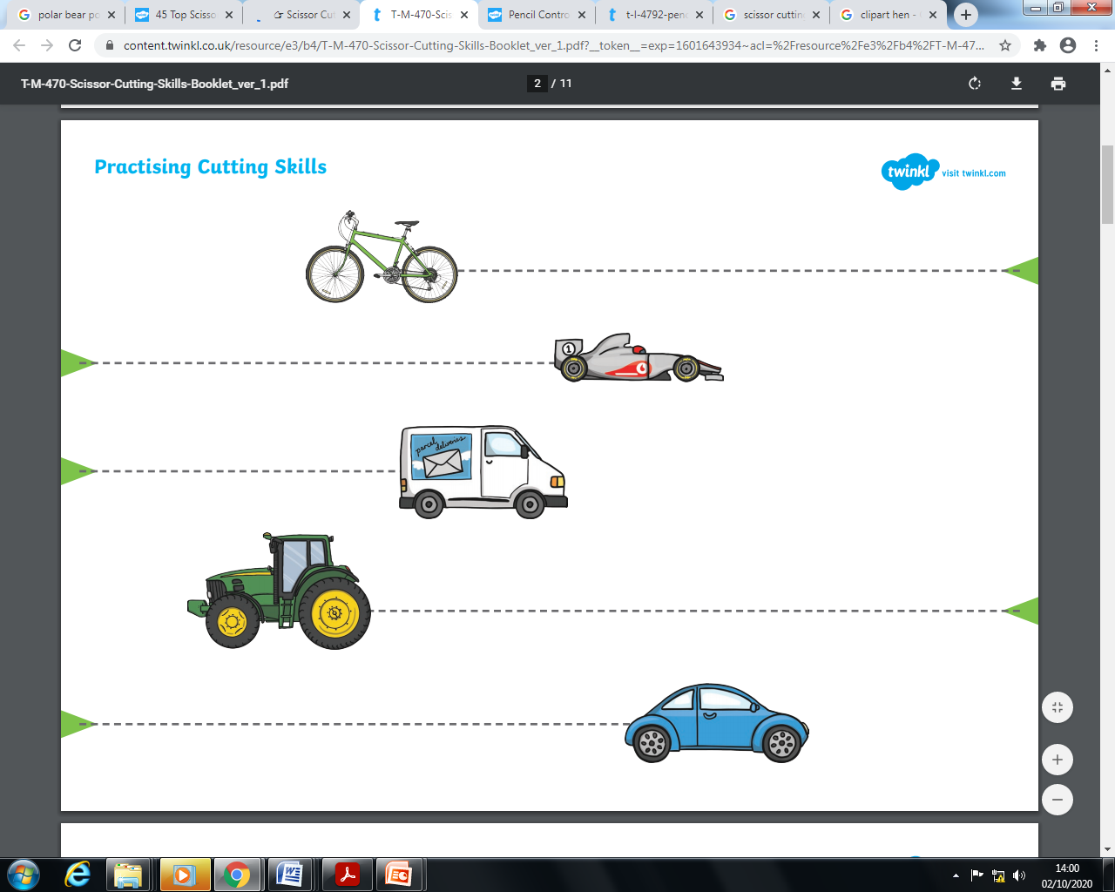

Slide 61
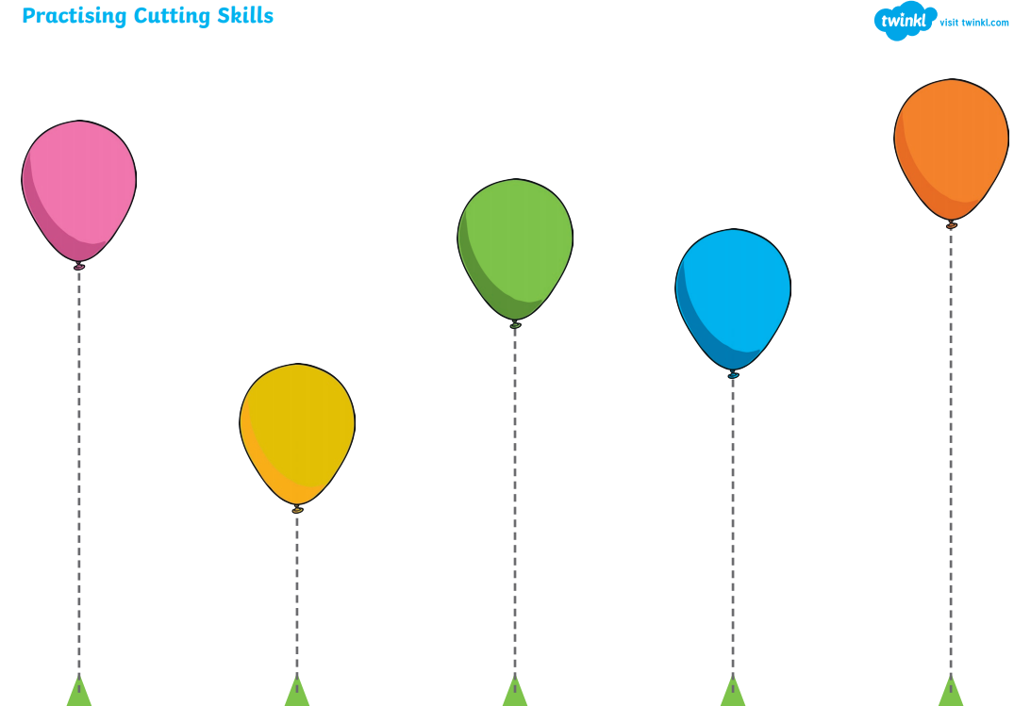

Slide 62
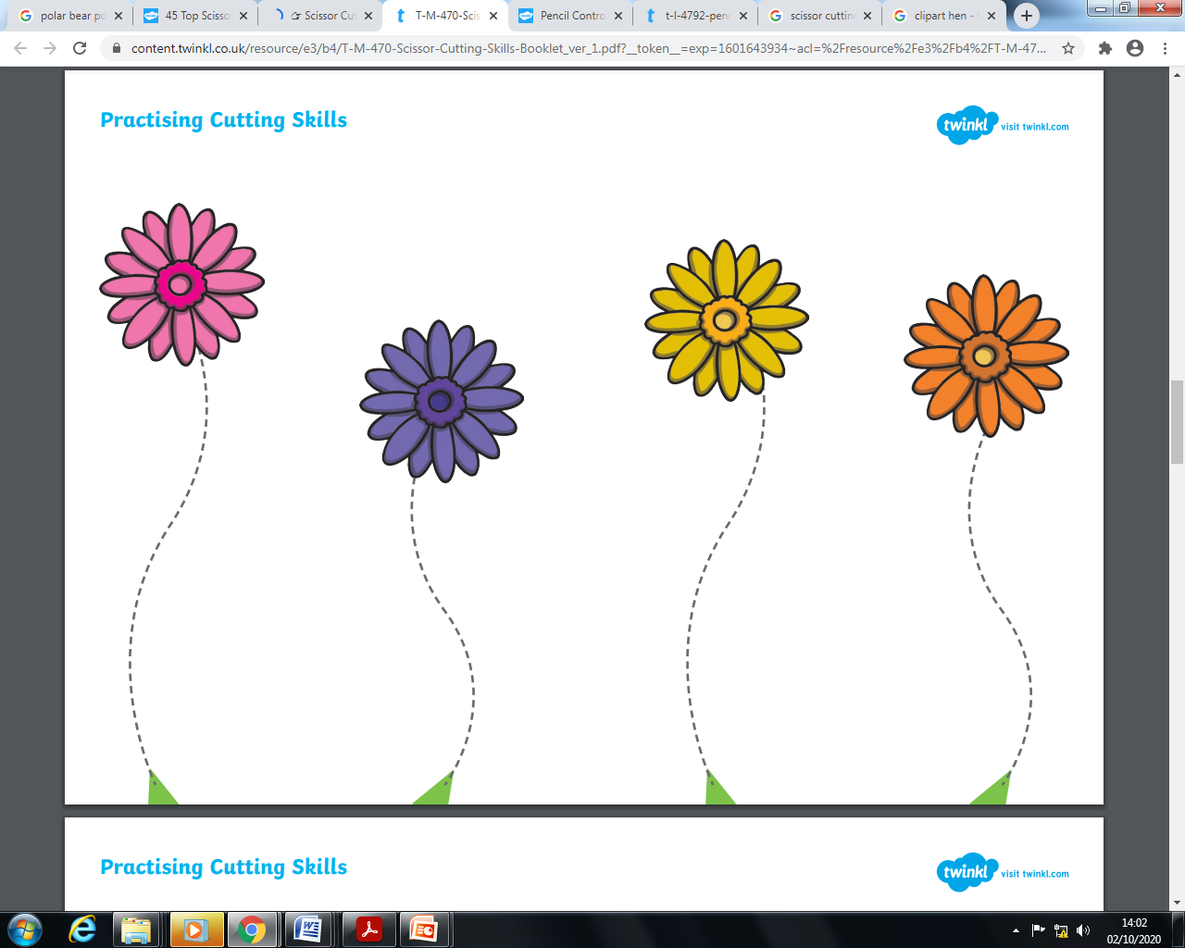

Slide 63
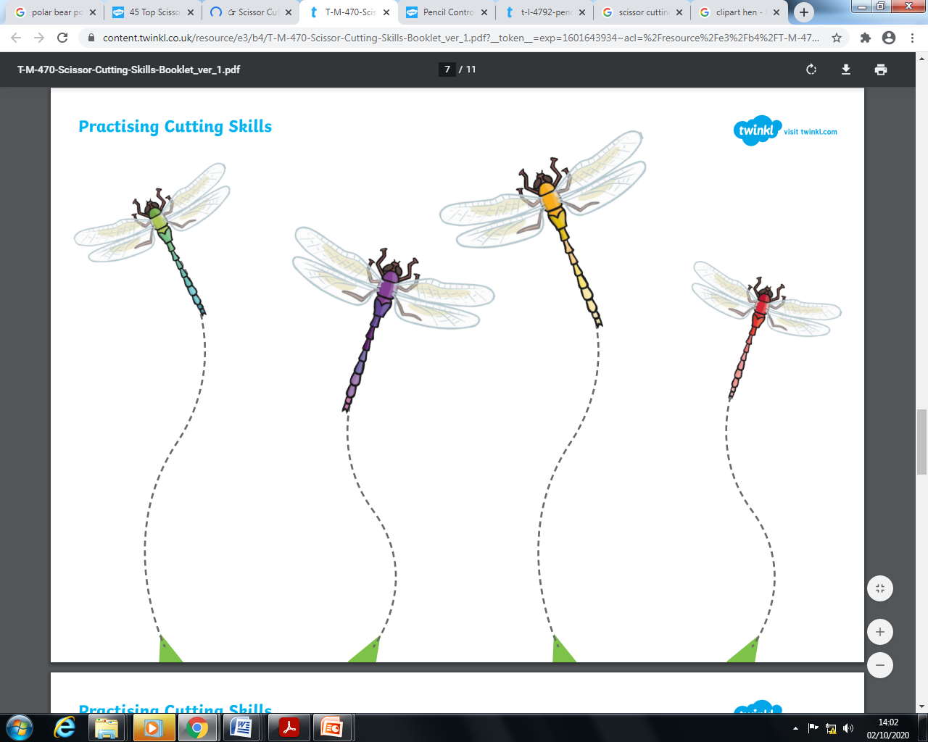

Slide 64
PE
Watch Joe Wicks on Youtube and encourage your child to follow a session.
https://www.youtube.com/playlist?list=PLyCLoPd4VxBsXs1WmPcektsQyFbXTf9FO

Slide 65
Don’t forget to send us all the learning you have done at home on
reception@whitehall.Leicester.sch.uk
Most of the pictures and worksheets on this power point and on our phonics videos are from Twinkl.

