Slide 1

Oliver’s Vegetables

Slide 2
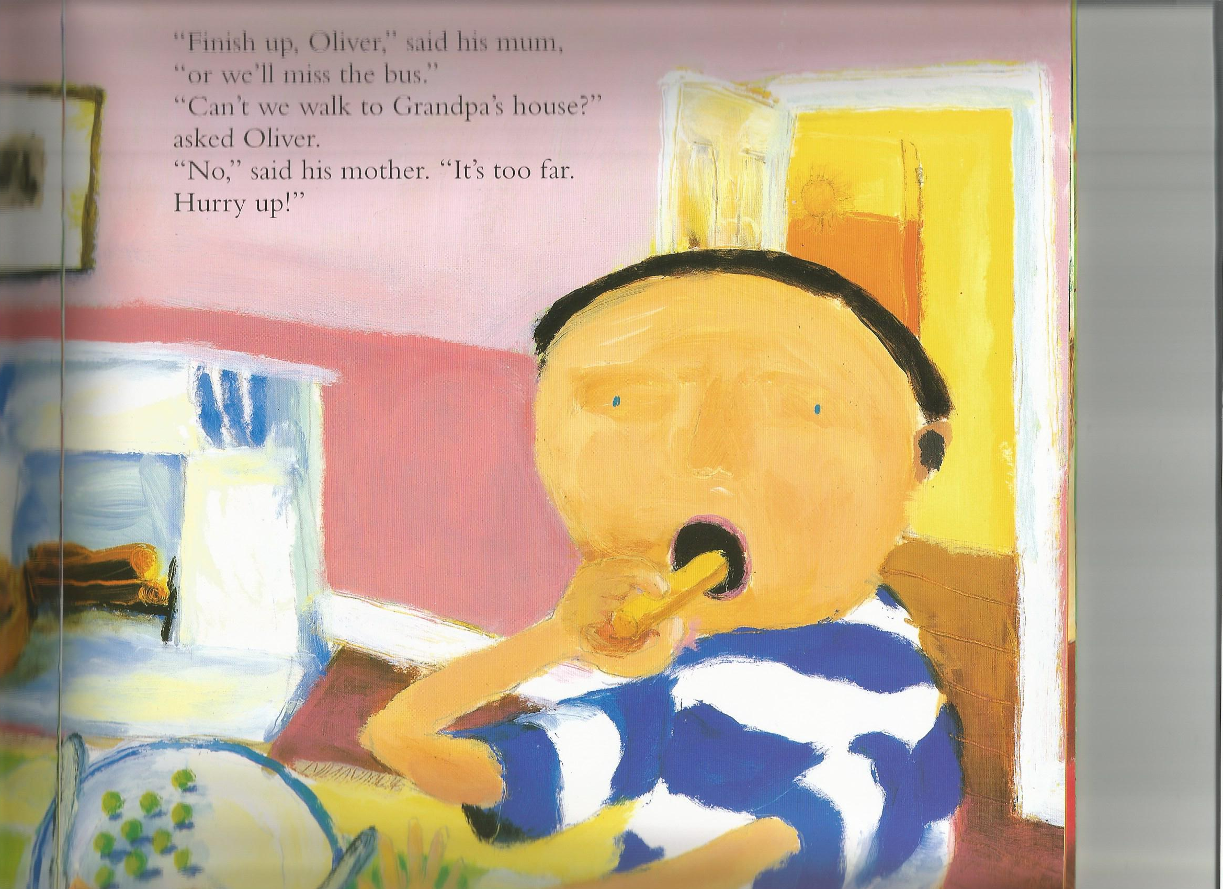
“Hurry up Oliver, said Mum, we are going to Grandpa and Gran’s house to stay.
“Ok,” said Oliver eating his chips.

Slide 3
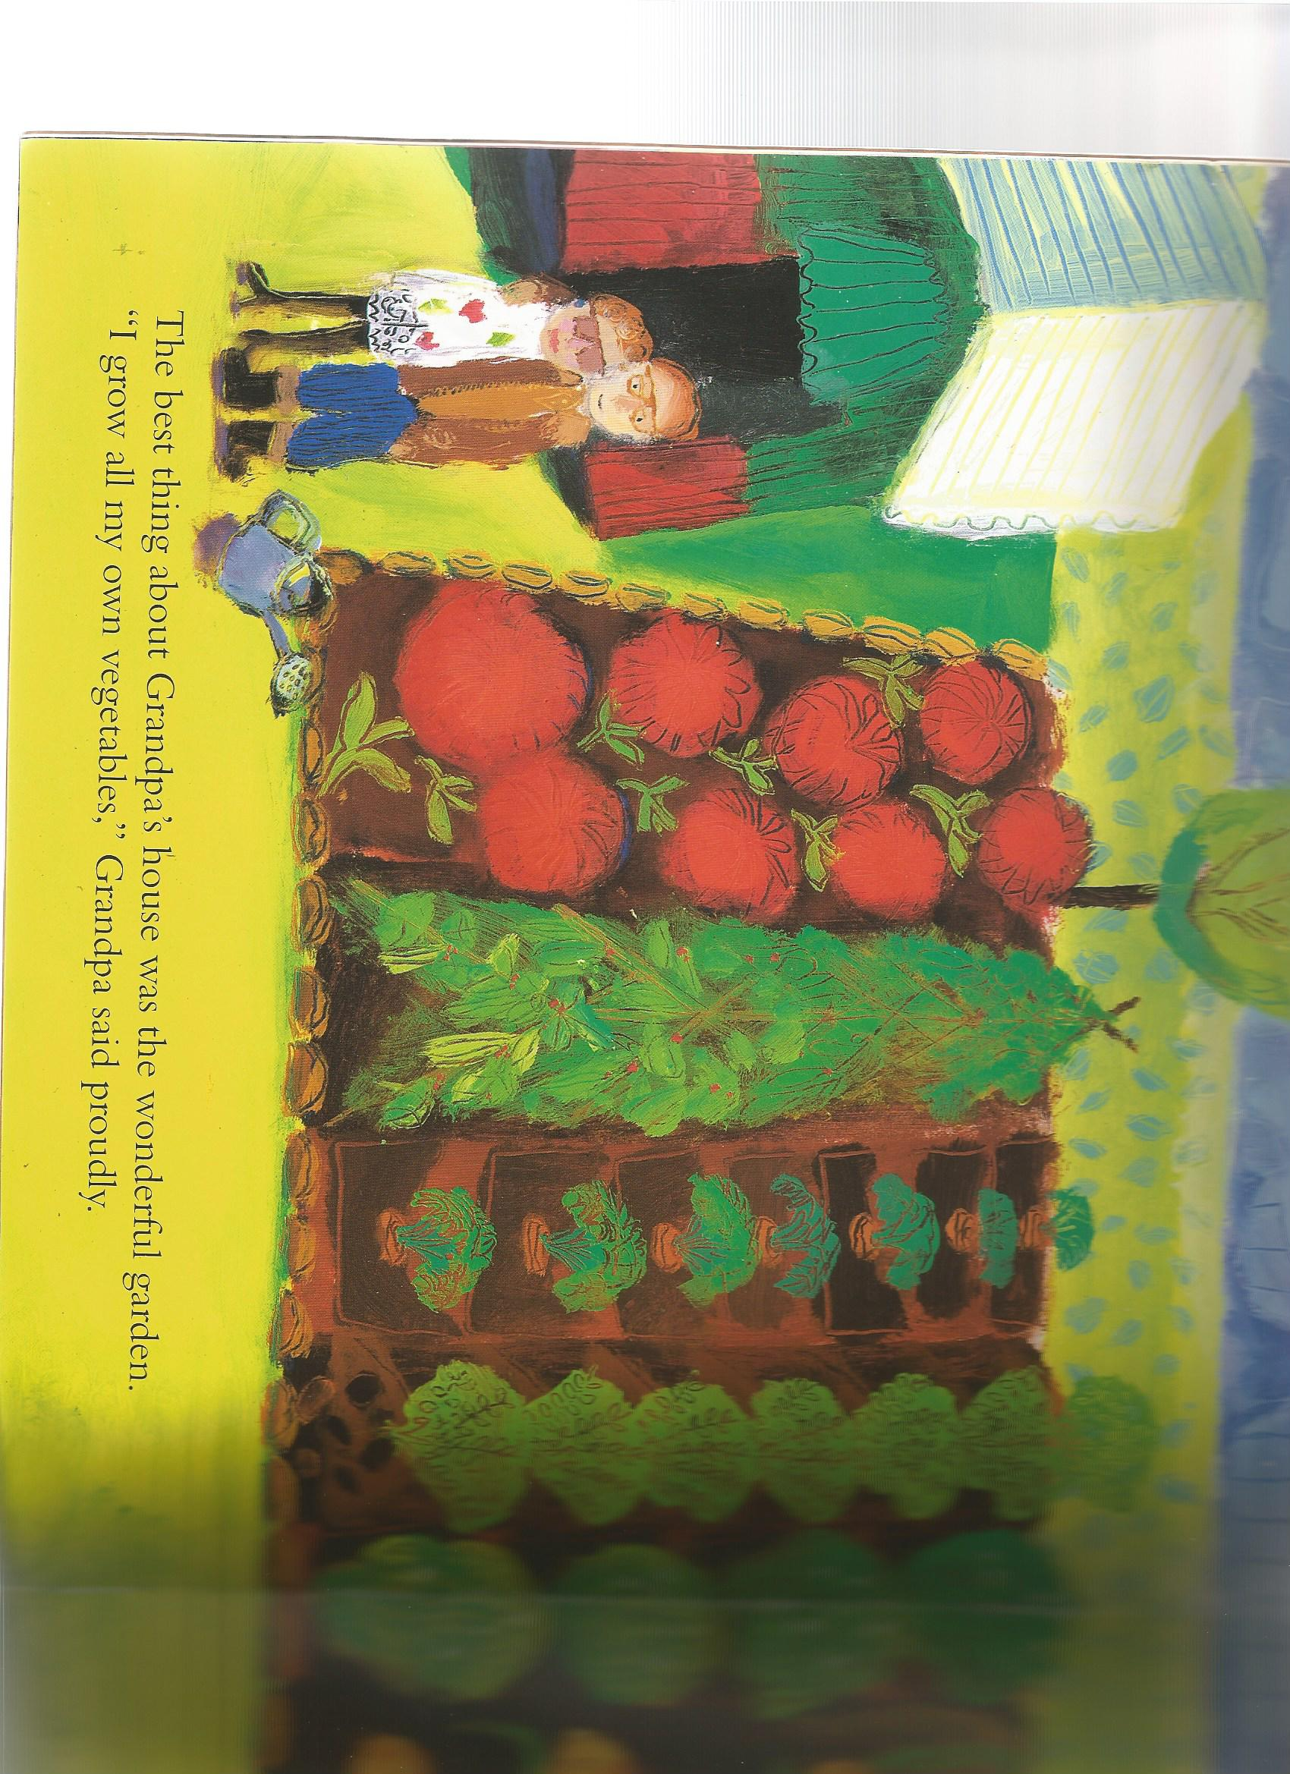
Grandpa had a wonderful garden.
“I grow all my own vegetables,” said Grandpa proudly.

Slide 4
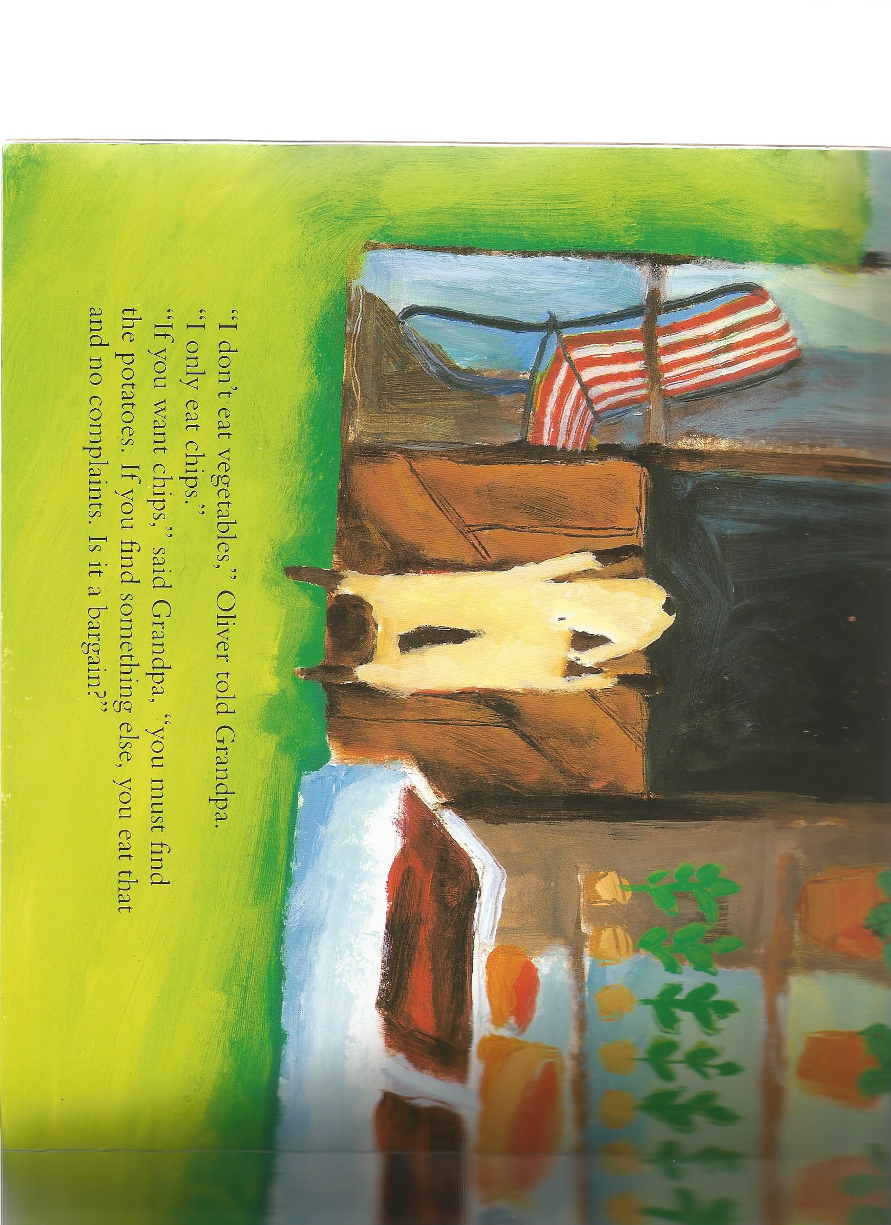
“I don’t eat vegetables,” Oliver told Grandpa.
“I only eat chips.”
“If you want chips,” said Grandpa. “you must find the potatoes. If you find something else, you must eat that.”

Slide 5
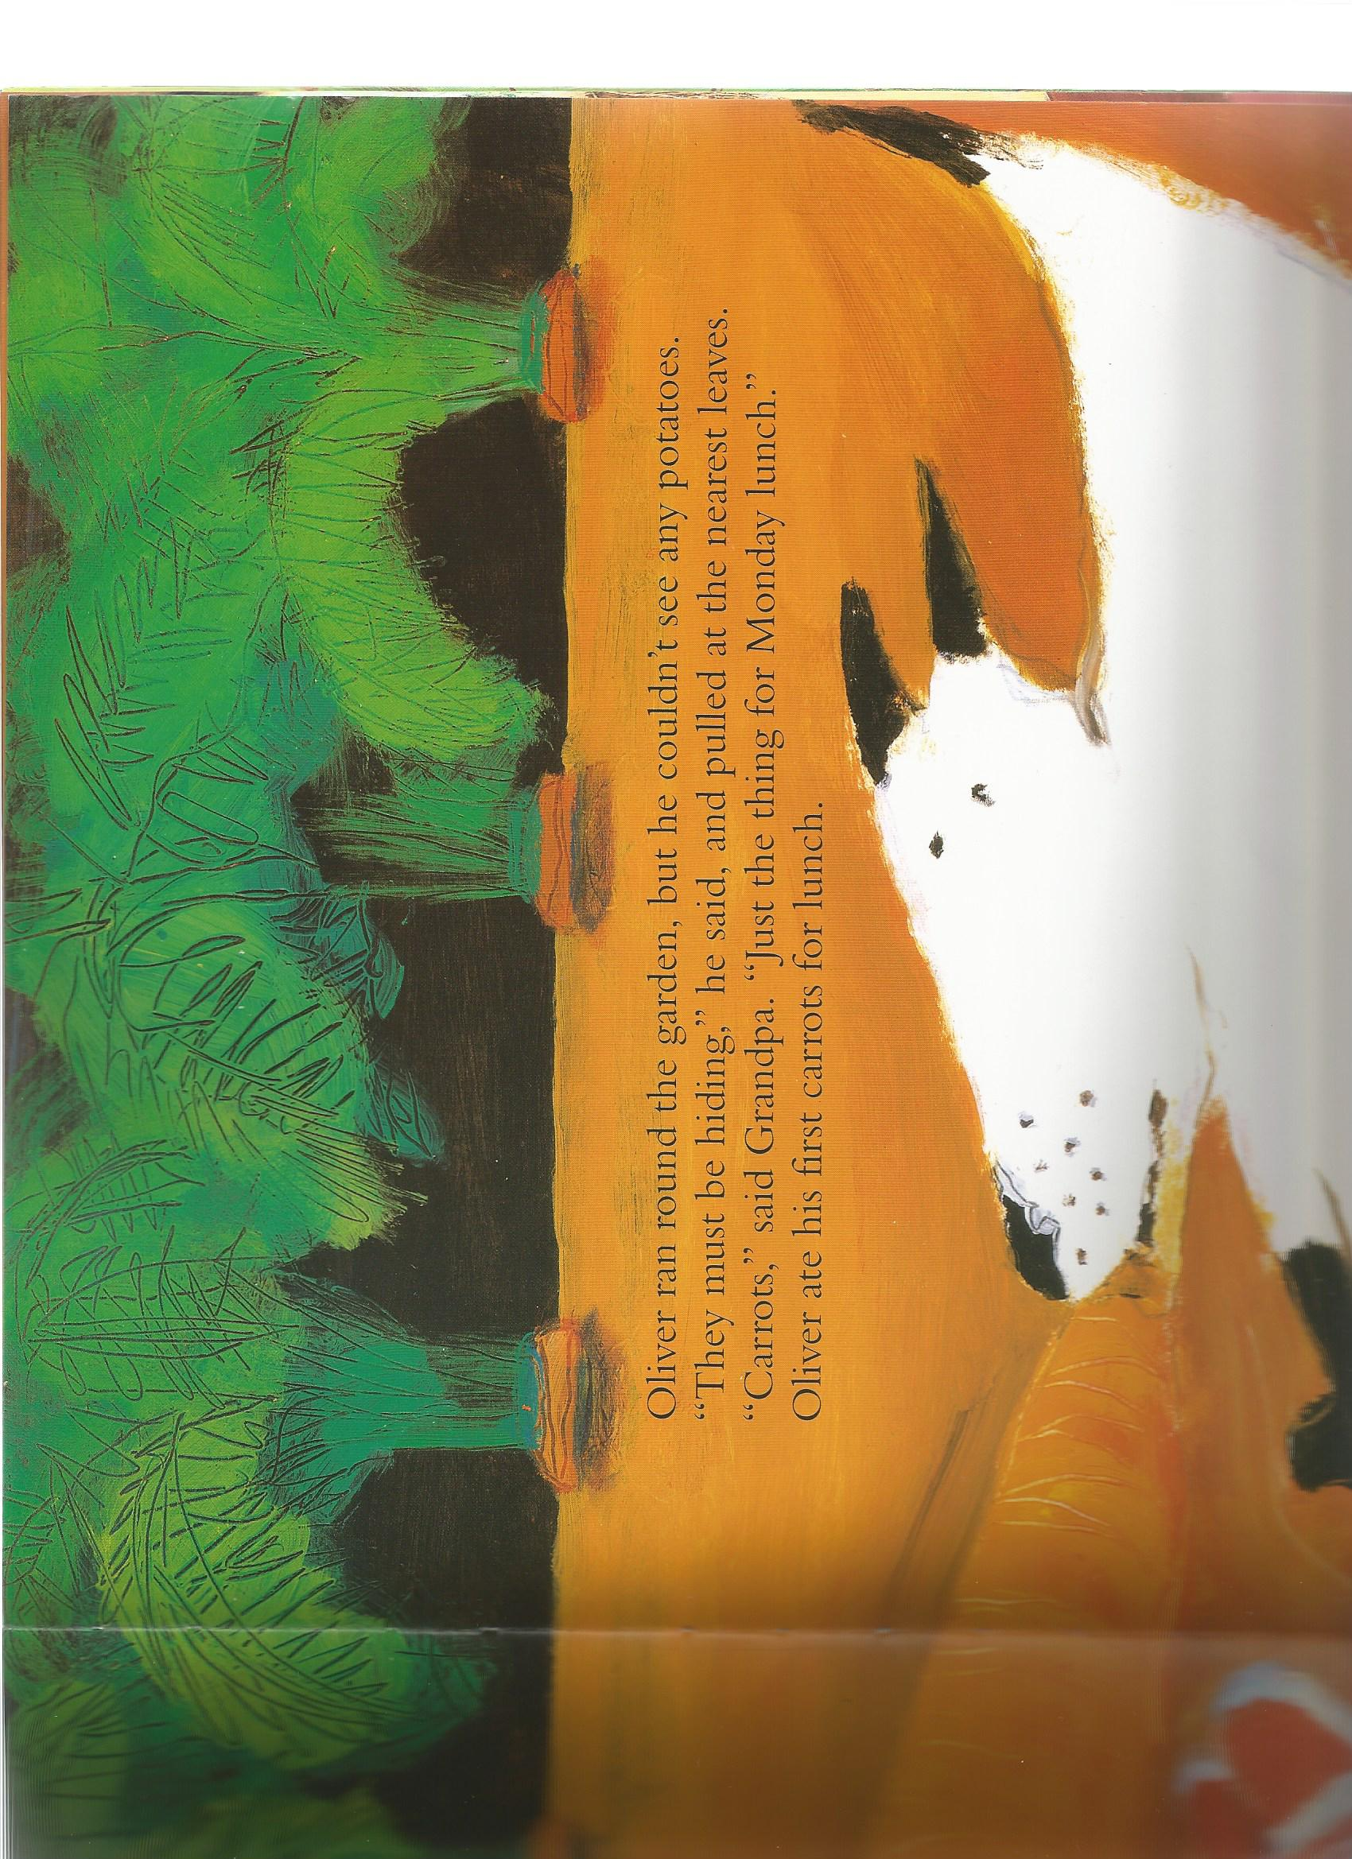
Oliver couldn’t find the potatoes. He pulled up the nearest leaves.
“Carrots!,” said Grandpa.
Oliver ate his first carrots for lunch.

Slide 6
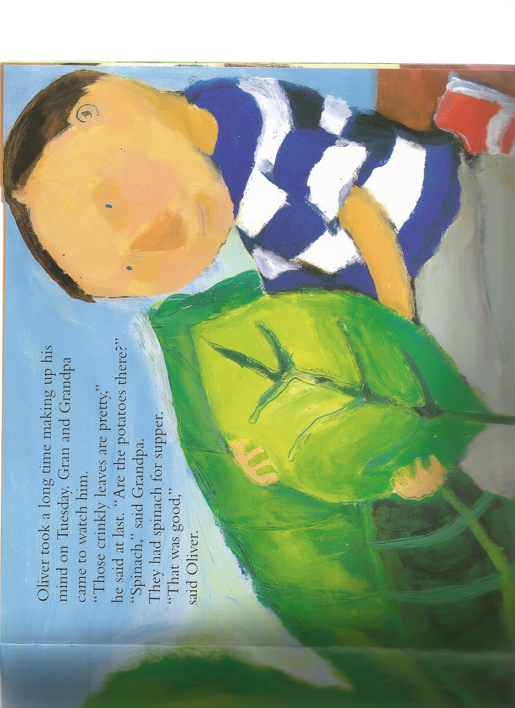
On Tuesday, Oliver found some crinkly, green leaves.
“That is spinach,” said Grandpa.
They had spinach for supper.
“That was good,” said Oliver.

Slide 7
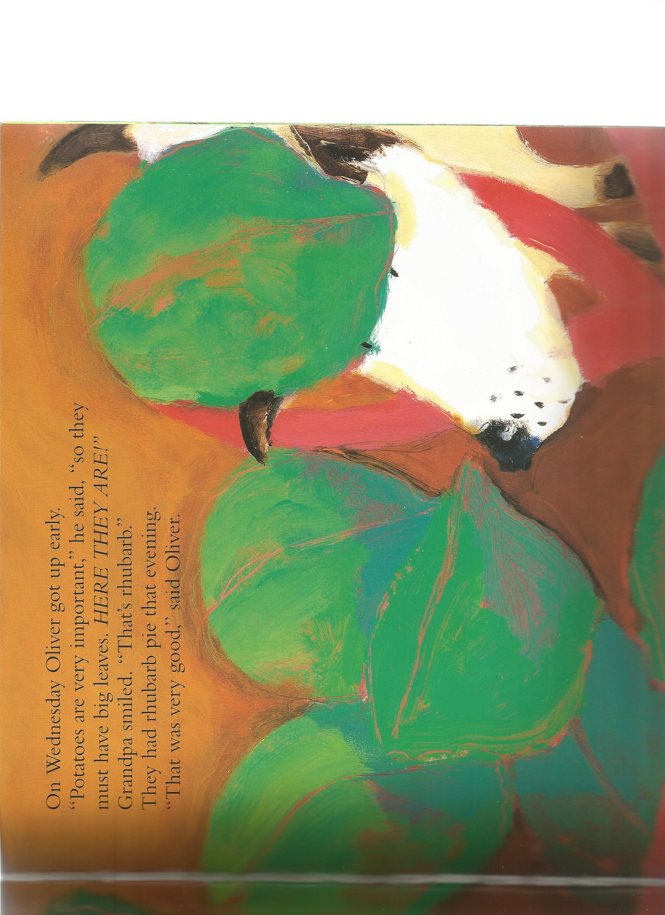
On Wednesday Oliver got up early.
“Potatoes must have big leaves,” said Oliver.
“That’s rhubarb,” smiled Grandpa.
They had rhubarb pie that evening.
“That was very good,” said Oliver.

Slide 8
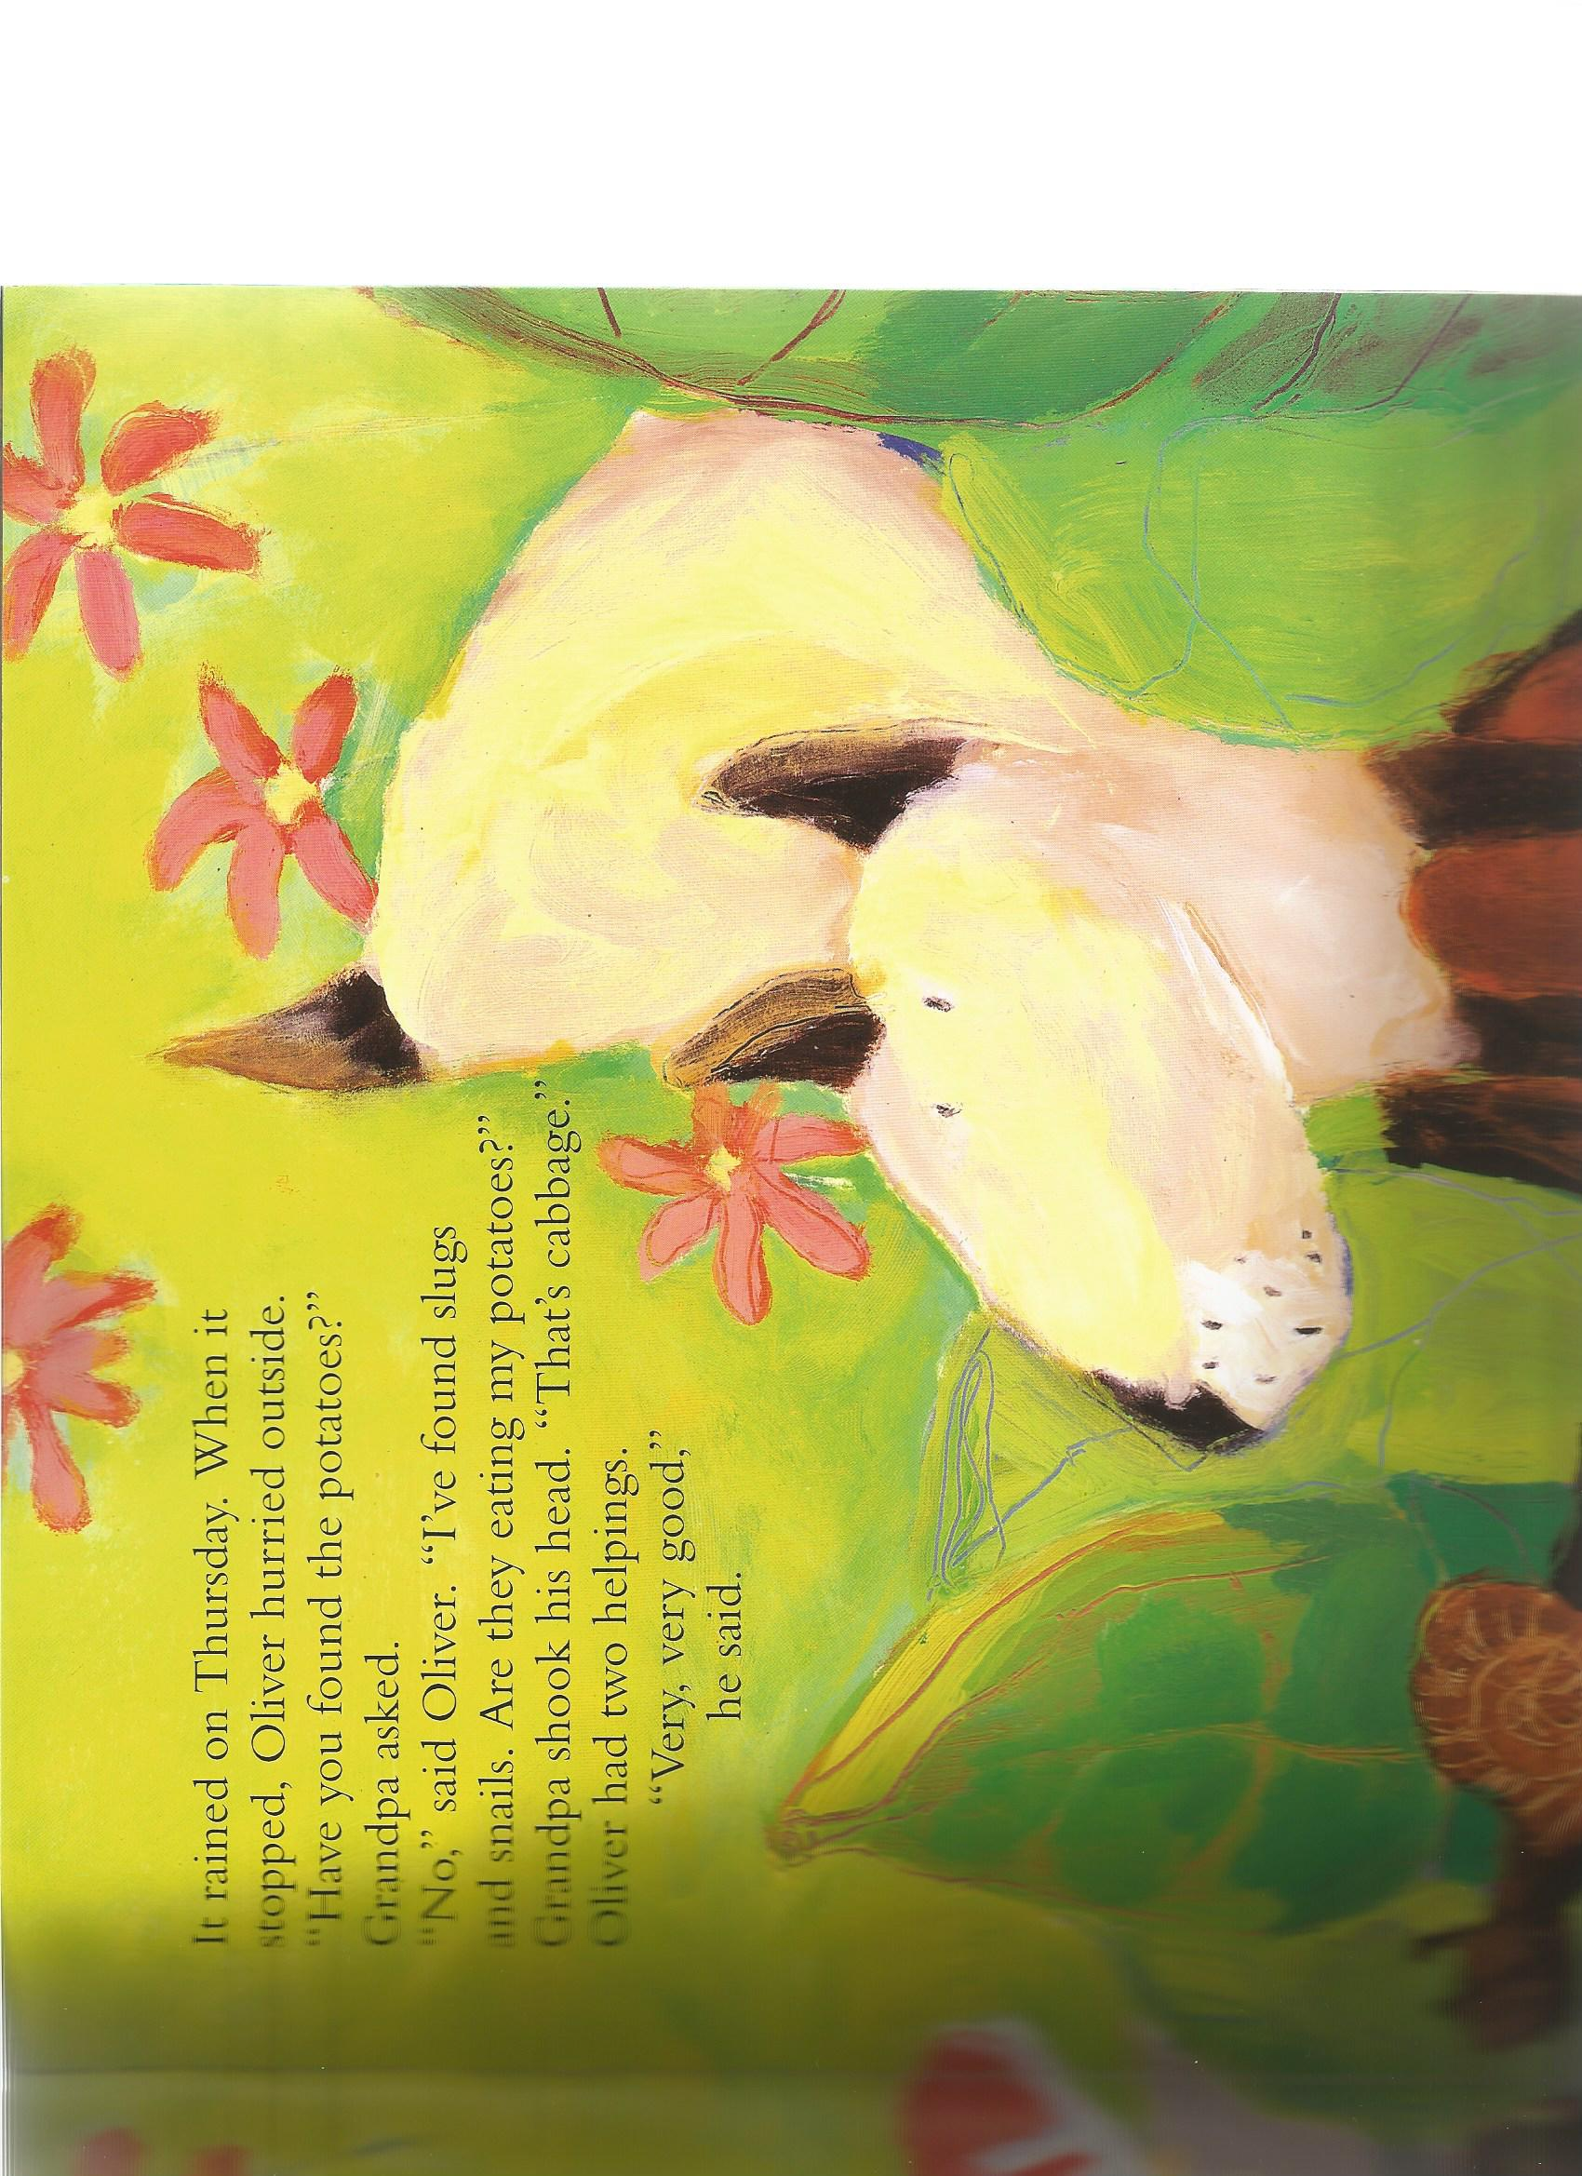
It rained on Thursday.
“I found slugs and snails. Are they eating my potatoes?” asked Oliver.
Grandad shook his head, “that’s cabbage.”
Oliver ate two helpings. “Very, very good,” he said.

Slide 9
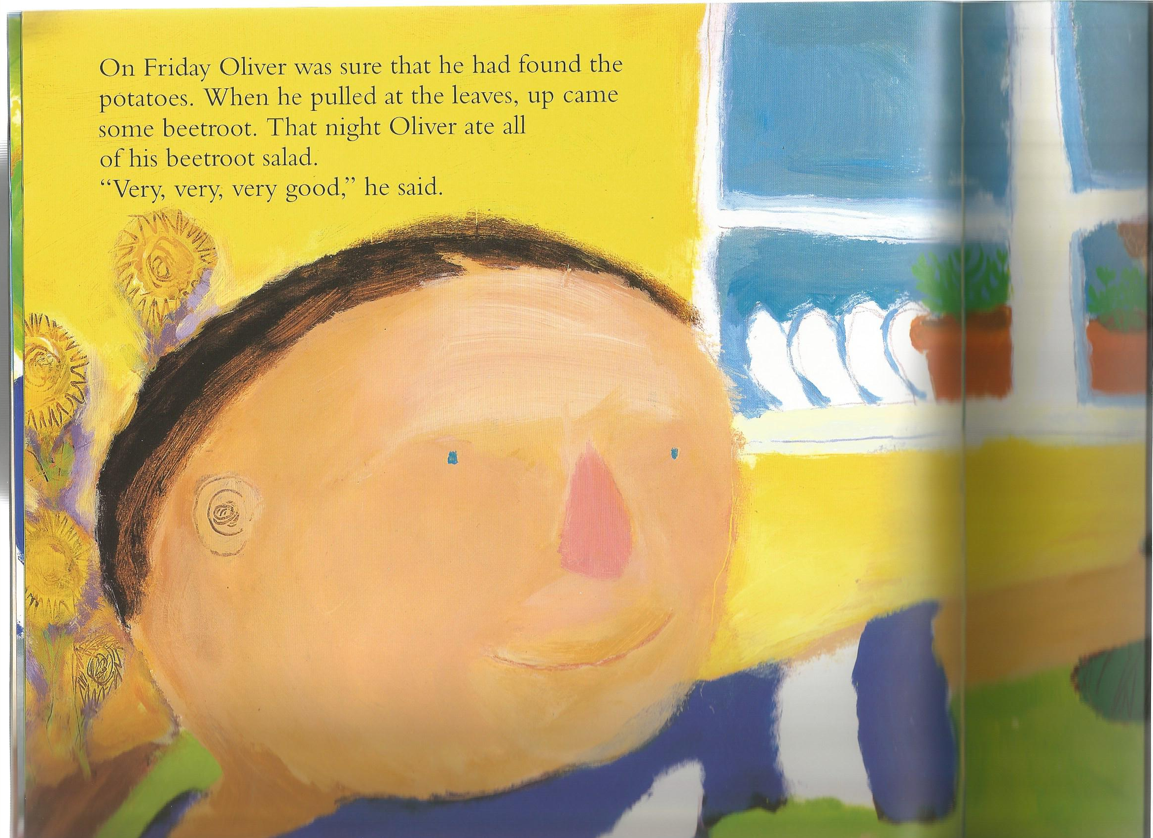
On Friday Oliver was sure he found the potatoes. When he pulled the leaves, up came beetroot!
That night Oliver ate all of his beetroot salad.
“Very, very, very good,” he said.

Slide 10
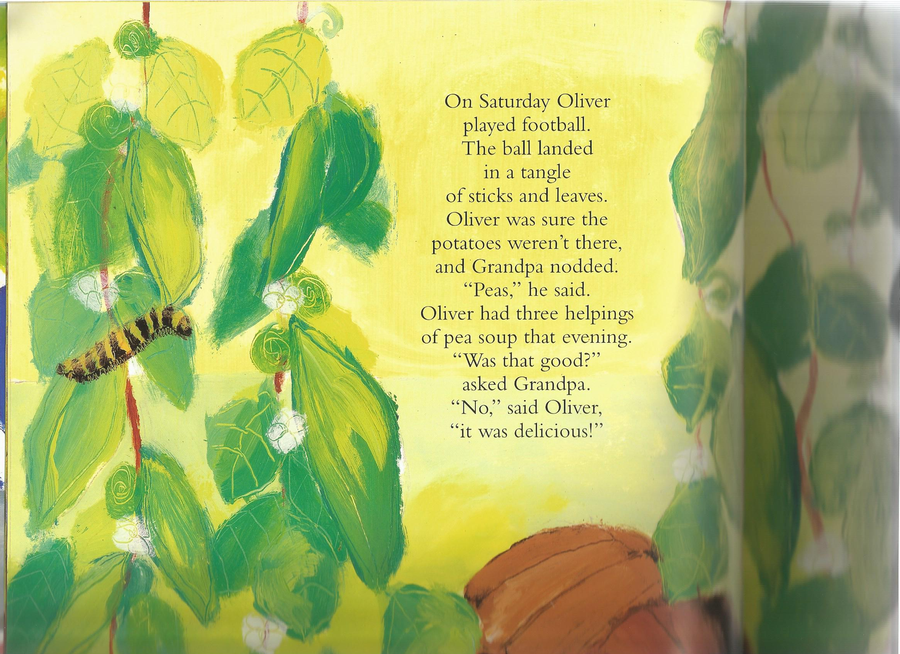
On Saturday Oliver found a tangle of sticks and leaves.
“They are peas,” said Grandad.
Oliver had three helpings of pea soup.
“It was delicious,” he said.

Slide 11
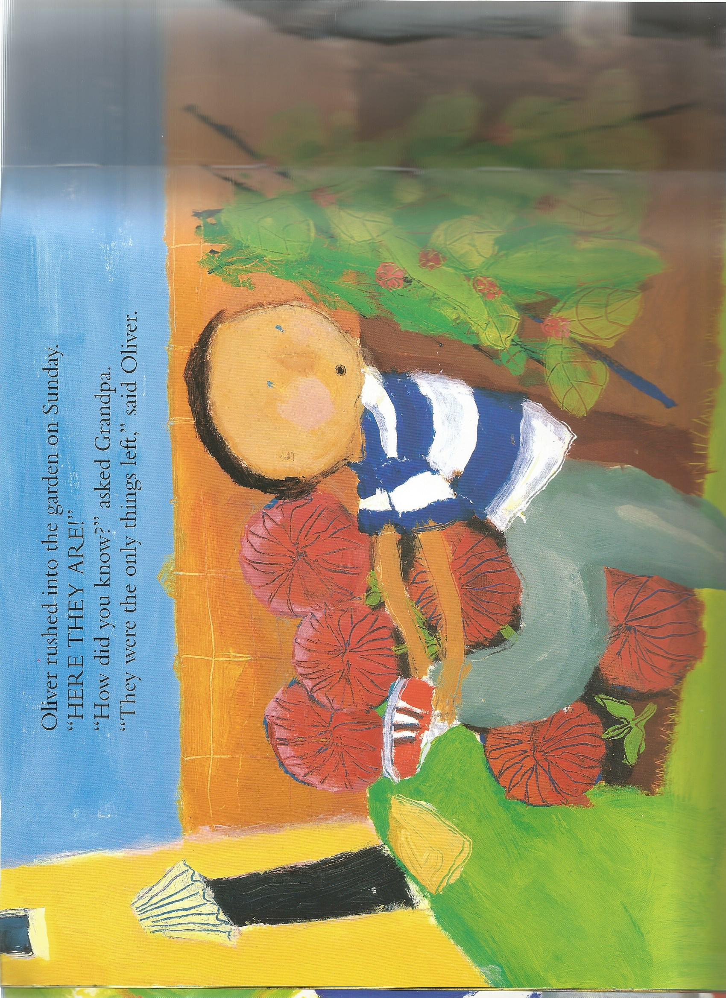
Oliver rushed into the garden on Sunday.
“HERE THEY ARE!”
“How do you know?” asked Grandpa.
“They are the only things left! Said Oliver.

Slide 12
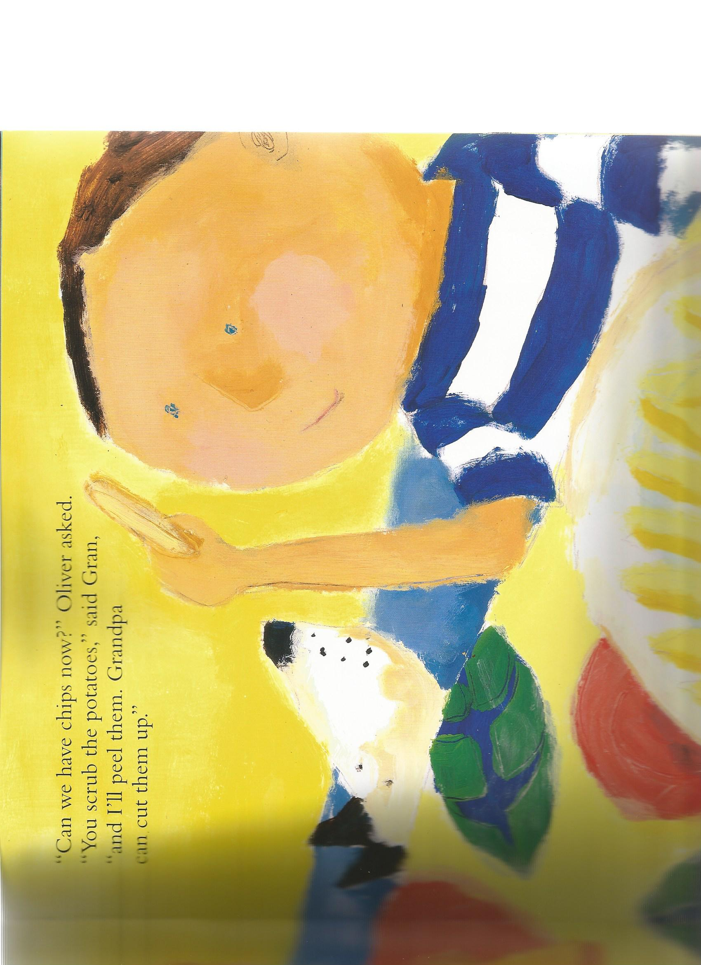
“Can I have chips now?” Oliver asked.
“You scrub the potatoes,” said Gran, “and I’ll peel them. Grandpa can cut them.

Slide 13
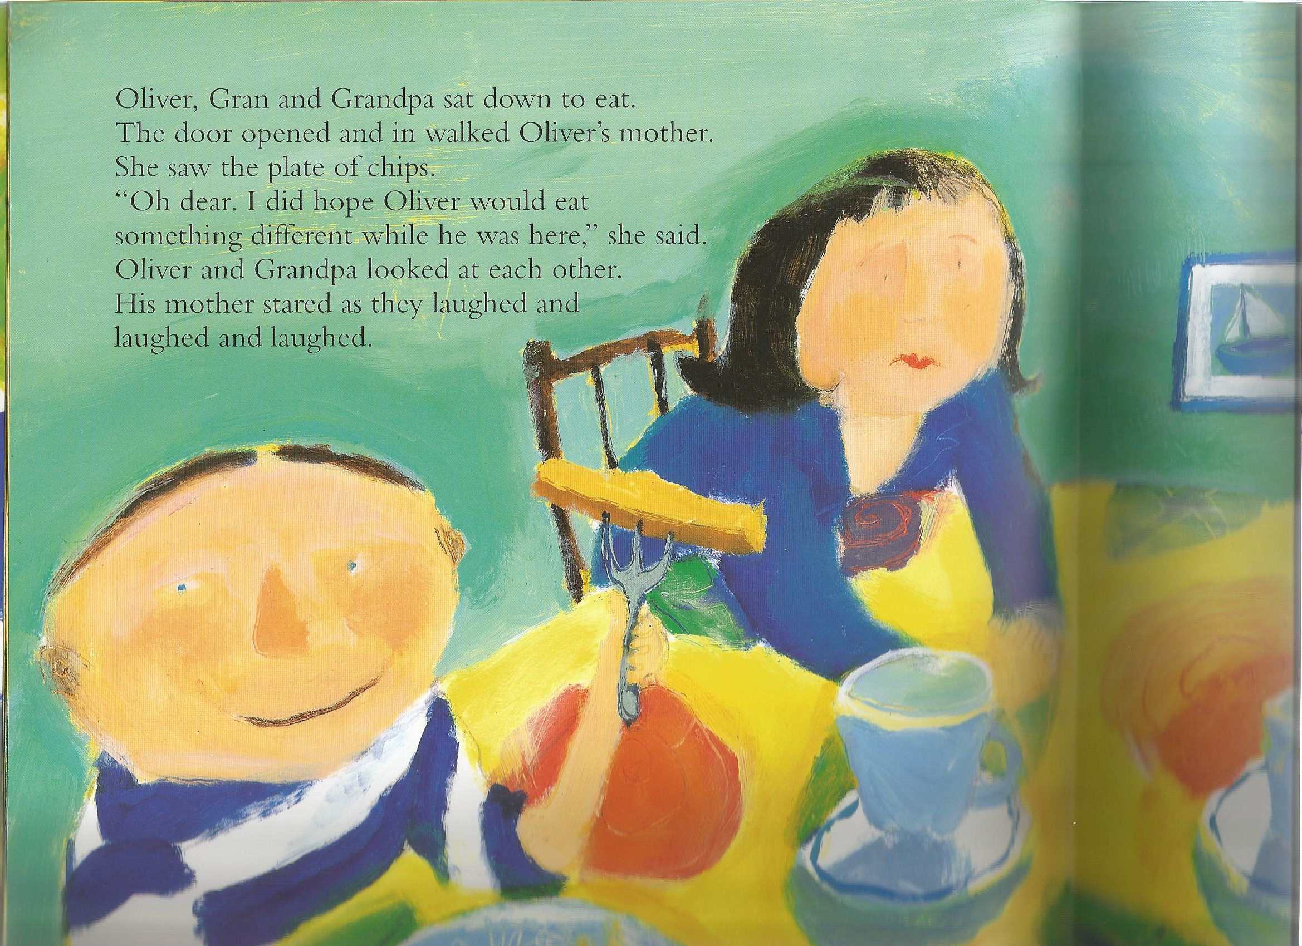
Mum came in. “Oh dear. I did hope Oliver would eat something different and not just chips!”
Oliver and Grandpa laughed and laughed!

