Slide 1
Maths

Slide 2
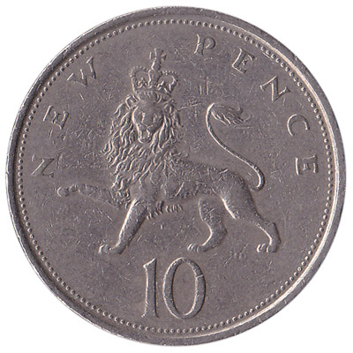
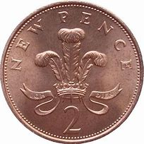
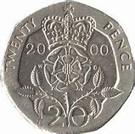
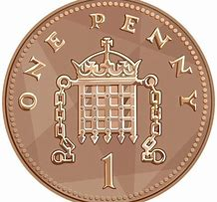
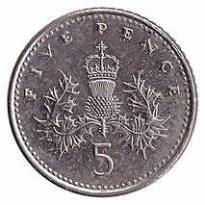
What do you notice? Monday
What is the same?
What is different?

Slide 3

Name the
3D Shape
?

Slide 4
Name this 3D Shape
cube
rectangle
cuboid

Slide 5
Name this 3D Shape
cylinder
pyramid
cone

Slide 6
Name this 3D Shape
cuboid
cone
sphere

Slide 7
Name this 3D Shape
cube
cuboid
cone

Slide 8
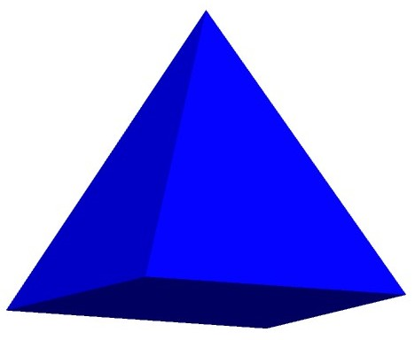
Name this 3D Shape
cuboid
Square based pyramid
triangle

Slide 9
Name this 3D Shape
cuboid
cylinder
sphere

Slide 10
Well done
for completing
the quiz!

