Slide 1
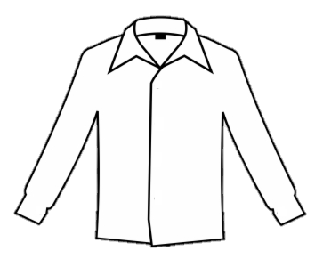



Slide 5
17
13
11
16
14
19
15
18
10
12
20

Slide 6
3D shapes
Look at the pictures and see what 3D shapes you can find.

Slide 7

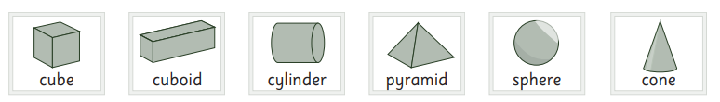

Slide 8


Slide 9
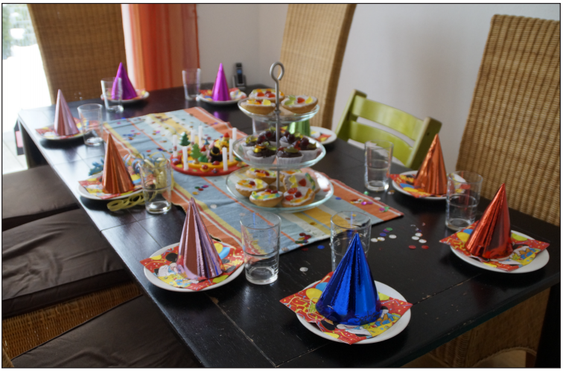

Slide 10


