Slide 1

Phase 4 phonics

Slide 2
We are going to recap our phase 3 sounds
Remember to bounce the sound 3 times.

Slide 3
qu

Slide 4
ch

Slide 5
sh

Slide 6
th

Slide 7
ng

Slide 8
ay

Slide 9
ee

Slide 10
igh

Slide 11
oa

Slide 12
oo

Slide 13
oo

Slide 14
ar

Slide 15
or

Slide 16
ur

Slide 17
ow

Slide 18
oi

Slide 19
ear

Slide 20
air

Slide 21
er

Slide 22
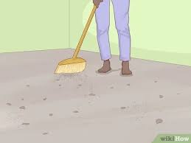

Slide 23
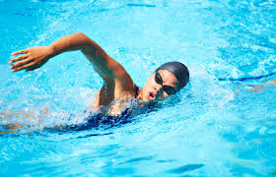

Slide 24
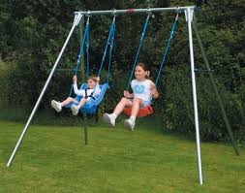

Slide 25
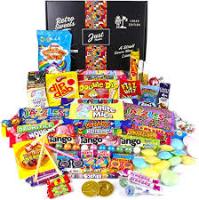

Slide 26
What did you notice about those words?

Slide 27
Remember to use your phoneme fingers
swim

Slide 28
Remember to use your phoneme fingers
sway

Slide 29
Remember to use your phoneme fingers
sweep

Slide 30
Remember to use your phoneme fingers
swift

Slide 31
I robot you blend
Listen carefully at the words I am going to robot, then you have a go at blending the sounds to see which word I am trying to say.

Slide 32
1.
2.
3.
4.

Slide 33
I give you a word, you segment
Listen carefully to the word that I give you. Now it’s your turn to segment the word, remember to use your robot arms.

Slide 34
1.
2.
3.
4.

Slide 35
s w
Adjacent consonants are two letters making two sounds.

Slide 36
Reading strategy
Look at the letters, make the sounds, blend the sounds together
Read the sounds you can see, the green card will move across as you read.

Slide 37
sway

Slide 38
sway

Slide 39
sway

Slide 40
sweet

Slide 41
sweet

Slide 42

sweet

Slide 43
sweet

Slide 44
swim

Slide 45
swim

Slide 46
swim

Slide 47
swim

Slide 48
swing

Slide 49
swing

Slide 50
swing

Slide 51
swing

Slide 52
Let’s try reading without the green card.

Slide 53
sway

Slide 54
sweet

Slide 55
swim

Slide 56
Writing strategy
Say the word, finger the word, write the word.
Have a go at writing the words that I give you.

Slide 57
1.
2.
3.
4.

Slide 58
Write a sentence
Now we are going to use all of the learning we have done today to write a sentence with our new adjacent consonant in.
Remember to use:
Capital letters
Full stops or question marks
Finger spaces
Adjectives
Conjunctions

Slide 59
Listen to the sentence and have a go at writing it.

Slide 60
Reading sentences
Is a swing a good thing?
Can frogs swim in trains?

Slide 61

Well done for completing your phonics lesson!

