Slide 1

Phase 4 phonics

Slide 2

We are going to recap our phase 3 sounds
Remember to bounce the sound 3 times.

Slide 3
qu

Slide 4
ch

Slide 5
th

Slide 6
sh

Slide 7
ay

Slide 8
ng

Slide 9
igh

Slide 10
ee

Slide 11
oo

Slide 12
oa

Slide 13
oo

Slide 14
ar

Slide 15
or

Slide 16
ur

Slide 17
ow

Slide 18
ear

Slide 19
oi

Slide 20
air

Slide 21
er

Slide 22
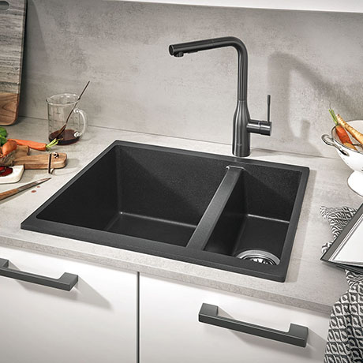

Slide 23
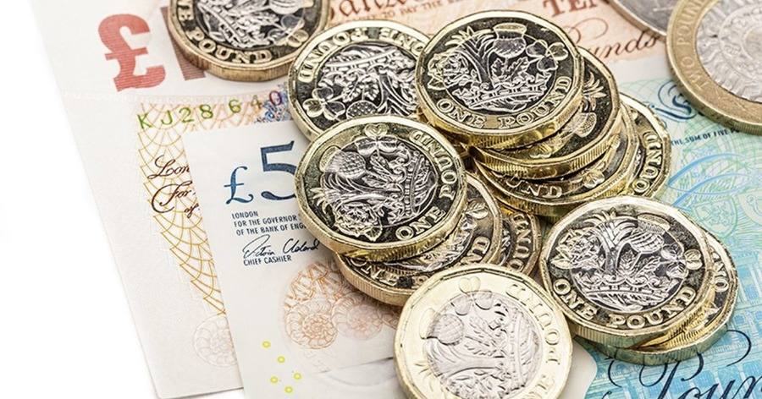

Slide 24


Slide 25
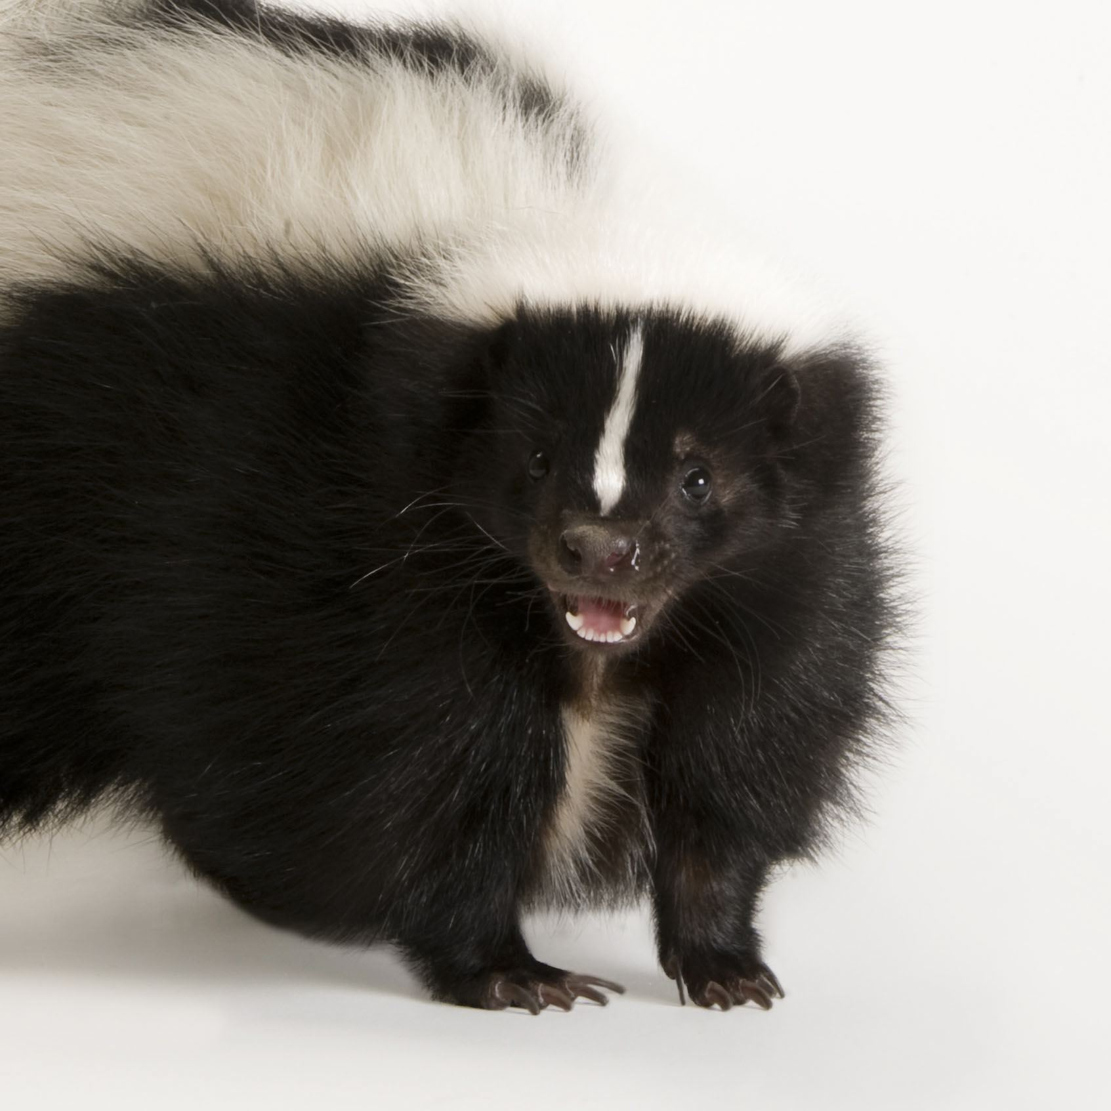

Slide 26
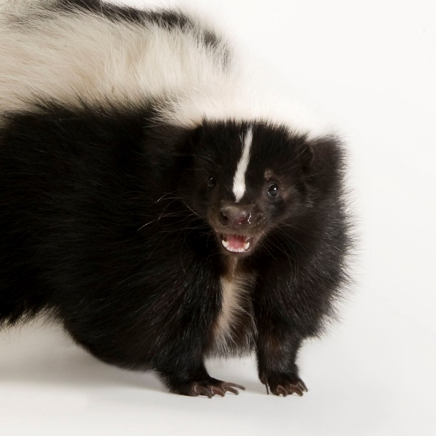
What did you notice about those words?

Slide 27
Remember to use your phoneme fingers
sink

Slide 28
Remember to use your phoneme fingers
bank

Slide 29
Remember to use your phoneme fingers
think

Slide 30
Remember to use your phoneme fingers
skunk

Slide 31
I robot you blend
Listen carefully to the words that I am going to robot,
then you have a go at blending the sounds to see which word I am trying to say.

Slide 32
1.
2.
3.
4.

Slide 33
I give you a word, you segment
Listen carefully to the word that I give you. Now it’s your turn to segment the word, remember to use your robot arms.

Slide 34
1.
2.
3.
4.

Slide 35
n k
Adjacent consonants are two letters making two sounds.

Slide 36
Reading strategy
Look at the letters, make the sounds, blend the sounds together
Read the sounds you can see, the green card will move across as you read.

Slide 37
chunk

Slide 38
chunk

Slide 39
chunk

Slide 40
shrink

Slide 41
shrink

Slide 42
shrink

Slide 43
shrink

Slide 44
thank

Slide 45
thank

Slide 46
thank

Slide 47
thank

Slide 48
Let’s try reading without the green card.

Slide 49
chunk

Slide 50
think

Slide 51
thank

Slide 52
Writing strategy
Say the word, finger the word, write the word.
Have a go at writing the words that I give you.

Slide 53
1.
2.
3.
4.

Slide 54
Write a sentence
Now we are going to use all of the learning we have done today to write a sentence with our new adjacent consonant in.
Remember to use:
Capital letters
Full stops or question marks
Finger spaces
Adjectives
Conjunctions

Slide 55
Listen to the sentence and have a go at writing it.

Slide 56
Sentence for reading.
The big boat sank down.

Slide 57

Well done for completing your phonics lesson!

