Slide 1

Phase 4 phonics

Slide 2

We are going to recap our phase 3 sounds
Remember to bounce the sound 3 times.

Slide 3
qu

Slide 4
ch

Slide 5
th

Slide 6
sh

Slide 7
ay

Slide 8
ng

Slide 9
igh

Slide 10
ee

Slide 11
oo

Slide 12
oa

Slide 13
oo

Slide 14
ar

Slide 15
or

Slide 16
ur

Slide 17
ow

Slide 18
ear

Slide 19
oi

Slide 20
air

Slide 21
er

Slide 22
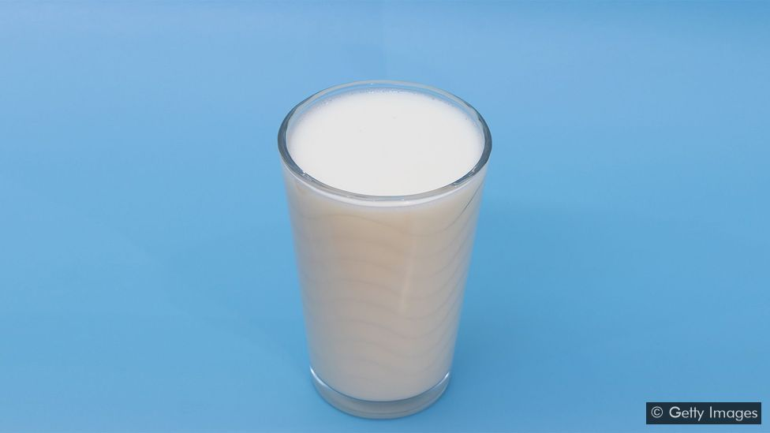

Slide 23


Slide 24
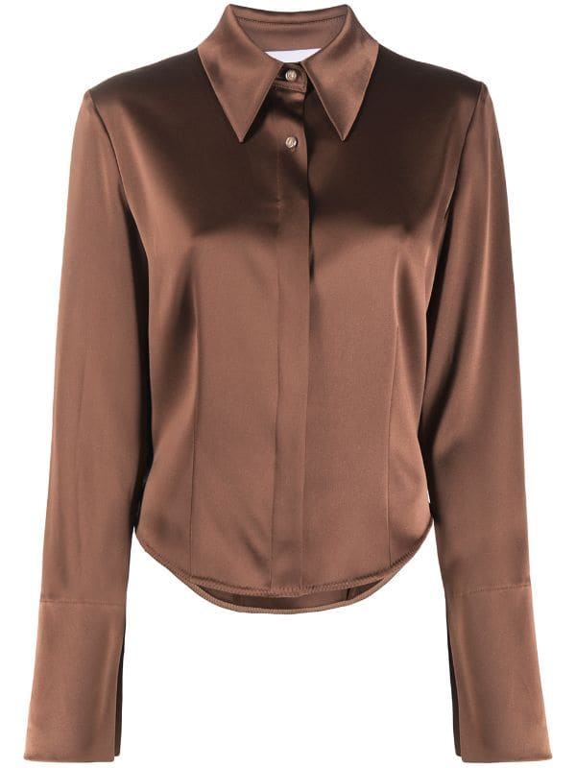

Slide 25


Slide 26

What did you notice about those words?

Slide 27
Remember to use your phoneme fingers
milk

Slide 28
Remember to use your phoneme fingers
walk

Slide 29
Remember to use your phoneme fingers
silk

Slide 30
Remember to use your phoneme fingers
chalk

Slide 31
I robot you blend
Listen carefully to the words that I am going to robot,
then you have a go at blending the sounds to see which word I am trying to say.

Slide 32
1.
2.
3.
4.

Slide 33
I give you a word, you segment
Listen carefully to the word that I give you.
Now it’s your turn to segment the word, remember to use your robot arms.

Slide 34
1.
2.
3.
4.

Slide 35
l k
Adjacent consonants are two letters making two sounds.

Slide 36
Reading strategy
Look at the letters, make the sounds, blend the sounds together
Read the sounds you can see, the green card will move across as you read.

Slide 37
bulk

Slide 38
bulk

Slide 39
bulk

Slide 40
bulk

Slide 41
milk

Slide 42
milk

Slide 43
milk

Slide 44
milk

Slide 45
sulking

Slide 46
sulking

Slide 47
sulking

Slide 48
sulking

Slide 49
sulking

Slide 50
sulking

Slide 51
Let’s try reading without the green card.

Slide 52
bulk

Slide 53
milk

Slide 54
sulking

Slide 55
Writing strategy
Say the word, finger the word, write the word.
Have a go at writing the words that I give you.

Slide 56
1.
2.
3.
4.

Slide 57
Write a sentence
Now we are going to use all of the learning we have done today to write a sentence with our new adjacent consonant in.
Remember to use:
Capital letters
Full stops or question marks
Finger spaces
Adjectives
Conjunctions

Slide 58
Listen to the sentence and have a go at writing it.

Slide 59
Reading sentence.
The farmer is milking the cow.

Slide 60

Well done for completing your phonics lesson!

