Slide 1
Can I develop my understanding of the apostrophe?

Slide 2
Are you uncertain about when to use an apostrophe? Many people have difficulty with this punctuation mark. The best way to get apostrophes right is to understand when and why they are used.
We will be looking at three specific ways in which the apostrophe is used in writing.
OMISSION
POSSESSION
USING ITS OR IT’S

Slide 3
Omission
The apostrophe should be used to show where a letter/ something is missing. This is called contraction!
Mrs Armitage didn’t like her Rolls Royce so she sold it.
The apostrophe in didn’t shows that the letter ‘o’ is missing= did not.
Mrs Ruprai doesn’t ever want leave Whitehall- even at weekends!
The apostrophe in doesn’t shows that the letter ‘o’ is missing= did not.
Miss Cassamo won’t admit that Mr Hill is the best!
The apostrophe in won’t shows that something is missing= will not

Slide 4
Now have a look at the following sentences. Either write the sentence with a apostrophe, or remove the apostrophe.
The chicken would not cross the road.
The pie does not want to be eaten.
As long as you use the antidote, you will not die from a snakebite.
She has had lots of fun at the park.
I could not find my socks this morning.
The traffic is awful on the way to London.
It is too hot for me.

Slide 5
How did you do?
The chicken wouldn’t cross the road.
The pie doesn’t want to be eaten.
As long as you use the antidote, you won’t die from a snakebite.
She’s had lots of fun at the park.
I couldn’t find my socks this morning.
The traffic’s awful on the way to London.
It’s too hot for me.

Slide 6
Possession
The apostrophe should be used to show when something or
someone in a sentence owns an object e.g.
The cat’s tail waved in the air.
The tail belongs to the cat so we need an apostrophe to show this.
Mr Green’s umbrella sheltered him from the rain.
The umbrella belongs to Mr Green so we need an apostrophe here too.

Slide 7
Now have a look at the following sentences. Decide where you need to put the apostrophe to show possession.
The lions road echoed around the valley.
Fourteen elephants ate all of the trees leaves in less than five
minutes.
Captain Holbarts ship crashed over the ferocious ocean waves.
The ladys handbag was snatched by the two thieves.
After a long walk, the childrens shoes were caked in thick mud.

Slide 8
How did you do?
The lion’s road echoed around the valley.
Fourteen elephants ate all of the village’s food in less than five
minutes.
Captain Holbart’s ship crashed over the ferocious ocean waves.
The lady’s handbag was snatched by the two thieves.
After a long walk, the children’s shoes were caked in thick mud.

Slide 9
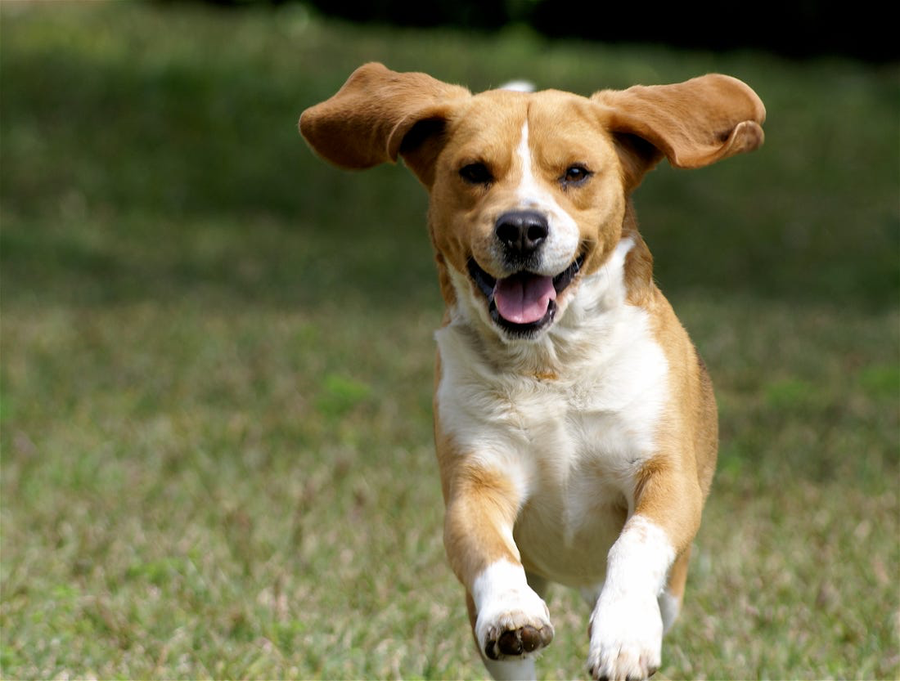
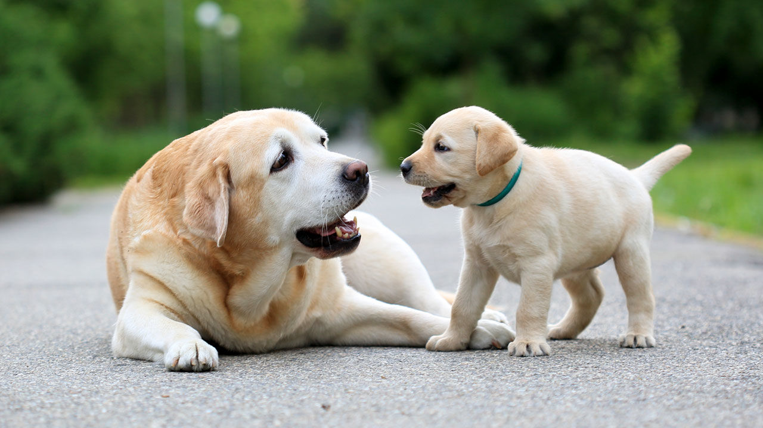
Decided Possession when something belongs to more than one.
Can you see the Dog’s owner?
Can you see the Dogs’ owner?

Slide 10
Your turn to have a go… First work out how many there are.
The teacher walked around checking all the students desks.
The gold ring dangled from the cows nose.
The cats ate from their bowls.
The members votes were added up.

Slide 11
Recap- Step by Step- Belongs to ONE person
Helens skirt is pretty.
Helen’s skirt is pretty.
The dogs lead is red.
The dog’s lead is red.
The boys crying was very loud.
The boy’s crying was very loud.

Slide 12
Recap- Step by Step- Belongs to MORE THAN ONE person
The farmers market was very busy.
The farmers’ market was very busy.
The dogs leads were on the hook.
The dogs’ leads were on the hook
The customers trolleys were dirty.
The customers’ trolleys were dirty.

Slide 13
When it comes to deciding between using its or it’s there is one
Simple rule to follow.
If you want to say it is or it has then you need to use it’s.
It’s been raining all day today. = It has been raining all day today.
It’s nearly half-past four. = It is nearly half-past four.
The rest of the time you just need to use plain old its.
The dog wagged its tail.

Slide 14
Look at the sentences below. Some sentence need it’s because they want to say it is or it has. The rest just need its.
The cat picked up its toy and jogged out of the kitchen.
“Its just not fair!” screamed Samantha angrily.
Its been the best day ever.
The hotel made its guests feel welcome by putting chocolates on their
Pillows.
The car stalled because its engine was in a terrible state.

Slide 15
How did you do? Can you explain your decisions to your parents?
The cat picked up its toy and jogged out of the kitchen.
“It’s just not fair!” screamed Samantha angrily.
It’s been the best day ever.
The hotel made its guests feel welcome by putting chocolates on their
Pillows.
The car stalled because its engine was in a terrible state.

