Slide 1
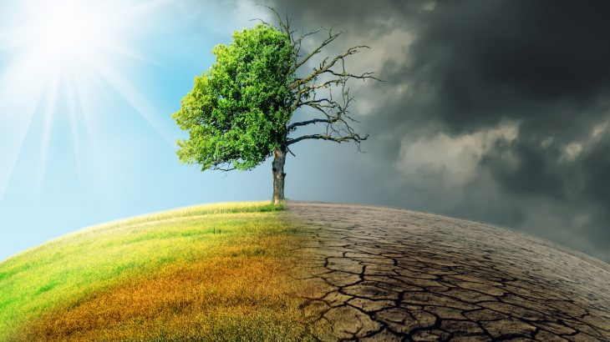
Climate Change

Slide 2
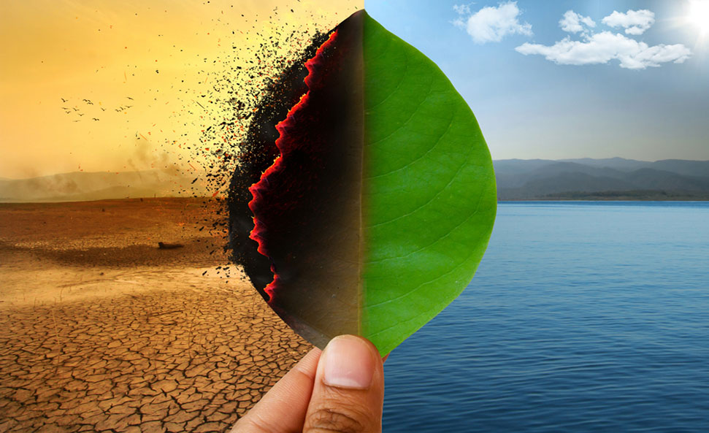

Slide 3
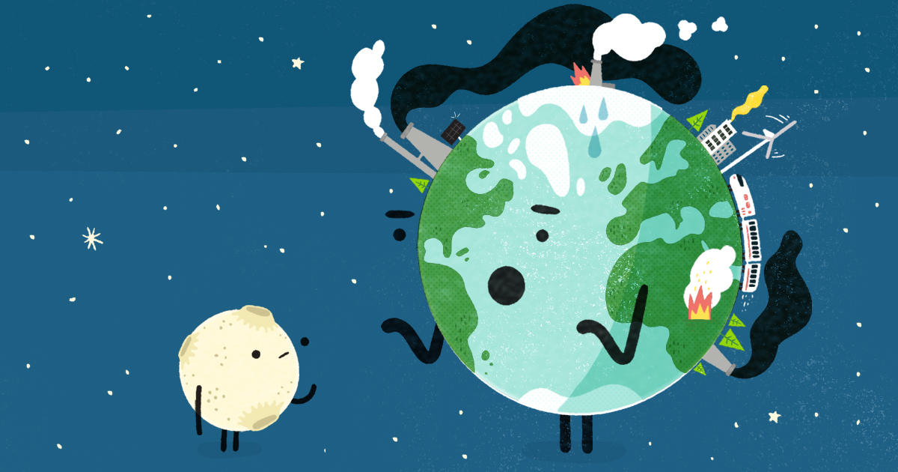

Slide 4
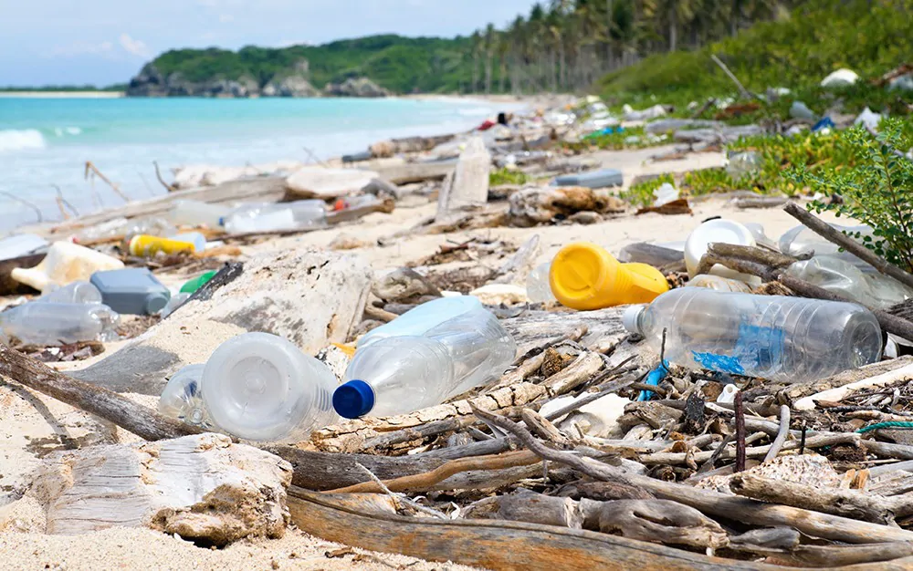

Slide 5
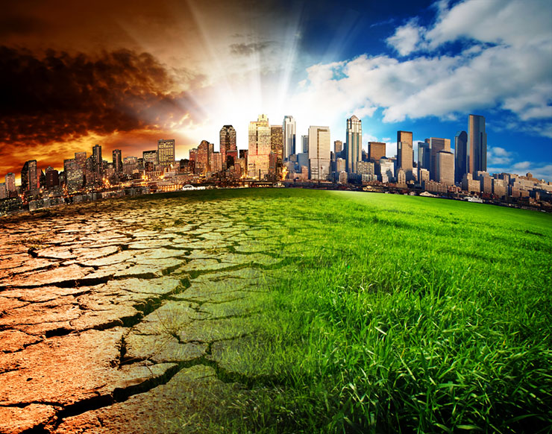
Climate Change
What is it?
What is renewable energy?
What is non-renewable energy?
Plastic
How is it damaging the environment?
What can be done to reduce this?
Create a leaflet displaying the two above pieces of information.
Be Creative!

